Slide 1
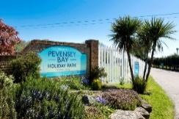
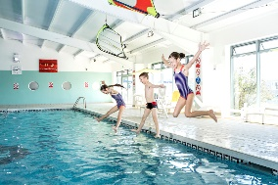
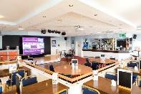
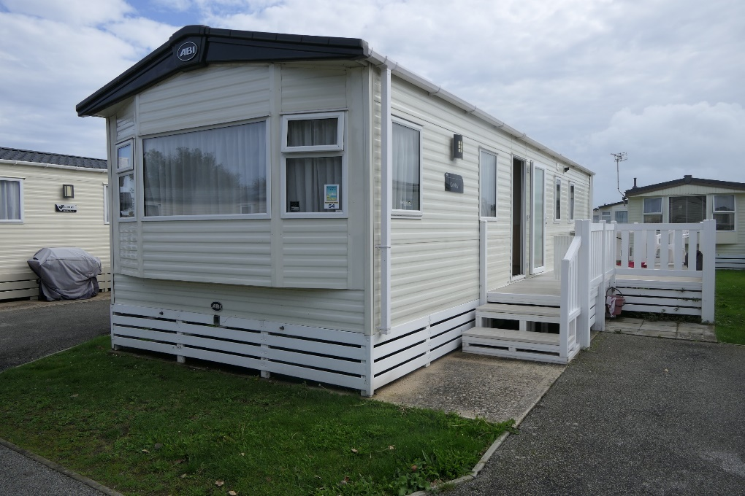
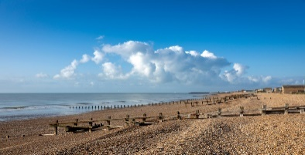
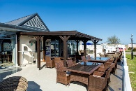
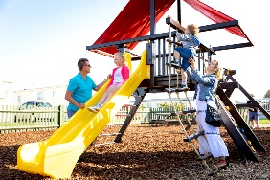
Pevensey Bay Holiday Park
East Sussex
https://www.parkholidays.com/our-parks/sussex/pevensey-bay/holidays
Registered Charity No. 1110644
Relaxed entertainment programme suitable for the whole family
Indoor Pool + Childrens/paddling pool
Indoor Bar/Restaurant
Launderette
Gym/Amusement arcade
Few minutes walk to the sandy beach (access through site)
Children’s play area
Outdoor café/bar
Local buses into Eastbourne, Bexhill, Hastings
and Pevensey Bay
Local shopping centre 5 mins drive, 15 mins walk
Railway station, shops, beaches & cinemas in Eastbourne 15 mins by car
Easy reach of Sovereign Harbour, Treasure Island, Drusillas Zoo Park and Knockhatch
Welcome to our caravan at:
Pevensey Bay Holiday Park
East Sussex
Available from April to October

Slide 2
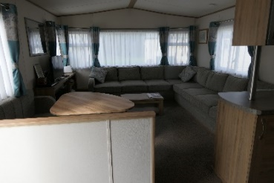
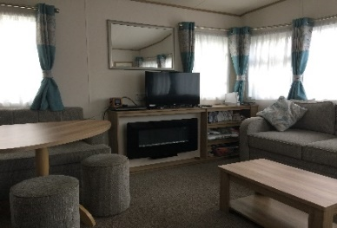
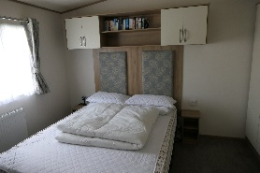
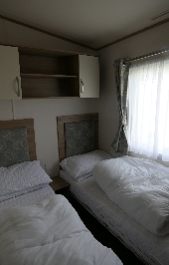
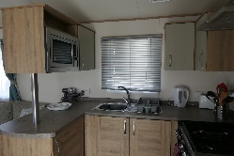
Caravan booking form (WW54)
Please return to:
Children with Cancer Fund
4 The Triangle
Willingdon
East Sussex
BN20 9PJ
Or complete, scan and Email to: holidays@childrenwithcancerfund.org.uk
Welcome to the Children with Cancer Fund caravan. CWCF is a small charity based in Polegate, East Sussex. We are here to help children with a diagnosis of cancer up until the age of 18 and their families by offering holiday breaks.
6 berth luxury caravan with Central Heating
Large lounge with games, TV, CD/DVD player, books etc.
Name:
Address:
 | Post Code:
Telephone:
Mobile:
Email
How did you hear about us?
Date: From | To
Please list ALL people who will be staying in the caravan |  |  | Age if under 18
1
2
3
4
5
6
Signed: |  | Date:
1 double bed in main bedroom with en-suite toilet
2 single beds in 2nd bedroom
1 sofa bed in lounge
All beds have duvets but you will need to bring duvet covers, pillows, pillow cases, sheets, towels and tea towels
Separate shower room with toilet/wash basin
Fully fitted kitchen inc. 4 ring hob/oven, microwave, kettle, fridge, freezer etc
Outside patio, BBQ, table. Chairs
Car parking for 1 car/additional parking nearby
Please note: No smoking. No Pets in caravan.
There are two hospitals in the area:
Eastbourne DGH, Kings Drive, Eastbourne BN21 2UD {15 mins drive}
Hastings Conquest, TN37 7RD (Kipling Ward) {30 mins drive}

