Slide 1
Data Manipulation & Visualization Methods
Quynh Tran
150569873

Slide 2
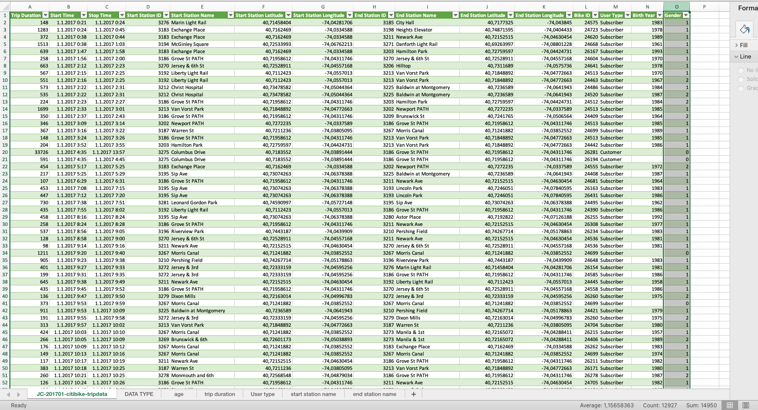
Data Specification
JC-201701-citibike-tripdata
Almost 13 000 rows
The data includes trip duration, start/end stations, user data

Slide 3
Data type:
- Interval – can be used for Start/End time because here we already known both the order and the exact differences between the values
- Ratio can be used for trip duration, birth year Iin which numeric values that tell about the order, the exact value between units.
- Nominal can be used for the rest of data because it is easily for labels without any value that can be ordered

Slide 4
Data Visualization using Tableau

Slide 5
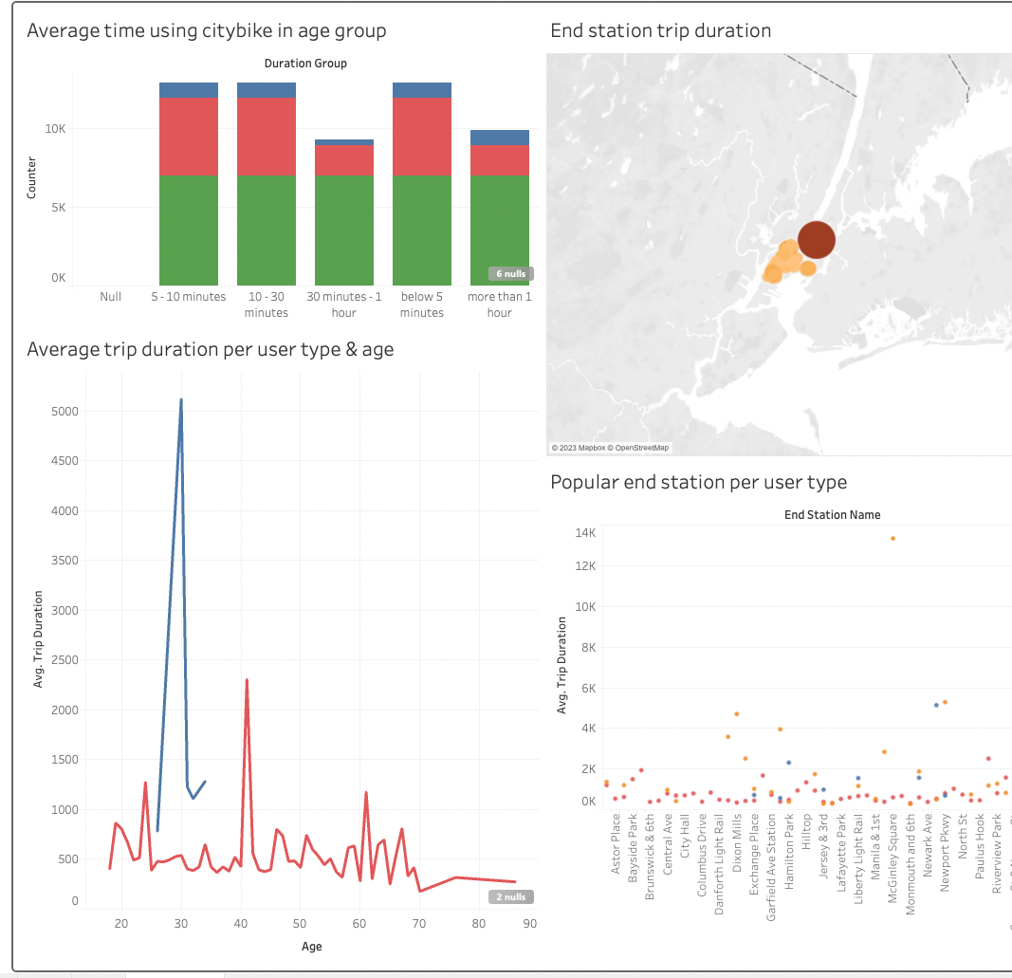
Dashboard
Visualization:
Geospatial,
Bar chart
Scatter pilots
Line chart
2. Interaction:
Zooming & scrolling: Users can zoom in and out of the geospatial to focus on specific location.
Tooltip: Hovering on all visualization will give tooltip to give more detail information

Slide 6
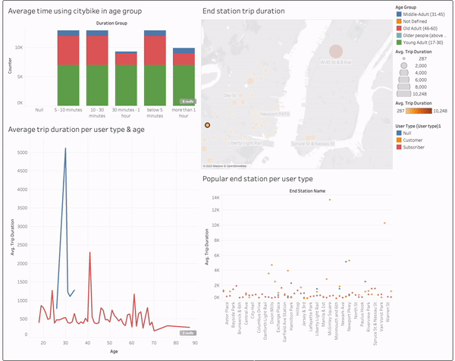
Animated dashboard

Slide 7
Thank you
Quynh Tran
Quynh.tran@tuni.fi

