Slide 1



PROPOSED UNIFORM AND CIVILIAN COLLECTIVE AGREEMENT
2025-2028

Slide 2
What to expect
This presentation is to reflect the changes that appear in comparison the 2020-2023 contract to the proposed 2025-2028 collective agreements.
There are wording changes within this collective agreement that have been made reflecting the CSPA changes and regulations
The articles now line up in both Civilian and Uniform, what is article 8 in the uniform is the same article 8 in Civilian.
The 2024 Collective Agreement year was signed in the beginning months of 2024 which allowed an extension to the 2023 contract and awarded us the 3.25% increase and was to follow the 2020-2023 CA.

Slide 3
2024 Contract extension
Civilian MOU reads the same
Notes:
Although there are deadlines for Mediation and Arbitration within this document it was mutually agreed up to continue negotiations as a new board has been introduced in September and the association required time to get the new members caught up to the events leading up to this.

Slide 4
Article 1: Definitions
Added wording classifying FT as CFT – Continuous Full Time
Added part time employees as “Contract Employee” means an employee working other than in a continuing full-time capacity.
Permanent rank (U)/ Home job assignment(C) – the full-time position held regardless of temporary assignments

Slide 5
Article 5: Complaint and Grievance Adjustment Procedure
Modernized wording for clarification that has no change to the effect or meaning
Added time to the stages of the grievance procedure. Throughout this article where there was 5 working days to respond, there in now 10 working days; with the exception of Step 1, which remains 5 working days from the time we become aware of the grievance until the time we bring the grievance to the supervisor
In the proposed step 4, the PSB will fix a time within 60 days (was 45 days) of receiving the grievance to hear submissions from the officer and/or the association grievance committee or its representative.

Slide 6
Article 6 – Annual Vacations Uniform
Years are based on fully completed calendar years (Jan1-Dec31)
Start date -3 years – 100 hours. Increase of 20 hours
Over 4 years – 140 hours . Increase of 20 hours
No change to the years 10,15 or 20
Over 25 years – 260 hours. Added This as there was not increase between year 20 and 30

Slide 7
Article 6 – Annual Vacation Civilian
Years are based on fully completed calendar years (Jan1-Dec31)
Start date -3 years – 87 hours. Increase of 17 hours
Over 4 years – 122 hours . Increase of 17 hours
No change to the years 10,15 or 20
Over 25 years – 228 hours. Added This as there was not increase between year 20 and 30

Slide 8
Article 6 Annual Vacation Uniform and Civilian
Any vacation selected during annual vacation draw that is later cancelled will become subject to discretionary time rules.
REMOVED
An officer that is injured or incapacitated prior to leave will have hours rescheduled.
Any officer that has commenced vacation leave and incurs an illness or injury shall not have their vacation credits deducted.
Civilian wording regarding of parameters of AT time usage has been removed

Slide 9
Article 7 Public and Declared Holidays Uniform and Civilian
Introduction of Float days
Holidays will be split into 2 separate categories; Public Holidays and Floating Public Holidays
_________________________________________________________________________________________________
Public Holidays |  | Float Holidays
New years day Family Day Good Friday Victoria Day | Canada Day Labour Day Thanksgiving Day Christmas Day Boxing Day | Easter Monday Civic Holiday National Day of Truth and Reconciliation Remembrance Day

Slide 10
Public and Declared Holidays
Uniform will receive (72) Seventy-two hours and Civilian to receive 63 (sixty-three) hours added to their public holiday bank on January 1st of each year and prorated for partial years.
Uniform and Civilian will be paid at the rate of time and one half when required to work on a public holiday however; wording stating that the Chief has the ability to direct employees to take public holiday leave as time off on the day the service is celebrating the holiday has been carried over from the 2020-2023 contract. This is to be done with no less that (3) three days notice.
The remaining (32) hours for Uniform and (28) hours for Civilian will go into a float bank that can be taken as time off at any time that is agreed upon. They may also be paid out at straight time should you choose to.

Slide 11
Public and Declared Holidays
Staff scheduled to work Monday to Friday will receive the holiday off with pay and time taken from their time bank. All Officers and CFT employees who are in a department that is regularly scheduled to work Monday- Friday/8 or10 hour shifts, may elect work the float day at straight time and take the time on a mutually agreed upon day. (For example: the records staff may elect to come in and work on Easter Monday and take another day off in its place. This could potentially give them 4 consecutive days off in the summer or any time of their choosing, for vacation instead of being forced to take them on the day that they are celebrated)
Any officer or staff working in relation to the courts shall align their public holiday entitlement with the day the courts designate them
Any officer required to work overtime on these days shall be paid (2.25) two and one quarter hours their regular hourly rate

Slide 12
Article 8: Bereavement Uniform and Civilian
7 Consecutive days for Father, Mother, Sister, brother, spouse, child or any dependent relative living with the officer or employee who's physical and financial care are the responsibilities of the officer or employee
4 Consecutive days for father-in-law, mother-in-law, sister, brother, grandparent or grandchild. (As before)
Leave through Bereavement is available to be approved withing (6) six months of the date of eligible death.

Slide 13
Article 9 Leave of Absence Uniform and Civilian
Parental Leaves
Parental leave has remained the same
Maternity leave for officers and CFT increased to 80% top up from 75% and increase to time as well. Maternity leave will be topped up for 19 weeks, an increase from previous 15 weeks.
MOU in place for Contracted employees stating that the historical practice of providing maternity “top up” will be discontinued for anyone Contract employees starting a maternity leave after January 1, 2028. This will be based on their median hours worked per week in the previous year and not to exceed a CFT entitlement
Unpaid LOA
During the leave there shall be no accumulation of seniority, annual vacation, public holiday leave or any other employer pain benefits.
All leave banks shall be expended in the year it was earned as well – no rolling over time and holding until the return from the Unpaid LOA

Slide 14
Article 10: Hours of Work Uniform and Civilian
Officers and Civilians who work (12) twelve hour shifts are able to split their (90) ninety minute lunch as either two (45) minute breaks or take together for a 1.5 hour lunch break at the discretion of the supervisor
Hours of work on a scheduled working day may be adjusted within that working day for operational purposes provided a minimum of (48) forty-eight hours notice given

Slide 15
Article 11: Equipment Uniform
List of equipment provided has been removed covered under the CSPA and changed to wording stating that the board shall provide all articles of equipment necessary for the performance of their duties
Any issued piece of uniform or equipment issued by the service that has been damaged or lost through the fault of the officer shall bear the cost of replacement. This is meaning any officer/employee that purposefully damages equipment, not wear and tear through the performance of their duties
Active uniformed officers performing operational field duties will receive an annual footwear allowance up to $250.00. This is one time per year with a receipt. Previous boot wording was in a directive that stated they would issue “a pair of boots” or give an allowance of $240 at the discretion of the commander
Cleaning allowance moved to Article 16

Slide 16
Article 11: Equipment Civilian
Any issued piece of uniform or equipment issued by the service that has been damaged or lost through the fault of the employee shall bear the cost of replacement. This is meaning any officer/employee that purposefully damages equipment, not wear and tear through the performance of their duties
The Chief may provide one-time clothing issuances to employees. These one-time issuances are not subject to re-issuance ie. The 2024 gifted shirts
Active employees performing uniformed Special Constable or cadet duties will receive an annual footwear allowance up to $250.00. This is one time per year with a receipt. Cleaning allowance moved to Article 16

Slide 17
Article 12: Classifications Uniform
No significant Change

Slide 18
Article 12: Continuing Full Time and Contract Employees Civilian
Any CFT employee shall be on probation for 12 months, increased from 6 months from previous contract and shall be extended by any absence greater than one week or longer by the corresponding time.
Any employee not in a CFT roll shall be considered to be a contract employee.
Contract Employees
Unless specified, contract terms shall be a full calendar year from the first day worked.
Contract extensions and renews would be granted in writing by the SPS otherwise, no offer as such the employment shall be presumed to conclude at the end of the contract term.

Slide 19
Article 12: Continuing Full Time and Contract Employees Civilian continued
Pay advancement shall occur at the same rate of CFT based on hours worked and with a performance appraisal.
Overtime will be paid when hours in one week exceed 44 hours. This is changed from having to reach 88 hours in a pay period
Recognition pay will be applied to contract employees based on total years of service with having worked a minimum of 700 hours within the eligible year.
Vacation pay will not be paid out on a bi-weekly
In all cases, should a part-time or contract employee be in receipt of health care benefits from the City of Sarnia benefit program or any other source, from the course of their employment, they will not be entitled to receive the 7% of their regular pay in lieu of benefits. (Meaning if you have second employment with the city and have benefits through them already you will not get the 7%)

Slide 20
Article 13: Salaries and Allowances Uniform and Civilian
When a payroll overpayment or underpayment occurs, payment corrections shall be made at the next possible pay period. No pay reductions to correct overpayments shall exceed 20% of the normal net payment within any one pay period, provided full repayment occurs within the current tax year. The member and Finance Director may mutually agree to alternate payment schedules. If no agreement can be reached, the finance director may impose a repayment schedule.
Acting positions and other temporary assignments into other job roles are paid only while the member is assigned to and performing those full duties, unless otherwise specified in this agreement. All officers and employees will revert to their permanent job assignment when not performing these temporary roles.
Notes:
In recognition of their support role and need for increased availability, members assigned to the temporary rank of Detective Constable, Detective, and Detective Sergeant shall receive increased pay of 6% (as reflected in the pay tables under this article). This is in lieu of any assignments under Article 17, unless otherwise specified by the Chief of Police.

Slide 21
Article 13: Salaries and Allowances Uniform only
3/6/9 wording also referred to as >8 years, >17 years and >23 years
Detective Sergent added at 132% increase of 1st class
Acting Inspector added to 139% increase from 1st class
Inspector increase to 150% of 1st class increased from 139%

Slide 22
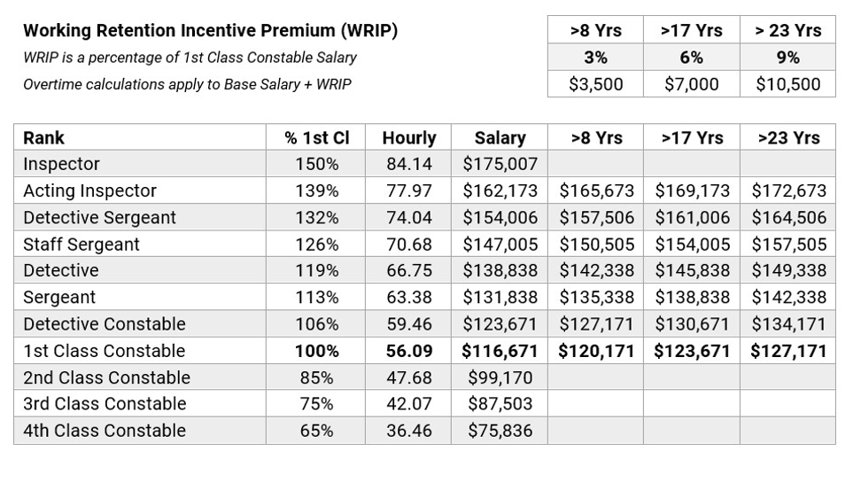
Article 13: Salaries and Allowances Uniform
SALARY RATES 2025 4% INCREASE

Slide 23
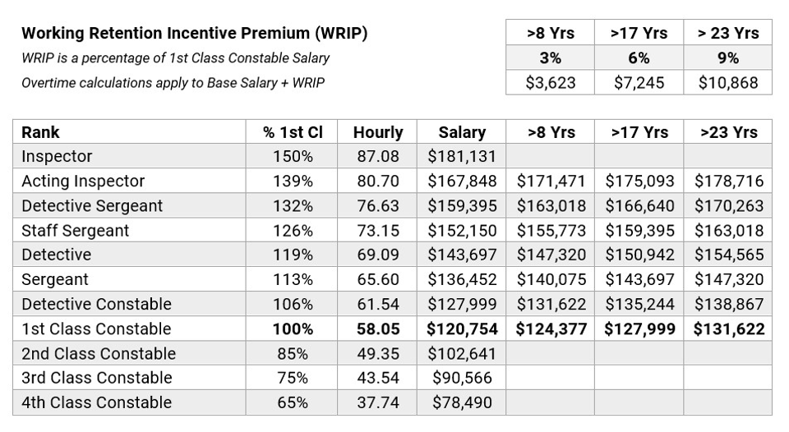
Article 13: Salaries and Allowances Uniform
SALARY RATES 2026 3.5% INCREASE

Slide 24

Article 13: Salaries and Allowances Uniform
SALARY RATES 2027 3.5% INCREASE

Slide 25
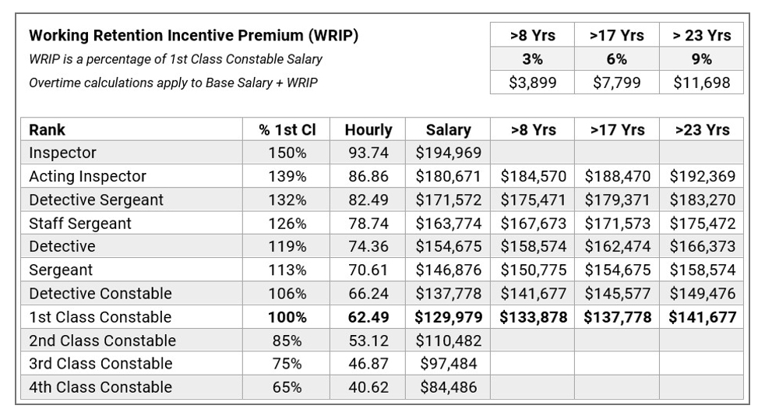
Article 13: Salaries and Allowances Uniform
SALARY RATES 2028 4% INCREASE

Slide 26
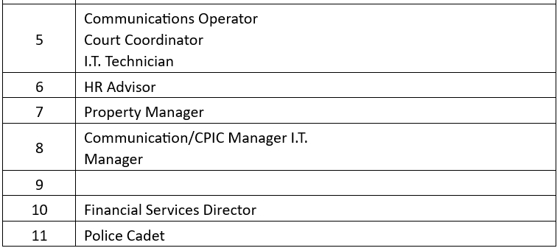
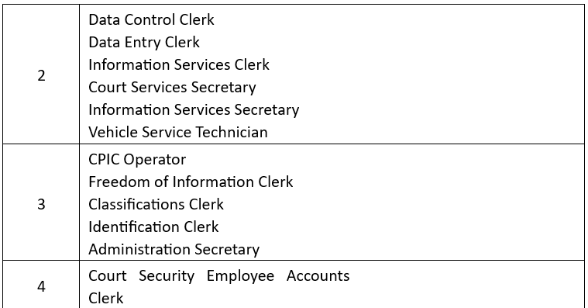
Article 13: Salaries and Allowances Civilian
All trainees will start at the year (1) one wage, 85% of full rate.
REMOVED: Training 50%, start at 75% and 6 months at 80% of full rate.

Slide 27
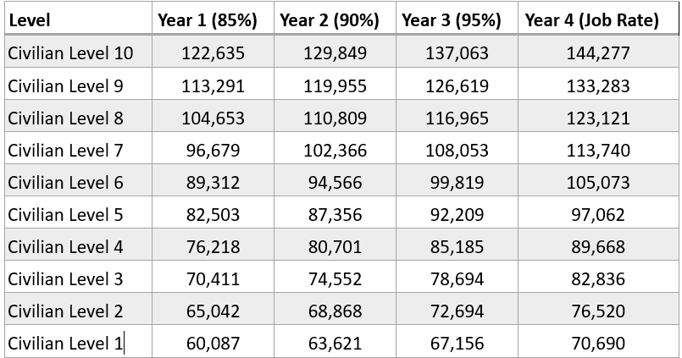
Article 13: Salaries and Allowances Civilian
SALERY RATES 2025 4 % INCREASE

Slide 28
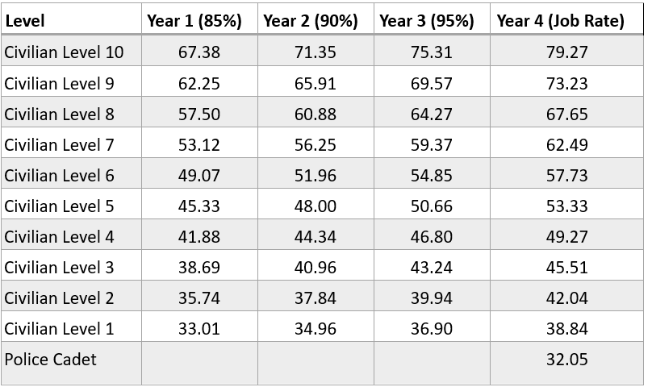
HOURLY RATE OF PAY 2025

Slide 29
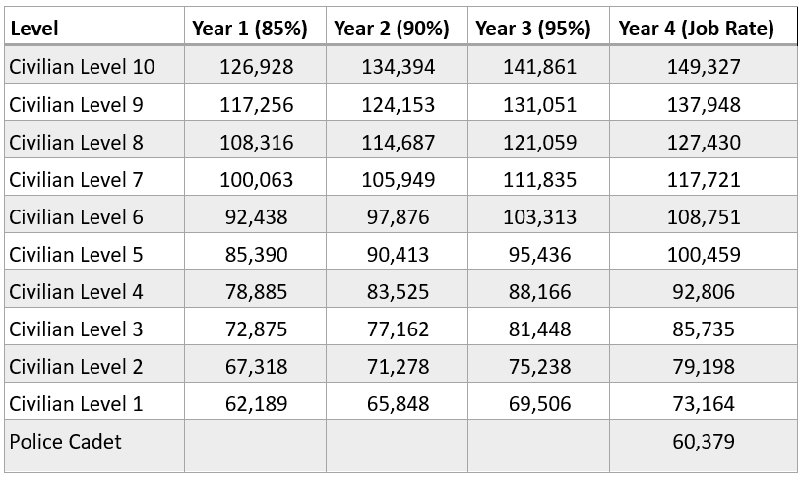
SALARY RATES 2026 3.5% INCREASE
Article 13: Salaries and Allowances
Civilian

Slide 30
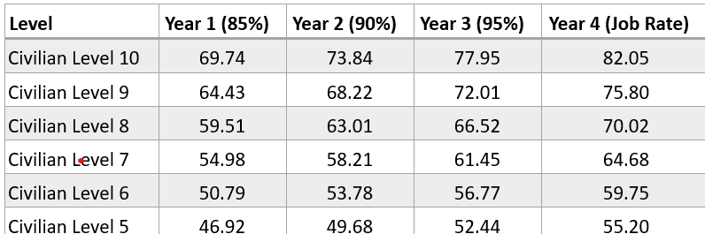
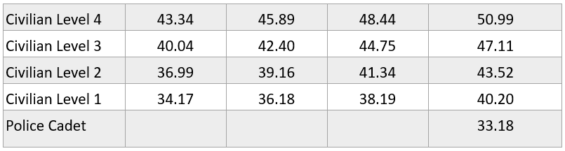
HOURLY RATE OF PAY 2026

Slide 31
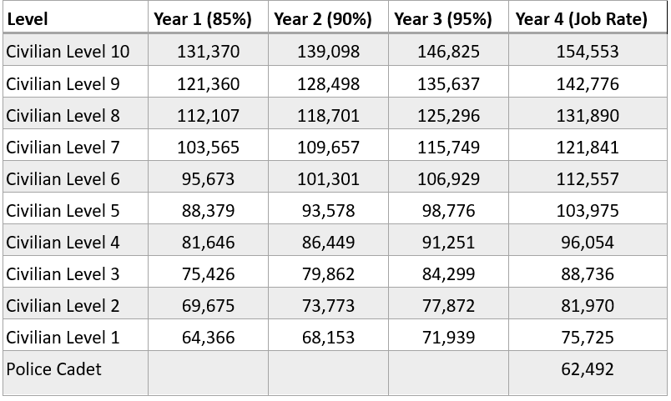
Article 13: Salaries and Allowances Civilian
SALARY RATE 2027 3.5% INCREASE

Slide 32
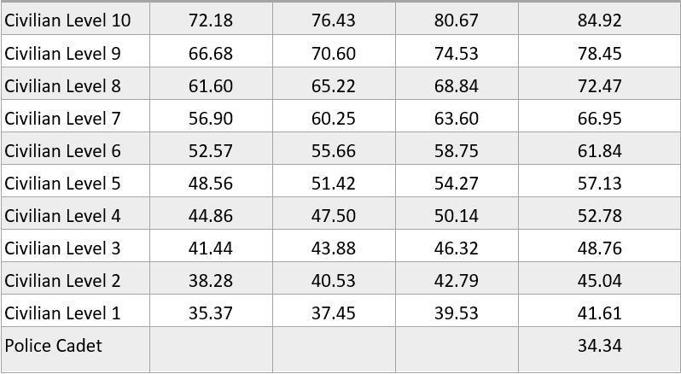
HOURLY RATE OF PAY 2027

Slide 33
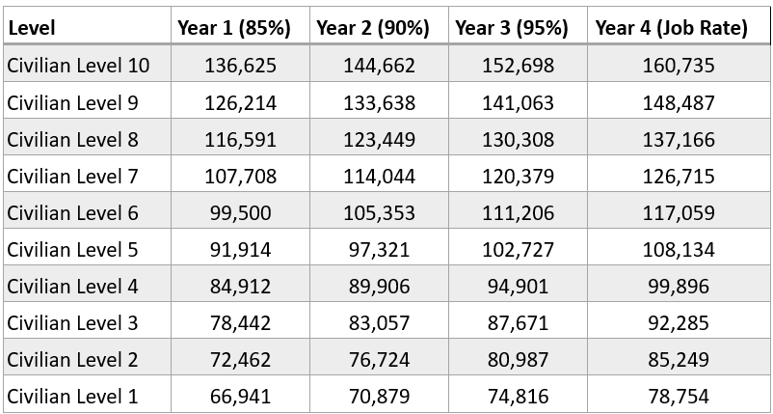
Article 13: Salaries and Allowances Civilian
SALARY RATE 2028 4% INCREASE

Slide 34
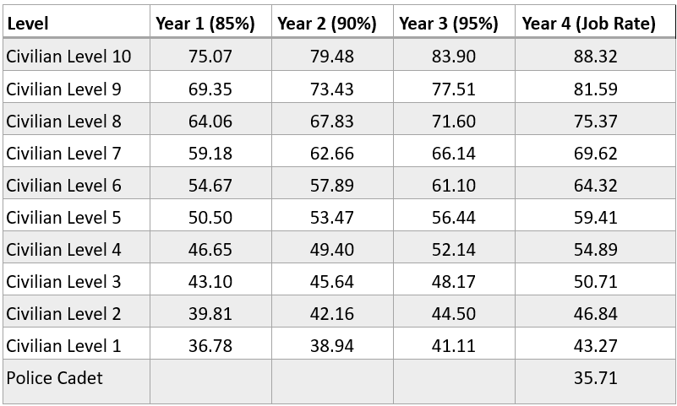
HOURLY RATE OF PAY 2028

Slide 35
Article 14: Overtime Uniform and Civilian
First hour of overtime is now granted at (30) thirty minutes past end of shift replacing previous (15) fifteen minute time frame. Every hour after the first hour of overtime will be granted at (15) minutes into the next hour.
Overtime does not apply to receiving emails, offers of voluntary overtime, or other forms of electronic communication that occur as a normal part of business operations. It also does not include the Service contacting an employee for the purpose of obtaining information in a Human Resources process (e.g. absent from work), an investigation (e.g. CSPA), or other lawful activities within the rights of the employer or as included within this Collective Agreement.

Slide 36
Article 4: Overtime
Meal allowance reimbursement of up to ($19) nineteen dollars (increase of ($2) two dollars) will be granted to employees required to work (3) three consecutive hours or more beyond their shift with an extra ($19) nineteen dollars for an additional 5 hours worked.
Meal allowances limited to (2) two per claim and requires an itemized receipt
Meal allowances will not be provided of a suitable meal has been provided to the officer/employee
Removed: Meal allowance when being called out 3 hours or less before beginning of shift

Slide 37
Article 15: Acting and Assignment Premiums Uniform
Training officers assigned to train 4th class constables shall receive $(3) three dollars an hour/($36) thirty-six dollars per shift (Increase from $(24) twenty-four dollars)
Acting pay is for hours worked in that position and no less/more and at the base rate of that position
Assignment premiums will not be paid when performing overtime for those who receive them at year end.
Any annual calculations shall be prorated for partial years
Officers shall not be compensated for more than 3 assignments at one time and calculated as follows starting with the highest paid assignment to lowest:
1st paid at 100%
2nd paid at 75%
3rd paid at 25%
Old wording stated $300 for intoxilyzer technician, containment team member, use of force trainer, DRE or traffic officer with level III course and not to be pyramided.

Slide 38
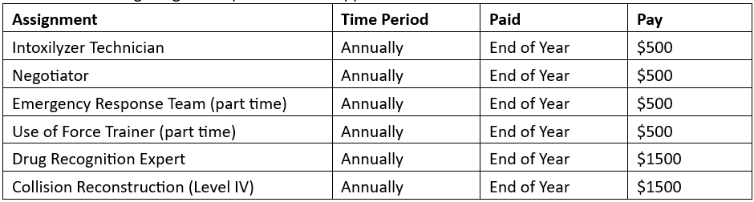
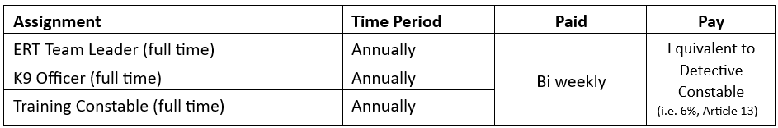
Article 15: Assignment premiums Uniform
In recognition of their specialized roles, and need for increased availability and scheduling flexibility, Constables assigned to the following roles shall receive increased pay 6% in lieu of and assignments and stand by pay.

Slide 39
Article 15: Acting and Assignment Premiums Civilian
A CFT employee temporarily performing the duties of a position in a higher salary group shall receive the next higher step rate and paid per hour basis.
If an employee accepts a CFT position within the role for which they were acting, those hours will go towards the grid level advancement for that roll.
Training rate of pay increases of ($3) three dollars per hour while training in that roll.

Slide 40
Article 15:Acting and Assignment Premiums Civilian (CFT and Contract)
Recognition pay
Five to nine years $300
Ten to fourteen years $400
Fifteen to nineteen years $550
Twenty to twenty-four years $700
Twenty-five and greater years $1,000
Previous Recognition Pay
Five to nine years $200
Ten to fourteen years $300
Fifteen to nineteen years $450
Twenty-five to twenty-nine years $600
REMOVED
Thirty years to thirty-four years $1,100
Thirty five years and above $1,300
Assignment premium for CFT performing the roll of Communicator are entitled to and incentive premium of $1000 a year and to be paid on the last pay of the year.

Slide 41
Article 16: Clothing and Cleaning Allowance Uniform
All officers assigned full time to non-uniformed (e.g. plain-clothes) duties shall be allowed $1,200.00 per year (increase of $200) for clothing expenses in lieu of the clothing issue provided under Article 11.01. Annual pro-rated payments shall be made the first pay in December of each year, changed from previous wording of semi-annually.
All officers required to work in plain clothes on a temporary basis exceeding (3) three consecutive months shall be eligible for a pro-rated plain clothes allowance (Not including those on workplace accommodation-This caveat removes the previous wording of the $100/month allowance that would be granted for maternity clothing)
Each active on duty officers shall be paid ($200) two-hundred dollars per year for cleaning allowance and paid on the 1st pay in December

Slide 42
Article 16: Clothing and Cleaning Allowance Civilian
Special Constables and Cadets working in a uniformed capacity shall be paid two hundred ($200) dollars (increase of $50) per year as a cleaning allowance. Payment shall be made on the first pay in December provided the employee is on active duty for more than 50% of each calendar year.

Slide 43
Article 17: Stand By Pay Uniform Article 17: Personnel Files Civilian
Replacing Article 17 - On Call Pay
No Change

Slide 44
Article 18: Shift Differential Uniform and Civilian
Shift hours | Uniform | Civilian
Reoccurring standard shift ends after 7:00pm and before or at 12am | $500 | $350
Reoccurring standard shift ends after 12:00am and before or at 3am | $750 | $400
Reoccurring standard shift ends after 3:00am | $1500 | $500
Previous wording was based on the shift start time whereas the proposed is based on the end time of your shift and read as follows:
any start after 12:00pm received a ($300) three-hundred dollar differential
any shift starting after 6:00pm and before 6:00am received a ($350) three-hundred dollar differential
The reasoning for the difference between the shift differential for Uniform and Civilian is for the purpose of acknowledging the efforts required of those working the front line of the department

Slide 45
Article 20: Health Care Benefits Uniform and Civilian
Registered Massage Therapy treatments to a maximum of ($1,300) One Thousand and Three Hundred dollars. Reasonable and customary charges do not apply to this benefit. Removed (12) twelve massage therapy sessions
2 year Vision Care plan that shall include eyeglasses to a maximum of $850 (increase from $500) and Eye Exams covered to a maximum of $200 (increase from $100) for each employee and their dependents.
Two year vision allotments are also still available to use towards a (1) one time laser eye surgery treatment

Slide 46
Article 20: Health Care Benefits Uniform and Civilian
Physiotherapy, chiropractic and acupuncture treatments to a maximum of $1,200 inclusive per calendar year (No change). Osteopath and Naturopath to a maximum of $200 inclusive per calendar year
Speech Therapy treatments to a maximum of $400 per calendar year. A Physician referral is required
Hearing aids including repairs, but excluding batteries, up to a maximum of $1,000 every three years. (Increase from $500, decrease in time, previous was every 2 years)

Slide 47
Article 20: Health Care Benefits Uniform and Civilian
Psychological treatments up to a maximum of $4,000 per calendar year, $2,000 for each eligible dependent. Reasonable and customary charges do not apply to this benefit. Previous wording was to a maximum of $2,500. (Increase of $1,500 to officer/employee but decrease of $5oo to dependents)
Diabetic equipment including blood glucose monitoring devices, up to a yearly maximum of $1,500 after Provincial coverage is exhausted
Orthodontics shall continue on a 50/50 co-insurance basis with a lifetime maximum of $4,000 (Increase form $3000) for each dependent child. The Plan shall also include a Major Restorative rider (crowns, caps, bridges, etc.) on a 50/50 co-insurance basis with an annual maximum of $2,000.

Slide 48
Retiree Benefits Plan
The plans shall continue until such retiree attains sixty-five (65) years of age or becomes covered by such benefits in part or in whole by another source, whichever is sooner. (New wording)
If the member who is eligible dies, these benefits shall be extended to their surviving spouse or dependents under twenty-one (21) years of age. The said benefits shall continue until such time as the deceased employee would have attained sixty-five (65) years of age or the spouse/dependents become covered by such benefits in whole or in part by another source, whichever is sooner.
REMOVED :Massage treatment, physiotherapy, chiropractic and acupuncture, as well as osteopath and naturopath and psych. Also not offering the coverage for diabetic equipment.

Slide 49
Retiree Benefits Plan
If the eligible member has a dependent over the age of twenty-one (21) years who remains dependent because of a physical or mental handicap; these benefits will not be denied the dependent. The said benefit shall continue for five (5) years or until such time as the deceased employee would have attained sixty-five (65) years of age, whichever is sooner.

Slide 50
Line of Duty Death
Where an Officer or Special Constable or Police Cadet is killed or dies as a result of injuries received in the performance of their lawful duties, leaving behind a spouse or any defendant children, the Board shall pay to the officer's surviving spouse and/or children, a supplementary monthly payment.
REMOVED
Identification Technician from civilian

Slide 51
Article 21: Group Life Insurance Uniform and Civilian
The Board agrees to contribute 100% of each CFT employee's premium for enrolment in a Group Life Plan providing for four (4) times their annual base salary rounded up to the nearest $500.00, or to the insurer’s maximum coverage of $700,000, whichever is less. (Added wording)

Slide 52
Article 22: Pensions Uniform and Civilian
Uniform
In accordance with the terms, conditions and eligibility rules of OMERS, the Board through OMERS shall provide an early retirement benefit with OMERS to permit early retirement without actuarial reductions in benefits within ten (10) years prior to an officer's normal retirement date when:
a)the officer is declared by the employer to be unable to perform the duties of their employment due to mental or physical incapacity (partial disability). This is done through medical assessment. As per Sec. 88 CSPA
b) the officer has completed thirty (30) years of OMERS recorded service with the employee
Civilian
In accordance with the terms, conditions and eligibility rules of OMERS, contract employees as defined in Article 12 who are eligible may be enrolled in the OMERS plan upon request.

Slide 53
Article 23: Court Time Uniform
The supervisor may reschedule the officer’s hours, within their existing scheduled working days, and/or otherwise direct the officer regarding their attendance. Where possible, any shift working hours change(s) shall be agreeable between the officer and the supervisor
An officer required to appear in court after or before a scheduled nightshift shall be provided with a minimum of eight (8) clear hours of rest, after and before the day of the court appearance, without loss of time.
Normal reporting time shall be one-half hour before the start of criminal or superior court, and the court starting time for other courts.
If the attendance of an officer of the Service is required at court on a day of their annual vacation, they shall be paid for the actual hours worked, but no less than four hours, at double time.

Slide 54
Article 23: Court Time Uniform
Lead investigators attending criminal court on a rest day, shall be paid 3 hours of overtime as per Art. 14, plus three (3) hours credit in the first hour (at straight pay). Overtime rates applied to every hour after the initial 3 hours. This is limited to one lead investigator (Officer in Charge) per criminal trial matter.
All secondary officers are paid overtime with 3 hours upfront in the first hour and overtime per hour after the initial 3 hours.
If an officer is compelled to attend criminal court for the purpose of testimony or POA court with less than 48 hours’ notice provided, they shall receive payment as per the proposed court time with an extra 4 hours of overtime for the first 3 hours

Slide 55
What does the new Court time look like?
Hours in Criminal Court | 1 | 2 | 3 | 4 | 5 | 6 | 7 | 8
Previous hours at straight time | 6 | 7 | 8 | 9 | 10 | 11 | 12 | 13
Lead Investigator converted to straight time hours (3 hours OT plus 3 hours straight time) | 7.5 |  |  | 9 | 10.5 | 12 | 13.5 | 15
Secondary officer/POA converted to straight time hours (3 hours OT for first 3 hours) | 4.5 |  |  | 6 | 7.5 | 9 | 10.5 | 12
Short notice (48 hours or less)Lead Investigator | 13.5 |  |  | 15 | 16.5 | 18 | 19.5 | 21
Short notice (48 hours or less) secondary officer/POA | 10.5 |  |  | 12 | 13.5 | 15 | 16.5 | 18
For the lead investigator only, 1st hour receives 3 additional hours at straight time as well as 3 hours at OT rate; the equivalent of 7 hours straight time in the first 3 hours. OT rate for every hour after.
Secondary officers, and officers attending POA court shall be paid 3 hours of OT for the first hour and 1 hour OT for every hour after the initial 3 hours.
If officers are compelled to attend criminal court or POA court with less than 48 hours notice the officer shall receive the same payment arrangement but with an extra 4 hours of OT in the first hour giving 13.5 hours in the first hour of criminal court.

Slide 56
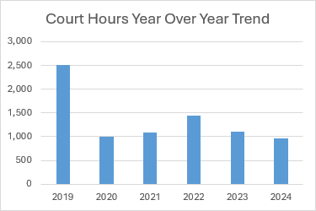
Court Time Officer Usage
Year | $ | 1st Class Hourly Rate | Estimated Hrs
2019 | $120,937 | $48.24 | 2507
2020 | $48,717 | $48.72 | 1000
2021 | $54,113 | $49.70 | 1089
2022 | $73,065 | $50.70 | 1441
2023 | $57,416 | $51.72 | 1110
2024 | $51,894 | $53.93 | 962 | To Sep 30
Court Pay OT from Jan –Dec 2024 has accounted for only 10% of the overtime in the organization

Slide 57
Article 23:Court Time Civilian
Wording for Civilians mirrors uniform in respect to rescheduling employee’s hours within their scheduled working days
For days that cannot be altered from scheduled rest days they shall receive 3 hours of time and one half for the first 3 hours front loaded in the first hour.
Same 8 hour clear hours of rest after and before the court appearance without loss of time.

Slide 58
Article 24: Short Term/LTD/WSIB Uniform and Civilian
Any Employee absent from the workplace due to illness due to STD, LTD, or under WSIB for a period of (30) thirty consecutive days or more retroactive to the first date of absence shall:
Not accrue STD credits
If on LTD and WSIB there will be no entitlement to accrue vacation, public holiday time or retention incentive during period of absence.
Be moved to an (8) hour Monday-Friday reassignment during absence
If absence ends prior to the end of the year any earned public holiday or vacation credit shall be assigned within the remaining calendar year. If this is not possible public holiday and vacation time may be carried over, and accumulated earned time banks may be paid out or carried forward

Slide 59
Article 24: Short Term/LTD/WSIB Uniform and Civilian
Emphasis has been placed on maintaining communication while off. Failure to actively participate in any absence management or RTW in a co-operative fashion may result in unpaid leave.
This cooperation and participation includes establishing mutually agreeable communication conduits, maintaining reasonable communications, promptly responding to requests or messages within three (3) business days (unless otherwise agreed), and providing acceptable documentation as required.
Officers shall notify the employer of any anticipated court matters or duty related commitments potentially impacted by their absence. Officers shall avail themselves of any medically supported accommodation to facilitate court attendance. Failure to notify the employer and/or failure to attend court without prior notice and/or medical documentation substantiating the absence may result in disciplinary actions

Slide 60
Article 24: Short Term/LTD/WSIB Uniform and Civilian
On or before the term of the absence or workplace accommodation period the officer shall either give:
A medically substantiated update to extend or alter the conditions of the leave or accommodation or apply for WSIB
Provide notice that they will be immediately returning to work
Elect to retire if eligible
If the term expires without any of the above conditions met it will be considered an unpaid leave
Any absence greater than 30 days may be referred to an IME at the cost of the board. The Employee shall be notified in writing prior to.

Slide 61
Article 24: Short Term/LTD/WSIB Uniform and Civilian
Short Term Disability
There is 2 levels of STD credits
Primary STD credits at 100% pay coverage
Secondary STD credits at 75% pay coverage
Primary STD credits will be granted on January 1st of each year
Uniform to receive (72) seventy-two hours at 100% pay coverage to a max of 216 hours in any 3 calendar year period
Civilian to receive (63) sixty-three hours at 100% pay coverage to a max of 189 hours in any 3 calendar year period.

Slide 62
How do time credits work?
Primary and Secondary STD credits work on a 3 year and 2 year rotation of credits
Every year 72/63 hours will be added to your STD credits to a max of 216/189 hours.
In a 3 year span you can only use 216/189 hours as well.
Think of it as two rings. The inner ring can hold 216 credits.
When a sick credit is used it moves to the out ring where it sits for3 years before it can go back to the inner ring. The first 3 years of this will feel like you are constantly draining your credits but as you enter the 4th year you will be gaining those credits back and becoming whole again on a continual basis.
If you are perpetually using your 72/63 hours each year you will never build up a bank to use in the event you need more. Using your whole banks immediately will be detrimental in the long run as it will take you 3 years to get the credits back in your “inner circle”
The same theory applies to the Secondary credits but is on a 2 year credit rotation of the 480 hours
Used credits
Available credits

Slide 63
Article 24: Short Term/LTD/WSIB Uniform and Civilian
Secondary STD Credits
These credits are available annually of January 1st of each eligible year and work on a two year basis. These shall be prorated in the first year of employment
Uniform to receive (480) four-hundred and eighty hours
Civilian to receive (420) four-hundred and twenty hours
Within any two (2) year period, an employees are eligible for up to a maximum of seventeen (17) weeks of coverage, or up to the completion of the elimination period for LTD, whichever comes first. This shall be provided in the following sequence:
• Primary STD credits to exhaustion, then
• Secondary STD credits to exhaustion, then
• ALL employee time banks to exhaustion, then
• Tertiary STD credits may be retroactively applied for any employee who is approved for full LTD but has exhausted coverage to complete the 17-week elimination period. Tertiary credits will be 60% pay, and only available after the exhaustion of all other STD credits and employee time banks.

Slide 64
What does this mean for me today and in the future?
STD credits will be prorated for new employees in their first year or granted 24 hours, whichever is greater.
Yes you DO keep what is in your bank now. It will all roll over and gain 72/63 in January 2025 to a max of the 215/189
If you use 72/63 hours every year and no more you will never run out of sick time
What happens if I get sick or injured and will be on LTD?
In the event you become incapacitated in any way and will be moving towards LTD, the existing Primary and Secondary credits shall be exhausted first. If these banks are full you will successfully reach the 17 week period that must be completed before LTD can be claimed.
Should you not have the credits available and all time banks have been exhausted you will be granted tertiary credits at a rate of 60% base wage. This is time that does not require any form of “payback” and is not being taken from any future credits or bank. The board has agreed to see that the employee is successfully brought to the LTD benefit with undo hardship

Slide 65
Article 24: Short Term/LTD/WSIB Uniform and Civilian
STD claims of 3 days or less does not require a medical note
Upon 3rd incident of illness, a note MAY be required
STD claims anticipated to be, accumulated to be greater than (14) days shall require a doctors note
The service shall pay the cost of up to (5) five requested medical certificates, up to $75 each (previous was $50) within a (3) three year period (was yearly)
Secondary STD claims shall be topped up to 100% by the employees other time banks unless directed otherwise
Upon real or anticipated exhaustion of primary credits and exhaustion of secondary, the employee may apply to LTD

Slide 66
Article 24: Short Term/LTD/WSIB Uniform and Civilian
Long Term Disability (Wording taken from Previous Contract)
The Board shall provide, at its expense, an LTD plan from the first day of the month following the first month of employment
The LTD Plan shall provide a benefit of 70% of gross pre-disability regular monthly earnings, at the rate of the employees permanent rank or home job assignment max of $7,500 per month, for illness or injuries extending beyond available coverage under STD.
The monthly employment, disability and retirement income receivable from all sources may not exceed 85% of pre-disability income, and the LTD Plan benefit may be reduced accordingly.
The LTD Plan benefits shall be payable until the earliest of:
the insured person ceases to be disabled;
the insured person becomes eligible for an unreduced pension under OMERS;
the insured person reaches their normal retirement age (NRA) under OMERS; he insured person dies. THIS IS ALL HISTORICAL WORDING

Slide 67
Article 24: Short Term/LTD/WSIB Uniform and Civilian
WSIB
During the waiting period of approval from WSIB, available STD credits shall be used (tertiary if needed)
Officers/employees on permanent accommodation or return to work accommodation with reduced hours will receive pay for actual hours worked. Any approved WSIB loss of earnings (“LOE”) time would be paid.
Officers who call in sick while on an approved WSIB accommodation and in receipt of WSIB payments, will be recorded as sick and available sick credits applied, unless the reason for the absence is approved as related to the WSIB claim.
Pre-disability earnings shall be deemed at the officer’s permanent rank or home job assignment (i.e. exclusive of acting or assignment premiums).

Slide 68
Article 24: Short Term/LTD/WSIB Uniform and Civilian
Where a currently serving officer’s/employee’s claim is allowed by the WSIB, the officer will continue to be paid by the Police Service Board under the following formula:
“top-up” to not exceed one hundred percent (100%) of pre-disability net earnings, using a formula which takes into consideration:
The LOE awarded by WSIB
Traditional public deductions and Associations dues,
The anticipated income tax that would have likely been returned to the Officer had the officer continued to receive full salary with regular deductions,
The individual officer’s net claim code per the TD1 filed with the Employer at the time of disability,
Any WSIB retirement fund deduction the member opts in to will be excluded from the top up calculation.

Slide 69
What does that look like?
 | Description | Employee @ work | Employee - WSIB
Earnings | Salary (T4 ) Loss of earnings Benefits Top up as per contract EI Rebate | $151,546.04 $97.06 | $65,500.00 $86,046.04 $97.06
Gross Pay |  | $151,643.10 | $151,643.10
Deductions | CPP EI OMERS Union Taxes | $3,867.50 $1,049.12 $19,777.94 $2,087.10 $33,634.12 | $3,867.50 $1,049.12 (see below) $2,087.10 $17,500.00
Net Pay |  | $91,227.32 | $127,139.38
OMERS disability waiver: While on a disability waiver, you continue to accumulate credited service in the OMERS Plan as if you were still working. The OMERS Plan covers the contributions you and your employer would have made if you were not on a disability leave. – taken from OMERS website https://members.omers.com/disability-benefits

Slide 70
Article 24: Short Term/LTD/WSIB Uniform and Civilian
The benefit under WSIB is conditional on the member receiving a LOE benefit, remaining an employee of the service and not receiving any other secondary employment income. The member must immediately disclose receipt of any such amounts to the service.
This “top-up” shall cease when the officer is eligible to retire with an unreduced pension in accordance with OMERS , or when the officer reaches their normal retirement age in accordance with OMERS regulations, whichever comes first.
“Top up” shall be provided by first cashing out any earned time banks. Any remaining “top up” entitlements shall be provided by the employer once the officer’s time banks are exhausted.
If the employment relationship ends for any reason while an officer is off work on an approved WSIB claim, the WSIB top-up would no longer apply.

Slide 71
Article 24: Short Term/LTD/WSIB Uniform and Civilian
WSIB LOE benefit will be increased by COLA annually
If the claim is denied it will be considered an overpayment for the top that was provided and will be paid back as an overpayment
In relation to the OMERS disability payment: Once the officer becomes eligible for an OMERS disability waiver of contributions, the calculation of net pay will assume that the Officer is in receipt of an OMERS disability waiver of contributions.
However, where an officer has applied for the OMERS disability waiver of premiums and has been denied, the employer will pay the officer and employer share of OMERS contributions, provided that the officer submitted all the necessary medical documentation requested by OMERS to assess their eligibility for a waiver to ensure that the Officer’s service is not adversely affected by a denial.

Slide 72
Article 25: Promotions Uniform
Historical wording has been carried over with the addition of:
Promotional candidates seeking to enter a promotional competition must be capable of performing any established job assignments and all requirements for the rank sought.

Slide 73
Article 25: Job Postings Civilian
Vacant positions shall be posted internally for a period of not less than ten (10) working days (exclusive of public holidays). Vacant positions may be concurrently posted externally, subject to the needs of the service.
a vacancy occurs when an authorized strength CFT position exists, where no CFT employee is assigned on a permanent basis. Any vacant CFT position shall be posted within six (6) months of the vacancy occurring.
However, if the vacancy is to be converted or otherwise repurposed, the Association shall be notified forthwith. The conversion or repurposing shall be completed within twelve (12) months of the vacancy materializing.
Upon completion of a competition for a position, and provided that more than one (1) qualified candidate is identified through the selection process, the employer may maintain a list of qualified candidates from which any vacancy that occurs within a twenty-four (24) month period will be filled.

Slide 74
Article 26: Seniority Uniform
Historical wording has been carried over with the exception of the Layoff wording, which has also been removed from the title of the article

Slide 75
Article 26: Seniority/Layoffs Civilian
This is renamed from the 2023 contract article 16: Permanent Employee
In the event of a lay-off, employees shall be laid off in reverse order of their seniority, within the job classification that is surplus. The Board shall notify employees who are to be laid off, thirty (30) days prior to the effective date of lay-off, or award pay in lieu of the thirty (30) days’ notice. It is understood that lay off is applied first to contract employees and then to continuing full time employees.
A laid off employee shall have the right to recall for up to twenty-four (24) months from the date of lay off.(previous wording was 9 months) In the event of any future openings, laid-off employees shall be recalled in order of their seniority. No new employee shall be hired until those laid off and who still have seniority have been given the opportunity of recall.

Slide 76
Article 26: Seniority/Layoffs Civilian
SURPLUS POSITIONS
This wording is referring to a job classification that in its current form is deemed by the Chief to be no longer required. This includes outsourcing to provisions withing the CSPA.
When a Civilian position is declared surplus the following shall occur:
(90) ninety day written notice that shall include the anticipated effective date
Permit the affected employee to apply to any suitable vacancies prior to the surplus taking effect (rate of pay shall be as set in said new position) or,
With consent of employee and association, transfer the employee to a new or alternate vacancy waving the provisions of posting the position (same or lower pay grid)
With consent of the employee and association, create a new role within the organization at the same or lower pay grid.

Slide 77
Surplus continued
If the affected employee is unwilling or unable to obtain or accept a position from these options, the Service may place the employee into an existing role commensurate, to the extent possible, with their knowledge, skills, or abilities. This shall be done in consultation with the Association and the employee. No role under this section shall be implemented that does not address the needs of the organization.
If the existing assigned role is at a lower pay scale, the employee shall retain their annual salary at the rate of their last day in the former role (red circle).
e) If the employee is unable or unwilling to accept options provided pursuant to the surplus new position or the service is unable to provide alternatives under those sections, then a layoff may be invoked.

Slide 78
Article 28: Disbandment Uniform and Civilian
Upon the municipality entering into a formal costing process or agreement with the OPP to disband the Sarnia Police Service, all officers of the Sarnia Police Service shall be entitled to a compensatory payment of one days’ (eight (8) hours) pay for uniform and one days’ (seven (7) hours) pay for civilian for every full or partial month that the costing process is formally underway, or until the Sarnia Police Service is disbanded. This acknowledges that any costing process has a significant negative impact on the well-being of the members, morale, performance, member families, and the organization. This does not constitute severance.
The board will endeavor that every full time officer or CFT be offered employment in a similarly paid position with the OPP.
In the event that they are not offered this the employee shall additionally be suppled with paid notice for (6) six weeks for every year of service to a max of 48 months
$7,500 offered for tuition assistance for (4) four years should the employee not be placed within the service and not eligible for unreduced pension.

Slide 79
Article 28: Disbandment Uniform and Civilian
If the City of Sarnia and the County of Lambton agree to provide unified municipal police and the Sarnia police service becomes that service the parties agree to negotiate, cost, provisions for those off with illness and injury, retired members etc

Slide 80
Article 29: Senior Officers/executives
Articles that do not apply to senior executives
Public Holiday Pay
Overtime
Acting Pay and Assignment Premiums
Clothing/Cleaning allowance
Shift Differential
In lieu of overtime that is worked 10 days of lieu time will be granted Jan 1 of each year
May have their working hours adjusted as per the needs of the service with 48 hour notice

Slide 81
Article 29: Senior Officers/executives
Uniform only: Senior officers available for and being scheduled as a Duty Officer outside of normal working hours (i.e. Incident Commander or Critical Incident Commander), shall receive additional Duty Officer premium pay of eight thousand five hundred ($8,500) annually.
In recognition of higher rates of public and ceremonial duties, the Board agrees to provide Senior Officers/executives an annual clothing and cleaning allowance of $2,200 per year for uniformed officers and $1,500 for civilian
Senior officers/executives, that receive a performance appraisal rating of satisfactory or higher in all categories, and with the endorsement of the Chief, shall be annually provided with a performance week of forty (40) hours uniform and thirty-five (35) executives to be accrued in a time bank until retirement or resignation. Upon retirement or resignation, this bank may be taken in time off, or paid out at the discretion of the Chief of Police
Should the senior officer or executive go off on STD,LTD or WSIB for longer than 30 days incentives shall be prorated.
This article shall be rescinded upon implementation of any Sarnia Police Senior Officers Association Collective Agreement.

Slide 82
Article 30: Suspension with Pay Uniform and Civilian
This article speaks of the use of holiday time. Booked or otherwise
Booked holiday time will be left as such and Public holiday time shall be taken as they fall in the Calander year during said suspension
All attempts shall be made to use all vacation credits in the same year

Slide 83
Article 31: Suspension without Pay
No time bank or sick credits accrual shall happen in the time frame the officer/civilian is off
Any public holiday credits previously earned prior to the unpaid suspension shall be paid out at the end of the year if the employee is still off

Slide 84
Article 32: Retirement Notice Uniform only
01 When an officer provides a minimum of six (6) months written irrevocable notice to the Chief of Police of their date of retirement, they may receive two (2) retirement gratuity weeks of annual leave in pay or in time off immediately preceding the retirement date, should the officer elect to cancel or otherwise rescind their retirement, they will permanently disqualify themselves from this article and will not be eligible to re-apply.
In the six month period prior to their retirement date, officers on an unsubstantiated absence from the workplace for 30 days or more, on unpaid leave, any form of suspension, absent under STD, LTD, or WSIB provisions are not eligible for the 2 week gratuity
Eligibility must be maintained up to and including the retirement date provided in order to receive this
Any payments elected for under this article are to be made at the officer’s normal rate of pay upon retirement, exclusive of any premiums
Officers shall have their final year of public holiday, assignment premiums, and other forms of compensation prorated based on eligible time worked within that calendar year. Any owed entitlements of time shall be assigned or paid out at the discretion of the Chief of Police.

Slide 85
Article 33: Resignation/Termination
Minimum 2 weeks required
The officer may apply to the Chief to have unused time credits converted to pay providing the officer can substantiate why they were unable to provide notice earlier that would permit the time to be taken off.
All equipment, identification and property must be returned
Time banks will be prorated
OFFICERS ONLY:If an officer is no longer able to perform the core duties of a police officer (CSPA section 82(1)), and prior to initiating the termination process under section 88 of the CSPA, the Chief of Police may consider available accommodation options under the Civilian Collective Agreement. Any such accommodation shall require the agreement of the Association and Chief of Police. If the officer is permanently accommodated as a civilian member, they shall thereafter be subject to the Civilian Collective Agreement.
Officers shall in all respects, co-operate and actively participate in any reasonable process required to determine this accommodation. Officers shall, within 30 days, submit and actively participate in required medical examination(s) pursuant to any termination process under the CSPA section 88.

Slide 86
Civilian MOU
Contract Employees
With the implementation of this Collective Agreement, the Sarnia Police Service Board and the Association undertake to provide all employees other than continuous full time, a contract retroactive to and commencing on January 1, 2025. This initial minimum term of the contracts shall be based on the contract employee’s hire date with the Sarnia Police Service.
• Hired in 2019 or before: no expiry date
• Hired in 2020 to 2022: minimum four (4) year term
• Hired in 2023 to Ratification: minimum three (3) year term (conditional upon successful completion of initial required employment training)

Slide 87
Civilian MOU
Discontinuation of Contract Maternity “Top Up” Entitlements
All contract employees retain access to any legislative leave(s) and continue to receive pay in lieu of benefits. The historical practice of providing maternity “top up” will be discontinued within the life of this agreement. In order to implement this change, a transition period for only contract employee maternity leaves has been agreed upon.
Contract employees commencing a maternity leave prior to January 1 2028, will be temporarily eligible for top up continuation (as per Article 9), based on their median hours worked per week in the previous year. This top up shall not be more than a full time employee would receive, and it shall be commensurate with the contract employee’s current rate of pay at the time the leave commenced.

Slide 88
MOU Uniform and Civilian
Historical Vacation Reconciliation
Annual Vacation adjustment for members hired before 2023
All serving members hired before 2023, who did not receive annual vacation in their first year of employment, will now additionally receive that prorated first year of vacation allocation in their 2025 time banks.

Slide 89
MOU Uniform and Civilian
Collective Agreement Language
The Association understands that the Police Service Board shares the same common interest in ensuring a mutually agreeable and positive working agreement between the employer and the members of the Sarnia Police Association.
To preserve the intent of the Collective Agreement, both the Sarnia Police Service Board and the Association acknowledge that this Agreement was extensively rewritten to improve the document’s relevance in today’s working environment and to provide a modern framework going forward.
As such, the Association and the Sarnia Police Service Board agree to address any unforeseen issues during the life of this agreement to mutually ameliorate any shortcomings, implications of the CSPA, and interpretations and/or misunderstandings of the intent the language to ensure its true meaning and to not unduly impact the Service or members or the Sarnia Police Association.
This Letter of Understanding shall be appended to the Collective Agreement for its duration and may be renewed by agreement of the parties.

Slide 90
The Wrap up
Increase vacation for employees starting to year 10. (40) Forty hours for Uniform and (34) thirty-four for civilian
Vacation increase at year 25 of 260 hours for Uniform and 210 for civilian
Truth and Reconciliation has been added to the float holiday time
Introduction of float days benefiting straight day employees who have traditionally been required to take these holiday hours from their bank and on the day they service recognized them. These may be cashed out and you still will receive time and one half should you work them.
Historical wording of Officers and Employees being able to be sent home with notice on holidays remains
Increase to bereavement for immediate family
Increase to Maternity leave, 5% increase and 4 extra weeks added (80% for 19 weeks)
Increased lunch break to (2) two 45 minutes or (1) one hour and a half break for 12 hour shifts

Slide 91
Annual footwear wording added. No longer requiring approval for new boots
Increase to training pay for coaches as well as increase to staff that is training under the CCA
Assignment premiums have made significant improvements and are now able to pyramid them.
Assignment premium added for civilian Communicators
Recognition pay increased for civilian with the loss of increase over 30 years of service
Increase to clothing and cleaning allowances
Increase to shift differential
OT granted at 30 mins initially
8 hours clear BEFORE and after court
Changes to Court pay with the biggest change to scheduled secondary officer and POA Court with increase to pay for Lead Investigators and last minute call ins
Surplus wording added for Civilian and offer to civilianize officers who are no longer able to perform core duties in any position

Slide 92
Benefits
Massage now a monetary amount
Vision increase by $500, eye exam increased by $100
Physio, chiropractic and acupuncture increase $300
Hearing aids increase $500 (now every 3 years instead of 2 years)
Psych increased by $1,500 Decreased $500 for dependants
Diabetic equipment added to coverage of $1,500
Orthodontics increased $1,000

