Slide 1
Castlight

Slide 2
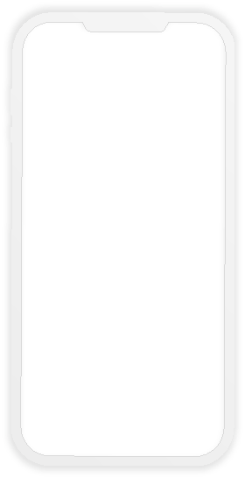
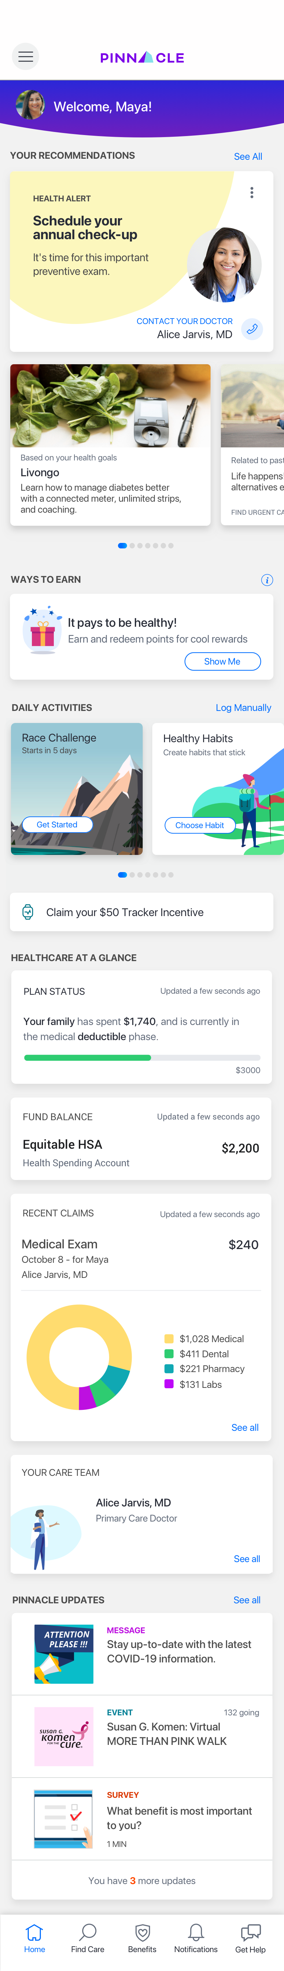
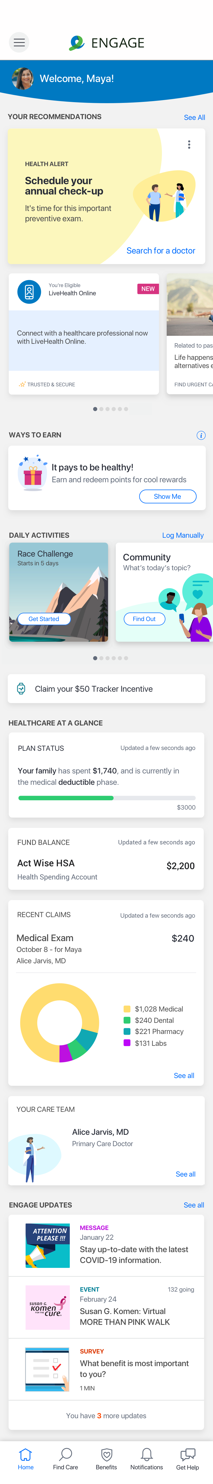
What is Castlight?
A comprehensive, digital resource that helps you navigate your benefits plus focus on your health and wellbeing.
View your benefit plans and programs
Search for the care you need
Receive timely recommendations
Stay on track with your health
Unrivaled decision support with the most personalized health and wellbeing experience

Slide 3
Castlight is personalized just for you
Information is based on your unique profile and benefits
Receive provider recommendations with the background and expertise relevant to YOUR specific needs and conditions
Get timely, regular notifications that help you manage your health, such as an annual exam reminder
Track and manage your spending to become a better healthcare consumer
Set wellbeing goals in line with your overall health and earn rewards for working towards them
Maximize the programs and benefits available to you
The more you use it, the more personalized it becomes

Slide 4
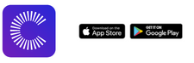
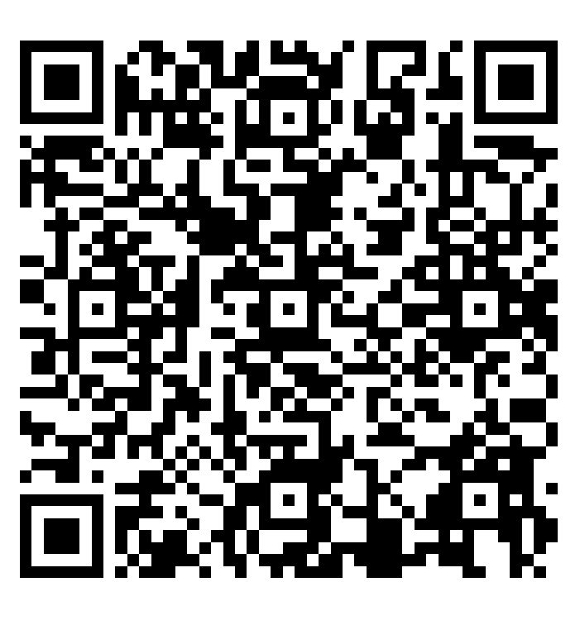
How to access
Bullet points do not end in periods
Titles can be up to 2 lines long, but try to keep titles as short as possible
If you have an account:
Visit mycastlight.com OR
Scan the QR code
Not registered yet?
It’s easy to register using one of three ways:
Visit mycastlight.com
Download the Castlight Mobile App from the App Store or Google Play
Scan the QR code

Slide 5
How Castlight can help

Slide 6
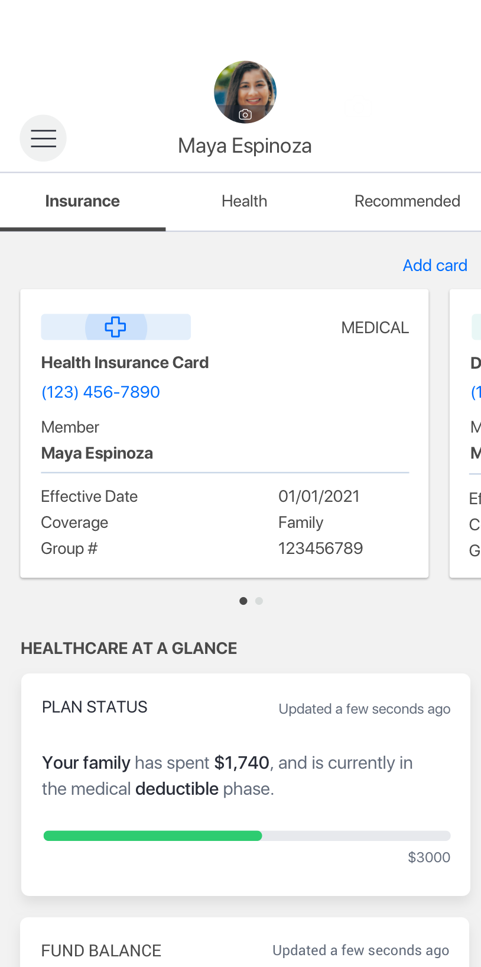
Understand your coverage
Navigate to the Benefits page and review your plan status and coverage:
View your dedicated Care Team
Access your digital insurance card
See your recent medical claims and spending
Check progress towards your deductible
View your HSA balance

Slide 7
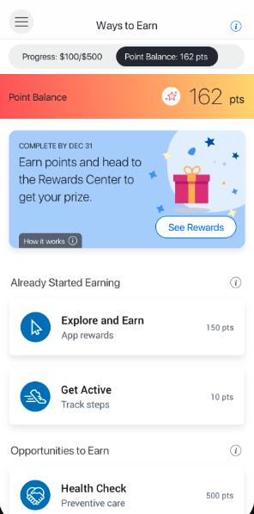
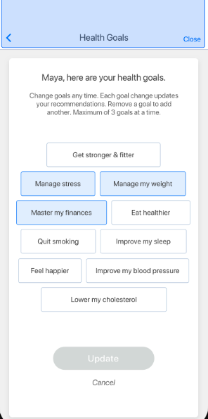
Take charge of your wellbeing
Review progress on your health goals and make sure you’re up to date on preventive care and screenings.
Complete activities, earn points, and redeem them for rewards.
Earn rewards like gift cards, medical contributions, or enter a sweepstakes

Slide 8
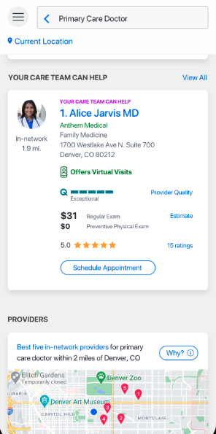
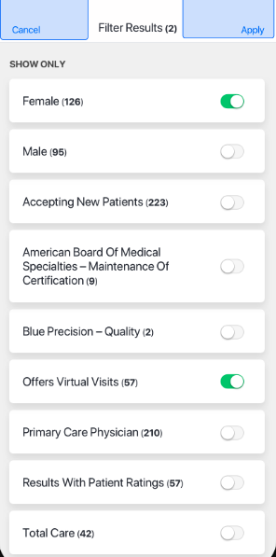
Plan your healthcare spending
Navigate to the Find Care page and estimate costs for care you may need:
Doctor’s visits
Procedures
Lab tests
And more
Plus, use Castlight’s filter to find the right doctor for you

Slide 9
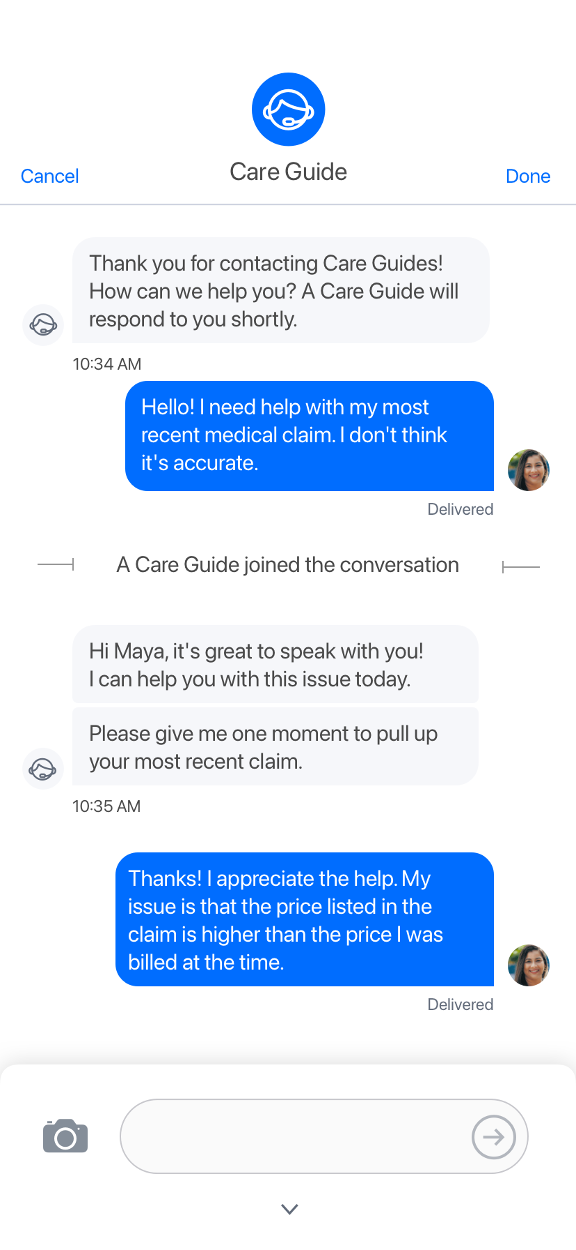
Connect with a Care Guide
Castlight Care Guides are here to help.
Ask questions about your benefits
Get help finding the best doctor
Schedule appointments
Understand your medical claims
Negotiate out-of-pocket expenses
1:1 support from an expert when you need it most

