Slide 1
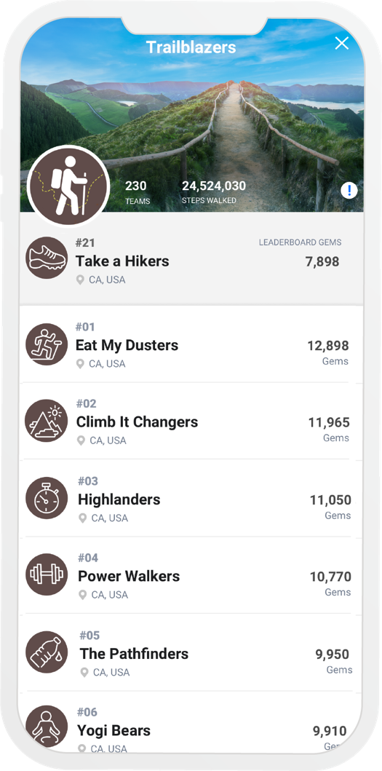

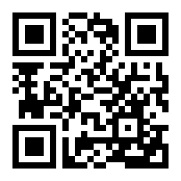
TRAILBLAZERS
LEADERBOARD CHALLENGE
Take the path less traveled. Join the [Company Name] Leaderboard challenge. Team up with coworkers online for the ultimate trek to the top!
ENROLLMENT BEGINS MO XX
CHALLENGE RUNS. MO XX – MO XX
JOIN IN CASTLIGHT TODAY. DOWNLOAD THE MOBILE APP OR VISIT MYCASTLIGHT.COM
[INSERT CUSTOM INCENTIVE COPY HERE – REMOVE IF NOT APPLICABLE]
[CUSTOMER LOGO]

