Slide 1
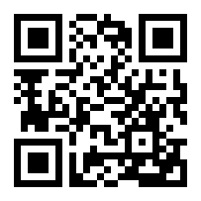

[INSERT CUSTOM INCENTIVE COPY HERE – REMOVE IF NOT APPLICABLE]
WALK
FRIENDS
WITH
CHALLENGE
Join in Castlight today. Download the mobile app or visit mycastlight.com
[CUSTOMER LOGO]

Slide 2
Join the [Company Name] social steps challenge. Your mission: Invite friends and start your journey, together.
Enrollment begins [Month XX]
Challenge runs [Month XX] – [Month XX]
Join in Castlight today. Download the mobile app or visit mycastlight.com

