Slide 1
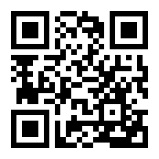
[INSERT CUSTOM INCENTIVE COPY HERE –
REMOVE IF NOT APPLICABLE]
RECHARGE
Get ready for Recharge, your wellness journey brought to you by [CUSTOMER NAME]! Join through Castlight and grow together with coworkers. Complete fun activities that build skills — from better managing stress to boosting your mood.
Enrollment begins [Month XX]
Journey runs [Month XX] – [Month XX]
JOIN IN CASTLIGHT TODAY. DOWNLOAD THE MOBILE APP OR VISIT MYCASTLIGHT.COM
[CUSTOMER LOGO]

