Slide 1
Sign up for Castlight today and get $50 off an activity tracker.
[CUSTOMER LOGO]

Slide 2
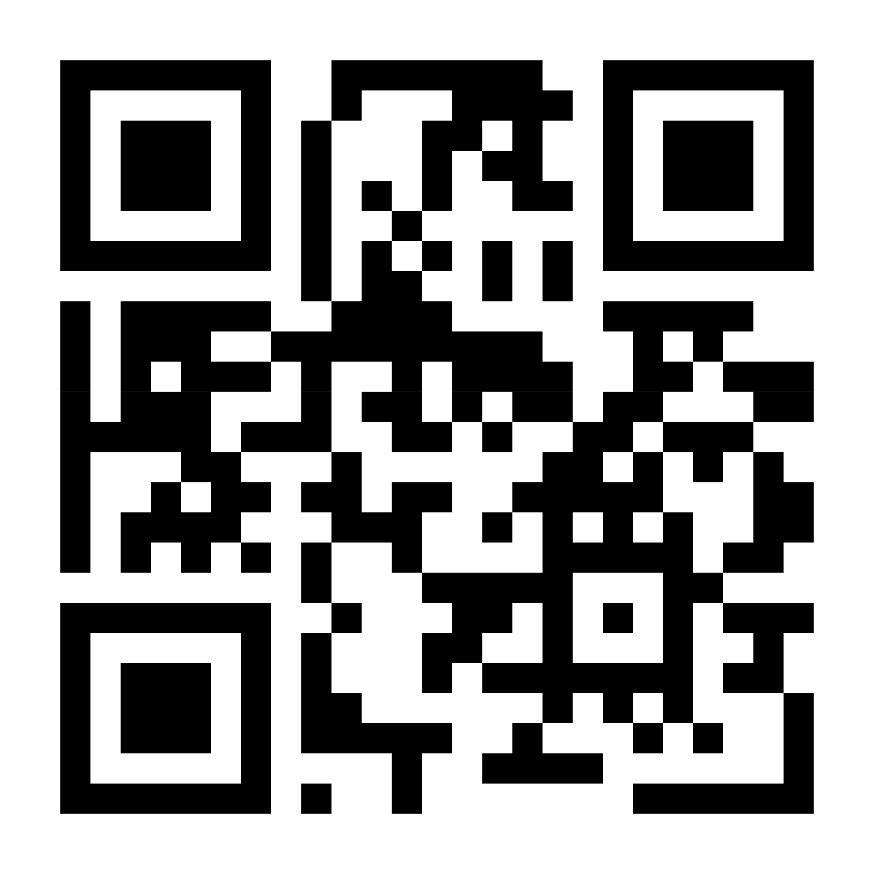
Download the Castlight app to register in seconds or visit mycastlight.com

