Slide 1
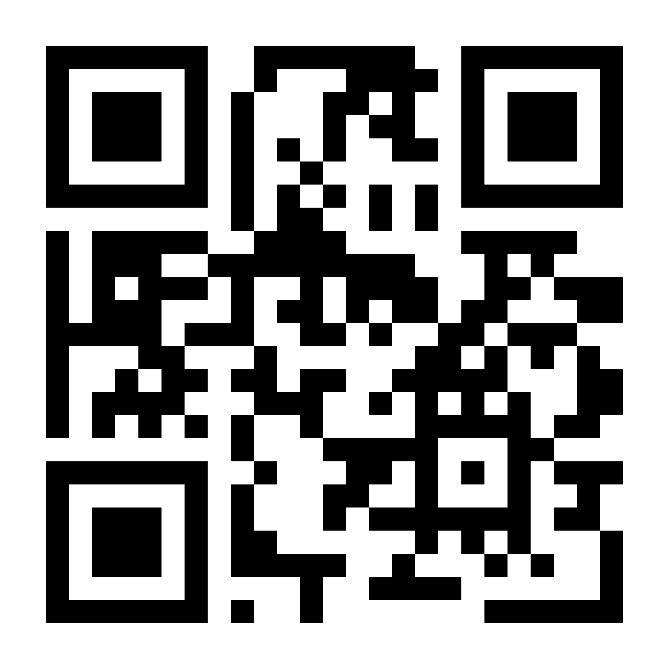
Download the Castlight app to register in seconds or visit mycastlight.com
[CUSTOMER LOGO]

Slide 2
Download the Castlight app to register in seconds or visit mycastlight.com

