Slide 1
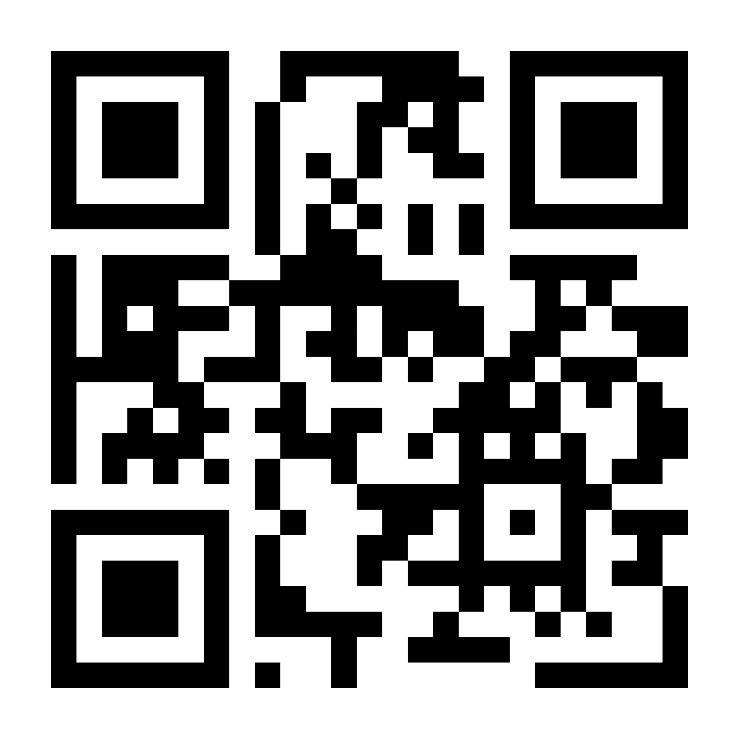
Chat in the Castlight app
Download the Castlight app or visit
mycastlight.com/mybenefits
to register. Once registered, select
“Get Help” to start your chat
Call 800-681-6758
8am - 9pm EST
Monday - Friday
Sign up for Castlight today and
get $50 off an activity tracker.
Download the Castlight app to register
in seconds or visit mycastlight.com
[CUSTOMER LOGO]

