Slide 1
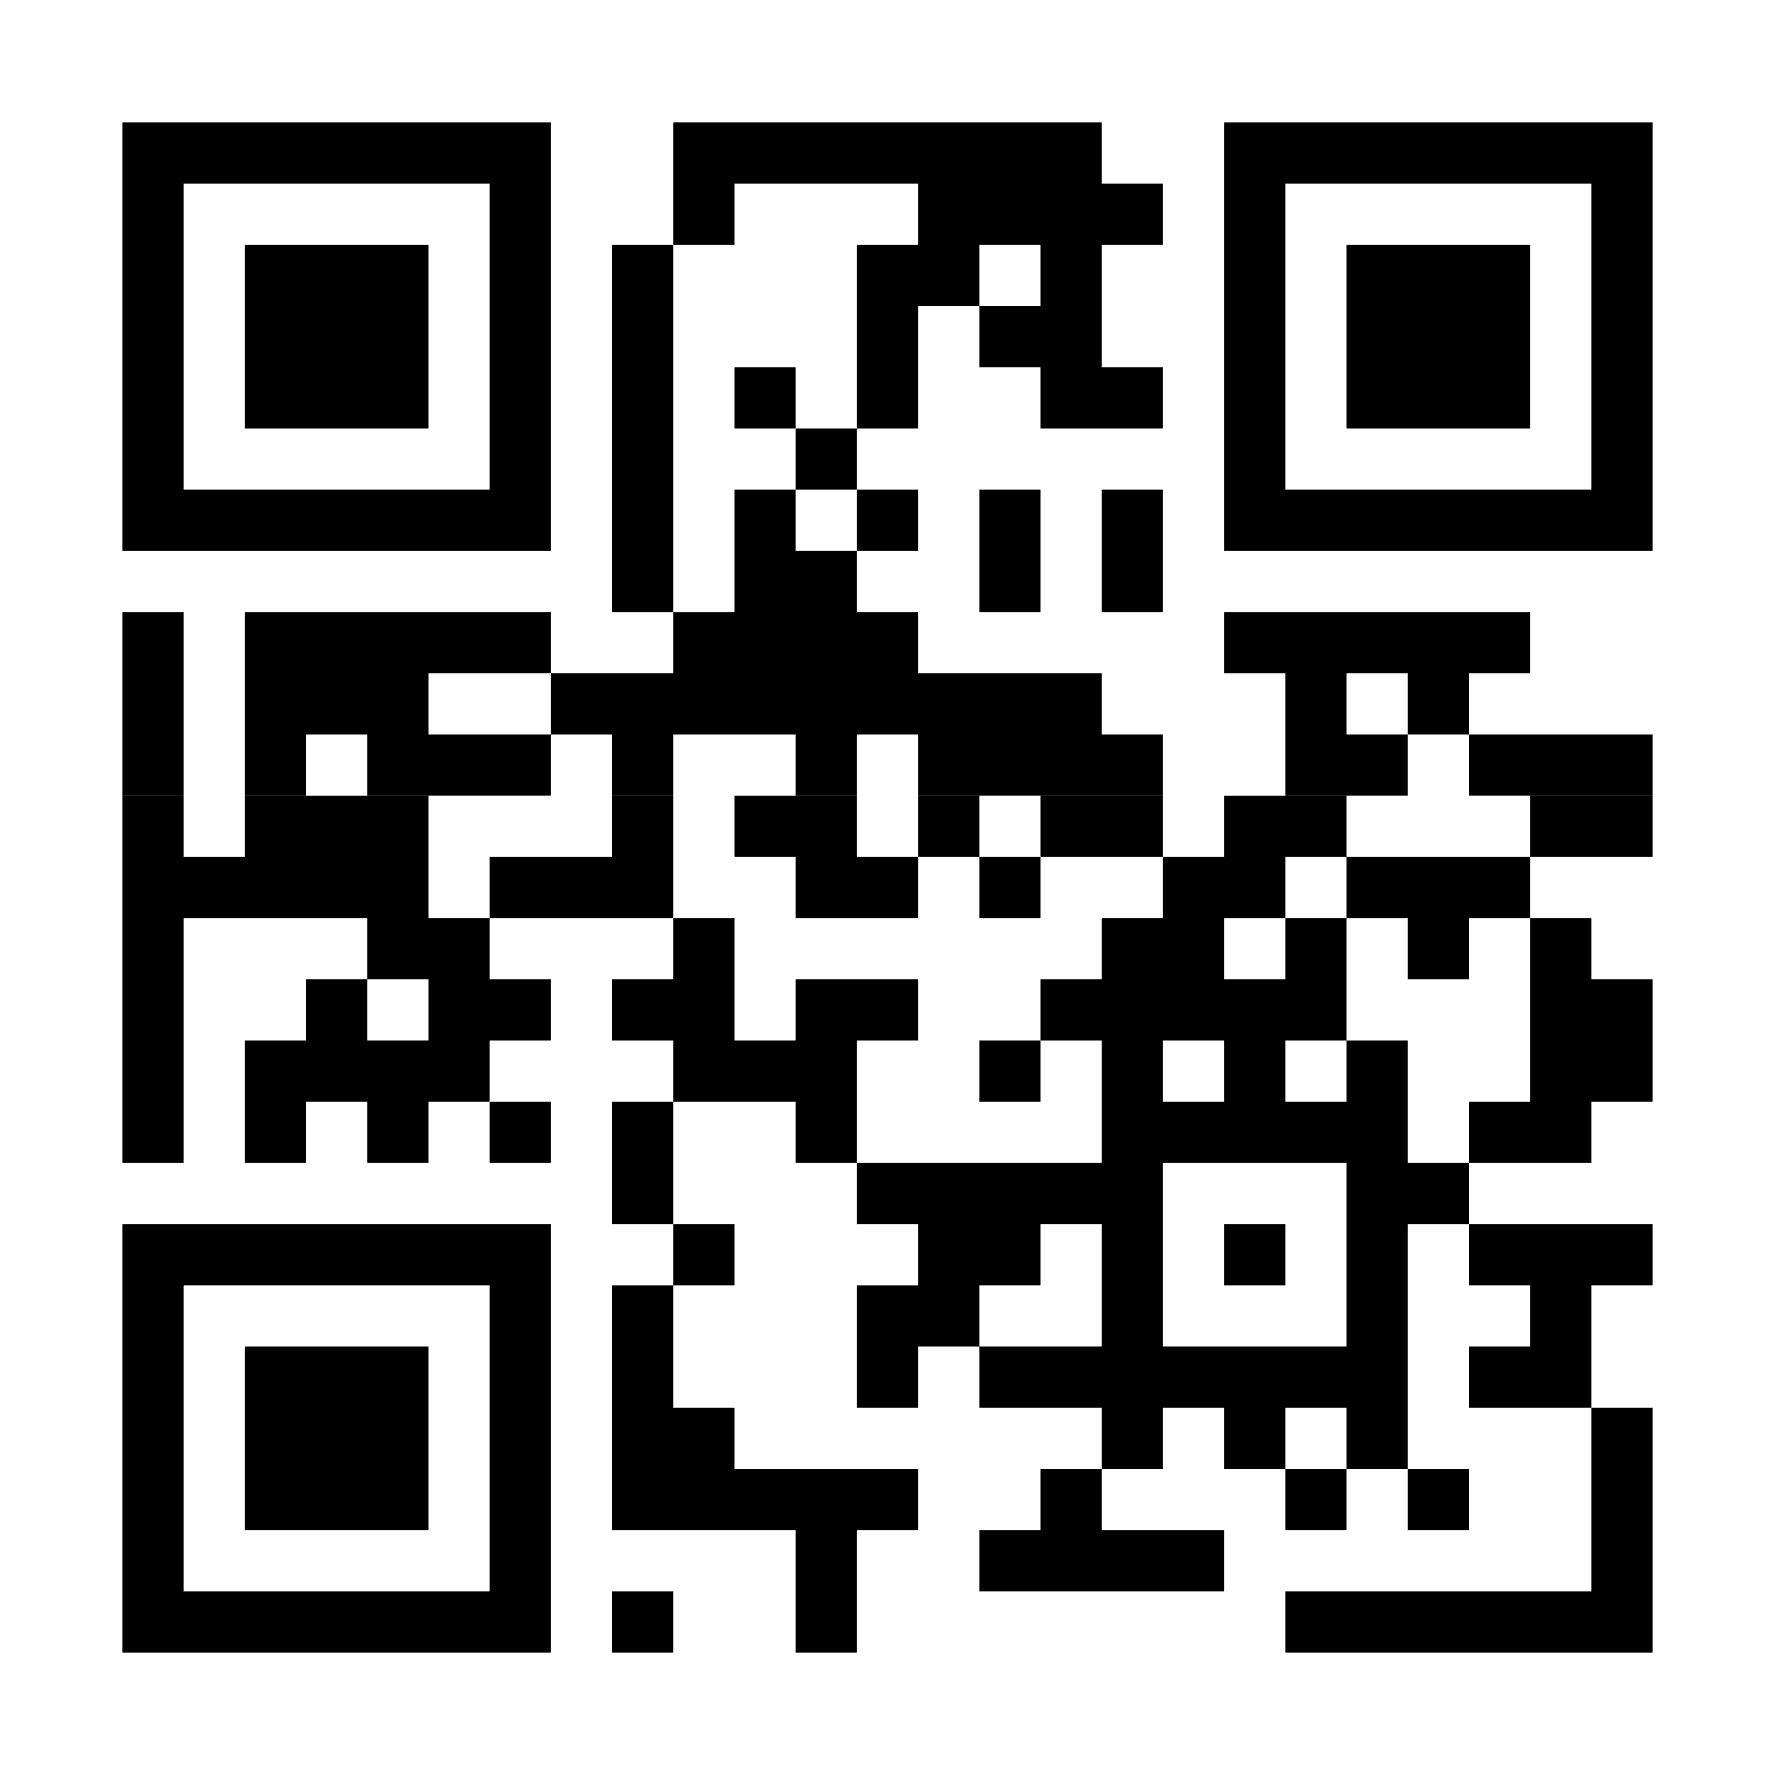
Sign up for Castlight today and get $50 off an activity tracker.
Download the Castlight app to register in seconds or visit mycastlight.com
[CUSTOMER LOGO]

