Slide 1
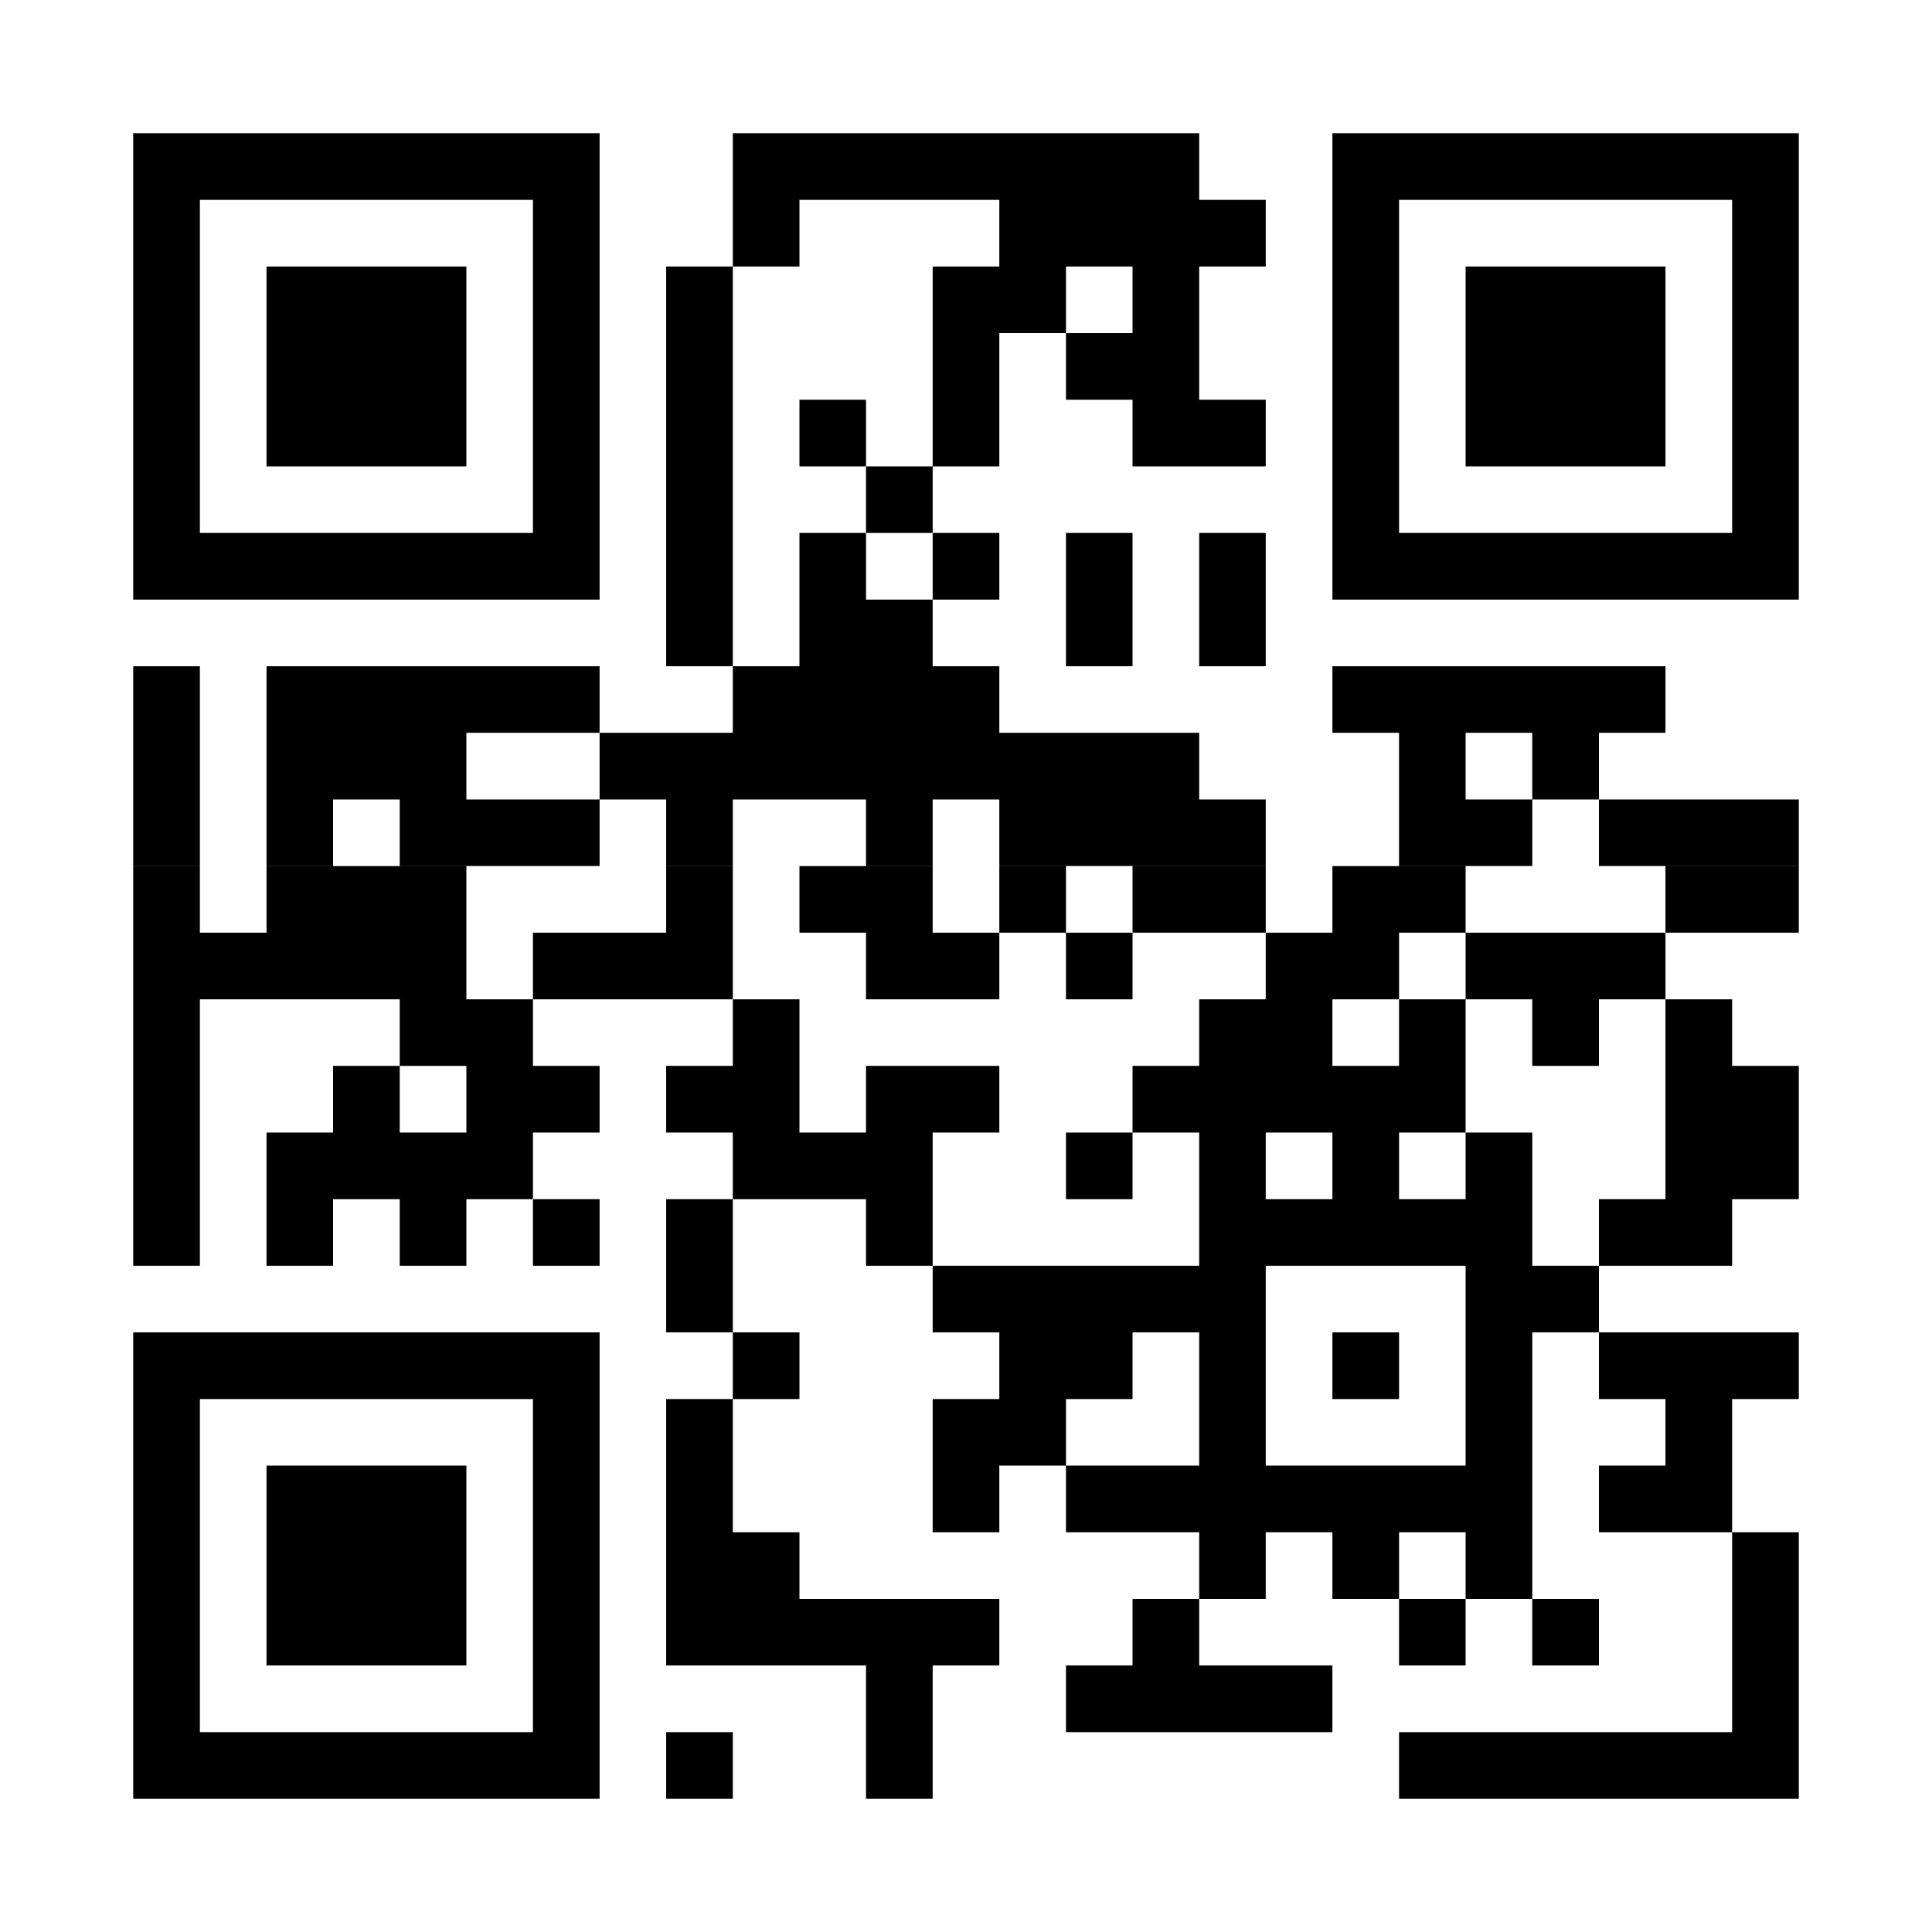
Sign up for Castlight
at mycastlight.com or download the Castlight Mobile app
Download the Castlight app to register in seconds or visit mycastlight.com
[CUSTOMER LOGO]

