Slide 1

Preventing Child Sexual Exploitation and Abuse
Supplementary Activities & Scenarios for Contractor Training
DECEMBER - 2024

Slide 2

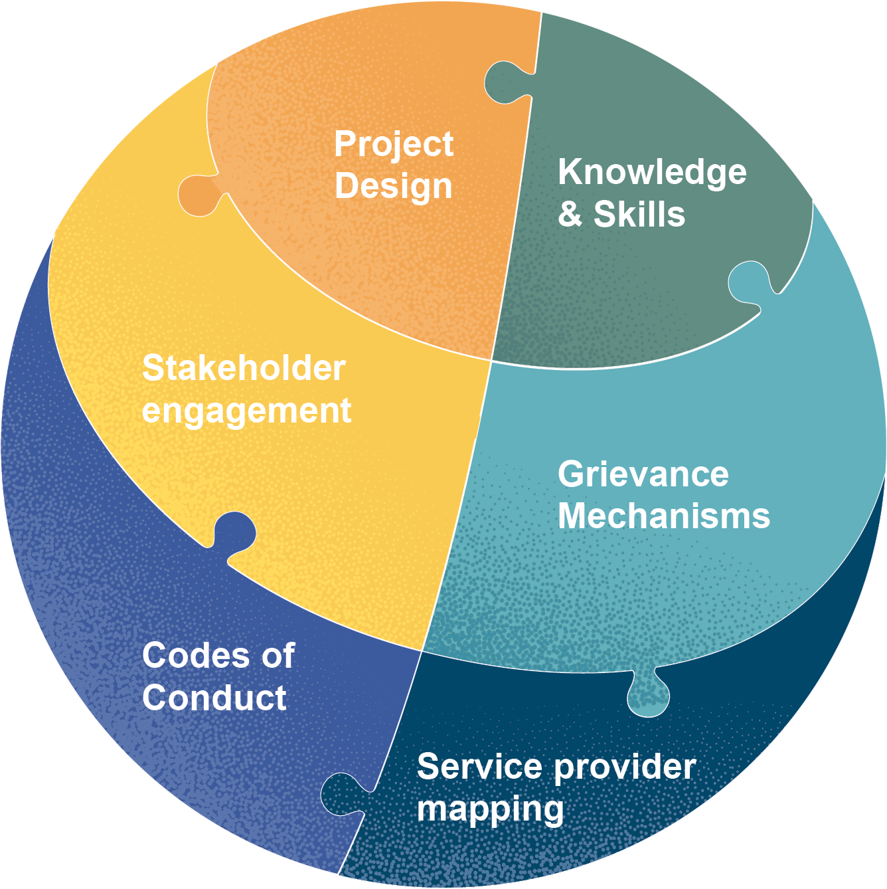
A note about this tool, and how to use it:
These additional activities and scenarios aim to increase civil work contractors' ability to prevent, recognize, report, and address child sexual exploitation and abuse. It can be used in conjunction with the tool "Preventing Child Sexual Exploitation and Abuse: Training for Contractors." This tool is intended to be adapted to the specific project and country context by the client's gender/social/GBV specialists or GBV service providers providing training to civil work contractors about addressing child sexual exploitation and abuse.
This tool is a product of the CPC Learning Network and includes lessons learned while supporting the executing agencies of transport projects in Nepal and Bolivia to address risks of child sexual exploitation and abuse. The projects were financed by the World Bank. The content of this tool does not necessarily reflect the views any of the World Bank, its Boards of Executive Directors, or the governments they represent. For more information and additional CSEA tools to support your work, visit: https://www.cpcln.org/resources/six-actions-to-keep-children-safe-from-sea

Slide 3

Agree/Disagree

Slide 4



Activities
AGREE / DISAGREE
DISAGREE
UNSURE
AGREE

Slide 5
One of the foreign supervisors, who decides how much a contractor worker is paid, is visiting a work site. After a visit, he asks the contractor worker to take him to meet young boys for massage. ​
Is this okay?
DISAGREE
UNSURE
AGREE
Notes:
Answer: No, this is not okay. He is asking the contract worker to facilitate exploitation of the boys. The contractor should not agree to this request and should report it.
[Engage audience in conversation about the difficulty of reporting a supervisor and reporting methods that may help facilitate this.]

Slide 6
[Name] is a truck driver and supplies construction supplies at a construction site. On one of his trips, he recognized a 17-year-old girl from the community walking on the side of the road and gave her a ride back to the community. Since then, to impress her, he frequently offers to drive her wherever she is going. He really likes the girl and wants to pursue a relationship with her. The girl’s family approves of their relationship. ​
Is it okay for [Name] to start a relationship with her?
DISAGREE
UNSURE
AGREE
Notes:
Answer: No, it is not okay to start a relationship with her. Regardless of the family’s approval, she is still underage and there is a large power difference between her and the truck driver. This is against policy and against [relevant national laws].

Slide 7
One day, you are back from work at your guest house, and you see [Name] has taken the 17-year-old girl from the community to his room.
Should you take action?
DISAGREE
UNSURE
AGREE
Notes:
Answer: Yes, you should take action. This is an example of sexual exploitation and abuse and [code of conduct] requires that you act when you see it. You do not need to know everything about a scenario to report it.

Slide 8
A 15-year-old girl who wears make-up, a short skirt, out at night in a bar and talks to men is somewhat to blame if she is exposed to sexual abuse. Sexual abuse can be the child’s fault because of the way they dress and behave. ​
Is this statement true?
DISAGREE
UNSURE
AGREE
Notes:
Answer: no, it is not true. Nothing a child does makes them responsible for abuse. It is the responsibility of adults in the community to not abuse children.

Slide 9
17-year-old boy, who is the head of his household, is working on road construction for the project. He is strong and well built, maybe stronger than the older men on the site. He will turn 18 years old in a few months. ​
Should he be allowed to work?
DISAGREE
UNSURE
AGREE
Notes:
Answer: although this is not sexual exploitation and abuse, it is an example of child labor. He should not be allowed to work and it is against policy and [relevant national laws].
[Engage audience in conversation about the potential differences between cultural norms or beliefs around maturity and the policies that are used on the project, which are based on age.]

Slide 10
A contractor got sick, so his son, who is well built and looks old enough, had stepped in for his father. Allowing the son to replace his father will bring much needed money for treatment of his father and bring food to his family. ​
What should be done?
DISAGREE
UNSURE
AGREE
Notes:
Answer: although this is not sexual exploitation and abuse, it is an example of child labor. He should not be allowed to work and alternative arrangements should be sought to assist his father.
[Engage audience in conversation about the potential differences between cultural norms or beliefs around maturity and the policies that are used on the project, which are based on age.]
[Discuss resources that are available for illness or time off on the project, including pay, policies and community supports.]

Slide 11
Case Scenarios

Slide 12
Case scenarios: What’s happening in these scenarios? (Part 1)
Mrs. Teresa sends her 14-year-old daughter, provocatively dressed, to the hotel of the engineer who works on the highway under construction for a dinner. The engineer accepts and invites the teenager to share the dinner in his room.
1
CRIMINAL/LEGAL
Francisco, the contractor in charge of Human Resources for the highway under construction, offers 15-year-old Ana a position as his assistant for 3 months. She is grateful and accepts the position, and they have sexual relations.
2
Pancho, a machinist working on the highway under construction, goes drinking on Friday at the jukebox. Pancho meets Angela, 17 years old, with whom Pancho drinks excessively and despite Angela’s resistance, they have sex.
3
Eloy, owner of the town's restaurant, is hired to provide lunch to the contractors of the highway under construction. He meets Adela, 16 years old, daughter of the community’s mayor and begins to have a sexual relationship with her with the family's permission.
4
Notes:
Scenario #1
Mrs. Teresa sends her 14-year-old daughter, provocatively dressed, to the hotel of the engineer who works on the highway under construction for a dinner. The engineer accepts and invites the teenager to share the dinner in his room.​
#1 expected answers: this is inappropriate contact, This should raise suspicion/be a red flag.
Scenario #2
Francisco, the contractor in charge of Human Resources for the highway under construction, offers 15-year-old Ana a position as his assistant for 3 months. She is grateful and accepts the position, and they have sexual relations.​
#2 expected answers: this is sexual exploitation because a favor was traded for sex. It is against policy and against [applicable national law].
Scenario #3
Pancho, a machinist working on the highway under construction, goes drinking on Friday at the jukebox. Pancho meets Angela, 17 years old, with whom Pancho drinks excessively and despite Angela’s resistance, they have sex.​
#3 expected answers: this is sexual assault. Presenter should clarify that force is not necessary for it to be sexual assault, only the lack of consent. Note Angela cannot consent with Pancho, a project worker, because she is under 18.
Scenario #4
Eloy, owner of the town's restaurant, is hired to provide lunch to the contractors of the highway under construction. He meets Adela, 16 years old, daughter of the community’s mayor and begins to have a sexual relationship with her with the family's permission.​
#4 expected answers: something may be exchanged here or implied to be exchanged, so it sounds like exploitation. The permission of the family is not relevant.

Slide 13
Case scenarios: What’s happening in these scenarios? (Part 2)
Antonio likes to spend his weekends inviting adolescent girls and boys to his hotel where he shares alcoholic beverages with them and takes photographs in different erotic scenes to sell them and earn money.
1
CRIMINAL/LEGAL
Yolanda's hotel is contracted to workers on a section of the highway under construction. She invites teenagers under 18 years of age with promises of money and gifts in exchange for sexual services arranged with the contractors of the highway under construction.
2
The owner of the Yotaú discotheque promotes among his customers the sightseeing of tourist sites in the municipality accompanied by teenage girls.
3
Doña Juana, owner of La Brisas lodging, recruits teenage girls and offers them to guests through a photo catalog for payment.
4
Notes:
Scenario #1
Antonio likes to spend his weekends inviting adolescent girls and boys to his hotel where he shares alcoholic beverages with them and takes photographs in different erotic scenes to sell them and earn money.​
#1 expected answers: exploitation, child pornography. We can explain that the most precise term is child sexual abuse material. Pornography is material made consensually by adult performers.
Scenario #2
Yolanda's hotel is contracted to workers on a section of the highway under construction. She invites teenagers under 18 years of age with promises of money and gifts in exchange for sexual services arranged with the contractors of the highway under construction.​
#2 expected answer: trafficking, trafficking for the purposes of prostitution, sexual exploitation.
Scenario #3
The owner of the Yotaú discotheque promotes among his customers the sightseeing of tourist sites in the municipality accompanied by teenage girls.​
#3 expected answer: inappropriate contact. If someone says “sex tourism”, we can say that it is possible this is part of travel for the purpose of sexual abuse.
Scenario #4
Doña Juana, owner of La Brisas lodging, recruits teenage girls and offers them to guests through a photo catalog for payment.​
#4 expected answer: exploitation for prostitution. We can clarify that “child prostitute” is not accurate if this term comes up. Sex work implies work that is consensual and involves adults, whether it is legal or not in a country. Children cannot consent to sex work.

Slide 14
Q&A

Slide 15
Thank you!

