Slide 1

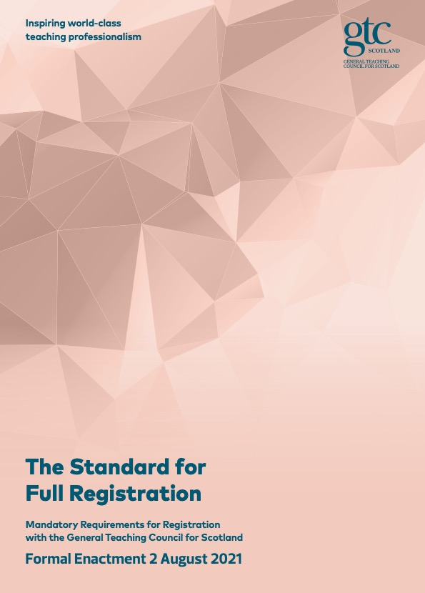


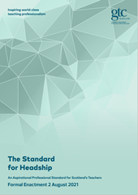

The Professional Standards
for Scotland’s Teachers
Exploring Our
Professional
Values
Becoming, Being & Growing

Slide 2

GTC Scotland Professional Standards & Values - Professional Learning Resource Overview
Please use the workbook to support and record reflections and discussions
PART 1 | Introduction to the Professional Standards and Professional Values
PART 2 | Reflection on Professional Values Activity – paired Professional Learning Conversation: The Professional Journey Map
PART 3 | Bringing the Professional Standards alive through our practice and next steps planning
PART 1 | Introduction to the Professional Standards and Professional Values
PART 2 | Reflection on Professional Values Activity – paired Professional Learning Conversation: The Professional Journey Map
PART 3 | Bringing the Professional Standards alive through our practice and next steps planning
Notes:
Note – this resource is divided into four parts which aim to help you, either as an individual or as part of a collaborative group, to explore the Professional Standards & Values and consider your next steps in your own professional learning journey.

Slide 3
Getting started with this resource
Please use the workbook to support and record reflections and discussions
The resource is designed for you as an individual or to facilitate discussion with your colleagues.
Please use the reflective workbook and supporting slides to explore and record your reflections.
Please remember you can save the reflective notebook as part of your professional learning record.
Notes:
This resource can be used individually but is best supported through discussion with colleagues. The workbook icon will be displayed where there is an activity to do or record in the accompanying workbook. A simple way to record this professional learning is to upload your completed workbook onto MyPL in the MyGTCS website.

Slide 4
PART ONE
Introduction to the Professional Standards and Professional Values

Slide 5
Professional Standards for teachers in Scotland have multiple purposes
to create a shared language for teaching professionals
as a benchmark for professional competency (SPR & SFR)
to provide a framework for Initial Teacher Education, probation and leadership pathways and professional learning programmes;
to develop and enhance professionalism
to support career-long professional growth
to ensure and enhance public trust and confidence in the teaching profession.
Read the Professional Standards for Teachers
Notes:
The Professional Standards outline what it means to become, to be and to grow as a teacher in Scotland. A commitment to the professional values of social justice, trust and respect and integrity are at the heart of the Professional Standards and underpin our relationships, thinking and professional practice in Scotland. The educational experiences of all our children and young people are shaped by the professional values and dispositions of all those who work to educate them. Values are complex: they are the ideals by which teachers shape their practice as professionals. Starting with teachers as individuals, values extend to our learners, our colleagues and community and to the world in which we live. Our commitment to career-long professional learning is a critical part of developing our professionalism

Slide 6
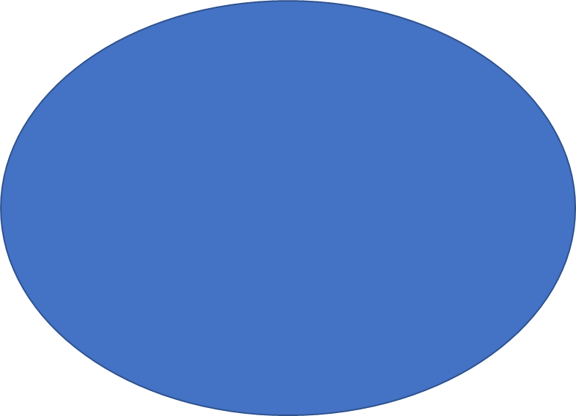
Key cross-cutting themes
Professional Values & Professional Commitment: social justice, integrity, trust and respect, professional commitment
Leadership
Read about the key cross-cutting themes of the Professional Standards
Learning for
Sustainability

Slide 7
The Professional Values
The professional values of social justice, integrity, trust and respect and a professional commitment are at the core of the Professional Standards.
Social Justice is the view that everyone deserves equal economic, political and social rights and opportunities now and in the future
Trust and Respect are expectations of positive actions that support authentic relationship building and show care for the need and feelings of the people involved and respect for our natural world and its limited resources
Integrity is the practice of being honest and showing a consistent and uncompromising adherence to strong moral and ethical principles and values
Making a professional commitment to learning and learners that is compatible with the aspiration of achieving a sustainable and equitable world embodies what it is to be a teacher in Scotland.
Read more about the Professional Values

Slide 8
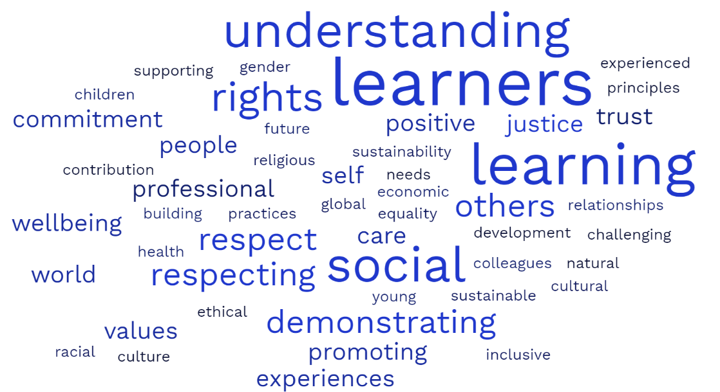
The Professional Values Word Cloud

Slide 9
The Professional Values:
Help
teachers develop their professional identity and ‘way of being’ as education professionals
Develop and drive
teacher’s individual and unswerving professional commitment to all learners and colleagues
Support and encourage
teachers to see beyond the classroom or subject
Help
teachers to know and develop the whole child through addressing their individual needs
Develop
teacher’s understanding of their role in collaborative working with a range of partners
Recognise
the contribution that teachers can make to safeguarding young people and where necessary transform their lives

Slide 10
Professional values at the heart of the Professional Standards
A focus on professional values helps teachers develop their professional identity and underpins a deep commitment to all learners’ cognitive, social and emotional growth and wellbeing.
The professional values (Social Justice; Trust and Respect; and Integrity) are integral to, and demonstrated through, teachers’ professional relationships, thinking and actions in their professional practice.
Teachers’ commitment to reflecting on the connections between professional values and actions and career-long professional learning is a critical part of enhancing their professionalism.
Professional values have an important emphasis on inclusion, equality and diversity.

Slide 11
PART TWO
Reflections on Professional Values Activity Paired conversation
The Professional Journey Map

Slide 12
What is a Professional Value?
A professional value is a deeply held belief in which you have an emotional investment and therefore guides your decisions and actions
Workbook
Initial Notes & Thoughts

Slide 13
Professional Values (vocabulary)
Kindness
Honesty
Integrity
Courage
Truthful
Growth
Commitment
Trust
Wisdom
Learning
Respect
Equity
Challenge
Authenticity
Fairness
Inclusiveness
Valuing

Slide 14
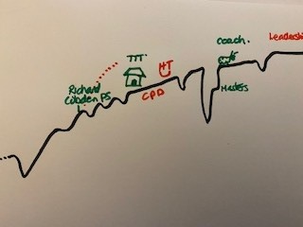
Exploring Professional Values – Professional Journey Map
Individual reflection Professional Journey Map (10 mins)
Take a blank sheet of paper, starting where feels natural, you might begin with what brought you toward teaching, sketch out your Professional Journey Map, take a photo to share with co-coach to prepare for the coaching conversation.
Workbook
Activity 1

Slide 15
Professional values exploration
Co-coaching reflections (15 to 20 mins)
Identifying your professional values:
Share the key aspects of your professional journey map
How did each experience inform your professional values?
Where have your professional values informed your decision making and actions?
Clarify your professional values:
Support/challenge each other to identify 3-4 professional values that have shaped/influenced your professional career.
  What motivated you to become a Teacher?
  Why do you remain a Teacher?
Workbook
Activity 1

Slide 16
PART THREE
Bringing the Professional Standards alive through our practice

Slide 17
Professional Values - Professional Standards
What do the Professional Values mean to you?
In your role, what are the implications for you and those you support?
In your opinion:
What is already working well?
What are the key challenges you are likely to face?
What support would be helpful?
What are your next steps?
Workbook
Activity 2

Slide 18
Further Reading (available through MyGTCS Research Tab – EBSCO Resource)
Websites
Visit MyGTCS for resources to support and record your professional learning
Visit our website to access the Professional Standards and supporting information about GTC Scotland
View the coaching and mentoring matters resource from Education Scotland
Professional Reading
You can access a range of resources through EBSCO via the research tab on MyGTCS. Some recommended reading:
Education for Values : Morals, Ethics and Citizenship in Contemporary Teaching - Jo Cairns, Roy Gardner & Denis Lawton - 2003
Teaching in the Knowledge Society : Education in the Age of Insecurity - Hargreaves, Andy - 2003
Coaching and Mentoring : Exploring Approaches to Professional Learning - Christine Forde & Jim O'Brien - 2011
Professional Learning Conversations : Challenges in Using Evidence for Improvement - Lorna M. Earl & Helen Timperley - 2009
Leading Democratically - Brookfield, Stephen - 2010

