Slide 1
Recovery-Oriented Systems of Care(ROSC) Onboarding Training FY26
Johanna Gonzalez-ROSC Coordinator
IDHS-DBHR

Slide 2
Illinois ROSC Support Structure

Slide 3
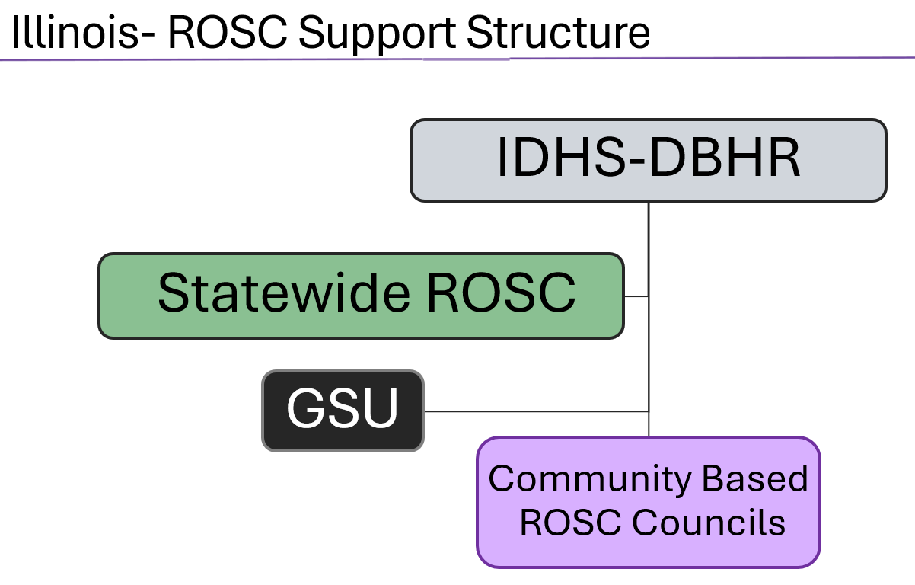
Notes:
I’d like to start with a quick introduction of the key players involved in supporting the ROSC Councils. These are the individuals and groups that make up the support structure and help ensure the councils function effectively.

Slide 4
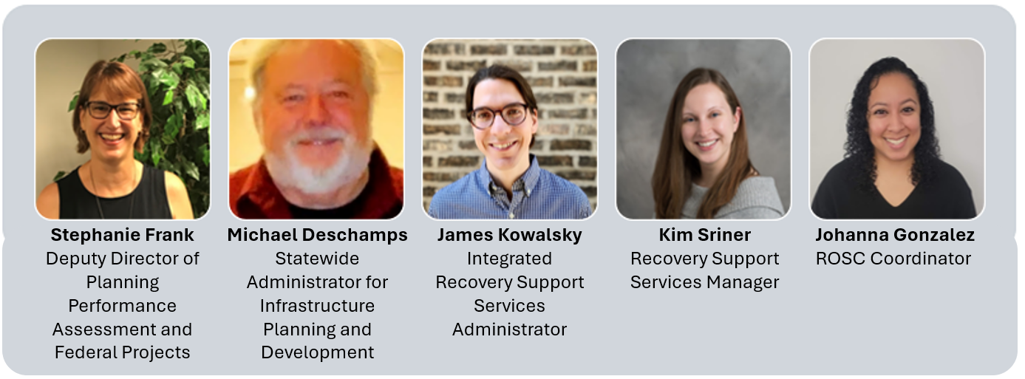
IDHS-DBHR Team

Slide 5
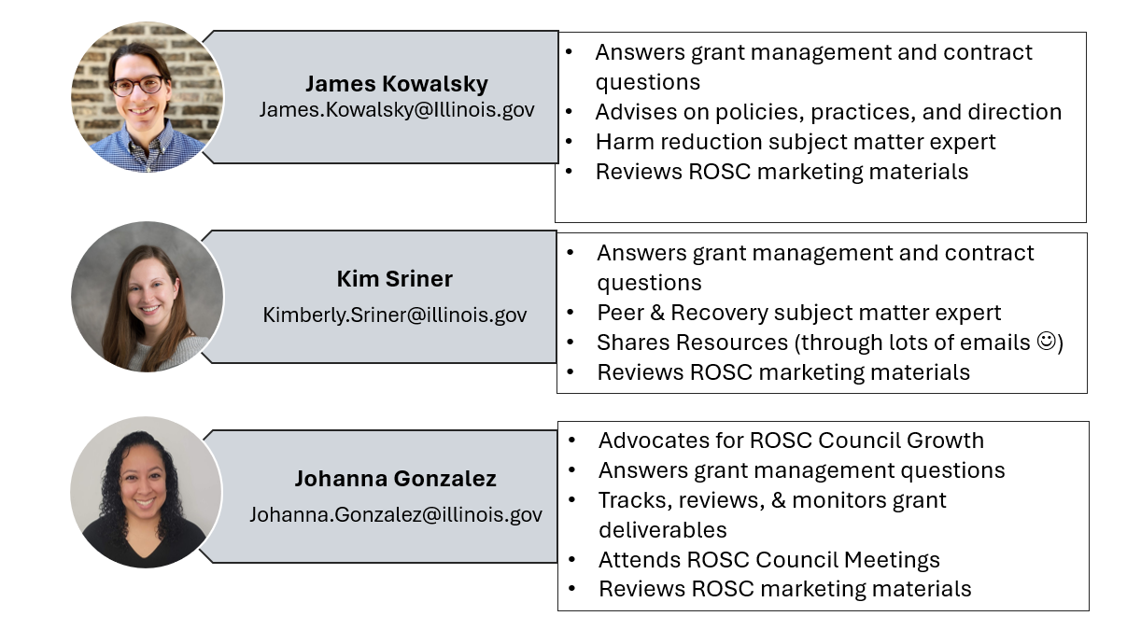

DBHR Team-ROSC Project Roles

Slide 6
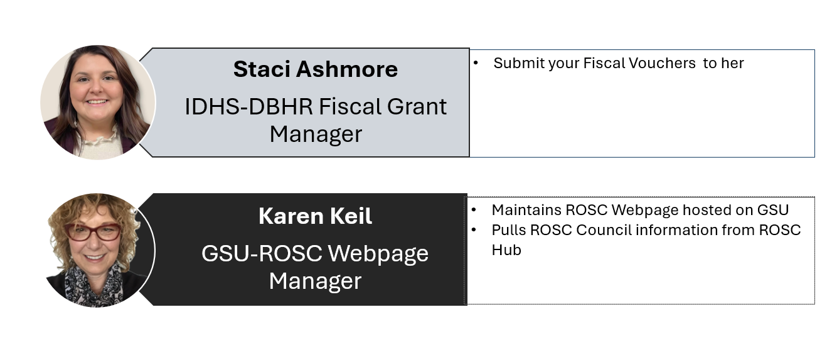

Slide 7
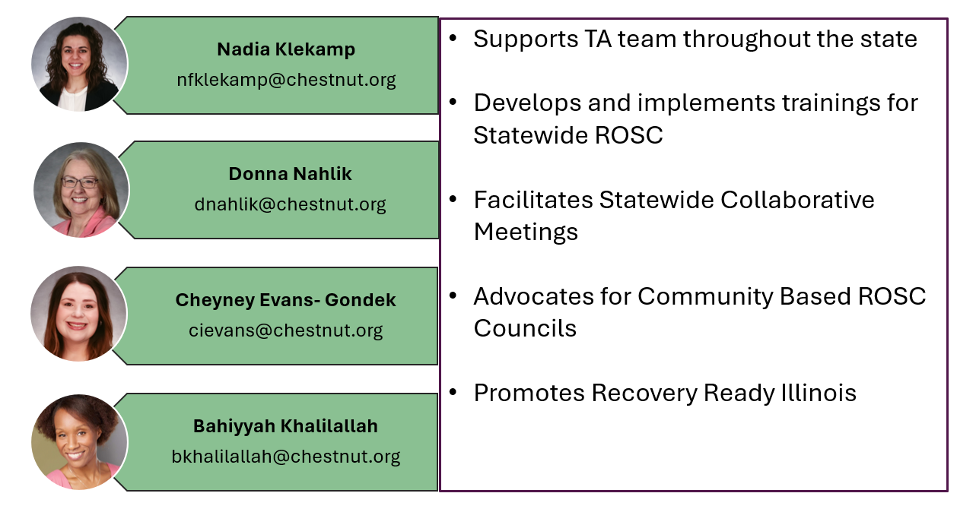
Statewide ROSC Leadership Team Roles

Slide 8
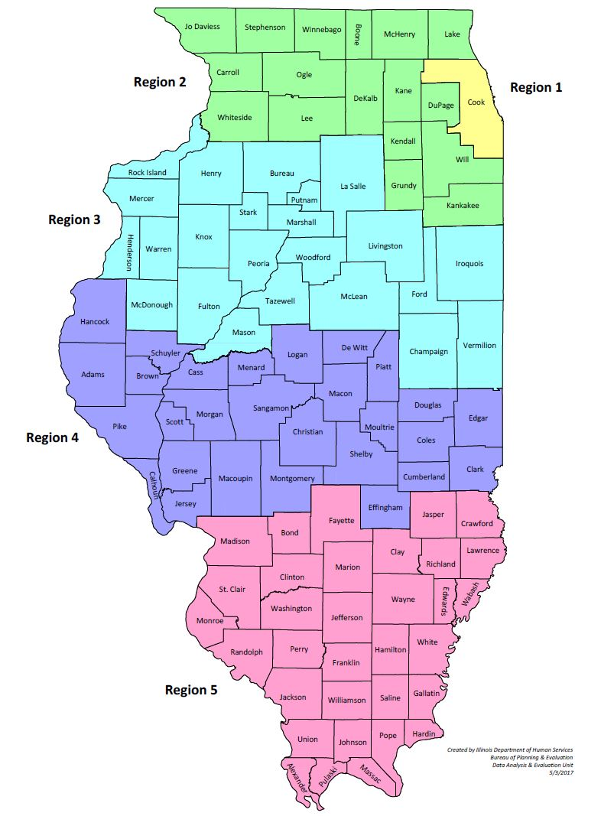
IDHS-DBHR IL Regional Map
Each region has an assigned TA/SRLC

Slide 9
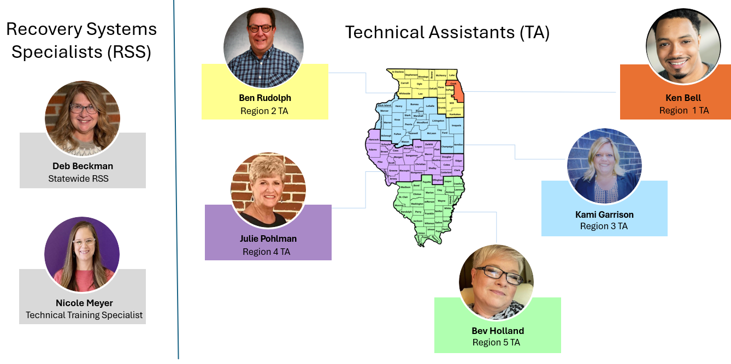
Statewide ROSC TA & RSS Team: Built for Support

Slide 10
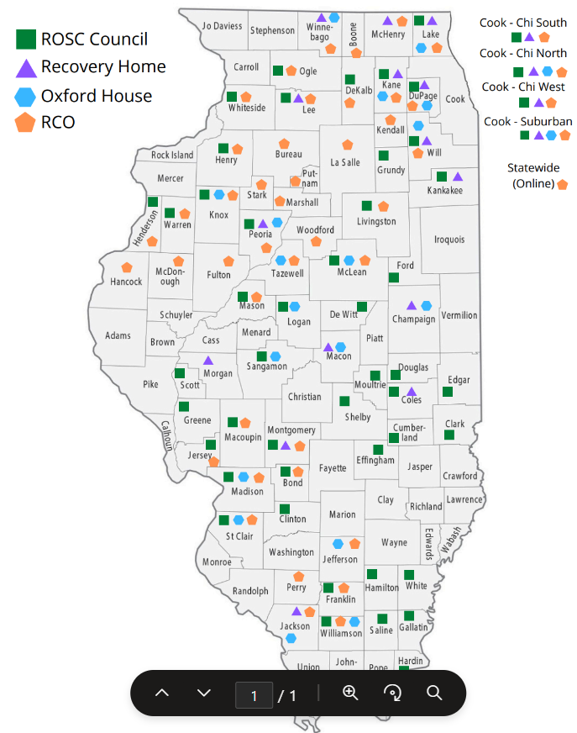
IDHS-DBHR Updated Resource Map 07/01/2025
FY26 ROSC Coverage:
47 ROSC Councils
49 Counties

Slide 11
Deliverables Grant Expectations
FY26

Slide 12

ROSC Definition
A Recovery Oriented Systems of Care (ROSC) is a coordinated network of community-based services and supports that is person-centered and builds on the strengths and resilience of individuals, families, and communities to experience recovery and improved health, wellness, and quality of life for those with or at risk of substance use and/or co-occurring conditions. The central focus of a ROSC is to create an infrastructure, or "systems of care", with the resources to effectively address the full range of substance use and/or co-occurring disorders within communities.
Notes:
Please note that we updated ROSC definition and removed the word ABSTINENCE and ACHIEVE replaced with EXPERIENCE.
Included language substance use and/or co-occurring conditions/disorders. (some people reported not liking the word Challenges)
We all know language is always changing therefore this may look different next year. (we are all learning and growing and so should our program)

Slide 13
The goals of each Illinois ROSC Council will include:
1. Reducing stigma
2. Promoting Medication Assistance Recovery (MAR) and other evidence-based practices
3. Promoting Harm Reduction (HR)
4. Ensuring effective service delivery
5. Prioritizing equity
Notes:
New language this year

Slide 14
Core Roles & Activities of ROSC Councils
Fostering collaborations and maximizing combined strengths and resources of diverse stakeholders to achieve meaningful impact and positive change in your communities
ROSC councils focus should be big picture, systemic changes, implementation of systems that will outlive the life of a ROSC council
Trainings in Harm Reduction, Recovery 101, Addiction 101, and Health & Wellness are open to everyone and offer a great opportunity to build understanding and awareness.
Coalition Outreach should be for coalition engagement not for recruiting clients for services
Implementing organizational policy changes, advancing evidence-based practices such as harm reduction and medication-assisted recovery, increasing public awareness, and addressing broader societal and systemic challenges.
Community Education/Stigma Reduction Efforts
Use a "Train-the-Trainer" approach to equip community members to lead support groups and educational sessions, instead of ROSC staff facilitating the groups themselves

Slide 15
What ROSC Funds Can’t Be Used For
Individual direct service (1:1 support of community members) Group direct services (support groups, SMART recovery)
Linkage service, “warm Hand-offs” (facilitating access to services by transporting community members to services or accompanying them to appointments)
Transporting PLEs to events or meetings
Participating in health fairs with the purpose of sharing information about lead agency services (the purpose should be for community education, networking to promote ROSC council, and information gathering).
Fundraising Activities (e.g., soliciting for cash or other financial donations, hosting events with a registration fee, selling items, or other activities to benefit ROSC or another community-based organization). This includes rental space, printing materials, and personnel costs (staff time).

Slide 16
When ROSC Councils identify a need or gap in their community, it’s not for the ROSC to do the work but for the ROSC to champion the need for it, to identify the relevant stakeholders, and to facilitate the development of a collaborative response.

Slide 17
IDHS/DBHR strongly supports multiple pathways to recovery, and the full and meaningful participation of people with lived experience (PLEs), including people who currently or formerly use drugs.
Lived Experience means personal knowledge about recovery from substance use disorder (SUD) and/or co-occurring disorders gained through direct involvement, which may include that individual's involvement as a patient, family member, or loved one of a person receiving SUD and/or MH services.

Slide 18
Successful ROSC councils will:
Identify and address 2-3 key challenges within their communities that can be tackled during the three-year grant period, and track progress towards their established SMART goals and overall community impact. SMART goals are objectives that are Specific, Measurable, Achievable, Related, and Time bound.
Align their identified challenges with the broader goals of the Illinois ROSC Council by promoting a culture that nurtures recovery, building capacity and infrastructure to support a recovery-oriented system of care, and fostering a commitment to implement, enhance, and sustain that system.
Adopt a strategic, data driven approach, which includes mapping resources, assessing needs, promoting empowerment, and expanding access to a wide range of prevention, treatment, and support services.
Notes:
Remember ROSC offers a safe place to be able to brainstorm and produce innovative ideas as I like to call it you are the table that brings everyone together.
This can mean advocating for resources that support people in recovery, reducing stigma by providing trainings such as multiple pathways to recovery to the community, to health providers. Developing programs that connect individuals in recovery with trained peers. This work requires networking and collaboration. Launching public awareness campaigns. This will enhance the ability to provide sustainable, effective support for individuals recovering from SUD/MH and promoting long-term recovery.
3. Using all your deliverables to guide your work

Slide 19
ROSC STAKEHOLDERS
ROSC Councils will collaborate with key leaders in the community to foster a supportive recovery environment. Depending on the challenge identified by the ROSC Council the following stakeholders may be included in the ROSC Council.
Stakeholders should include, but are not limited to members of the following: individuals that live in the community, local hospital systems, primary care, mental health providers, law enforcement, states attorneys, drug courts, public defenders, Centers for Community Engagement, landlords, local business owner(s), local and state government representatives and policymakers, People with Lived Experience (PLEs), SUD prevention/intervention/treatment providers, SUD peer Recovery Support Services (RSS) provider(s), harm reduction provider(s), and others.
It is encouraged for the ROSC council to collaborate with existing Recovery Community Organizations (RCOs) and if there aren't any in their area, explore ways to develop an RCO. It is also encouraged for ROSC council to collaborate with existing coalitions who are doing similar community work.
Notes:
The development of an RCO is no longer required but still encouraged to meet the needs of your community.
By collaborating with existing coalitions, you are joining forces, and your community's impact may be larger.

Slide 20
Due Date 07/30/2025
ROSC Deliverables:
Deliverable 1: Within 30 days of award, ROSC council must complete the general contact information form for the ROSC council webpage creation. A link to this form will be provided to you at the beginning of your grant cycle.
https://www.coalitionsupport.org/statewideroscil/statewide-rosc-intake-form

Slide 21
Due Date 07/30/2025
ROSC Deliverables:
Deliverable 2: Within 30 days of award, the ROSC council must submit a list of council members using the template provided by IDHS/DBHR. Council membership should be a variety of community stakeholders as referenced in Exhibit A. This membership roster must be submitted to IDHS/DBHR via ROSC HUB when completed.
Lead agencies are encouraged to hire PLEs as their ROSC Coordinator and PLEs should also be actively involved in the ROSC council itself. ROSC council members that are PLEs may represent other stakeholder sectors, for example they have their own lived recovery and own a local business. This membership roster must be uploaded to the ROSC Hub when completed at the beginning of the fiscal year.
Notes:
Everyone this year is on the same deadline for submissions. We spread out submissions throughout the fiscal year and clarified some of these deliverables.
For new ROSC you may want to include partnerships and members who plan to attend ROSC monthly meetings. For existing ROSC Councils, you may use July’s attendance and members.
Please label Initial FY26 Membership Roster
When you have someone in your roster who represents for example someone from Healthcare who is also a PLE please include that under notes PLE (no need to log that name twice)

Slide 22
Due Date 08/30/2025
ROSC Deliverables:
Deliverable 3: Within 60 days of award, the ROSC council shall have a kickoff ROSC council meeting. Going forward, meetings shall be held monthly. Events or community trainings sponsored by the ROSC should not take the place of regular monthly meetings. Each meeting shall, at a minimum, include a representative from the Lead Agency. ROSC council meetings shall have an agenda and record meeting minutes including attendees. The meeting minutes must be submitted to IDHS/DBHR via ROSC HUB when completed each month.

Slide 23
Due Date 08/30/2025
ROSC Deliverables:
Deliverable 4: Within 60 days of receiving the award, each ROSC Council will utilize the community survey template provided by IDHS/DBHR to assess the five key goals of the Illinois Department of Human Services/Division of Behavioral Health & Recovery (IDHS/DBHR): reducing stigma, promoting medication assisted recovery, harm reduction, increasing service delivery, and prioritizing equity.
ROSC Councils may choose to add up to 10 additional questions to the template to address local needs, subject to IDHS/DBHR review and approval before distribution. The survey must be administered to a representative sample of the population within the ROSC Council's coverage area, ensuring appropriate geographic, socioeconomic, and racial demographic representation. The survey data will provide critical insights for the community resource list and the strategic plan.
The finalized template must be submitted to IDHS/DBHR via the ROSC HUB when completed.
Notes:
We rolled out this survey last year and although we had some feedback about the questions that we selected we want to continue measuring data based on those initial 10 questions. We do welcome you to add up to 10 additional questions in case you want to clarify information.

Slide 24
Due Date 10/30/2025
ROSC Deliverables:
Deliverable 5: Within 120 days of award, the ROSC council will complete a thorough community resource list. This will be a complete list of all social service and other community resources in the ROSC council coverage area. This ideally looks like a categorized list broken out by sectors of resources including addresses, phone numbers, hours of operation, website, and brief description of service/resource offerings for each item.
This should include, but is not limited to, an inventory of all SUD/MH resources, including licensed SUD prevention and treatment services, and highlighting MAR services; peer recovery support services; harm reduction services; the location of recovery residences and other housing providers; healthcare; community assets (e.g., parks, libraries, or other public amenities), and legal services.
This list must be submitted to IDHS/DBHR via ROSC HUB when completed.
Notes:
Resource list must be revised from previous years and updated with new information. This should be a live document that your agency shares with your stakeholders.

Slide 25
Due Date 12/30/2025
ROSC Deliverables:
Deliverable 6: Within 180 days of receiving the award, each ROSC Council will develop a 3-year strategic plan including a detailed 12-month plan that addresses the two to three key challenges they have identified for focused action.
The strategic plan should incorporate relevant data about the community area that indicates the need to address the identified key challenges and implement the activities identified in the strategic plan. The strategic plan must outline specific SMART goals, objectives, and activities based on the community survey results and assessed needs. It must establish clear, achievable milestones for each state fiscal year, with measurable progress expected. The plan should also clearly define the organization's mission and vision, ensuring alignment with Illinois ROSC goals.
This strategic plan will serve as a guide for decision making and resource allocation, helping the ROSC Council stay focused on achieving its desired outcomes. Strategic plan as well as the raw data from the community survey must be submitted to IDHS/DBHR via the ROSC HUB when completed.

Slide 26
Performance Measures/Standards
The ROSC council will submit a membership roster utilizing the provided template within 30 days of award 100% of the time as described in Exhibit B.
ROSC council will hold monthly ROSC council meetings. Monthly meeting minutes with attendance included will be submitted to ROSC HUB by the 15th of the following month 100% of the time. ROSC council events or trainings do not take the place of meetings, and it is expected that the lead agency have policies regarding facilitation of meetings if the main facilitator is unavailable.
The Monthly Expenditures Payment Voucher is due the 15th of each month for the preceding month's expenses 100% of the time. The monthly voucher template will be provided to the grantee at the beginning of the fiscal year after the grant agreement is signed and returned.
Periodic Performance Reports (PPR) and Periodic Financial Reports (PFR) will be due the 30th of the month for the preceding quarter. Four quarterly reports must be completed 100% of the time. The PPR template will be provided by to the grantee before the first quarter's report is due.

Slide 27
Performance Measures/Standards
ROSC council will submit a quarterly ROSC council report which will include progress towards their established SMART goals and community impact by the 15th of the month following the end of the quarter 100% of the time. A template will be provided by IDHS/DBHR before the first quarter's report is due.
The Closeout Report is due within 30 days of the end of the fiscal year which ends on June 30th. The close out template will be provided to you near the end of the fiscal year.
ROSC staff must actively engage and fully participate in monthly learning collaborative meetings, monthly regional TA meetings with Statewide ROSC Leadership Center, and other meetings required by IDHS/DBHR 100% of the time. Please note that two of the learning collaborative meetings are held in person each year; attendance from at least one (and up to four) members for each ROSC council is required. For all ROSC Council staff, trainings are required via Learning Management System (LMS) offered by SRLC.
ROSC Council website must be updated monthly via ROSC Hub to ensure the meeting/event calendar, meeting minutes, and contact information are current 100% of the time.

Slide 28
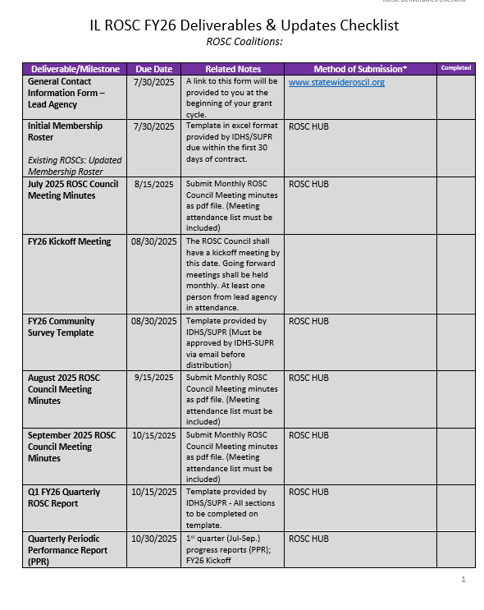
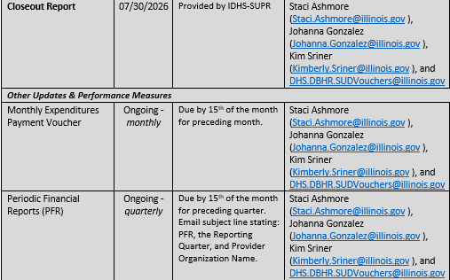
FY26 Deliverables & Updates Checklist

Slide 29
Changes for FY26
Membership Roster: Now submitted once at the start of the fiscal year(No longer monthly or quarterly)
Monthly Reports are now Quarterly Reports Meeting Minutes must now include attendance records.
No longer required to submit: Membership Protocols, Communication & Outreach Plan, Needs Assessment, Community Asset & Resource Map
Note: These documents are still essential tools for your coalition’s strategic planning and community work. You are expected to maintain and use them even though submission is no longer required.

Slide 30
Quarterly ROSC Report
Provide regular updates to IDHS/DBHR on the health, engagement, and progress of the ROSC Council, including successes, challenges, and emerging needs.
Support reflection and evaluation of the Council’s activities in relation to SMART goals, strategic priorities, and community-level impact.
Serve as a planning and accountability tool to guide ongoing efforts, ensure alignment with the strategic plan, and inform continuous improvement.
Notes:
We changed this requirement to quarterly instead of monthly this year

Slide 31
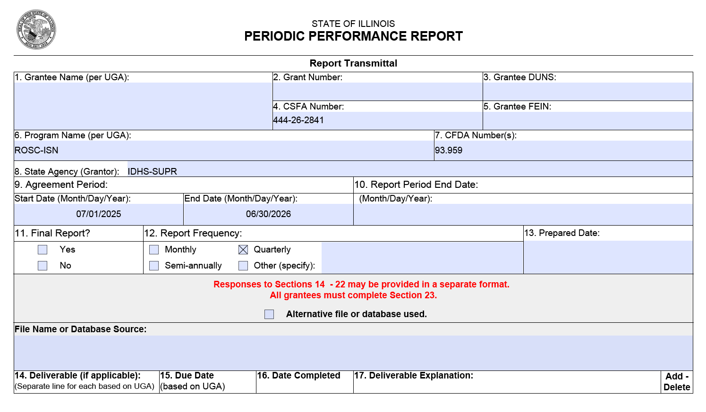

















FY26 PPR
Periodic Performance Report
IDHS-DBHR PPR FY26 Template will be sent at a late time.
If your organization covers multiple counties, indicate the specific coverage area for this PPR in parentheses.
Pink sections need to be completed by each grantee.
Period Report End Date
Q1: Reporting Period 7/1-9/30/25; DUE 10/31/25
Q2: Reporting Period 10/1-12/31/25; DUE 1/31/26
Q3: Reporting Period 1/1-3/31/26; DUE 4/30/26
Q4: Reporting Period 4/1-6/30/26; DUE 7/31/26

Slide 32
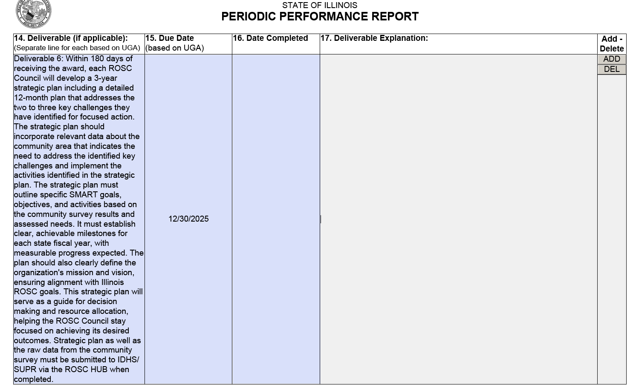
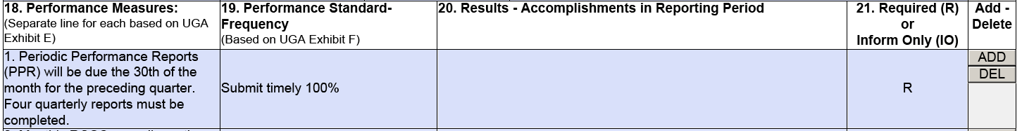









FY26 PPR
Periodic Performance Report
This template outlines the required deliverables your agency must report back to the ROSC HUB.
Include the date you submitted the document to the ROSC HUB.
#17 Deliverable Explanation: Use your Quarterly Report to reflect on SMART goals. If an extension was requested and granted, document it clearly in this section.
#20 Results-Accomplishments in Reporting Period

Slide 33
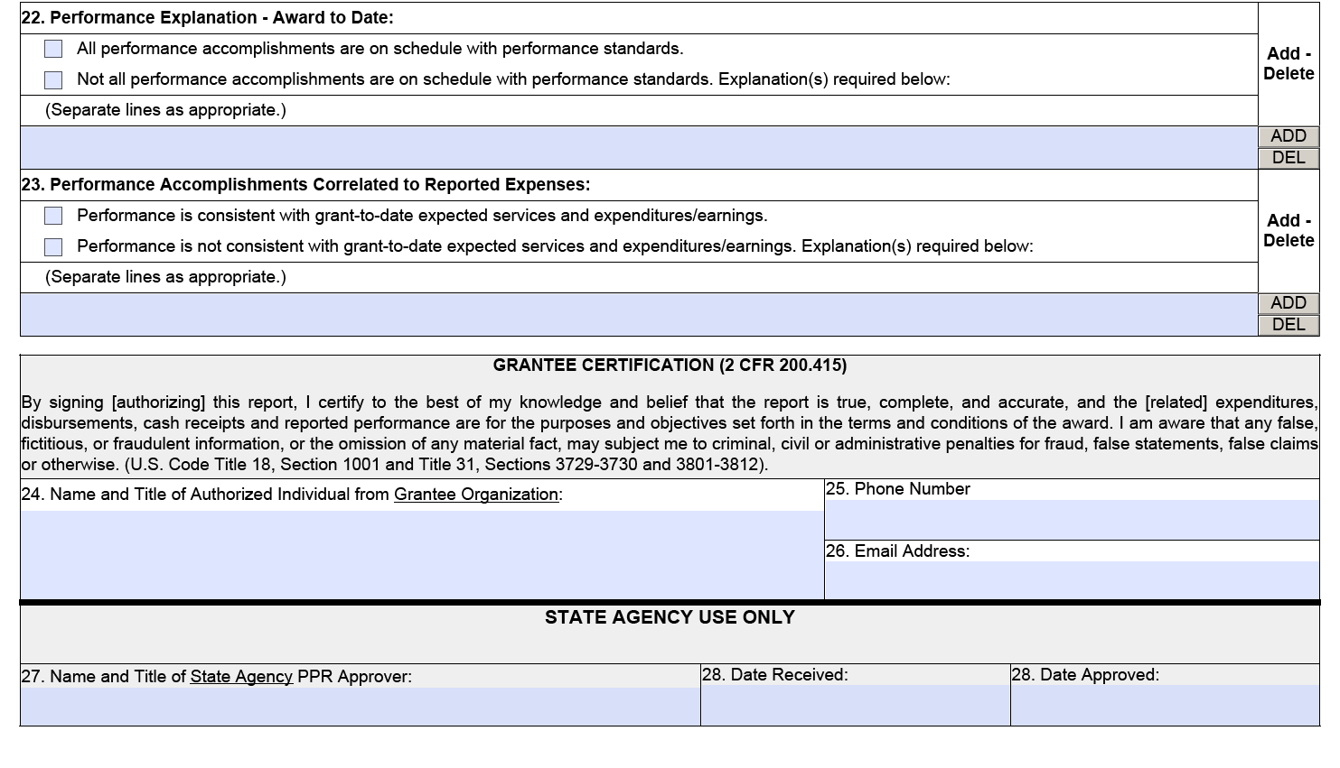





FY26
Periodic Performance Report
#22 Performance Explanation-Award to Date (must be answered include comments if applicable)
#23 Performance Accomplishments Correlated to Reported Expenses (must be answered include comments if applicable)
Signature (Name and Title), Phone number, Email address.

Slide 34
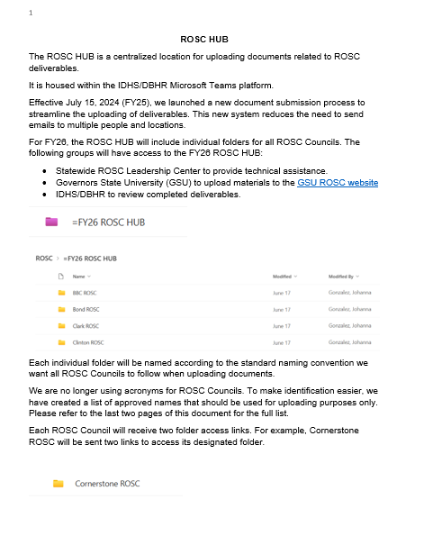
ROSC HUB-FY26
Notes:
Please read and review troubleshooting section will be very helpful.

Slide 35
ROSC HUB-FY26
The ROSC HUB is a centralized location for uploading ROSC deliverables. It is housed within the IDHS/DBHR Microsoft Teams platform.
Replaces email submissions to streamline the process.
Each ROSC council will receive 2 links: upload link for submissions and a view-only link to track submissions. (date/time stamped)
Statewide ROSC Leadership Center(SRLC), Governors State University (GSU), and IDHS-DBHR reviewers all have access to all ROSC HUB folders.
Key Reminders: Use approved ROSC names when uploading (not your own name), save files with simple names, IDHS-DBHR ROSC Coordinator will move files into folders (no sorting needed), no need to email for confirmation.
All deliverables should be in PDF format except Initial Membership Roster and Meeting and Events Template (Excel)

Slide 36
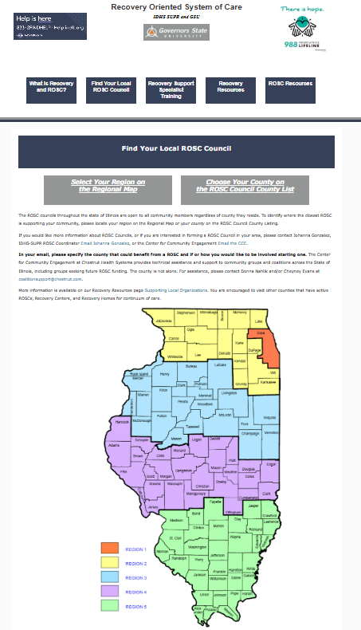
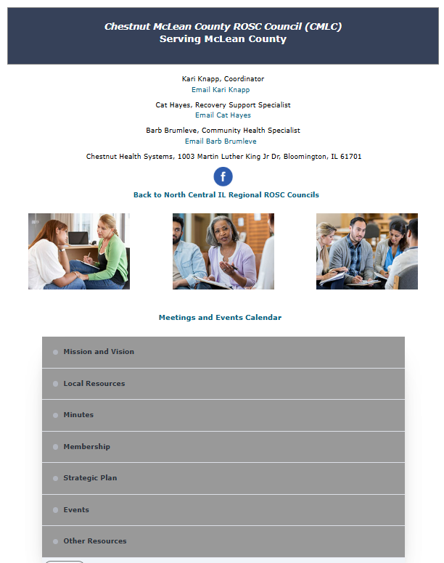
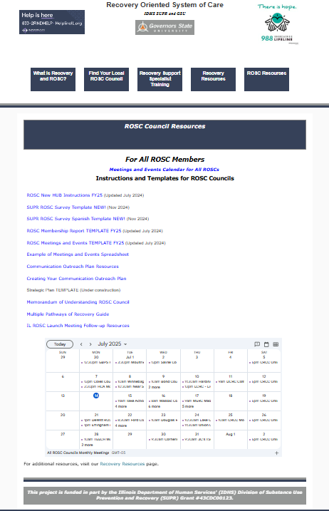
GSU Website-Recovery-Oriented Systems of Care
Notes:
This website is being updated to reflect our new ROSC Councils please be patient with Karen Keil she usually works one day of the week on updated.

Slide 37
GSU Website
https://www.govst.edu/Recovery-Support/Find-Your-Local-ROSC-Council/
A centralized platform supporting Illinois’ network of ROSC councils — local grassroots think tanks that drive system-level change by coordinating, informing, and strengthening recovery efforts, rather than providing direct services.
Provides tools for ROSC council success, including templates, planning guides, outreach materials, and meeting resources.
Provides a publicly accessible directory of ROSC councils to help community members, stakeholders, and organizations connect with local recovery efforts.
All required deliverables will be uploaded to your designated ROSC webpage.
Features up-to-date recovery resources, such as hotlines, referral tools, and community support links.
Supports new and existing grantees with guidance on forming, growing, and sustaining local recovery councils.
Please make sure your ROSC Calendar is updated with future ROSC meeting dates and times

Slide 38
Marketing Materials
All advertising materials purchased with IDHS/DBHR grant funds shall include the following statement:
Funded in whole or in part by the Illinois Department of Human Services, Division of Behavioral Health and Recovery
Materials should be approved by IDHS/DBHR before publication. Please email materials for review to Johanna Gonzalez (Johanna.Gonzalez@illinois.gov ), Kim Sriner(Kimberly.Sriner@illinois.gov ), and James Kowalsky (James.Kowalsky@illinois.gov)
If you do not get a response to one of your marketing review request within 2 days, please resend to us and one of us will make sure we get to them ASAP.
Marketing materials must be relevant, promote grant-funded services or support linkage to them
Marketing materials must be nonjudgmental, person-centered language avoid stigmatizing language (e.g., “addict”, “substance abuse”)

Slide 39
IDHS-DBHR Fiscal Forms
FY26

Slide 40
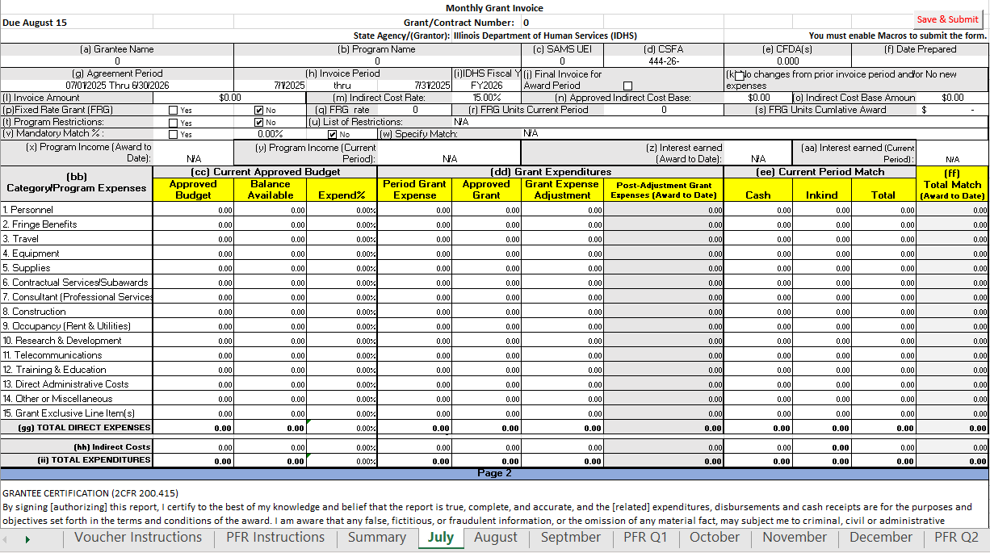
FY26 Monthly Expense Voucher
Vouchers are set up the same as in previous years. New feature: Monthly tabs added at the bottom of the workbook. This layout allows Excel to use more formulas to auto-populate information. Improves efficiency and makes monthly reporting easier

Slide 41
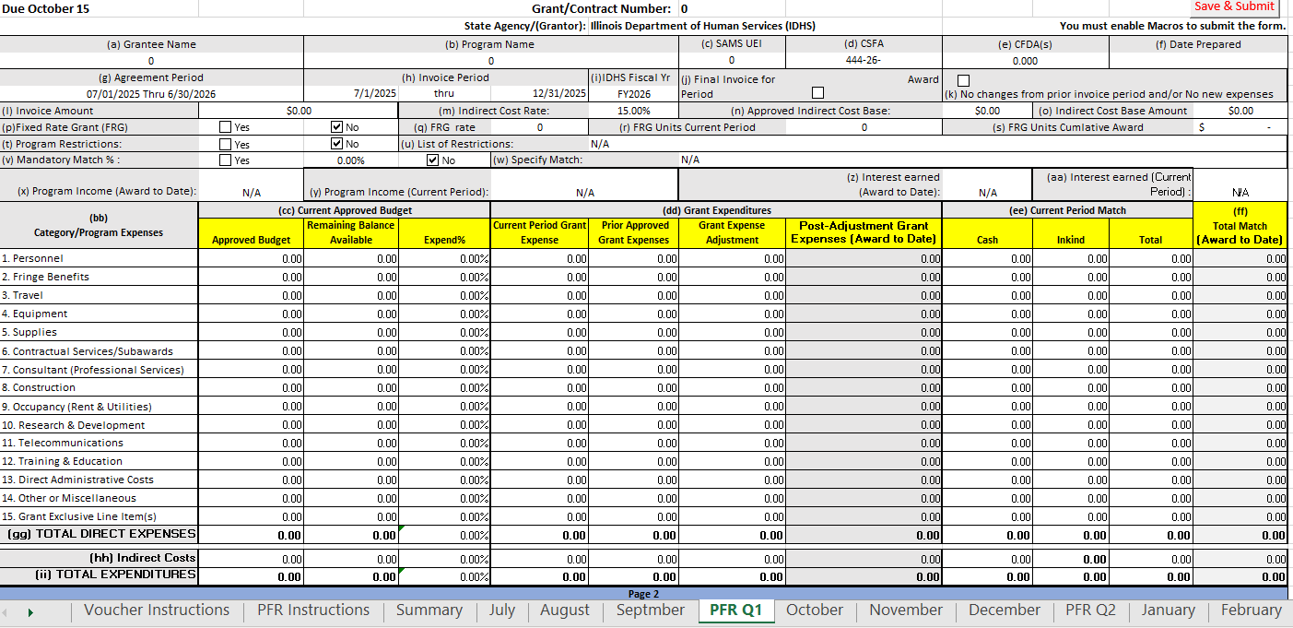
FY26 Periodic Financial Report
New This Year: PFR Requirement. PFR is now integrated into the same workbook as your vouchers. Many fields will auto-populate to help reduce errors. Aims to minimize corrections and resubmissions. Purpose: Increase transparency and streamline funding. Voucher workbooks will be released within the next 1–2 weeks

Slide 42
Questions?
Thank you all for attending today. I appreciate your time and engagement, and I look forward to working with you throughout this fiscal year.
Notes:
This presentation will be posted on SLACK, and it will be emailed to you so you can refer to it. I know there are a lot of words in this, but I do think its important for us to have a walk through of what we expect from all the ROSC.
I welcome thoughts, questions, comments.
As always, I am always a quick call away or a quick short WebEx away if you need me throughout this FY. I am pretty good at answering my phone as some can attest to that LOL!.

