Slide 1

For Zoom joiners, please keep the video on if you can.
This will help all of us focus on the Word of God.
Public Reading of Scripture
Guidelines
3

Slide 2
To be respectful of hearing
God’s Word during PRS,
please refrain from:
Eating Food
Using Phone (except Bible Tracker)
Multitasking (e.g. treadmill)
When coming to G&M offices, please wear business casual attire.
Public Reading of Scripture
Guidelines

Slide 3
We Recommend:
Just Listening
Listening and Following the Bible on the Screen or in Print
Public Reading of Scripture
or
Guidelines
3

Slide 4


February 2026

Slide 5





Five Pillars of PRS
In Community
1 Timothy 4:13
Public Reading of Scripture (PRS) is the Biblical Practice of Listening to the Bible Together.
Listening
Revelation 1:3
Whole Bible
Matthew 4:4
Regularly
Psalm 1:2
High Quality
Nehemiah 8:8

Slide 6





In Community
1 Timothy 4:13 (NIV)
Until I come, devote yourself to the public reading of Scripture, to preaching and to teaching.
Blessed is the one who reads aloud the words of this prophecy, and blessed are those who hear, and who keep what is written in it, for the time is near.
Listening
Revelation 1:3 (ESV)
But He answered and said, “It is written, ‘Man shall not live by bread alone, but by every word that proceeds from the mouth of God.’ ”
Whole Bible
Matthew 4:4 (NKJV)
Regularly
Psalm 1:2 (NKJV)
But his delight is in the law of the Lord, And in His law he meditates day and night.
So they read distinctly from the book, in the Law of God; and they gave the sense, and helped them to understand the reading.
High Quality
Nehemiah 8:8 (NKJV)

Slide 7
PRS Examples in the Old Testament
Exodus 17:14a (ESV)
Then the Lord said to Moses, “Write this as a memorial in a book and recite it in the ears of Joshua,…
Exodus 24:7a (ESV)
Then he took the Book of the Covenant and read it in the hearing of the people.
Deuteronomy 31:11b (ESV)
You shall read this law before all Israel in their hearing.
Jeremiah 36:6b (NIV)
Read to the people from the scroll the words of the Lord that you wrote as I dictated.

Slide 8
PRS Examples in the New Testament
Luke 4:16b (NKJV)
And as His custom was, He went into the synagogue on the Sabbath day, and stood up to read.
Acts 15:21 (NIV)
For the law of Moses has been preached in every city from the earliest times and is read in the synagogues on every Sabbath.
Colossians 4:16a (ESV)
And when this letter has been read among you, have it also read in the church of the Laodiceans;...
1 Thessalonians 5:27 (ESV)
I put you under oath before the Lord to have this letter read to all the brothers.

Slide 9
English:
Arabic:
French:
Japanese:
Korean:
Mandarin:
Russian:
Spanish:
98 hrs
90 hrs
98 hrs
118 hrs
85 hrs
100 hrs
98 hrs
106 hrs
How Long Does It Take
to Listen to the Whole Bible?
Listening to Audio Drama Bibles in the PRS App

Slide 10
Listening Time for Each of 66 Books of the Bible
Old Testament
Genesis | 4h 49m | Ecclesiastes | 42m
Exodus | 4h 1m | Song of Songs | 23m
Leviticus | 2h 43m | Isaiah | 4h 32m
Numbers | 3h 48m | Jeremiah | 5h 3m
Deuteronomy | 4h 38m | Lamentations | 31m
Joshua | 2h 21m | Ezekiel | 4h 57m
Judges | 2h 17m | Daniel | 1h 30m
Ruth | 17m | Hosea | 41m
1 Samuel | 2h 59m | Joel | 14m
2 Samuel | 2h 29m | Amos | 32m
1 Kings | 2h 58m | Obadiah | 4m
2 Kings | 2h 45m | Jonah | 12m
1 Chronicles | 2h 47m | Micah | 28m
2 Chronicles | 3h 8m | Nahum | 9m
Ezra | 54m | Habakkuk | 11m
Nehemiah | 1h 12m | Zephaniah | 12m
Esther | 43m | Haggai | 8m
Job | 2h 19m | Zechariah | 45m
Psalms | 6h 2m | Malachi | 13m
Proverbs | 2h 4m | 39 Books Total | 76h 58m
New Testament
Matthew | 2h 49m | 1 Timothy | 16m
Mark | 1h 43m | 2 Timothy | 12m
Luke | 2h 54m | Titus | 7m
John | 2h 14m | Philemon | 3m
Acts | 2h 45m | Hebrews | 53m
Romans | 1h 9m | James | 15m
1 Corinthians | 1h 2m | 1 Peter | 16m
2 Corinthians | 40m | 2 Peter | 10m
Galatians | 21m | 1 John | 17m
Ephesians | 21m | 2 John | 2m
Philippians | 15m | 3 John | 2m
Colossians | 14m | Jude | 4m
1 Thessalonians | 13m | Revelation | 1h 16m
2 Thessalonians | 7m | 27 Books Total | 20h 50m
In English (NKJV)
The Word of Promise Audio Bible

Slide 11
Our Recommendation for Public and Private Bible Listening (Reading) Goals
OT – NT – Psalms | Hours Per Week
 | Two Years | One Year
 | 1h 00m | 2h 00m
 | 1h 15m | 2h 30m
 | 1h 30m | 3h 00m
 | 2h 15m | 4h 30m
 | 2h 30m | 5h 00m
 | 3h 00m | 6h 00m
 | 3h 30m | 7h 00m
 | 3h 45m | 7h 30m
 | 4h 30m | 9h 00m
 | 4h 30m | 9h 00m
 | 5h 00m | 10h 00m
 | 6h 00m | 12h 00m
(77 hrs)
(21 hrs)
(6 hrs)
1
1
1
2
2
2
3
3
3
4
4
4
–
–
–
–
–
–
–
–
–
–
–
–
1
2
3
3
4
6
5
6
9
6
8
12
–
–
–
–
–
–
–
–
–
–
–
–
2
3
4
4
6
8
7
9
12
8
12
16
Times
Times
Times
Times
Times
Times
Times
Times
Times
Times
Times
Times
How Much Bible to Listen to (Read) in One or Two Years?
Hours are approximate, using English (NKJV) Audio Bible in the PRS App.
Balancing OT & NT and Praying Psalms Often

Slide 12
Why Balance OT & NT and Pray Psalms Often?
Hebrews 1:1-2a (NIV)
In the past God spoke to our ancestors through the prophets at many times and in various ways, but in these last days he has spoken to us by his Son,...
Psalm 55:17 (NKJV)
Evening and morning and at noon I will pray, and cry aloud, And He shall hear my voice.
Psalm 72:20 (NKJV)
The prayers of David the son of Jesse are ended.
Luke 9:35 (NKJV)
And a voice came out of the cloud, saying, “This is My beloved Son. Hear Him!”
Luke 21:36a (NKJV)
Watch therefore, and pray always…

Slide 13
Cautions When Listening to the Bible
Deuteronomy 6:4-5 (ESV)
“Hear, O Israel: The LORD our God, the LORD is one. You shall love the LORD your God with all your heart and with all your soul and with all your might.
John 5:39-40 (NIV)
You study the Scriptures diligently because you think that in them you
have eternal life. These are the very Scriptures that testify about me, yet
you refuse to come to me to have life.
Malachi 1:6a (ESV)
“A son honors his father, and a servant his master. If then I am a father, where is my honor? And if I am a master, where is my fear? says the Lord of hosts to you.”
Matthew 7:26 (ESV)
And everyone who hears these words of mine and does not do them will be like a foolish man who built his house on the sand.

Slide 14

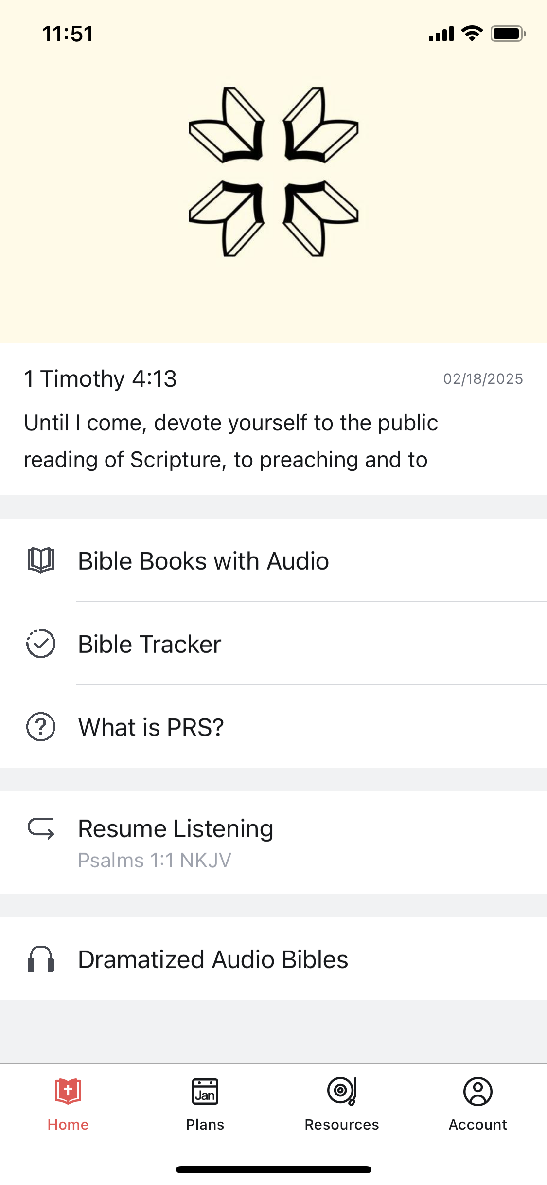
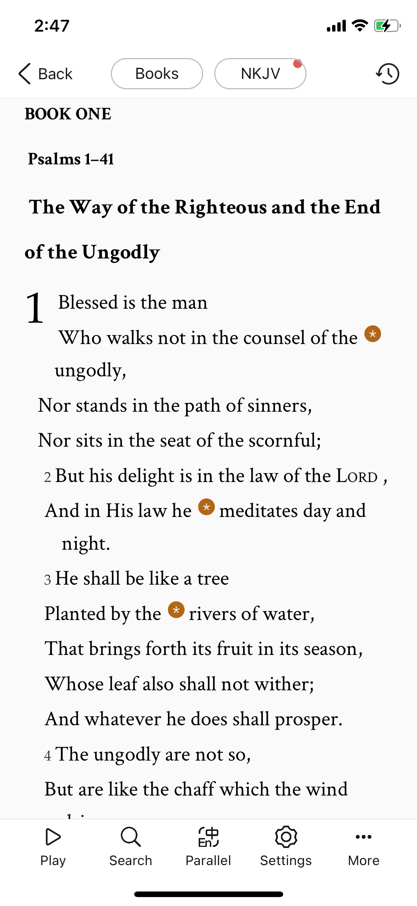
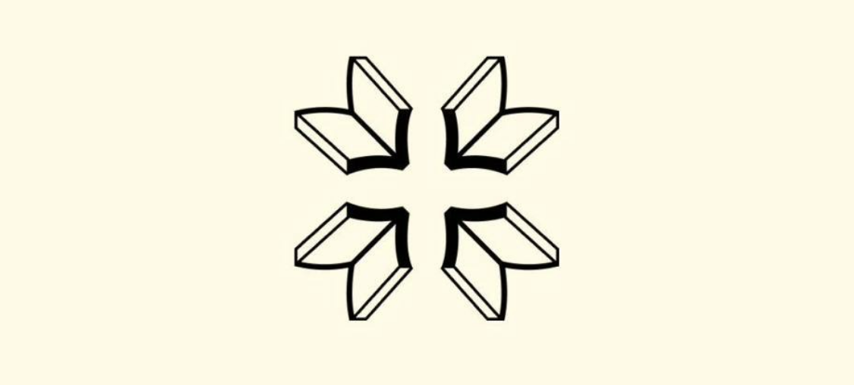


All Free!
Public Reading of Scripture
App

Slide 15
All Free!
Best Audio Drama Bibles
Available Now:
English NKJV
English NLT (NT)
Spanish
Korean
Japanese Mandarin
Russian
Indonesian
Arabic NVD
Arabic GNA
French
Coming Soon:
2026
In Public Reading of Scripture
App
Q1
Portuguese (NT)
Hindi (NT)
Portuguese (OT)
Hindi (OT)
Q3
Q4

Slide 16
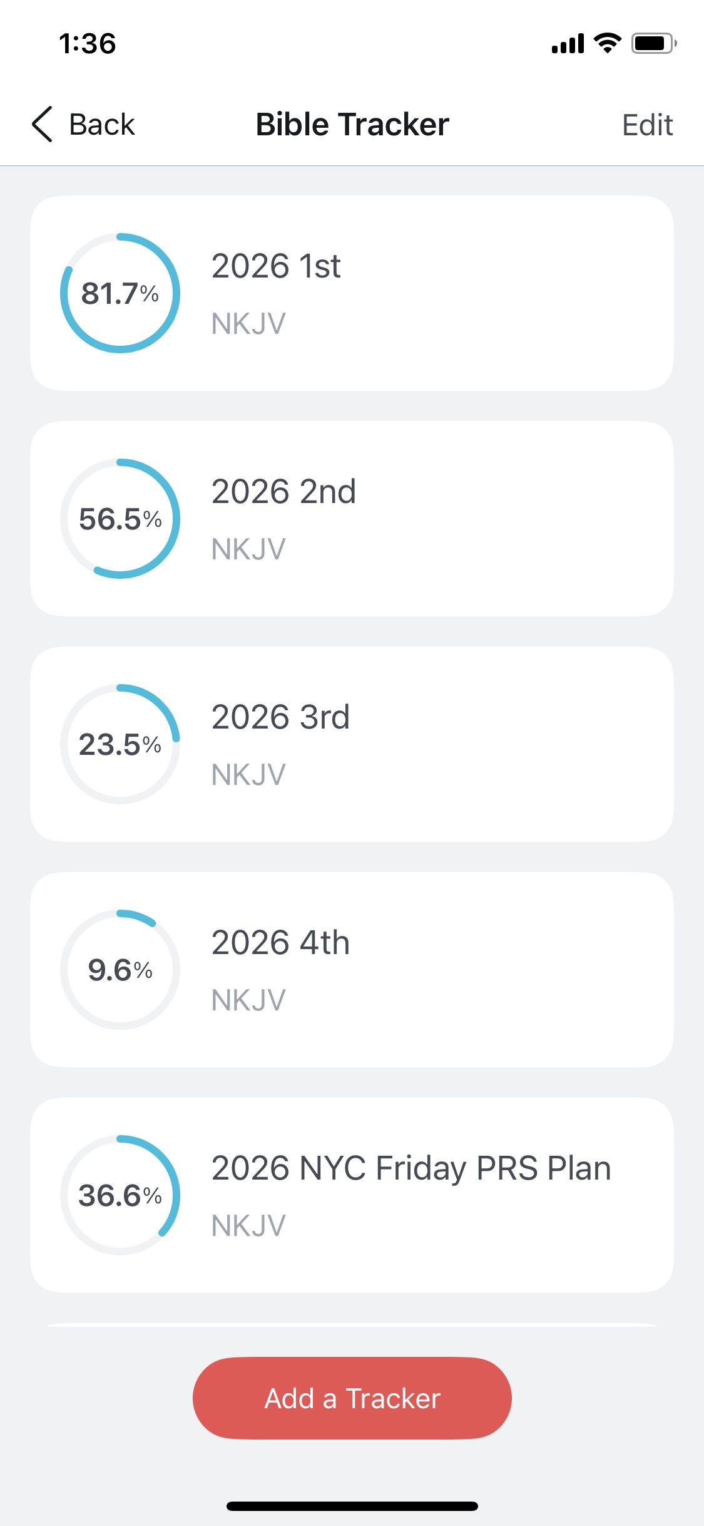
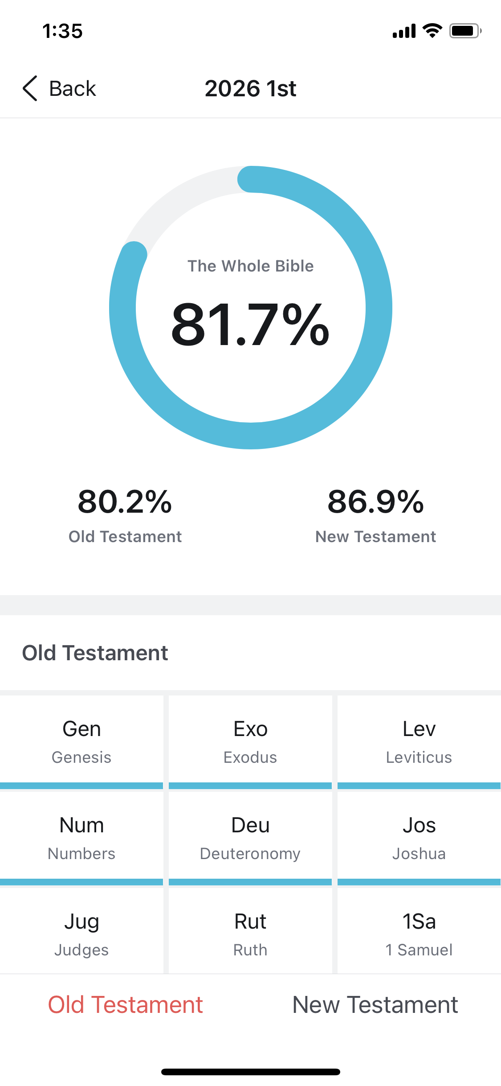
Track Bible Listening (Reading)!
Bible Tracker
in the App

Slide 17


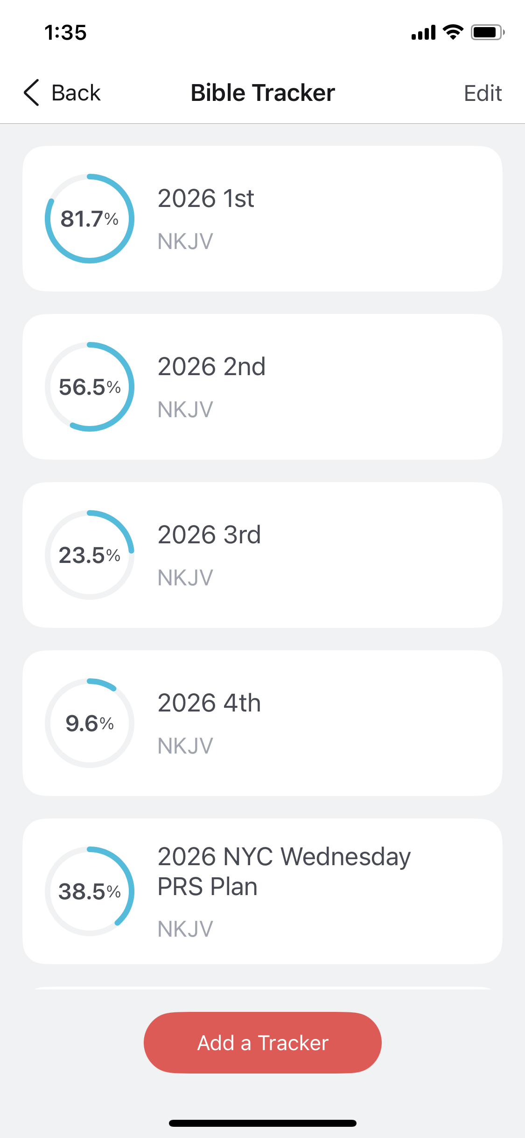


For 1-2-3 Goal,
we recommend setting up
5 Trackers.
2026 1st
2026 2nd
2026 3rd
Like this
2026 4th
2026 NYC Wednesday PRS Plan
Download PRS App

Slide 18
Training Together, Not Trying Alone.
A disciple is not above his teacher, but everyone when he is fully trained will be like his teacher. Luke 6:40 (ESV)
Commit these to faithful men who will be able to teach others also.
You therefore must endure hardship as a good soldier of Jesus Christ. No one engaged in warfare entangles himself with the affairs of this life, that he may please him who enlisted him as a soldier. And also if
anyone competes in athletics, he is not crowned unless he competes according to the rules. The hardworking farmer must be first to partake of the crops. 2 Timothy 2:2b-6 (NKJV)

Slide 19
Psalm 15
Genesis 25-27
Mark 1-3
Psalm 16
Track
Today’s Scriptures
Scan to download the free PRS App

Slide 20



Belong to a PRS Group, Preferably with 1 or 2 Friends
Ecclesiastes 4:12, Luke 4:16
3 Steps for Successful
Bible Listening (Reading)
Set a One or Two-Year Goal
Deuteronomy 8:3, Matthew 4:4
Track and Share It
Proverbs 27:17, 1 Timothy 4:15

Slide 21



Step 1. Belong to a PRS Group, Preferably with 1 or 2 Friends
Ecclesiastes 4:12 (NKJV)
Though one may be overpowered by another, two can withstand him. And a threefold cord is not quickly broken.
Luke 4:16 (NKJV)
So He came to Nazareth, where He had been brought up. And as His custom was, He went into the synagogue on the Sabbath day, and stood up to read.
Step 2. Set a One or Two-Year Goal
Deuteronomy 8:3 (NKJV)
So He humbled you, allowed you to hunger, and fed you with manna which you did not know nor did your fathers know, that He might make you know that man shall not live by bread alone; but man lives by every word that proceeds from the mouth of the Lord.
Matthew 4:4 (NKJV)
But He answered and said, “It is written,
‘Man shall not live by bread alone, but by every word that proceeds from the mouth of God.’ ”
Step 3. Track and Share It
Proverbs 27:17 (NIV)
As iron sharpens iron, so one person sharpens another.
1 Timothy 4:15 (ESV)
Practice these things, immerse yourself in them, so that all may see your progress.

Slide 22
G&M U.S. 2026 Wednesday PRS Plan
January
February
March
April
May
June
Psalms
Genesis
John
Psalms
Genesis
John
Mark
Psalms
Genesis
Mark
Psalms
Genesis
Jeremiah
Mark
Romans
Psalms
Jeremiah
1 Corinthians
Psalms
Jeremiah
2 Corinthians
Revelation
July
August
September
October
November
December
Psalms
Jeremiah
Revelation
Philippians
Colossians
Psalms
Jeremiah
Ezra
Hebrews
1 Peter
Psalms
Ezra, Joel
Song of Songs
2 Chronicles
2 Peter, James
1, 2 Timothy
1, 2, 3 John
Psalms
2 Chronicles
Galatians
Luke
Psalms
2 Chronicles
Luke
Psalms
2 Chronicles
Ecclesiastes
Luke

Slide 23
1 Timothy 4:13 (NIV)
Until I come, devote yourself to the public reading of Scripture,
to preaching and to teaching.
Comprehensive
Christian Learning
Listening to Scripture: Public & Private
Preaching God’s Word
Teaching:
Reading Books
(JSU Book Club & Private)
Bible Study

Slide 24

G&M U.S. Weekly English PRS & JSU Schedules
Monday Dinner
Wednesday Lunch
Friday Breakfast
JSU 5:30 PM ET
PRS 7:00 PM ET
JSU 11:00 AM ET
PRS 12:30 PM ET
PRS 7:00 AM ET
JSU 8:45 AM ET
Current Book
Seven Men (8 hrs)
by Eric Metaxas
Current Book
Seven Women (7 hrs)
by Eric Metaxas
Current Book
Pro Rege (For the King)
Volume 3 (~13 hrs)
by Abraham Kuyper
Next Book (est. Jun 8)
God, AI and the End of History (~13 hrs)
by John Lennox

Slide 25

For more information, check out
www.prsi.org
www.justshowup.club

Slide 26

If you can, join us for
coffee & tea in the kitchen
until 2:15 PM

