Slide 1


July 2026

Slide 2

1.
2.
3.
4.
5.
Mention your name and where you are from.
Everyone speaks same amount of time
(~1 min, use timer) or you can skip.
Reference specific pages when possible.
Focus on sharing what you learned or disagreed with. If you have a question, mention it and discuss
privately afterwards.
When sharing, use “I” not “we” or “you.”
This helps each person learn and share independently. Facilitator will correct you
when mistakes are made.
Members who repeatedly and carelessly disregard
the guidelines should expect to be disinvited.
It is because we are training the trainers.
Just Show Up
Book Club Guidelines

Slide 3
JSU Book Club Books
Your first JSU Book Club book is a gift.
To purchase this book at $10,
please see the facilitator.
Otherwise, kindly leave the book on the table after you read them.

Slide 4
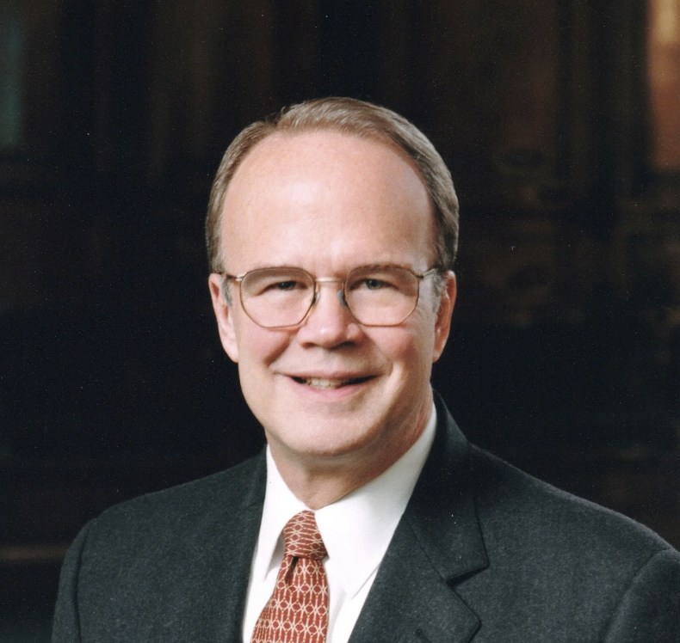
James Montgomery Boice (1938—2000):
An American theologian, pastor, Bible teacher, and author.
Studied at Harvard University, Princeton Theological Seminary, and University of Basel.
Served as a Senior pastor at Tenth Presbyterian Church in Philadelphia for 32 years.
Hosted The Bible Study Hour radio broadcast for over 30 years.
Wrote 50+ books, including Foundations of the Christian Faith and extensive expositional commentary series.

Slide 5
Benefits:
Finishing books by just showing up.
No (or optional) homework!
Learning from authors & participants.
Building learning communities of all subjects: Theology, History, Investing, Management, Hobbies, Science, etc.
Reading together increases private reading.
Reading & listening simultaneously helps focus on the content.
Enhances understanding & knowledge.
Doable in many settings such as family,
office, church, schools, etc.
Just Show Up Book Club

Slide 6
Proverbs 9:10 (NKJV & NIV)
The fear of the Lord is the beginning of wisdom,
and knowledge of the Holy One is understanding.
Comprehensive
Judeo-Christian Learning
1 Timothy 4:13 (NIV)
Until I come, devote yourself to
the public reading of Scripture,
to preaching and to teaching.
Public Reading of Scripture:
Listening to Scripture Together
Preaching: Hearing Biblical Preaching
Teaching:
Reading Books (JSU Book Club & Private)
& Studying the Bible

Slide 7

G&M U.S. Weekly English PRS & JSU Schedules
Monday Dinner
Wednesday Lunch
Friday Breakfast
JSU 5:30 PM ET
PRS 7:00 PM ET
JSU 11:00 AM ET
PRS 12:30 PM ET
PRS 7:00 AM ET
JSU 8:45 AM ET
Current Book
Nehemiah: An Expositional Commentary (6 hrs)
by James Montgomery Boice
Current Book
Daniel: An Expositional Commentary (6 hrs)
by James Montgomery Boice
Next Book (Aug 5)
Seven More Men (7 hrs)
by Eric Metaxas
Current Book
Pro Rege (For the King)
Volume 3 (~13 hrs)
by Abraham Kuyper
Next Book (Jul 31)
God, AI and the End of History (~13 hrs)
by John Lennox

Slide 8

For more information, check out
www.prsi.org
www.justshowup.club

