Slide 1

The Golden Age of Nuclear?
Observations from the market
Fiona Reilly HonFEI, HonFNucl
November 2025

Slide 2

Caveat! Too much to talk about!!
Too much in here
Fission not fusion (that would take another 3 hours)
Not all fission projects….
Public information

Slide 3
UK

Slide 4
UK Large Reactor Projects
Country | Technology | State Aid and Government Support Package | Financing | Comments
UK (HPC) | EPR | CfD | Corporate EDF and CGN | Contingent equity exceeded and significant delay U1 begin operation 2030 (01/01/24 announcement)
UK (SZC) | EPR | RAB and GSP | Equity: HM Government (UK): 44.9% stake, - largest shareholder. La Caisse (Caisse de dépôt et placement du Québec): Canadian institutional investor 20% stake. Centrica: 15% EDF: 12.5% Amber Infrastructure Group: initial 7.6% stake, with an option to acquire an additional 2.4% from the government. Debt: National Wealth Fund (NWF): a term loan of up to £36.6 billion to finance the plant's construction. Treasury is giving the NWF additional financial capacity to deliver this investment. Bpifrance Assurance Export: France's export credit agency £5 billion debt guarantee to back commercial bank loans. Commercial bank loans: 13 loans | FID July 2025 FC November 2025
UK (Wylfa) | ?? | RAB? | ??

Slide 5
UK SMRs/ Micro Reactors
Technology | State Aid and Government Support Package | Developer | Financing | Comments
Rolls Royce SMR (chosen July 2025) | RAB or other? | GBE-N with partners | HMG, private equity and NWF? | Still early, deal not agreed Site to be announced late Autumn
Holtec 300 SMR | Unclear | Holtec International, EDF and Tritax | Unclear | Data centres power by SMRs. At former Cottam coal-fired power station, Nottinghamshire
Last Energy PWR-20 | Unclear | Last Energy and DP World | £80m private investment | First port-centric micro reactor at London Gateway Operational 2030. 20MWe to power the logistics hub with grid export capacity
WEC AP300 | Unclear | Community Nuclear Power | Unclear | North Teeside Operational early 2030s
Notes:
Holtec, EDF and Tritax - plans to develop advanced data centres powered by small modular reactors at the former Cottam coal-fired power station in Nottinghamshire. Holtec estimate the project value to be around £11 billion, and it is expected to create thousands of high-skilled construction jobs, as well as long-term roles in operations for the local community.
Last Energy and DP World – plans to establish one of the world’s first micro modular nuclear power plants, backed by £80 million in private investment, to unlock a clean power supply for the expansion of DP World’s London Gateway port and business park.

Slide 6
UK AMRs
Technology | Government Support | Developer | Financing | Comments
UKJ-HTR | AMR RD&D project – NNL and Japan | NNL and Japan – Technology Development | Co-funded at present | Redesign of several structures, systems and components. Primary and most efficient use case is for high temperature heat production but could also offer the opportunity to produce electricity (as supplementary) for localised use.
TerraPower Natrium – 345MWe | None at present | Terrapower and KBR - conducting studies and evaluating sites for deployment |  | Sodium-cooled fast reactor with molten salt-based energy storage.
X-Energy Xe-100 | None at present | Centrica and X-Energy Joint Development Agreement – |  | Plan to develop 12 units generating 960 MWe at Hartlepool. Potential heat application
Notes:
X-Energy and Centrica - plans to build up to 12 advanced modular reactors in Hartlepool, with a follow-on UK wide programme targeting a fleet of 6GW of nuclear power. According to the companies, the Hartlepool project would generate enough power for up to 1.5 million homes and create up to 2,500 good jobs. The companies estimate the overall programme could deliver at least £40 billion in economic value, with £12 billion in value focussed for the North East of England.
TerraPower and KBR – plans to conduct studies and evaluate sites in the UK for the deployment of the Natrium advanced reactor technology, with each Natrium reactor supporting around 1,600 construction jobs and 250 permanent jobs and delivering safe, reliable and flexible nuclear power paired with gigawatt-scale energy storage.

Slide 7
Fuels
HALEU and Advanced Nuclear Fuels:
Urenco and Radiant – signs a deal, worth around £4 million, to supply advanced HALEU fuel to the US market. Urenco is building an Advanced Fuels Facility in the UK co-funded with the UK Government (£300m) and is exploring building a similar facility in the US.
Springfields received funding to support the production of this fuel, with the first plant aiming to be operational early next decade.
Coated Particle Fuel (CPF) / TRISO Fuel: In May 2024, the first tranche of this funding, awarding £196m to Urenco to deliver a first of a kind HALEU enrichment capability on a commercial scale, targeting first operations in 2031.
Springfields is conducting studies, in collaboration with Urenco, on the most effective route for a secure and reliable supply of coated particle fuel (specifically UCO-kernel TRISO fuel) for future HTGRs.
(SMR/AMR) Fuels: Springfields has received funding to enable the manufacture of a broader range of fuel types for future SMR and AMR designs. Westinghouse has already demonstrated readiness for SMR fuel fabrication capabilities at the site.
Molten Salt Reactor Fuel: Springfields is partnering with Terrestrial Energy and the National Nuclear Laboratory to pilot the supply of enriched Uranium Tetrafluoride (UF4) and molten salt fuel for use in Terrestrial's Integral Molten Salt Reactor.
Notes:
Urenco and Radiant – signs a deal, worth around £4 million, to supply advanced HALEU fuel to the US market. Urenco is building an Advanced Fuels Facility in the UK co-funded with the UK Government and is exploring building a similar facility in the US.

Slide 8
UK Enabling Activities
Regulation - The Nuclear Regulatory Taskforce announced February 2025, objective of bringing about change in our regulatory framework to better support delivery of new nuclear in the UK – streamlining, faster approvals, greater international collaboration, improved ways of working.
Siting - GBE-N has acquired sites at Wylfa (Anglesey) and Oldbury (Gloucestershire). Likely one will be chosen for Rolls Royce deployment.
Skills - The National Nuclear Strategic Plan for Skills identified the need to quadruple the number of nuclear fission PhDs the UK produces to develop a pipeline of future subject matter experts with the skills required to underpin the UK domestic civil and defence nuclear sectors in coming years. £45m funding to develop circa 500 PhD graduates over four cohorts, with the skills, experience and industry connections to enter the UK nuclear workforce upon graduation.

Slide 9
Rest of the World (some of it)

Slide 10
Global Large Reactor Projects
Country | Technology | Developer | State Aid and Government Support Package | Financing | Comments
France | EPR2 (6) | EDF/ French State | Preferential State Loan, CfD | French state and EDF
Poland | AP1000 | PEJ | State equity, 60 year CfD, Sovereign guarantee | State plus ECAs – USExim, EDC, Kexim, JBIC etc | State aid package under investigation by the Commission
Bulgaria | AP1000 | KNPP | State equity, CFD, Sovereign guarantee | State Equity and Citi Arranging Bank | Not approved by the Commission yet
Slovakia | AP1000 | JESS | Unclear but similar to Poland and Bulgaria | Expected to be similar to Bulgaria | Not approved by the Commission yet
Romania | CANDU | Nuclearelectrica | Sovereign guarantee | Nuclearelectrica, EDC, USExim, Kexim, SACE | Not approved by the Commission yet
Czechia | APR1400 | EDUII | State equity and debt, Revenue support | State and CEZ | Not approved by the Commission yet

Slide 11
Global Large Reactor Projects
Country | Technology | Developer | State Aid and Government Support Package | Financing | Comments
Czechia | APR1400? | Temilin | Unclear at this stage | Unclear at this stage | Early stage
Netherlands | EPR or AP1000 | Delta and Government? | Not clear | Not clear | Borssele site
Canada | Not decided – 4800MW | Bruce Power | Possibly a RAB | Not clear | Early stage – Notice under Impact Assessment Act
Canada | CANDU 1000 Mwe Monark | Bruce Power | Unclear | Unclear | Early stage discussions
Hungary | Rosatom | Parks II | State Financing | State financing with Russian Loan | State aid package overturned by ECJ on procurement grounds.
Saudi | Russian or American? | KACARE | Unclear | Unclear | Changing developments

Slide 12
USA Reactor Projects
US Government & WEC $80bn Deal (10 pack deal) to build AP1000 to support AI Demand - Each two-unit Westinghouse AP1000 power plant creates or sustains 45,000 manufacturing and engineering jobs in 43 states, and a national deployment will create more than 100,000 construction jobs.
Fermi America, 4 x AP1000 being deployed to support a pioneer in gigawatt-scale private grid infrastructure for hyperscale AI.
The ADVANCE Act (Accelerating Deployment of Versatile, Advanced Nuclear for Clean Energy Act) aims to streamline reactor licensing for faster and more efficient deployment.
US-UK partnership: The U.S. and UK are collaborating to speed up advanced nuclear technology development and deployment, including advanced fuels and the development of fusion power.
Microreactors for bases: The U.S. Army plans to install small, portable microreactors on military bases by 2028 to facilitate continuous operations. Private sector owned but government technical assistance and fuel.
Future applications: The U.S. is also exploring novel civil maritime nuclear applications, such as powered cargo ships and floating nuclear power plants, through collaboration with allies.
Notes:
The U.S. government has signed an $80 billion deal with Westinghouse Electric Company to build large-scale nuclear reactors to support growing electricity demand from artificial intelligence.
The partnership involves Westinghouse, Brookfield Asset Management (a subsidiary of Canada-based investment firm Brookfield Corp.), and Canadian uranium producer Cameco Corp.
The deal follows the directives set forth in the Trump administration’s May executive orders aiming to speed up development and deployment of nuclear reactors in the United States.
Westinghouse announced in July it plans to open 10 new plants in the U.S., with construction starting in 2030. To date, there are only two Westinghouse AP1000 reactors operating in the U.S.—Units 3 and 4 at Plant Vogtle in Georgia.
While Westinghouse was founded in Pittsburgh, Pa., it is currently under Canadian ownership after being purchased in 2022 under a strategic partnership between Brookfield (which owns a 51 percent stake) and Cameco (which owns a 49 percent stake), as Nuclear Newswire reported at the time.
The Trump administration is betting hard on nuclear to supply electricity for the growing number of data centers throughout the United States.
“Together with Westinghouse we will unleash American energy. This partnership embodies the bold vision of President Trump—to rebuild our energy sovereignty, create high-paying jobs, and drive America to the forefront of the nuclear renaissance,” Commerce Secretary Howard Lutnik said in a statement.
Jobs, economic growth: According to the companies, each two-unit Westinghouse AP1000 power plant creates or sustains 45,000 manufacturing and engineering jobs in 43 states, and a national deployment will create more than 100,000 construction jobs.
Future Westinghouse AP1000 sites include V.C. Summer in South Carolina, where utility Santee Cooper recently announced it's partnering with Brookfield to restart building the two AP1000 reactors that were left unfinished after Westinghouse filed for bankruptcy in 2017.

Slide 13
Global Small Reactor Projects
Country | Technology | Developer | State Aid and Government Support Package | Financing | Comments
Poland | GE X300 | ORLEN & Sythos | Unclear | Private | Synthos also looking to develop X300 projects in neighbouring countries
Sweden | Rolls Royce or X300 | Vattenfall | Unclear | Unclear | Down selected to 2 technologies.
Finland | Technology for electricity and heat | Helen | Unclear | Helen main developer financing to be determined
Czechia | Rolls Royce | CEZ | Unclear | CEZ invested in RR technology. The financing of a project is unclear | Race to be first between the UK and Czechia
Romania | NuScale | Nuclear electrics | Unclear | Private equity 35%, Nuclearelectrica, Nova Power
Canada | GE X-300 | OPG | Government funding. | Canadian Growth Fund ( up to 15%), Building Ontario Fund (up to 7.5%) Canada Infrastructure Bank (CIB): CAD970 million in specifically for Phase 1 OPG authorized to spend $6.1 billion to build the first reactor, plus $1.6 billion for common infrastructure.
Netherlands | Unclear | Government | Heat off-take? |  | Early Stage
Notes:
Canada Growth Fund (CGF): Committed to investing up to CAD2 billion through an equity agreement, taking a minority ownership position of up to 15% in the project. The CGF is a government-backed fund designed to attract private capital for Canada's clean economy.
Building Ontario Fund (BOF): Committed to investing up to CAD1 billion and acquiring a minority stake of up to 7.5%. The BOF is a provincial Crown agency that finances large-scale, revenue-generating infrastructure projects.
Canada Infrastructure Bank (CIB): Previously finalized an agreement with OPG in October 2022 to provide CAD970 million in financing specifically for Phase 1 work, which covered project design, site preparation, and procurement of long lead-time equipment.
Ontario Power Generation (OPG): Remains the majority owner and operator of the project. The government of Ontario also authorized OPG to spend $6.1 billion to build the first reactor, plus an additional $1.6 billion for common infrastructure shared among the four planned units.

Slide 14
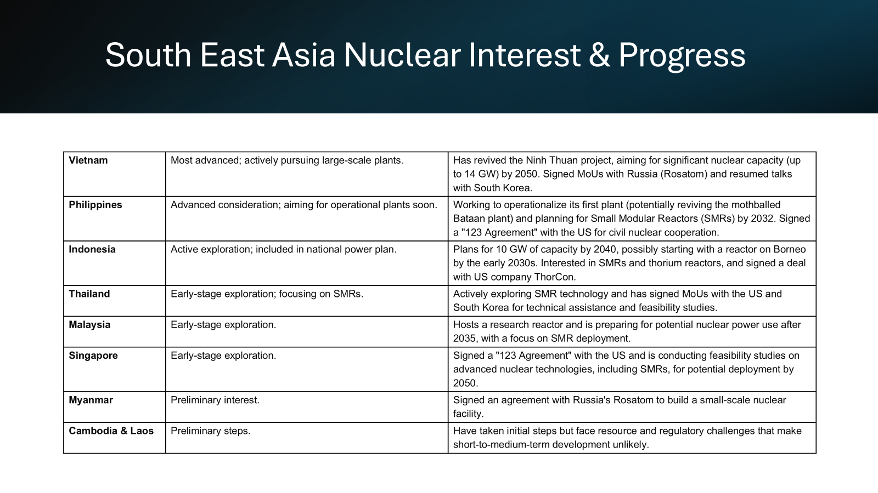
South East Asia Interest

Slide 15
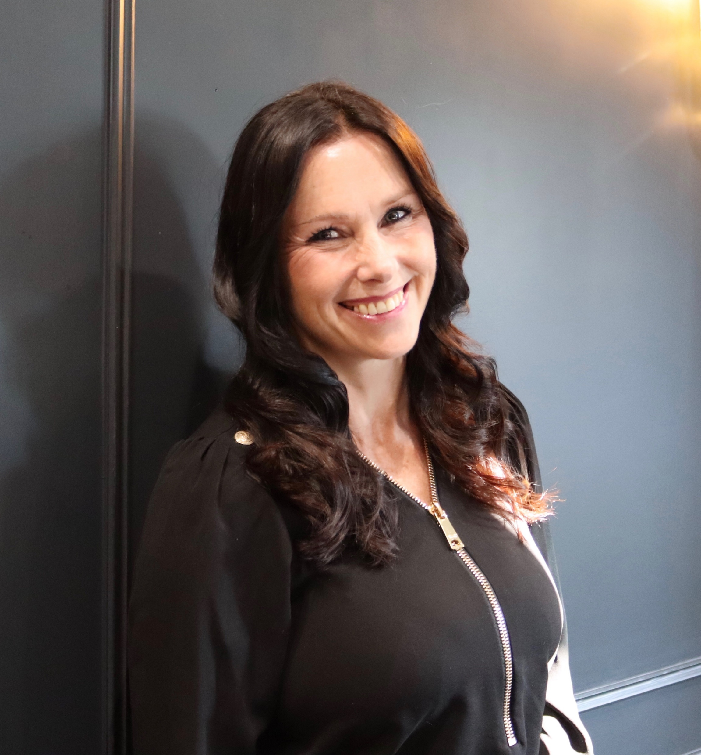

Fiona Reilly HonFEI, HonFNucl
CEO of FiRe Energy Ltd
Non-executive Director of Ansaldo Nuclear
Senior Energy Sector and Nuclear Specialist Adviser DBT
Senior UK Representative and Co-Chair of the EMWG for the Generation IV International Forum (GIF) (BEIS/DESNZ Appointment)
Member SAF and Nuclear Task and Finish
Leadership Team Global Women in Nuclear Legal Initiative
Nuclear Institute Mentor
Fiona is an Energy & Infrastructure specialist with over 30 years of experience. She brings sector expertise and a deep understanding of mega-projects across the nuclear and renewable energy markets, proven knowledge of ESG and governance best practice and compliance, strategic vision and leadership with regard to sustainable growth and innovation, commercial acumen and enjoy collaborating with like minded peers across industries.
Non-Executive and Strategic Leadership:
Non-Executive Director, Ansaldo Nuclear: Providing strategic direction and oversight in the nuclear sector, focusing on innovation and compliance.
Chair, Expert Finance Working Group on Small Reactors: Leading a public-private taskforce to develop financing frameworks that facilitate the growth of small modular reactors (SMRs) in the UK.
Senior Energy Sector & Nuclear Adviser DBT: Bringing specialist sector expertise to the department
Co-chair of the Economics and Modelling Working Group on the Generation IV International Forum and published Nuclear Energy: An ESG Investable Asset Class and Chair of a Nuclear Financing Taskforce
Non-Executive Director, Nuclear Industry Association: helping to transform the association.
Leadership in Global Women in Nuclear Legal Initiative: Promoting gender diversity and inclusion within the nuclear sector.
Member SAF & Nuclear Task & Finish Group: Group considering the UK’s development of synthetic fuels and nuclear.
Corporate Leadership:
CEO, FiRe Energy: Founding and leading a consultancy that provides strategic advice to energy companies, enhancing operations in low carbon energy production.
Solicitor Advocate and Partner and Global Head of Nuclear Services at international law firm Norton Rose Fulbright: Advising on innovative energy projects across the globe.
Global Nuclear Lead for Capital Projects and Infrastructure at PWC: Advising on large-scale infrastructure projects and strategic partnerships within the global energy market.
Executive Partner at Atlantic SuperConnection LLP: Leading a private equity funded energy development company

