Slide 1



EnergyEfficiency4SMEs Project
Reference: LIFE21-CET-AUDITS-EnergyEfficiency4SME/101076459
Seville, 23 October 2025

Slide 2



Non-profit, public law corporation
Founded in 1886
Enhancer of economic activity
Consultative/ advisory body for public administration
Represents the interests of the business community
Around 85 employees

Slide 3


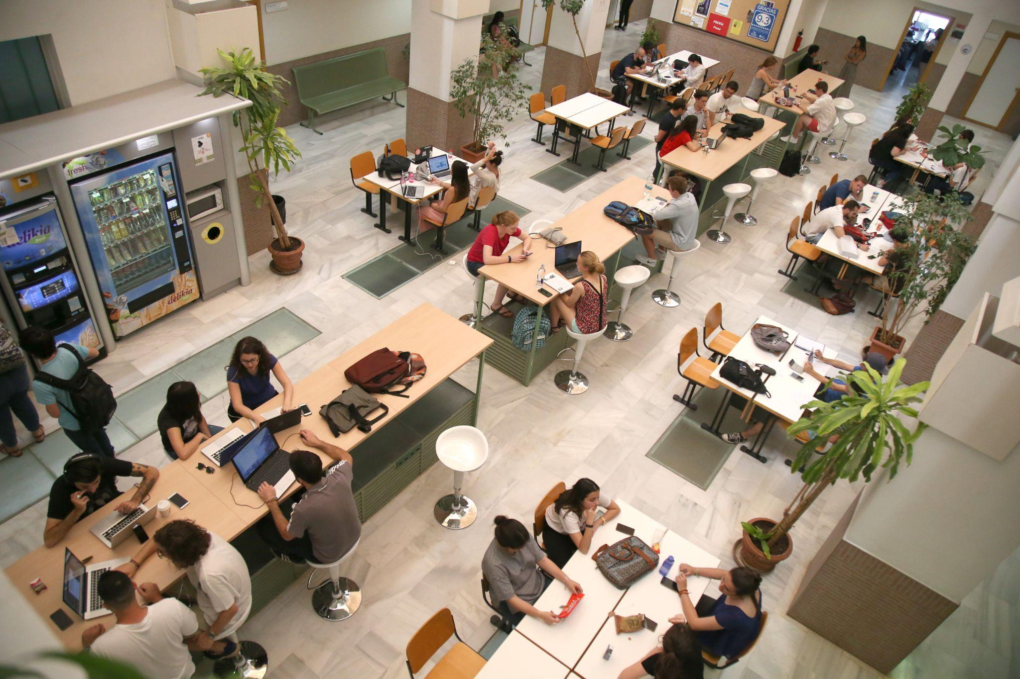
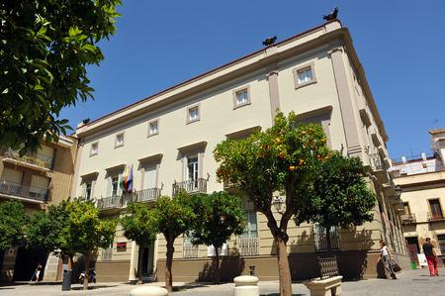

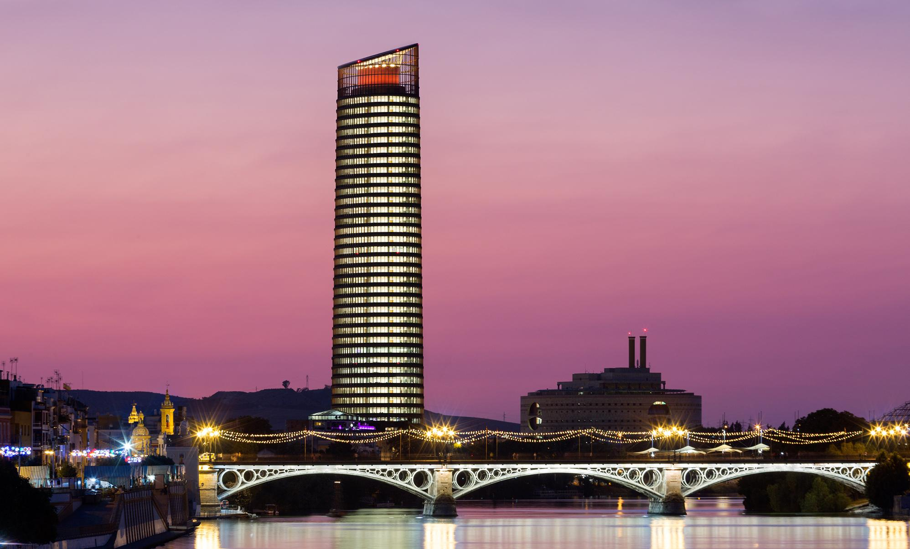
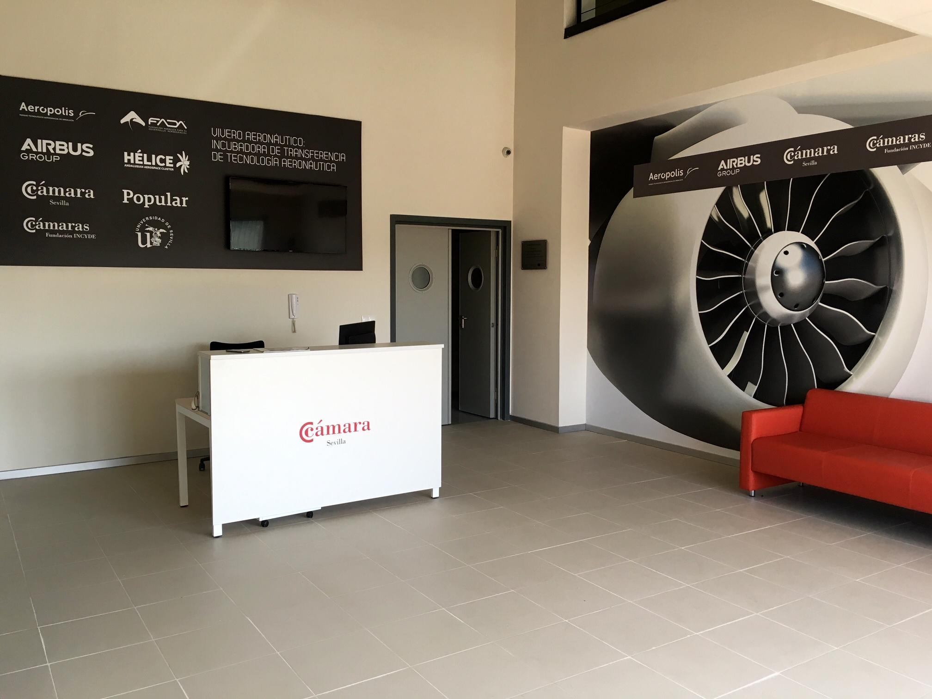

EUSA
University Center
Headquarters
Seville Tower, Business Club
Aerospace and technological transfer incubator in the Aerospace Park Aeropolis

Slide 4
MAIN SERVICES
SERVICES TO COMPANIES
Representation
Assessment and Counseling
Creation and development of businesses
Support to the internationalisation of companies
Training and Employment Services
Official Certificates
COOPERATION
with Other Chambers of Commerce
Spanish Councils of Chambers, ASCAME, AICO, EUROCHAMBRES
with Public Authorities
with Universities and Tech Centers
with Companies, especially SMEs
with European and non-European bodies

Slide 5
MAIN SERVICES
TRAINING AND EMPLOYMENT
Training for entrepreneurs and professionals, employees, unemployed people, etc.
University students and post-graduates (EUSA University Center – Seville)
VET/ Business School
Employment services: analysis of competences, internships, social programmes for disadvantaged groups, etc.
ENTREPRENEURSHIP
Supporting entrepreneurs in launching their projects
360º Office for start-ups
Business support program for women
Technical assistance for elaboration of business plans
SUSTAINABILITY AREA
Sustainable strategic plans assistance for companies and businesses.
Chamber of Commerce Spain's Sustainability Programme for SMEs.
Technical assistance with certifications and legal, regulatory and normative compliance in the area of sustainability.
Information on mandatory and voluntary registrations at the local, regional and national levels.
Training, awareness-raising and information on these matters.
Sustainability certificates
IS Biogas, CO-energy, C02 Compensation, EC Circular, F&B safe and sustainable

Slide 6

DESCRIPTION
EE4SMEs project is a initiative, co-funded by the European Union, that helps small and medium-sized enterprises (SMEs) to improve their energy practices.
The project has focused on sectors such as accommodation, food services, agri-food and metalworking. It has helped over 1,000 companies by carrying out energy audits, sharing best practice and encouraging the implementation of efficiency measures to reduce energy consumption and costs.
The EE4SMEs consortium consists of 23 implementing partners working together to support companies across 10 countries (Belgium, Austria, Bulgaria, Cyprus, Estonia, France, Germany, Italy, Malta and Spain).
Start Date: November 2022
End Date: October 2025

Slide 7
OBJECTIVES AND OUTCOMES
Improve energy management: Raise awareness and encourage SMEs to adopt sustainable energy management practices.
Support energy audits: Facilitate the implementation of energy audits to identify inefficiencies.
Implement efficiency measures: Help SMEs implement the recommendations from these audits, with over 1,000 measures having been implemented through the project to date.
Enhance cost-effectiveness: Improve the financial performance of SMEs by reducing energy waste and costs.
Share best practices: Adapt successful energy efficiency strategies from larger companies for use by SMEs.

Slide 8
Objectives – Seville Chamber of Commerce
7 energy audits for SMEs in Seville and the province
5 workshops/ seminars on energy efficiency aimed at SMEs (4) and business organisations (1):
Support participating companies with energy audit recommendations
Improve the skills and training of workers and professionals
Improve the skills and training of energy auditors
General Project Objectives (Europe)
151 (140) energy audits for SMEs
Support (more than) 1,000 companies through energy audit recommendations
Improve the skills and training of 1,000 workers and professionals
Improve the skills and training of 200 energy auditors

Slide 9
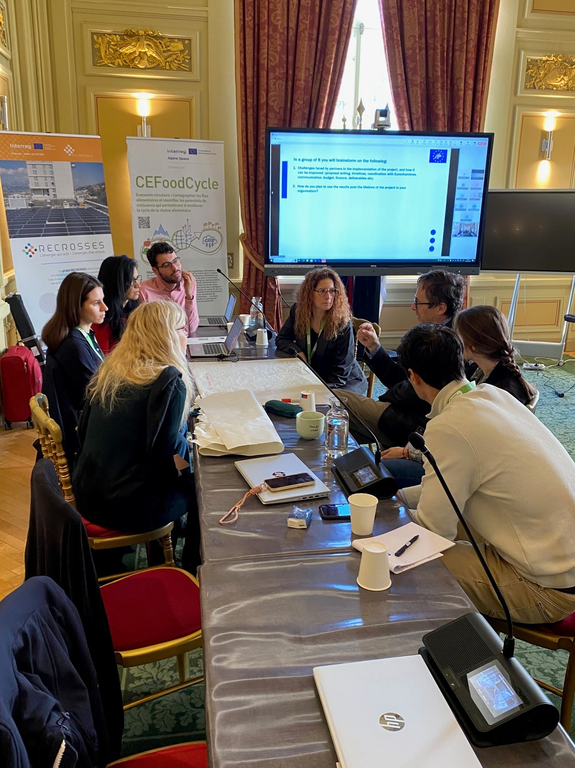
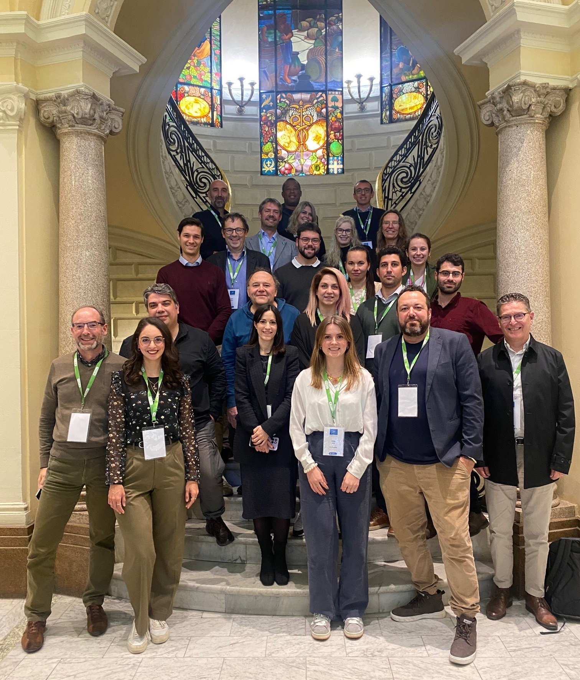
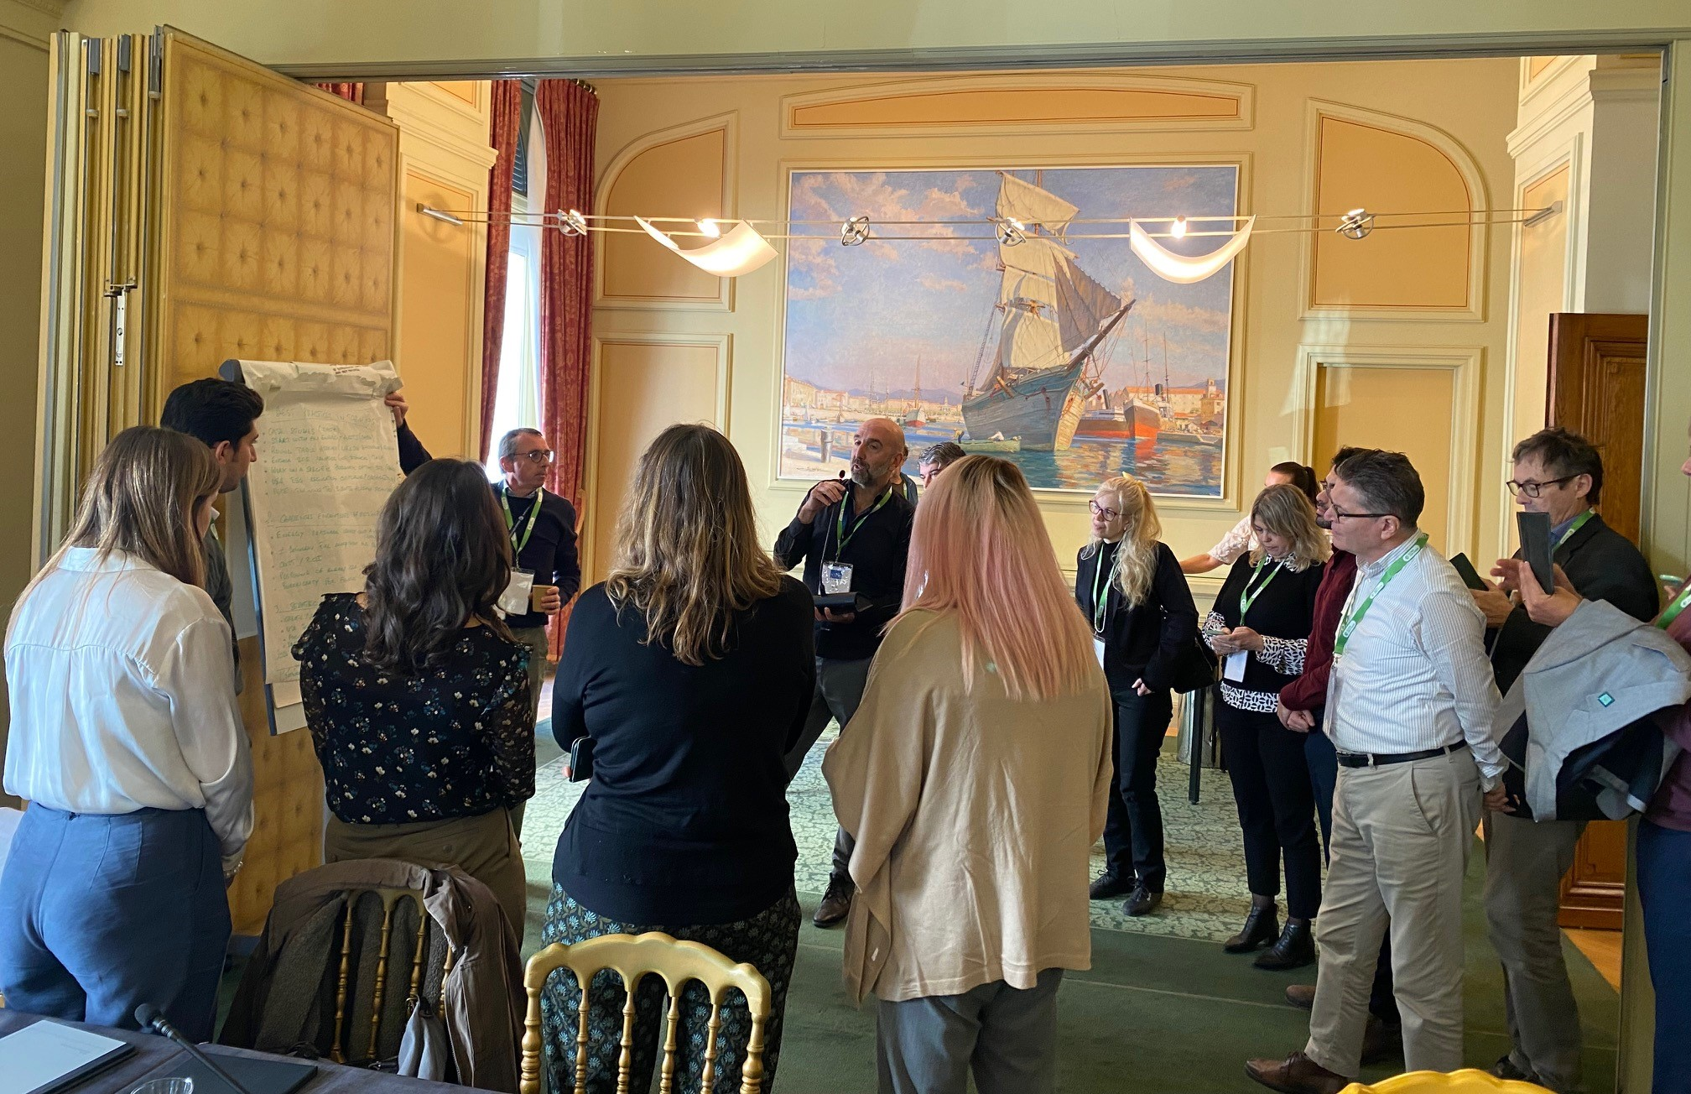
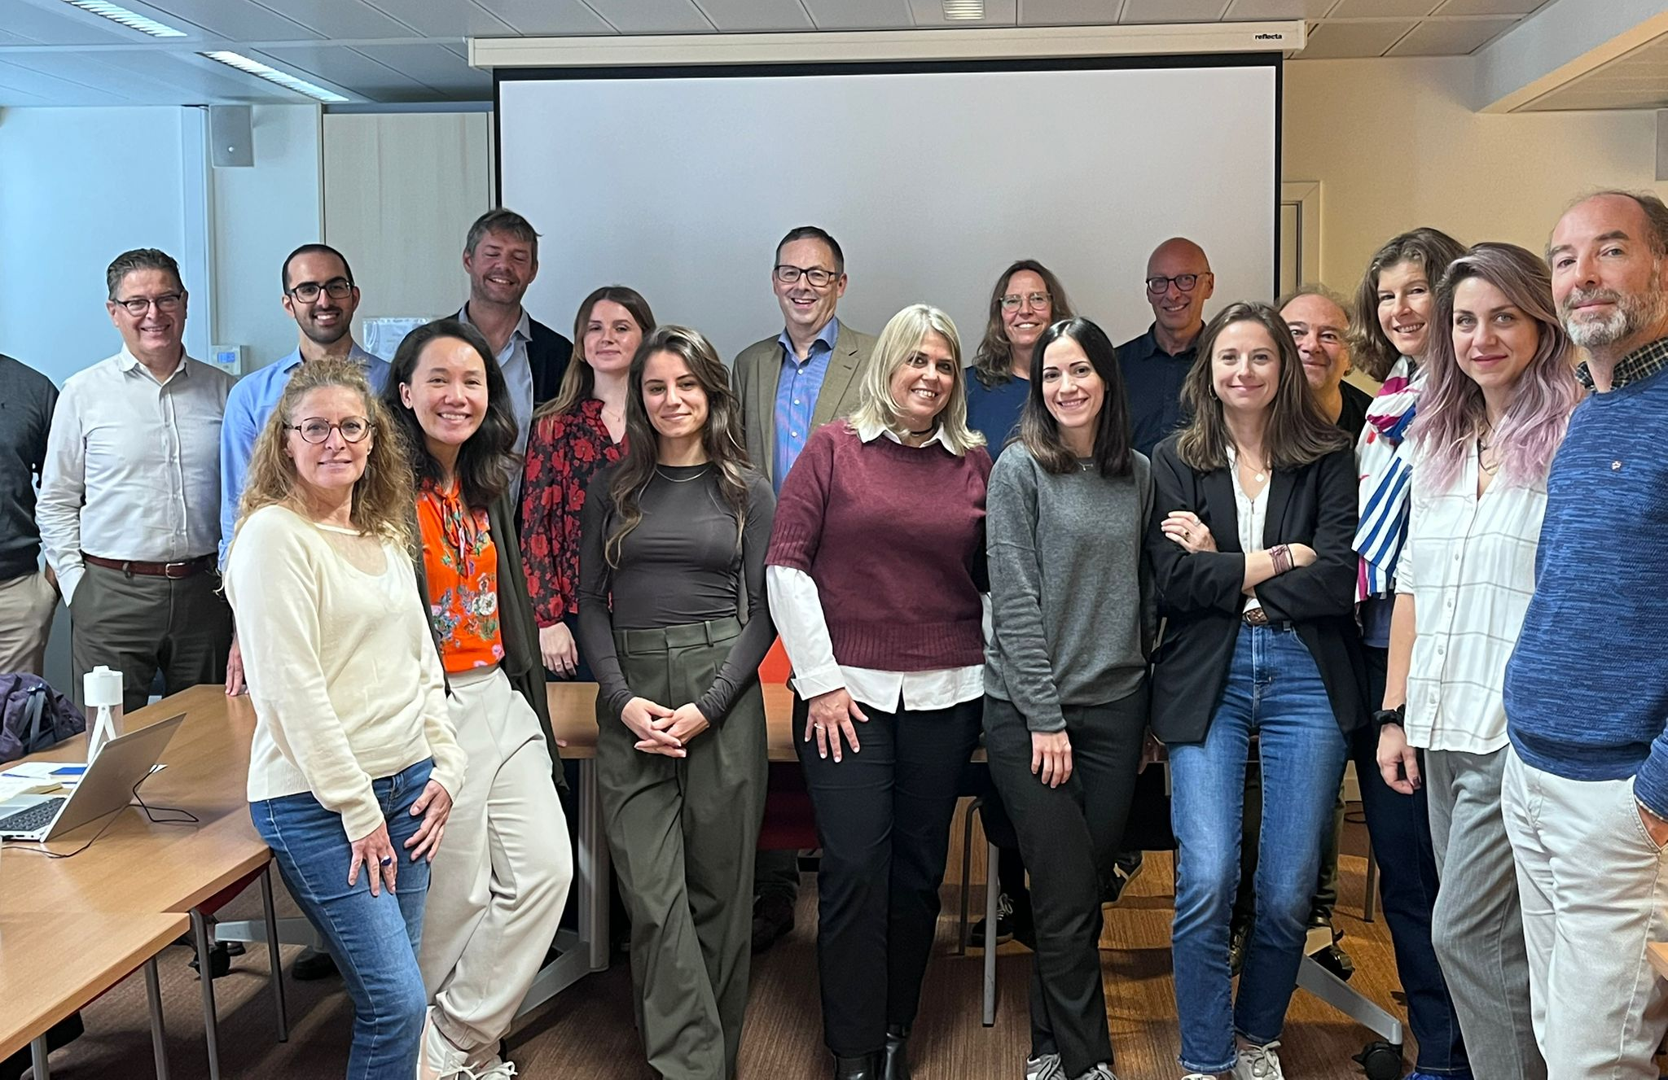
3 Transnational meetings
Kick-off meeting in Brussels (Belgium) in January 2023
Train the Trainer Workshop in Nice (France) in November 2024
Final Conference in Brussels (Belgium) in October 2025

Slide 10
HOW THE PROJECT CAN HELP
Provides resources: The EE4SMEs project website offers tools, best practices and an e-learning platform to guide SMEs through their 'green transformation.
It focuses on action: The project transitions from technical insights to the real-world implementation of efficiency measures (lighting, renewable energies, distribution networks and insulation, energy management, facade/ roof thermal insulation, heat pumps and heat recovery, industrial furnaces, office space, optimisation, pumps, raising staff awareness, ventilation, reduction in fuel consumption and gas emissions).
It encourages policy integration. It aims to embed SME-focused energy strategies into national and EU policies.
The overarching goal is to empower SMEs and significantly improve energy efficiency, promoting sustainable practices within targeted SME sectors.

Slide 11
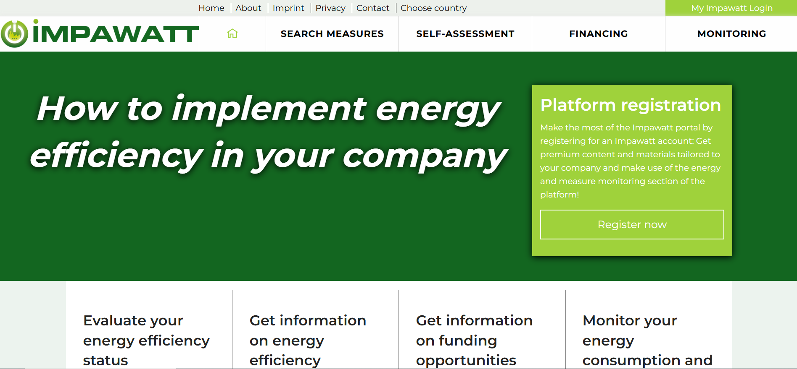
IMPAWATT PLATFORM

Slide 12
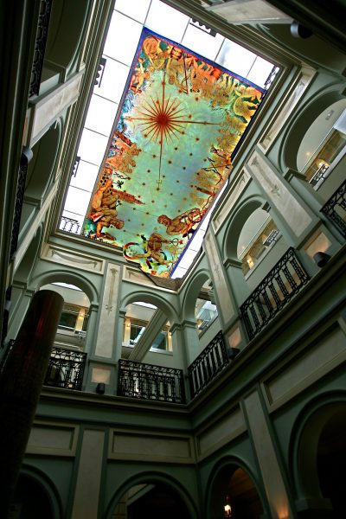
THANK YOU
Seville Chamber of Commerce
EU Projects Department
Nazaret Calzado
nazaret.calzado@camaradesevilla.com

