Slide 1

Welcome!
Inspiring more sustainable consumption
Agenda
17:00 – 17:20
Drinks, nibbles, intros
17:20 – 17:45
Overview of insights
17:45 – 18:30
Response & discussion
Purpose of today
Communicating about sustainability is challenging for brands
Not everyone requires the same message or has the same barriers to adopting sustainable actions
We wanted to bring to together thought leaders from across sectors with insight and communications expertise to present new data, discuss and debate the issue...
...with the aim of sharing learnings and starting to suggest solutions
Rules
There are no rules!
But seriously, Chatham House rule
Honest feedback and thoughts are actively encouraged
Share whatever you like with colleagues or on social media
All content will be shared after the session. We would also be delighted to come and talk your teams through our findings
Notes:
Introduction around the room – your name, your company and one key challenge you face when it comes to either encouraging more sustainable behaviour among consumers or communicating your companies sustainability claims and actions?

Slide 2
Inspiring more sustainable consumption
A behavioural segmentation & AI analysis

Slide 3
Why are we doing this?

Slide 4
We need to be more sustainable to give individuals, communities
and our planet a chance of a prosperous future. Business has a key role to play, alongside government, to support this.
Our responsibility
People tell us they want to make more sustainable consumption choices – but it can be challenging, the actions they want to take and barriers to doing so differ widely.
Challenge
To address such broad and necessary societal changes, we firmly believe in meeting people where they are in their behaviours and attitudes to establish new solutions for sustainability communications.
Our approach
We identified 6 behavioural segments from our research.
This helped to better understand people’s sustainable consumption behaviours and the barriers they face.

Slide 5
What did we do?

Slide 6

To better understand consumer behaviour, we ran a multinational survey
4 markets: UK, US, Germany and India.
8,000 participants in total.
We showed them a list of sustainable actions and asked them to choose up to 3 that apply to them.
Based on dominant sustainable actions individuals are taking we identified 6 segments.

Slide 7


We augmented our analysis with AI
We analysed 8,000 verbatim answers to the question ‘What do you see as the biggest challenges to you shopping in a more sustainable way?’
From this we identified 6 central barriers that prevent people from consuming more sustainably.

Slide 8
What sustainable behaviours set people apart?

Slide 9

BEHAVIOURS
Below is a list of things people can do to be more sustainable.
Which, if any, of these do you do the most?
Pick up to 3
Notes:
Approach
Survey of more than 8,000 individuals with 2,000 in each of the UK, US, Germany and India
Insight
6 distinct segments based on an analysis of their current sustainable behaviours

Slide 10
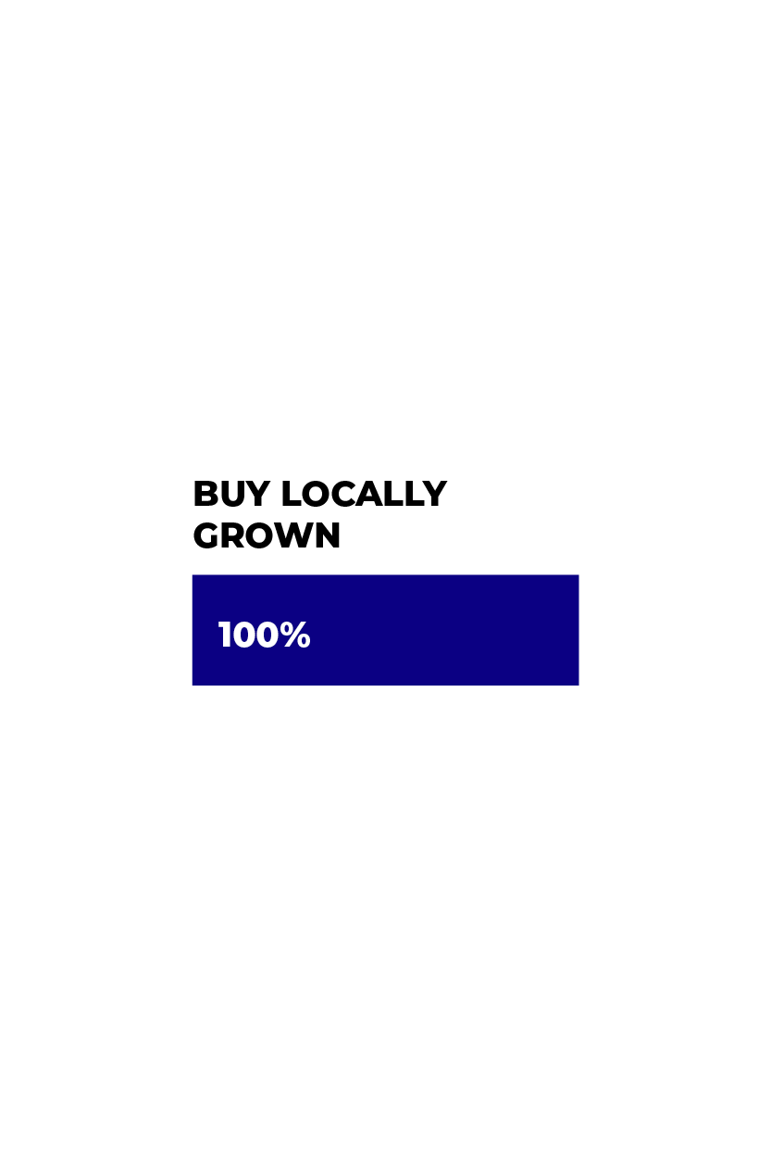
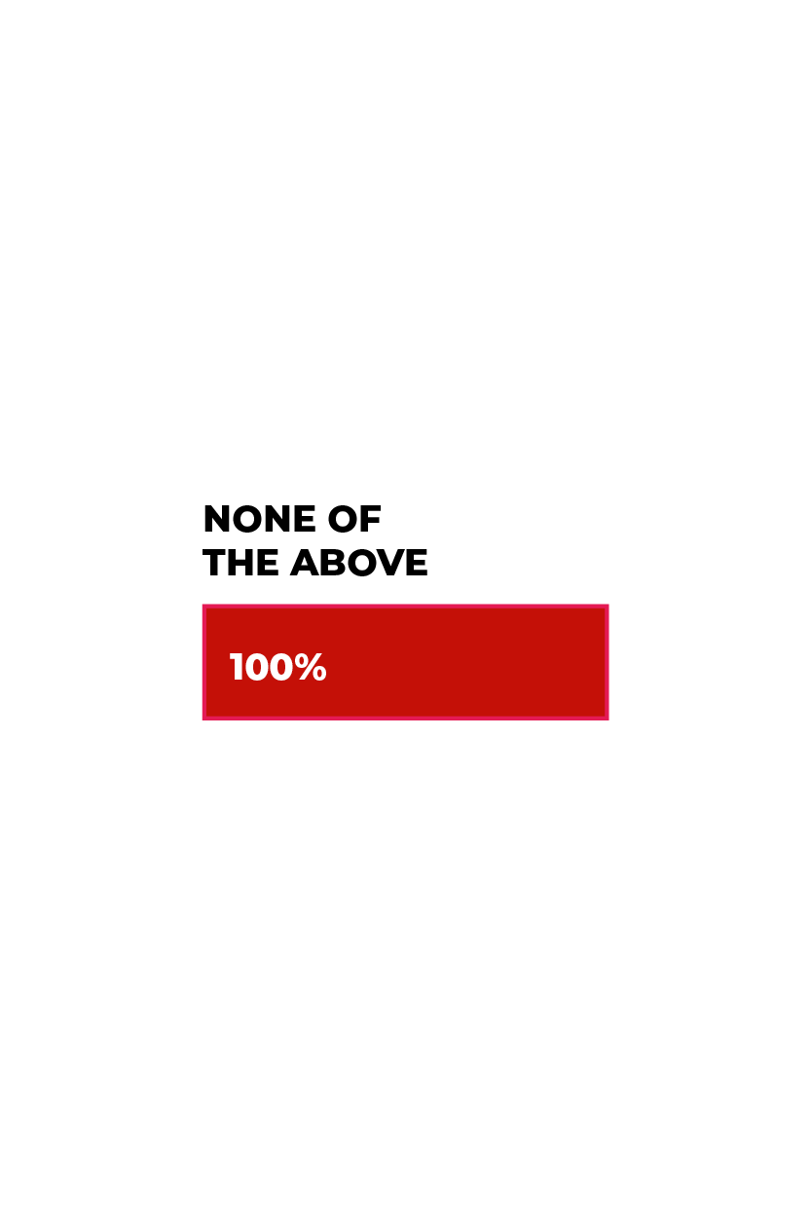
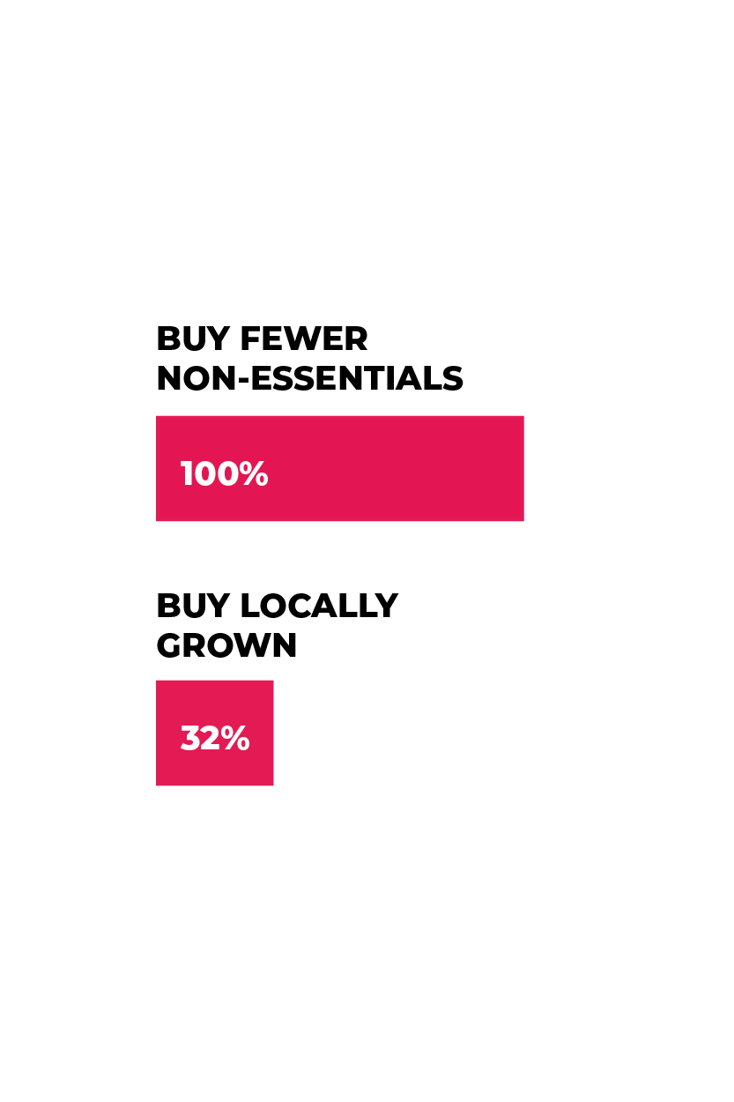
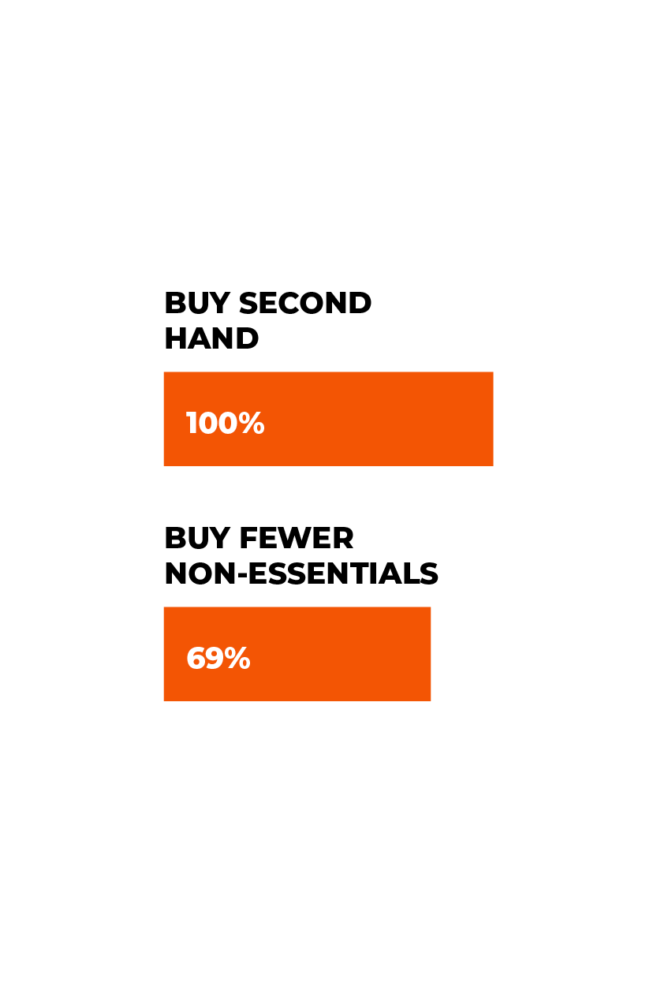

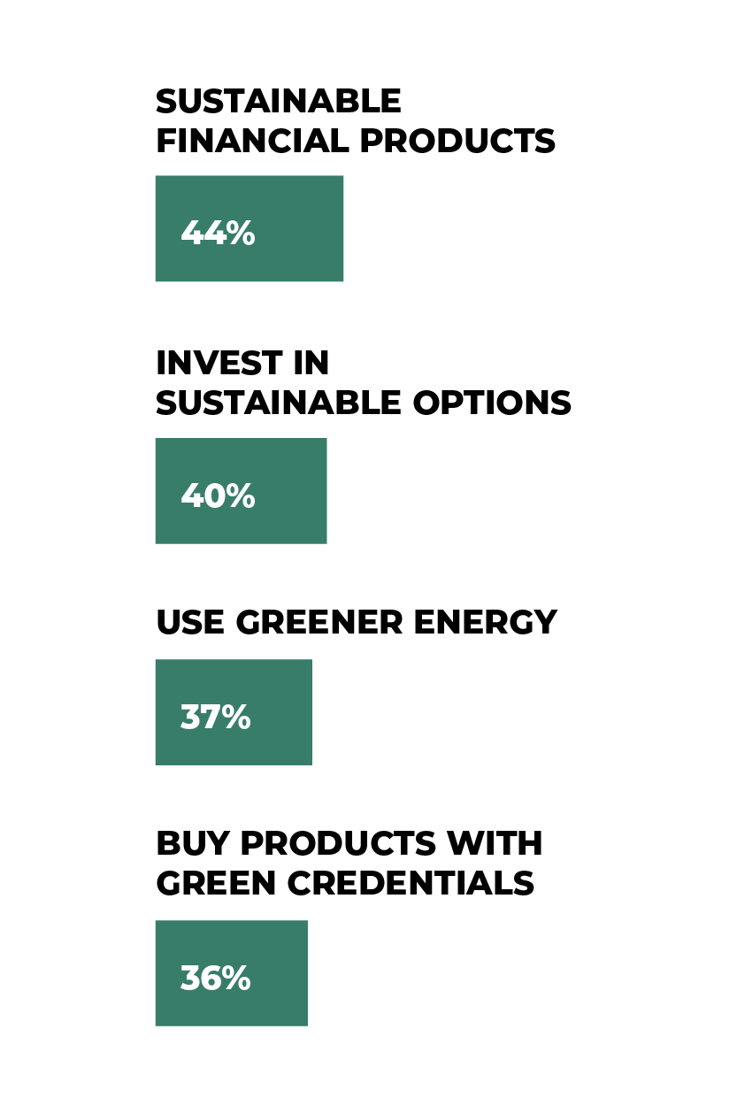
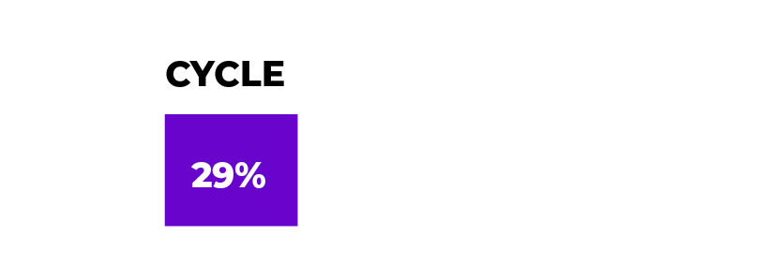
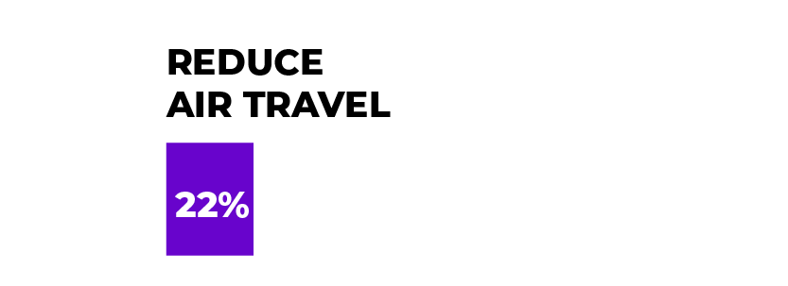
THE SEGMENTS
6 Segments characterised by their dominant sustainability behaviours
Reducers
Green
Movers
Local Champions
Thrifters
Green Investors
Do
Nothings
Notes:
Approach
Survey of more than 8,000 individuals with 2,000 in each of the UK, US, Germany and India
Insight
6 distinct segments based on an analysis of their current sustainable behaviours

Slide 11
SEGMENT OVERVIEW
Do Nothings
8%
14%
25%
Green Investors
Reducers
Thrifters
14%
Green Movers
23%
Local Champions
16%

Slide 12

There is more apathy towards sustainability in UK & US in comparison to India where sustainable consumption and investment is gaining momentum.
COMPARING SEGMENTS ACROSS MARKETS
“
There is far too much placed on ethical ways, very woke, I'm getting fed up with it and will not purchase from any company that follows this group thinking.”
“
You want to shop ethically and make sustainable shopping choices to reduce your impact on the planet and people. There are many issues - carbon emissions and work exploitation.”
Reducers
Green
Movers
Local
Champions
Thrifters
Green
Investors
Do
Nothings

Slide 13








REDUCERS – DEEP DIVE
Reducers
Profile
Lower life satisfaction
Pessimistic outlook
Highly brand loyal – especially utilities and home products
Attitudes
25%
Average age
47
I feel guilty for buying anything that's in plastic containers
I find less choices for ethical and sustainable shopping, due to which I get less opportunities to try a new variety of products
What can we learn from them?
Reducing is a low barrier sustainable action
Consciously determining essentials from non-essentials
“
WESTERN
Highest proportion
of over 55s
YOUNGER
OLDER
”
Joint most pessimistic about
climate change (with Thrifters)

Slide 14

GREEN MOVERS – DEEP DIVE
Green Movers
Profile
Relatively optimistic
Sceptical of purpose comms
Shop around – especially for entertainment
Attitudes
23%
Average age
40
As an average consumer you can't really check it (sustainability), you only see at the end that it's not true
Shopping ethically and sustainably takes a lot of time, energy and ability to decide
What can we learn from them?
Low barrier sustainable action, depending on infrastructure
Choosing to invest effort and time rather than finances
“
Largest segment
in Germany
Smallest
in US
40% U35, second youngest
behind Green Investors
YOUNGER
OLDER
”
Joint least likely to have
kids

Slide 15



LOCAL CHAMPIONS – DEEP DIVE
Local
Champions
Profile
High satisfaction with life
Willing to spend on ethical/sustainable
Shop around – especially for clothing
Attitudes
16%
Average age
45
(I want) locally produced products or goods. Fair trade and environmentally friendly
I mostly buy from the local sellers from whom I have been buying for years
What can we learn from them?
Motivated by felt consequences of climate change
Nuanced understanding - local = sustainable
Spending power in local areas
“
Greater representation in India (37% of this segment).
Financially comfortable
(43% earn $50k+).
Most concerned about extreme weather as a consequence of climate change.
”

Slide 16
THRIFTERS – DEEP DIVE​
Thrifters
Profile
Most pessimistic outlook – especially the economy
Lowest satisfaction with life
Brand loyal – except for financial products
Attitudes
14%
Average age
42
Love shopping at second-hand stores along with finding great coupons
I try to buy second hand as much as possible, but it can be expensive to buy sustainable products
What can we learn from them?
Overlap of financial reality and sustainable ideals
Experiential satisfaction of being a savvy shopper
“
Dominated by the
US and UK.
Majority female (71%)
”
Low to middle income.

Slide 17
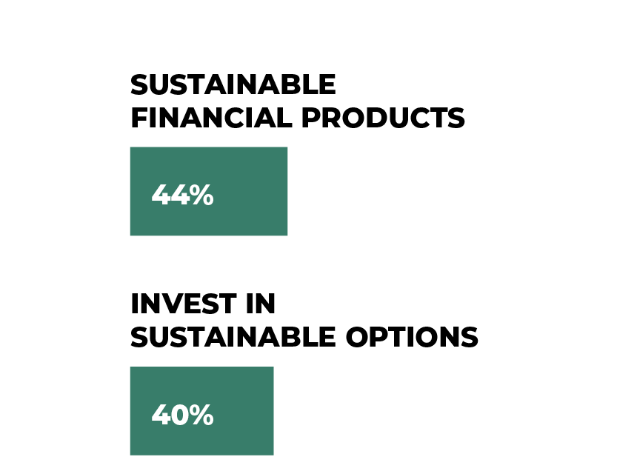
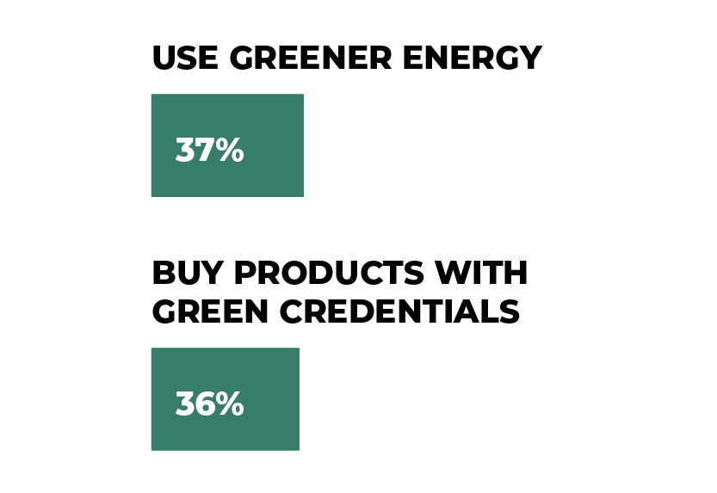

GREEN INVESTORS – DEEP DIVE
Green
Investors
Profile
Highest satisfaction with life
Most optimistic outlook
Most open to hearing more about brands’ ethics and sustainability
Attitudes
14%
Average age
38
Ethical and sustainable shopping is not about depriving yourself, but instead thinking about how your purchase choices can reduce your impact on people and the planet
What can we learn from them?
Sustainable investment sits across spend categories and financial products
Europe, US and women under-represented – why?
“
Heavily weighted towards India (50% of this segment).
Youngest segment
Most likely to have kids at home.
”
The least brand loyal across a range of categories.
Notes:
US: M 63% / F 37%
UK: M 71% / F 29%
Germany: M 56% / F 44%
India: M 52% / F 48%

Slide 18
DO NOTHINGS – DEEP DIVE
Do Nothings
Profile
Lower satisfaction with life
General disengagement with issues – except the economy
Little interest in brands’ sustainable messaging
Attitudes
8%
Average age
44
“
Companies should concentrate on making excellent, high-quality products/services and leave wokey claptrap virtue signalling on the shelf where it belongs
These days, due to inflation, I must prioritize the cost (over sustainability)
What can we learn from them?
Combine active anti-sustainability with green fatigue
Felt exclusion of lower income groups
Lowest income group
(43% earning under $30k).
Highly brand loyal
across categories (especially groceries and electronics)
”
Notes:
US: M 42% / F 58%
UK: M 54% / F 46%
Germany: M 50% / F 50%
India: M 62% / F 38%

Slide 19
Given we want to inspire more sustainable action, how easily convinced are our segments?

Slide 20


The desire to consume sustainably is there
‘This includes 43% of the
‘Do Nothing’ segment
“
‘% who want to act
more sustainably
The biggest challenge is promoting more ethical and sustainable shopping practices that require a change in consumer behaviour
TOTAL
“
93%
Making an effort by moving toward a lower carbon footprint means a great deal to me
So, what is holding them back?
92% across markets are acting to be
more sustainable
The vast majority, 93%, would like to do even more
People care about the planet, nature & people

Slide 21

The majority hold a sceptical view of purpose driven communications
HOW RECEPTIVE IS EACH SEGMENT TO PURPOSE DRIVEN COMMS?
“
“
Greenwashing and a general scepticism towards large corporations. If Lidl only pays 2% taxes in Germany it doesn't do anything for me that the roll bag is made from recycled paper. People have lost their trust in many ways. Unfortunately.”
It's really difficult to believe adverts and what we are told on the packaging. Sometimes companies do not list all the ingredients in a food package or a product. Most customer reviews also cannot be trusted.”
I find it hard to believe adverts from companies claiming they are doing something good
% Agree
66%
70%
71%
66%
75%
51%
Reducers
Green Movers
Local Champions
Thrifters
Green Investors
Do Nothings

Slide 22
What holds people back from making sustainable choices?

Slide 23






AI-driven analysis reveals 6 primary barriers
Missing regulation
No one knows who is in charge – lack of central regulation of what is ‘sustainable’
Distrust
of companies’ true intentions – greenwashing has eroded perceptions of authenticity
Lack of availability
It is more effortful to make the sustainable choice
Priced out
The financial cost outweighs the benefits
Lack of transparency
No clear, easily available info
Don’t care
Genuine disengagement
and green fatigue
‘What do you see as the biggest challenges to you shopping in a more sustainable way?’

Slide 24
AI-driven analysis reveals 6 primary barriers
While there is some natural variation, these barriers apply across markets and across segments
Missing regulation
No one knows who is in charge – lack of central regulation of what is ‘sustainable
Distrust
of companies’ true intentions – greenwashing has eroded perceptions of authenticity
Lack of availability
It is more effortful to make the sustainable choice
Priced out
The financial cost outweighs the benefits
Lack of transparency
No clear, easily available info
Don’t care
Genuine disengagement
and green fatigue
‘What do you see as the biggest challenges to you shopping in a more sustainable way?’

Slide 25
BARRIERS
Whilst barriers are common across segments, some resonate more strongly than others.
Reducers
Main barrier –
Missing regulation
Secondary barriers – Priced out & Distrust
See the lack of central regulation as a license for brands to not be held accountable for delivering more sustainable options.
Even if central regulation was in place, it is unlikely they will consume beyond what is necessary as reducing consumption is their path to sustainability.
Green Movers
Main barrier – Distrust
Secondary barrier – Priced out
Their suspicion and distrust of companies to provide truthful information that is not ‘greenwashing’ holds them back in making sustainable choices.
The higher cost of sustainable products is also a central barrier as many green movers’ mode of transportation started out of financial necessity.
Local Champions
Main barrier –
Lack of availability
Secondary barrier –
Lack of transparency
Though they desire to support local business, the lack of variety and choice in their immediate area is key barrier to consuming more sustainably.
They also feel there is a lack of readily available information – it is not clear where to best find sustainable products and how to identify them.
Thrifters
Main barrier –
Priced out
Secondary barrier – Missing regulation
Tendency to operate with a smaller budget makes the perceived cost of sustainable products their biggest barrier.
Circular economy helps balance costs with sustainability, therefore second-hand appeals over cheaper unsustainable products.
Green Investors
Main barrier –
Lack of transparency
Secondary barrier – Missing regulation
Lack of transparency and reliable information about companies hinders them making more confident investment choices.
Looking for, and willing to invest in, the sustainable option but need a clear hallmark of sustainability.
Do Nothings
Main barrier –
Don’t care
Secondary barriers – Distrust & Priced out
Simply do not engage with the environmental or ethical agenda and question the need for sustainability.
They also point to a distrust in companies due to the volume of green messaging and the unaffordability of sustainable choices.
25

Slide 26
COMMUNICATIONS
What does this say about sustainability messaging?
Reducers
A logical conclusion in our late capitalist era of excess (and now scarcity of public resources) – is this tapping into a deep-rooted need for less, in a time of overload?
Does this point to a need to completely recalibrate comms and the advertising world?
Green Movers
Their lifestyle choices already align with ‘greener’ options – would they be doing this anyway?
But you can build a positive ‘halo’ effect by clearly communicating their choices make a difference. And make sure the cost-effective nature of their sustainable choices are front and centre to drive this.
Local Champions
Connect global brands with local initiatives – and how their purchase power can and does make a difference – require an empowering message and to feel actively involved in their choices.
But the current information they access feels confusing – how can it be clearer amidst the range of behaviours and products they engage with?
Thrifters
Win-win messaging in a cost of living crisis - buy less, walk more, reduce temp of heating – all save money and are good for the planet.
But where does that leave retail propositions that require more units sold, not fewer?
Green Investors
Aspirational for those who feel they can afford it – making the choice to invest in better is an empowering message.
But there are additional layers of complexity to communicate which may fall flat - e.g. in recent labelling research, Green Improvers least well understood.
Do Nothings
More than just a lack of engagement – for some this is an active rejection of sustainability actions and the need to act, aligned with broader social and political allegiances.
Given high levels of distrust among this group could they ever be persuaded? Will this group grow or shrink over time?
26

Slide 27
COMMUNICATIONS
Key principles to take from this:
A new paradigm for consumption? Not about buying more but buying better – that can mean different things for different people but speaks to most of the segments’ behavioural choices (and sense of agency).
Keep it simple: Avoid complex claims that lack ‘ambition’ - even if they are impressive to experts e.g. by 2040, 80% of our transport will be ‘clean’.
It is not about you: make it about them (and aspirational): many brands talk about what they are doing – but people want to hear how they can help and make the right choice whilst living their life.
…But calibrate it carefully: there is only so much consumers can do, don’t put it all on them – do the right thing as a business, talk about what matters to them and how they can help and don’t expect everyone to like it. Who is your main customer? How can you help them?
27

Slide 28
DISCUSSION
What stands out about the segmentation? How could you use this?
Is there a need to revolutionise communication about sustainability (both the actions people can take and claims from brands)?
If so, what are the key principles – can there be aspirational sustainability?
28

Slide 29

Thank you!
cmcnaughtonnicholls@thinksinsight.com
jedwards@thinksinsight.com
T: +44 (0)20 7845 5880
www.thinksinsight.com
Thinks Insight & Strategy
West Wing
Somerset House
London
WC2R 1LA
United Kingdom

