Slide 1





RETURNING TO A DIFFERENT WORK ROLE, FOLLOWING AN ACQUIRED BRAIN INJURY
Dr Nisha Chauhan, Clinical Psychologist
University of Hertfordshire

Slide 2
SETTING THE SCENE
Thinking about your current job or day to day...
How did you get to where you are now?
How much does your job or day to day impact you?
How much do these tie to who you are as a person?

Slide 3
SETTING THE SCENE
Thinking about if you had to change career
or day to day activities...
What impact would this have on your life?
What impact would this have on who you are?
The impact of this change following ABI is what the research explored

Slide 4
BACKGROUND
Capitalism and work – how did we get here?
The journey to employment has been complex (Feudalism-Mercentalism-Capitalism). However, it’s complexities have led to the systems we are in now, as well as how we view work (meritocracy).
Working and the self in the context of the UK and the West today
This history has shaped a view of the position of work in our society, and what it means to not work or being unable to work. This has had a trickle down affect on disability and disablement (ableism).
The welfare state, austerity and work
This is further impacted by changes in the welfare system, how benefits are seen within the UK, and what it means to be ‘unemployed.’
The interruption of work
Because of these views and history, when we are unable to work, this can have a multifaceted effect on individuals.

Slide 5
HEALTH AND RTW
Systematic Literature Review:
It was found that many factors within the return to work (RTW) process impacted this, including navigating through many changes when RTW, the support received by others, the impact of the welfare state and money, and the journey to finding a sense of identity again.
Findings:
The results identified a difference when comparing ABI to other physical health issues discussed, where the impact of ABI is long-standing (Powell & Clarke, 2006) and the experience of returning to normalcy is not possible. This often resulted in return to a different work role (RTDW).

Slide 6
RESEARCH SET-UP
RECRUITMENT
& ANALYSIS
OBJECTIVES
To see what literature already existed (SLR)
To see if the project was worthwhile (co-production)
To inform how the research might be best carried out
Interpretative Phenomenological Analysis (IPA)
Eight participants from diverse backgrounds recruited with help from the service
ETHICS &
SETTING UP
University Research Ethics Committee (REC) and the NHS Ethics approval
Research materials were coproduced with Expert by Experience

Slide 7
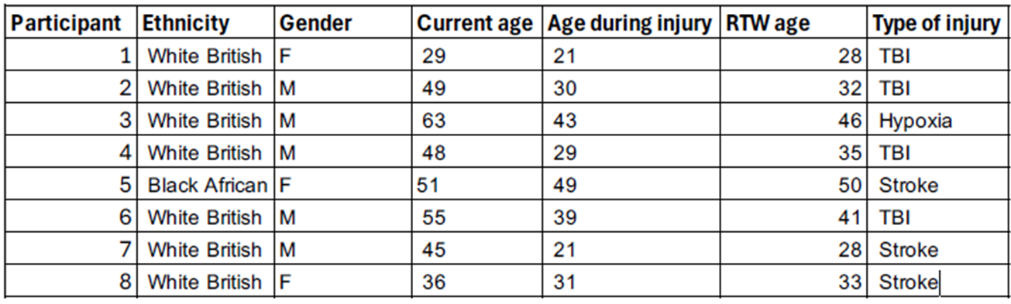
OUR PARTICIPANTS
Table 1: Participant Demographics

Slide 8
OUR PARTICIPANTS
Team lead
IT project manager
Warehouse worker
Catering
IT manager
Nursery assistant
Accountancy
Charity administration
Account manager
Retail assistant
Mini bus driver
Domestic staff
IT manager
Porter
Retail assistant
Rehab assistant

Slide 9
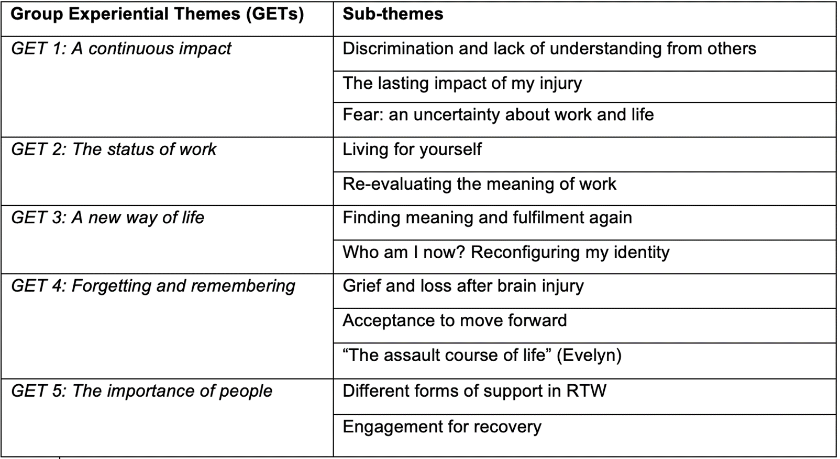
FINDINGS
Table 2: Group experiential themes and sub-themes

Slide 10
GET 1: A CONTINUOUS IMPACT
“Everything’s moved around, I said. […] And eventually they had to put it back to where you had it. It wasn’t something I could help. […] I said, ‘I don't think you understand what you’re doing.’ You know, you understand what, like a brain injury can do.”
“It was frustration because you couldn't do the things that you felt like you could do. You go up and do something and all of a sudden you just go blank. And you'd forget what you were doing.”
“See, I think it's probably the best because I mean if you plan it too far… It doesn’t work out that way.”

Slide 11
GET 2: THE STATUS OF WORK
“I really was setting myself on fire to keep nobody alive.”
“Would I go back to London and do something similar to what I was doing before and thinking about it? Like, do you know what? A part of me is like, yeah, let's bring it on. I can do it again. Then part of me is like, no, don't do that because it goes back to that constantly comparing thing, putting myself in that role. Again, I'm not the same person. I can't do what I used to be able to do. I can't work at that standard, at that intensity, at that pressure anymore.”
“That was quite a big realisation of, oh, actually I can still contribute to society. You know, I'm still a valuable member.”

Slide 12
GET 3: A NEW WAY OF LIFE
“Yeah, I'm a lot more empathetic. Yeah. It's probably because what happened was a bit shit. But yeah, I'm just a lot more empathetic and because I often need help to find the words that I'm trying to say. It makes me like, think about what I'm saying a lot more. So, it like, slows me down a little bit.”
“Well, well, like, when I stopped drinking, I was looking at, like, positive aspects of my life and thinking, actually, for much of it, you were a bit of sort of like a lazy little s***. Umm, actually, you weren't. You were actually quite hard working, and if you want something, you f****** got it.”

Slide 13
GET 4: FORGETTING AND REMEMBERING
“Because, like, I'm never going to know what would have been. […] I'm never going to know what I would have done. Like I'm never going to know if I would have got into [army training]. I'm never going to know if I would have been a good police person. […] Who knows? Because, that whole thing, [was] taken away from me.”
“Part of that is just partly denial, partly just not being capable of understanding the situation because probably I don't know whether itself. I mean I speculate that it’s a self-protection mechanism because when you're like that horrific, your brain can’t cope with it. So, it just shuts down. I came out of that fog over however long my brain decided it was safe to allow it to do so.”
“I don't think I will ever get to that highest level assault course again. I don't think I'll ever be a front runner again. I don't have the brain power to get me there, but I’m certainly not on the beginner’s course anymore.”

Slide 14
GET 5: THE IMPORTANCE OF PEOPLE
“And teach me how to write my CV. Which is the one I told you I was scared and doing the interviews. How to pitch yourself. You're good at selling. So, you can tell who you are. Definitely. So, I learned a lot to have a confidence back and to face everything.”
“I think if I hadn't had the kids, I think things would be a lot more different. I don't know. Would I carry on my life?”
“It's just so different and like I would put myself on the line […] for my teammates.”

Slide 15
CONCLUSION
  Identity can be relevant to the job we hold
  When this is threatened, meaningful identities can be found in other areas instead
  The importance of employment is not linear and does not have to hold the level of importance given to it by society and social expectations
  These expectations may have led to those we work with to have lived a life pre-injury that they were not proud of, on reflection
  Reconsidering the meaning of employment may result in finding new meaning elsewhere
  However, this journey can take time and space

Slide 16
CONCLUSION
“[…] Thinking, ‘I should be able to do everything.’ And then suddenly not being able to do any of it. And certainly not in the same way. Dealing with having to live with the new person you've become, which is maybe the person I was always meant to be in the first place anyway.”

Slide 17
CLINICAL RECOMMENDATIONS
  Use of acceptance and commitment therapy (ACT) and neuropsychotherapy as alternative ways of providing a Clinical Psychology provision where service users could be helped to reflect on who they were and continue to be
  Consideration of narrative approaches in vocational rehabilitation may help individuals make further sense of their experiences and accept new realities as a result of their injuries
  Changes to the welfare state to allow time for meaningful therapeutic work to be explored

Slide 18

FUTURE OF RESEARCH & CALL FOR CHANGE
  Call to change in welfare – in line with new NICE guidelines for rehabilitation (personalised assessment – “whether needs change over time”)
  Recent budget announcements – eligibility to SSP, UC reductions
  Research into the immediate change when RTDW – what does this mean for newly RTDW individuals?
  Reflect on the welfare state and it’s impact on vocational rehabilitation

Slide 19
REFERENCES
Demir, I. (2022). How and Why Should We Decolonize Global Health Education and Research? Annuals of Global Health, 88(1), Article 1. https://eprints.whiterose.ac.uk/187565/
Ellis, D. W. (1989). Neuropsychological Treatment After Brain Injury. Springer Science & Business Media.
Rauwenhoff, J. C., Bol, Y., van Heugten, C. M., Batink, T., Geusgens, C. A., van den Hout,A. J., Smits, P., Verwegen, C. R., Visser, A., & Peeters, F. (2023). Acceptance and commitment therapy for people with acquired brain injury: Rationale and description of the BrainACT treatment. Clinical Rehabilitation, 37(8), 1011–1025. https://doi.org/10.1177/02692155231154124
Schofield, T. P., Haslam, N., & Butterworth, P. (2019). The persistence of welfare stigma: Does the passing of time and subsequent employment moderate the negative perceptions associated with unemployment benefit receipt? Journal of Applied Social Psychology, 49(9), 563–574. https://doi.org/10.1111/jasp.12616
Tajfel, H., & Turner, J. C. (2014). The Social Identity Theory of Intergroup Behavior. In K. Kawakami (Ed.), The Psychology of Prejudice (1–Book, Section, p. II1). SAGE Publications Ltd.
Tyerman, A. (2020). Vocational rehabilitation. In V. Dietz, N. S. Ward, C. Kennard, V. Dietz, & N. S. Ward (Eds.), Oxford Textbook of Neurorehabilitation (p. 0). Oxford University Press. https://doi.org/10.1093/med/9780198824954.003.0027
Van Dyk, S. (2018). Post-Wage Politics and the Rise of Community Capitalism. Work, Employment and Society, 32(3), 528–545. https://doi.org/10.1177/0950017018755663
Watson, T. J. (2008). Managing Identity: Identity Work, Personal Predicaments and Structural Circumstances. Organization, 15(1), 121–143. https://doi.org/10.1177/1350508407084488
Wolfensberger, W. (2011). Social role valorization: A proposed new term for the principle of normalization. Intellectual and Developmental Disabilities, 49(6), 435–440. https://doi.org/10.1352/1934-9556-49.6.435

Slide 20
THANK YOU FOR LISTENING
nisha.chauhan5@nhs.net

