Slide 1

The Disability Employment Charter: a progress update
Professor Kim Hoque, King’s College London and Disability@Work
kim.hoque@kcl.ac.uk

Slide 2
Disability employment gap 2013-2025

Slide 3
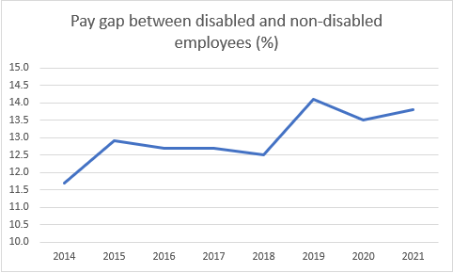
Disability pay gap
(ONS calculations):

Slide 4
Other outcomes – ‘in-work’ experience
Disability gaps have been identified (e.g. Hoque et al. 2017; Jones 2007; Jones 2016; Schur et al. 2009) regarding in-work experience in relation to:
    wellbeing
    job satisfaction
    contentment
    fairness perceptions
    work-life balance

Slide 5
Key question: what can be done to address disability employment disadvantage?

Slide 6
Focus of government policy
Governments have typically focused on the supply side – getting people off benefits, into job seeking activity and into work
  Individual Placement and Support
  Connect to Work
  Jobcentre Plus work coaches
  Benefits green paper (Pathways to Work)
BUT: greater focus is needed on the demand-side (i.e., the barriers disabled people face in getting into work, the design of jobs, and employer attitudes towards disabled people)
How are organisations doing on this?

Slide 7
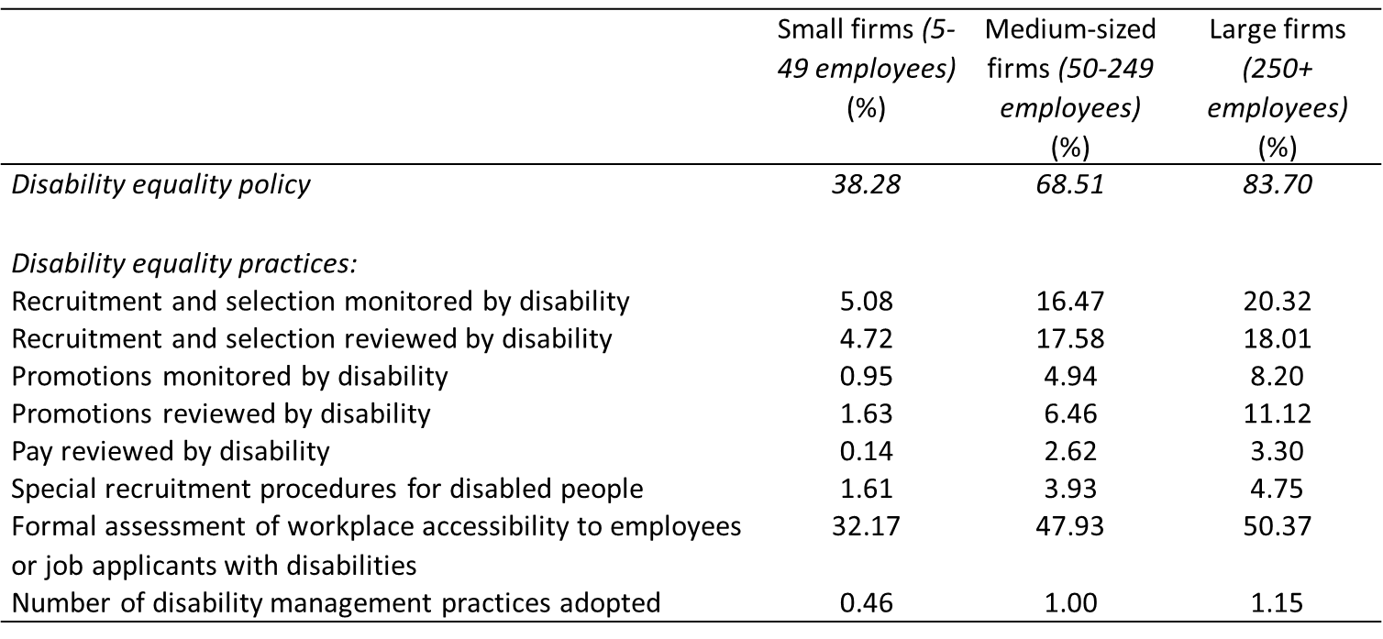
Disability management policy and practices in small, medium and large firms
All private sector workplaces
WERS 2011

Slide 8
How might the government encourage employers to improve their disability equality practices, and thereby improve disabled people’s employment outcomes?

Slide 9

the government’s main scheme to encourage employers to improve their disability employment outcomes
Three levels: committed, employer, leader
DWP estimate that 11 million people work in 19.5k Disability Confident organisations
Does it actually work?
In short (as I outlined in detail in my last presentation) – no. Our evidence based on approx. 128k employees in the WorkL database shows Disability Confident employers do not employ disabled people in proportionately greater numbers than non-Disability Confident employers, and do not provide disabled people with a better experience of work.

Slide 10
How might Disability Confident be given ‘teeth’?
  change the assessment criteria (particularly for the higher levels) to focus on outcomes rather than processes – i.e., requiring employers to meet minimum disability employment thresholds
  this would ensure certification sends a meaningful signal to disabled people regarding the organisations that are more likely to hire and retain them

Slide 11
Government’s recent overhaul of Disability Confident (January 2026):
Had early sight of the overhaul, and fed in our views
some positives: organisations will not be able to remain at the scheme’s entry level (Level 1 – committed) for more than 2 years
BUT: disability employment thresholds at Levels 2 and 3 were not introduced. Employers might be pushed up to the higher levels, but this will make no difference to disability employment outcomes.
unlikely the overhaul will lead to Disability Confident becoming more meaningful

Slide 12
Sir Charlie Mayfield’s ‘Keep Britain Working’ review
some positives – using procurement and tax levers to get more disabled people into work, for example
wants to develop a ‘Healthy Working Lifestyle’ standard – but how will it differ from Disability Confident?
establishment of Workplace Health Intelligence Unit and a Vanguard group of employers to generate/ test practical insights on ‘what works’
  BUT: a lot of the employers in the Vanguard group are in the Disability Confident Business Leaders group. Will they come up with anything different?
no real action proposed until 2029

Slide 13

300+ ORGANISATIONS WORKING TOGETHER
www.disabilityemploymentcharter.org

Slide 14
What is the Charter about?
Launched October 2021
The founder members: Disability@Work, Disability Rights UK, Leonard Cheshire, Scope, DFN Charitable Foundation, Shaw Trust Foundation, UNISON, and University of Warwick
Outlines nine policy areas on which the government should focus to address disability employment disadvantage (e.g., mandatory reporting, supported employment/ internships, Access to Work and Disability Confident reform, leveraging procurement, rights to facility time for trade union equality reps)
Our aim: to demonstrate to government the extent to which there is appetite for substantive change in disability employment policy, and consensus regarding what this change should comprise, with a view to encouraging the government to adopt the Charter’s proposals

Slide 15
Now has over 300 signatories:
  charities including Mencap, Mind, Sense, RNIB, RNID, National Autistic Society
  labour movement: e.g., Unite, UCU, British Medical Association, Trades Union Congress
  Corporates: e.g., Adecco, Coca Cola Europacific Partners, PageGroup, McDonald’s, Schroders, DPD UK, FM Conway, the Post Office
  other leading organisations: e.g., British Paralympic Association, Amnesty International, and a growing number of NHS Trusts and local authorities

Slide 16
The Charter’s proposals
1. Employment and pay gap reporting
The government should require all employers with 250+ employees to publish data annually on: the number of disabled people they employ as a proportion of their workforce; their disability pay gap; and the percentage of disabled employees within each pay quartile.
2. Supporting disabled people into employment
The government should: increase disabled people’s access to employment programmes and apprenticeships; increase the scale, quality and awareness of supported employment programmes and supported internships; and increase the provision of tailored careers advice to disabled people.
​
3. Reform of Access to Work (AtW)
The government should: remove the AtW support cap; ensure application/renewal processes are efficient, personalised, and flexible; entitle disabled job-seekers to ‘in principle’ indicative awards; facilitate passporting of awards between organisations and from Disabled Student’s Allowance to AtW; and increase awareness of AtW support.

Slide 17
4. Reform of Disability Confident
The government should: require all employers at Disability Confident Levels 2 and 3 to meet minimum thresholds regarding the percentage of disabled people in their workforce; and remove accreditation from employers that do not move up within 3 years from Level 1 to Levels 2 or 3.
5. Leveraging government procurement
The government should: ensure award decisions for all public sector contracts take into account the percentage of disabled people in the workforce of tendering organisations; require government contractors to work towards a minimum threshold regarding the percentage of disabled people in their workforce; and take failure to achieve this threshold into account in future contract award decisions.
6. Workplace adjustments
The government should: require employers to notify employees on decisions regarding reasonable adjustment requests within two weeks; make the option to work flexibly from day one the legal default for all jobs; introduce stronger rights to paid disability leave for assessment, rehabilitation and training; and fund an increase in Statutory Sick Pay to the European average.

Slide 18
7. Working with disabled people and their representatives
The government should: require employers to consult and negotiate with disabled people and their representatives on disability equality matters; and provide trade union equality representatives and disability champions with statutory rights to time off to perform their role.
8. Advice and support
The government should create a ‘one stop shop’ portal to provide information, advice and guidance to employers on recruiting and retaining disabled people, and to disabled people on their employment rights.
9. National progress on disability employment
The government should take into account increasing disability prevalence in calculating the disability employment gap, and use the ‘prevalence corrected’ employment gap measure in monitoring national progress on disability employment.

Slide 19
What have we achieved?
Under the previous government (as outlined in my previous presentation):
The Charter played a significant role in securing £3 million pilot funding for supported internships in the 2023 Spring Budget
Mentioned in the Disability Action Plan
Previous government’s review of Disability Confident. This sought to respond to recommendations from:
  The Work and Pensions Select Committee
  The Centre for Social Justice Disability Commission
  The Disability Employment Charter

Slide 20
Under the Labour government: recent policy announcements reflecting several of the Charter’s proposals
mandatory disability employment and pay gap reporting (likely to be introduced in the Equality (Race and Disability) Bill)
  included in the King’s speech (2024)
  Cabinet Office consultation summer 2025 – the consultation document suggested they had taken on board our recommendations for scheme’s design as outlined in ‘Progress Through Transparency’ (co-authored with the Institute of Directors)
  Consultation response is due imminently
  Why is mandatory reporting a good thing?
    puts disability on the corporate radar
    gives employers the metrics they need to assess if their disability inclusion policies are working
    will enable us to identify the best performing workplaces, and then understand what drives their success
    facilitates further reform of other schemes – e.g. Disability Confident
  We are currently working to get ‘Progress Through Transparency’ onto the radar of Parliamentarians to help ensure the Bill is not watered down as and when it passes through Parliament

Slide 22
Employment Rights Act:
  Statutory sick pay to be paid from day one, and the removal of lower earnings limits
  Flexible working the default from day one where practical
  Statutory rights to time off for trade union equality reps
  Came into force in early 2026
UNISON (one of the Charter’s founder members) played a critical role in making sure the above appeared in Labour’s general election manifesto

Slide 23
What of progress on the Charter’s other asks?
Access to work reform:
  Pays for adjustments in excess of those employers would be expected to provide under the Equality Act (specialist equipment, British Sign Language interpreters, travel costs).
  NAO (2026): major problems regarding processing backlogs (takes 109 days now on average to get a decision), more stringent and inconsistent decisions, complex application process
  We have had a series of meetings with the DWP Access to Work policy team outlining our concerns and recommendations for future reform (passporting of awards; ‘in principle’ indicative awards etc.)

Slide 24
Time limits on reasonable adjustments:
  Sir Stephen Timms announced at the Disability Employment Charter’s annual Parliamentary reception in May 2025 that he had instructed to Cabinet Office to explore introducing time limits within which employers will need to respond to reasonable adjustments (the charter calls for a 2-week time limit)
  We have fed into the research currently being conducted by Open Innovation
Government procurement expenditure
  Discussions underway with the Cabinet Office

Slide 25
Working in collaboration with charter signatories:
0utlyer
0utlyer is a full-service entertainment industry production company founded by Chris Martin (Coldplay); singer songwriter Emmanuel Kelly (who opened for Coldplay on the Music of the Spheres Tour, and has collaborated with Bruno Mars, Snoop Dogg, Paul Oakenfold) and film executive Joanne Reay
  the world’s only production company that has increasing the representation of disabled people at its core
  ensures a minimum of 30% of the staff involved in its own productions are disabled.
0utlyer signed the charter in July 2025
Currently working in collaboration to seek an amendment to the film and TV tax incentive scheme (AVEC and IFTC) to incentivise production companies to hire more disabled people into roles in front of and behind the camera
  met with Sir Stephen Timms MP (Minister of State for Social Security and Disability) in October
0utlyer will provide the secretariat to the new All Party Parliamentary Group for Disability (chaired by Richard Baker MP and Lord Shinkwin). The charter will be central to this.

Slide 26

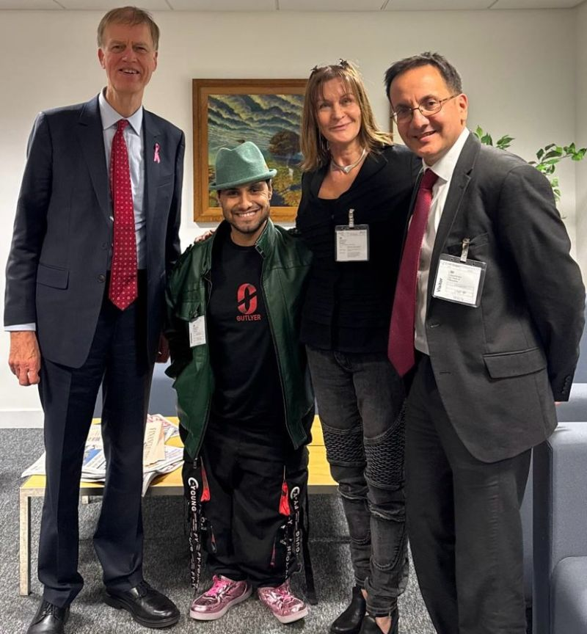
Emmanuel Kelly performing ‘A sky full of stars’ with Coldplay at the FIFA Club World Cup final halftime show in New York, July 2025
Sir Stephen Timms MP (Minister for Social Security and Disability); Emmanuel Kelly; Joanne Reay and Kim Hoque at Caxton House, October 2025

Slide 27

L-R: Alison McGovern MP (Minister of State for Local Government and English Devolution); Vicky Foxcroft MP (former shadow Disability Minister); Christina McAnea (UNISON general secretary); Paul Nowak (TUC general secretary)
The Charter’s founder members (Deirdre Costigan MP
second right)
Christina McAnea and Wes Streeting MP (Secretary of State for Health and Social Care)
Jeremy Hunt MP and David Forbes Nixon OBE
Sir Stephen Timms MP (Minister for Social Security and Disability)
L-R: Kim Hoque with Christina Rees MP and Angela Rayner MP

Slide 28
Disability employment and organisational performance outcomes
(see: Hoque, K. & Bacon, N. (2024) The employment of disabled people and organisational performance outcomes. Disability@Work)
Does employing disabled people in greater numbers reduce productivity and financial performance, and raise absence rates/ labour turnover?
Or: does it boost performance by allowing organisations to address skills gaps, labour shortages, mirroring customer base etc.?
Looking at approx. 800 private sector workplaces in the Workplace Employment Relations Study, we explore:
  Productivity, financial performance, and quality of product or service: Management ratings relative to other workplaces in the same industry on a five-point Likert scale where 1 = ‘a lot below average’ and 5 = ‘a lot better than average’.
  Labour turnover: number of resignations at the workplace over the last 12 months divided by the total number of employees 12 months ago.
  Absence rate: The proportion of working days lost through employee sickness or absence in the last 12 months.
Multivariate analysis controlling for: organisation size, log of workplace size, high-performance work practice adoption, single independent workplace, Standard Industrial Classification major group, national ownership, workplace age, standard statistical region, union recognition, workforce demographics

Slide 29
Relationship between percentage of workforce disabled and organisational performance in SMEs and large firms
Percentage workforce disabled | Productivity^{1,2} | Financial performance¹ | Quality of product or service¹ | Absence rate % | Labour turnover %
SMEs
Low (1%) | 3.64 | 3.54 | 4.08 | 4.38 | 12.17
Average (8%) | 3.69 | 3.61 | 4.11 | 4.20 | 10.00
High (15%) | 3.75 | 3.69 | 4.14 | 4.04 | 8.17
Large firms
Low (1%) | 3.73 | 3.58 | 4.10 | 4.09 | 10.66
Average (8%) | 3.70 | 3.61 | 4.11 | 4.30 | 10.50
High (15%) | 3.65 | 3.64 | 4.12 | 4.52 | 10.33
N | 759 | 768 | 794 | 717 | 779
¹ Scale of 1-5 where, compared with other workplaces in the same industry, 1 = a lot below average, and 5 = a lot better than average.
Green: weakly positively associated with percentage of the workforce disabled in SMEs (at the 10% significance level).
Red: percentage of workforce disabled is positively associated with the outcome in question (at the 5% significance level)

Slide 30
What do we make of the findings?
no evidence that the employment of disabled people is associated with negative performance outcomes in British private sector workplaces
  to the contrary, in SMEs, productivity is marginally higher, financial performance is better, and labour turnover is lower in workplaces employing disabled people in proportionately higher numbers.
  in large firms, none of the performance outcomes are any poorer in workplaces employing disabled people in proportionately higher numbers. Hence, any concerns managers might have that employing more disabled people might damage performance appear misplaced.
Government, employers’ organisations, disability campaigners, trade unions and supported employment providers might use these findings in their efforts to persuade employers to hire and retain disabled people in greater numbers. Our findings suggest that doing so would not be associated with any negative performance implications

Slide 31
300+ ORGANISATIONS WORKING TOGETHER
www.disabilityemploymentcharter.org
Please do consider getting your organisation signed up!

