Slide 1
Liquor Enhancement Open State Launch

Slide 2
Agenda
Liquor Channel Enhancement Overview
Data Review
Other Impacts
Timelines & Support
Next Steps

Slide 3
Liquor Channel Enhancements
From Liquor Plus to Total Liquor Open State (with Statelines)
Liquor Plus
October 2023
July 22nd/23rd 2024
9 SMMs + Census Retailers
+7 New Statelines (8 total)
Optional license. No impact to Liquor+.
Liquor+ → Total Liquor Open State
Required upgrade, all NIQ BevAl
Stateline
New Covered Open State
Investing to develop the most comprehensive liquor channel available with release across suppliers, distributors, Wall Street, and retail

Slide 4
NIQ Liquor Channel Enhancement
For more information about the Liquor Channel Enhancement, please reach out to your NIQ representative.
Discover new opportunities in the liquor channel
Expanding geographical coverage to combine all state lines, forming a national-level open state measure by Q2 2024
With increased coverage of key geographical areas
What is it
How it works
Key benefits
NIQ is enhancing our liquor channel measurement by expanding geographical coverage to provide the best view in the market with more expansive, granular, high-quality data trusted by Wall Street, top distributors, manufacturers and retailers.
With NIQ’s significant commitment and investment in the beverage alcohol industry, this new channel will combine new state line coverage to form a national-level open state measure, with total universe projection updates.
NIQ’s new Total US Liquor Open State channel will be replacing Total US Combined Liquor Plus channel.
Clients are required to upgrade to this new, enhanced liquor channel to ensure you continue receiving the most complete, clear view of the market available – with same high-quality data you can trust from NIQ.
Access NIQ liquor channel data via your preferred platform or delivery method.
Gain visibility into market-critical insights with enhanced market granularity and coverage
Capitalize on white space opportunities with increased liquor channel coverage
Better understand competitive threats across key liquor markets
Unlock insights with the expansion of independent liquor store coverage
Notes:
NIQ is investing in our Liquor channel and is working on a series of enhancements over the next year. The first enhancement was California, which was launched in November 2022 and is a projection of the entire state including independent liquor stores. California is important because of its size, the diversity of the population in the state and the fact that many new innovations launch in CA.

Slide 5
NIQ Beverage Alcohol State Line Coverage
For more information about Beverage Alcohol State Line Coverage, please reach out to your NIQ representative.
Insight into 8 state lines, critical to the liquor market
New state line coverage delivers a 90% increase in overall store coverage
New York
Colorado
$4.8B size (ACV)
+46% new stores covered
$2.3B / $2.0B​
spirits / wine total volume
Massachusetts
$2.6B size (ACV)
+21% new stores covered
$680M / $850M / $530M​
beer / spirits / wine total volume
$3.1B size (ACV)
+8% new stores covered
$800M / $940M / $700M beer / spirits / wine total volume
California
New Jersey
$9.0B size (ACV)
+2,650% new stores covered
$1.8B / $2.3B / $700M​
beer / spirits / wine total volume
$4.0B size (ACV)
+25% new stores covered
$440M / $1.3B / $990M beer / spirits / wine total volume
Maryland
Texas
Florida
$2.2B size (ACV)
+34% new stores covered
$560M / $770M / $470M beer / spirits / wine total volume
$5.4B size (ACV)
+750% new stores covered
$430M / $3.2B / $390M​
beer / spirits / wine total volume
$2.9B size (ACV)
+9% new stores covered
$320M / $1.5B / $480M
beer / spirits / wine total volume

Slide 6
Data Review
2024 Channel Enhancement

Slide 7
2024 Liquor Open State Channel Enhancement Expanded Coverage enabling the Full View for Liquor Delivering July 22nd / 23rd, 2024
 | New / Expanded Markets New Total US Liquor Open State market replaces Total Liquor Plus New Statelines incorporated - released in ’22 (CA) and ’23 (CO, MA, MD, FL, NJ, NY, TX) New Florida Stateline Liquor market replaces Florida SMM Liquor Updated all Combined Channel Markets that had “Any Channel” + Liq Plus
 | Noteworthy Retiring Markets* Total US Liquor Combined will be retired along with old markets Florida SMM Liquor Minneapolis SMM Liquor retired (including Combo Markets with this SMM) (remains in projection, not independently reportable) Food Drug Liquor Combined and Liquor Plus markets are being retired
 | Coverage Expansion Expected coverage increases from Total Combined Liquor Plus to Total US Liquor Open State Projected for all Open States (31 States +DC) - Census Sample Integrated (CSI) Market Expanded Sample: 4x the independent Liquor sample stores
Beer 2.8x
Wine 1.8x
Spirits 2.2x
 | ACV Updates Retailer store ACV update Stateline & Total Channel Universe Updates (projected ACV updated for total channel)
 | History re-set to Jan 2021(3.5 Yrs) at event delivery, building to 5 years
*Comprehensive list to be provided
Notes:
Changes to expect

Slide 8
The Liquor channel migration to Total Open State Liquor will expand representation in BevAl
NielsenIQ estimated volume coverage (cases) Total US (Off-Premise Only)
Gaps include Closed State for Beer, Costco, Pure Play eCom and NABCA for Wine & Spirits (which we can align to the hierarchy)

Slide 9
Total Liquor Open State Data Changes
2024 Channel Enhancement

Slide 10
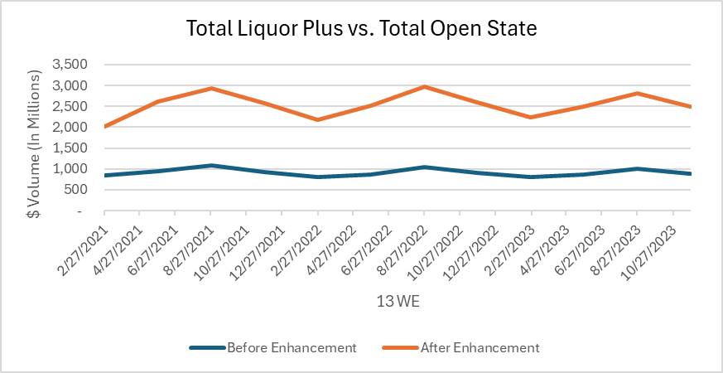
Volume Changes for BevAL Beer – Total Liquor Plus vs. Total Open State
The more pronounced seasonality is coming from the new markets

Slide 11
Manufacturer $ Share for BevAL Beer – Total Liquor Plus vs. Total Open State
Some manufacturers are seeing larger than the 2.8x increase
Manufacturer | $ After Enhancement | $ % Diff vs. Before | YOY $ Change After Enhancement | Pt Diff vs. Before | $ Share After Enhancement | Pt Diff vs. Before | YOY Share Change After Enhancement | Pt Diff vs. Before
ANHEUSER-BUSCH INC. | 2433 | 3.5x | -10.1% | -1.3% | 24.2% | 4.8% | -2.1% | -0.6%
CONSTELLATION | 2042 | 3.8x | 6.1% | -1.8% | 20.3% | 5.3% | 1.6% | 0.2%
MOLSON COORS BEVERAGE CO | 1637 | 2.9x | 5.2% | -0.5% | 16.3% | 0.5% | 1.2% | 0.0%
ALL OTHER COMPANIES | 971 | 1.8x | -5.4% | -1.0% | 9.7% | -5.7% | -0.3% | 0.1%
BOSTON BEER | 533 | 2.6x | -8.6% | 2.4% | 5.3% | -0.4% | -0.4% | 0.2%
MARK ANTHONY BRANDS | 530 | 2.7x | -4.0% | -0.6% | 5.3% | -0.2% | -0.1% | 0.0%
HEINEKEN USA | 507 | 2.5x | -4.6% | -3.9% | 5.0% | -0.7% | -0.1% | -0.2%
DIAGEO | 253 | 2.7x | 0.1% | -1.8% | 2.5% | -0.1% | 0.1% | 0.0%
PABST BREWING CO. | 139 | 2.8x | 0.1% | -1.4% | 1.4% | 0.0% | 0.0% | 0.0%
NEW BELGIUM BREWING | 122 | 2.1x | 1.2% | 1.8% | 1.2% | -0.4% | 0.0% | 0.0%
D.G. YUENGLING | 120 | 2.5x | 38.8% | 31.0% | 1.2% | -0.2% | 0.4% | 0.2%
SIERRA NEVADA | 94 | 2.2x | 0.7% | -0.5% | 0.9% | -0.2% | 0.0% | 0.0%
FIFCO USA | 64 | 2.5x | -3.1% | -1.9% | 0.6% | -0.1% | 0.0% | 0.0%
SAPPORO BREWERIES LTD | 59 | 2.1x | -0.8% | -3.2% | 0.6% | -0.2% | 0.0% | 0.0%
DUVEL USA | 37 | 3.2x | -1.7% | 2.0% | 0.4% | 0.0% | 0.0% | 0.0%
52 WE 11/25/2023; In Millions

Slide 12
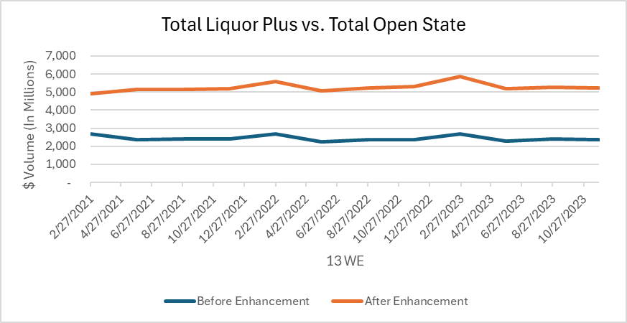
Volume Changes for BevAL Spirits – Total Liquor Plus vs. Total Open State
Spirits volume is higher, but trends are consistent

Slide 13
Manufacturer $ Share for BevAL Spirits – Total Liquor Plus vs. Total Open State
Some manufacturers are seeing larger than the 2.2x increase
Manufacturer | $ After Enhancement | $ % Diff vs. Before | YOY $ Change After Enhancement | Pt Diff vs. Before | $ Share After Enhancement | Pt Diff vs. Before | YOY Share Change After Enhancement | Pt Diff vs. Before
DIAGEO | 4158 | 2.1x | -0.2% | 1.4% | 19.3% | -0.9% | -0.4% | 0.0%
ALL OTHER COMPANIES | 2121 | 1.8x | 4.5% | 0.3% | 9.8% | -2.5% | 0.3% | -0.2%
SAZERAC | 2106 | 3.4x | 6.2% | 6.1% | 9.8% | 3.5% | 0.4% | 0.4%
BACARDI | 1570 | 2.1x | 0.0% | 2.7% | 7.3% | -0.2% | -0.1% | 0.1%
BEAM SUNTORY | 1353 | 2.1x | -1.5% | 0.0% | 6.3% | -0.4% | -0.2% | -0.1%
PERNOD RICARD | 1326 | 1.9x | -5.2% | -1.2% | 6.2% | -1.1% | -0.5% | -0.1%
E&J GALLO | 1138 | 2.6x | 12.7% | -0.8% | 5.3% | 0.8% | 0.5% | 0.0%
BROWN-FORMAN | 1089 | 2.3x | 1.3% | 0.5% | 5.1% | 0.2% | 0.0% | 0.0%
FIFTH GENERATION | 943 | 2.0x | 6.5% | 5.1% | 4.4% | -0.5% | 0.2% | 0.1%
PROXIMO | 933 | 2.7x | 8.1% | 4.3% | 4.3% | 0.7% | 0.3% | 0.1%
MOET HENNESSY USA | 890 | 2.7x | -8.8% | 0.4% | 4.1% | 0.8% | -0.5% | -0.1%
HEAVEN HILL | 813 | 2.8x | 5.6% | 0.2% | 3.8% | 0.8% | 0.1% | 0.0%
CAMPARI AMERICA | 669 | 2.2x | 4.8% | -5.3% | 3.1% | 0.0% | 0.1% | -0.2%
WILLIAM GRANT | 359 | 1.6x | -0.9% | 1.5% | 1.7% | -0.7% | 0.0% | 0.0%
REMY COINTREAU | 343 | 2.4x | -11.4% | -2.0% | 1.6% | 0.1% | -0.2% | -0.1%
52 WE 11/25/2023; In Millions

Slide 14
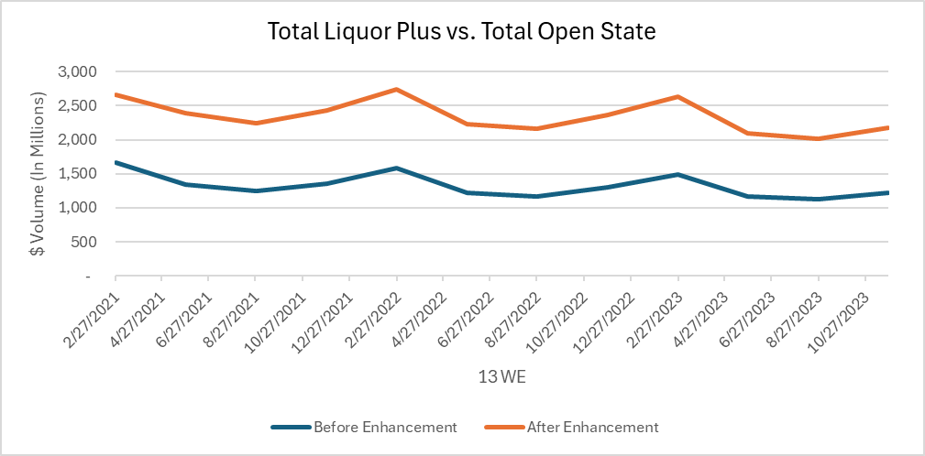
Volume Changes for BevAL Wine – Total Liquor Plus vs. Total Open State
Wine volume increased, but trends are consistent

Slide 15
Manufacturer $ Share for BevAL Wine – Total Liquor Plus vs. Total Open State
Some manufacturers are seeing larger than the 1.8x increase
Manufacturer | $ After Enhancement | $ % Diff vs. Before | YOY $ Change After Enhancement | Pt Diff vs. Before | $ Share After Enhancement | Pt Diff vs. Before | YOY Share Change After Enhancement | Pt Diff vs. Before
ALL OTHER COMPANIES | 2282 | 1.7x | -7.0% | -1.6% | 25.6% | -1.7% | -0.3% | -0.2%
E&J GALLO | 1331 | 2.1x | -3.5% | 0.8% | 14.9% | 2.4% | 0.4% | 0.3%
CONSTELLATION | 522 | 1.7x | -9.2% | -1.3% | 5.9% | -0.3% | -0.2% | 0.0%
MOET HENNESSY USA | 455 | 1.5x | -11.3% | -5.3% | 5.1% | -0.8% | -0.3% | -0.3%
DEUTSCH FAMILY | 413 | 1.8x | 1.5% | 0.4% | 4.6% | 0.0% | 0.3% | 0.1%
THE WINE GROUP | 399 | 2.2x | -10.7% | -0.9% | 4.5% | 0.9% | -0.2% | -0.1%
DFV WINES | 292 | 2.1x | -6.6% | 1.3% | 3.3% | 0.5% | 0.0% | 0.1%
TRINCHERO FAMILY | 289 | 2.4x | -1.5% | -0.2% | 3.2% | 0.8% | 0.1% | 0.1%
TREASURY WINE ESTATES | 234 | 1.7x | -4.6% | 0.5% | 2.6% | -0.2% | 0.0% | 0.0%
JACKSON FAMILY WINES | 226 | 1.7x | -7.9% | -2.4% | 2.5% | -0.2% | -0.1% | 0.0%
DUCKHORN WINE COMPANY | 141 | 1.5x | -0.1% | 0.9% | 1.6% | -0.4% | 0.1% | 0.0%
WAGNER FAMILY WINES | 138 | 1.4x | 16.6% | -4.1% | 1.5% | -0.4% | 0.3% | -0.1%
PALM BAY INTERNTL | 137 | 1.8x | -3.7% | -2.1% | 1.5% | 0.0% | 0.0% | 0.0%
STE MICHELLE ESTATES | 134 | 1.7x | -15.4% | -2.5% | 1.5% | -0.1% | -0.2% | 0.0%
KOBRAND | 125 | 1.6x | -12.1% | -1.4% | 1.4% | -0.2% | -0.1% | 0.0%
52 WE 11/25/2023; In Millions

Slide 16
Explanation of the Changes: Methodology
General Knowledge on what's changing

Slide 17
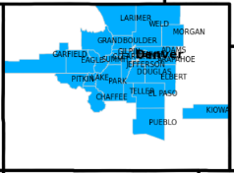
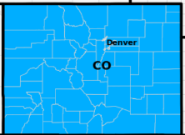
Liquor Channel Enhancement: Non-Census Increase
With the move to reporting Statelines, we increased sample in the SMMs
With the release of the statelines in October 2023, we more than doubled the number of sample stores in most states
While some of this increase covered each states “white space”, many stores were added to each SMM
We were able to obtain more representative stores of the Universe we are measuring (e.g. independents and stores in smaller counties)
This more affects Manufacturer/Brand representation within each SMM
Denver SMM
Colorado Stateline

Slide 18
Liquor Channel Enhancement: Universe Updated
What is the universe?
The universe is the population of retail outlets meeting our channel definition. It is estimated by ACV, and that estimate is informed by sources such as TDLinx, public data, 3rd party data, etc.
We will be updating the Liquor Channel universe estimates.
What's the effect?
Our early review of the universe estimate indicates that the growth rate of the current 'projected' portion of the Liquor channel (primarily independents) is higher than it will be in the revised estimate (which delivers with this enhancement)
The enhancement will update the update the Liquor Channel universe.
You should expect to see more pronounced data changes in the SMMs and some 2023 estimates for statelines
Projects to the Universe
Store Sample

