Slide 1
Executive Summary
September 2024

Slide 2
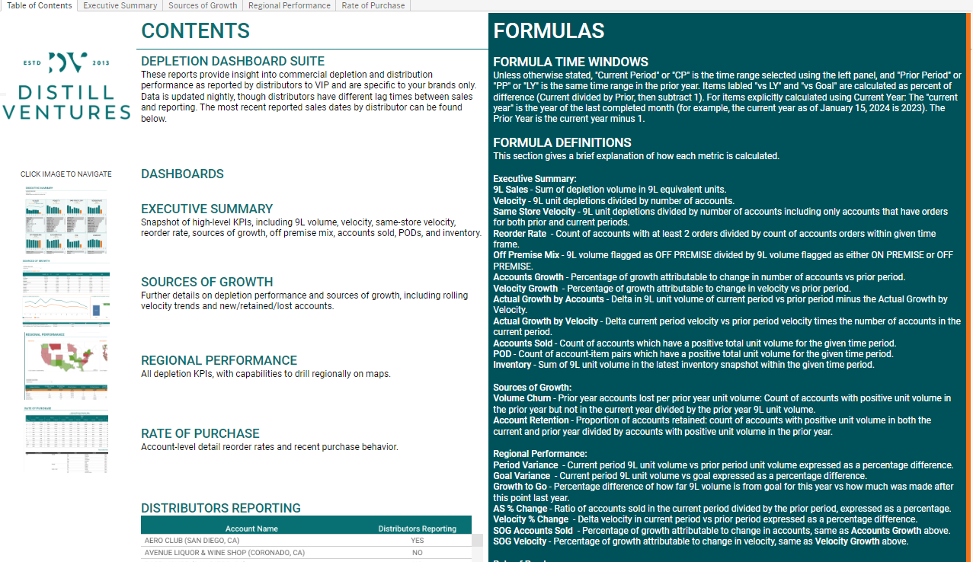
Executive Summary – Table of Contents
Navigation Bar
Use this panel top navigate quickly to different dashboards and views within the report.
Executive Summary
Table of contents provide a summary of dashboards and relevant calculations.
Formulas and Definitions
Formulas and definitions used in the report are explained here.
Detailed Nav Pane
Use this pane to navigate to the relevant report dashboards.
Dashboards
A brief description of each dashboard is available here. Click on a dashboard image to navigate to this dashboard.
Distributors Reporting
Does this distributor have updated distribution data for the current month?

Slide 3
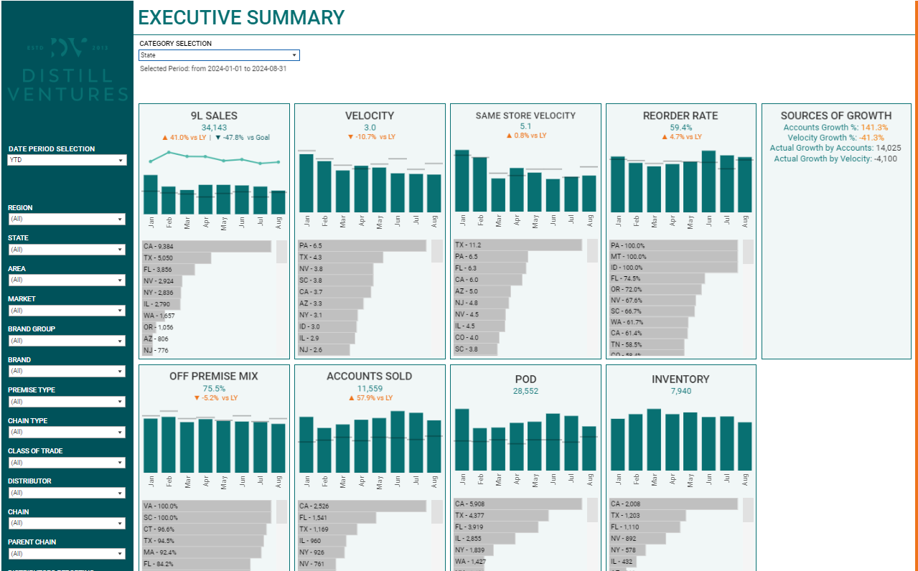
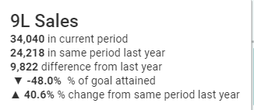
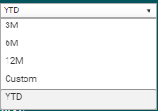
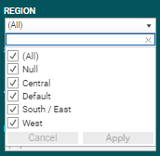
Executive Summary
Executive Summary
This report dashboard gives an overview of KPIs including sales volume, velocity, re-orders, premise mix, growth metrics, and a snapshot of inventory data.
Category Selection
Category Selection shows quick breakdown by the selected value from: Class of Trade, State, Brand Group, Premise Type, and Chain.
Filter Pane
Select filters for the report.
The date selection has preset options for year to date, and trailing 3, 6, or 12 months. A custom date range option is available to select a specific date range where additional input boxes will appear.
Filters include:
Region
State
Area
Market
Brand Group
Brand
Premise Type
Chain Type
Class of Trade
Distributor
Chain
Parent Chain
Distributors Reporting
To apply a filter, open the dropdown panel, select the desired values, then press the Apply button.
On-Hover Tooltips
Hovering the mouse cursor over any calculated value will give some additional context or information.

Slide 4
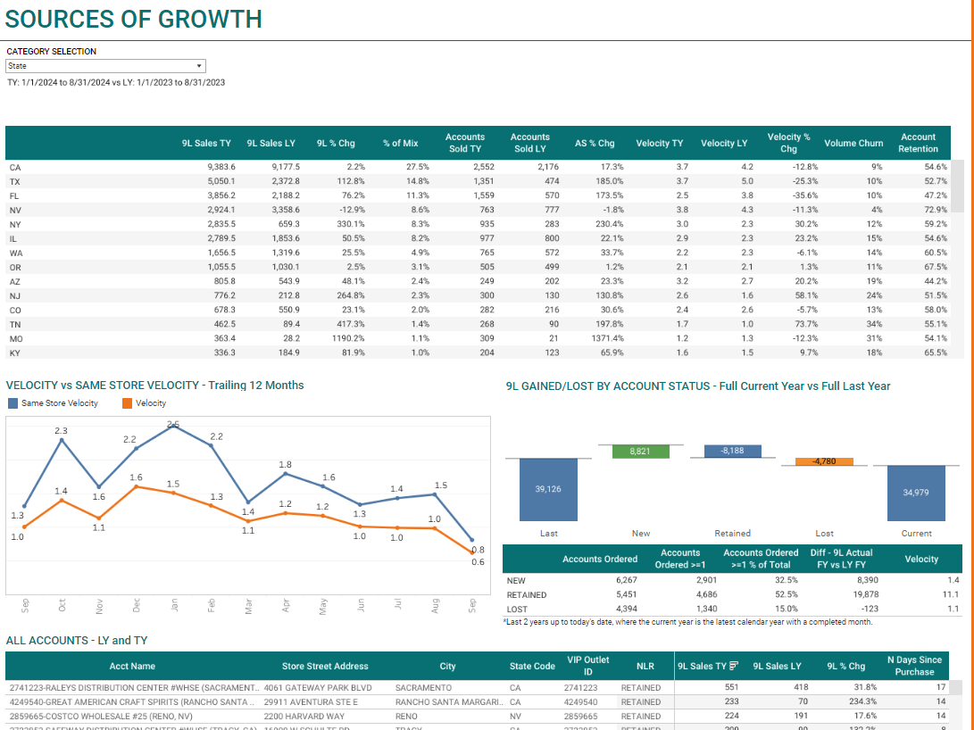
Executive Summary - Sources of Growth
Sources of Growth
Detailed depletion performance and analysis by new, lost, and retained accounts.
Details by Category Selection
By category selected in CATEGORY SELECTION, see key metrics such as 9L sales, accounts sold, velocity, churn, and account retention.
New Lost Retained Accounts
See the current vs prior year accounts which are new, lost, or retained, and how many accounts have placed orders within each category for current vs prior year.
Velocity and Same Store Velocity
For trailing 12 months, see a comparison of velocity and same store velocity (i.e. stores with multiple sales).

Slide 5
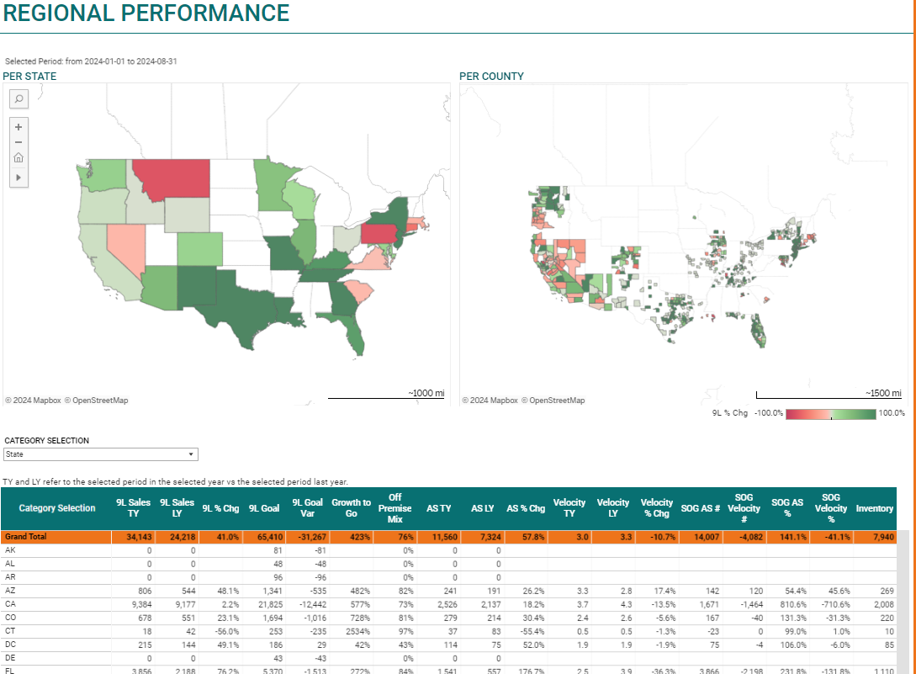
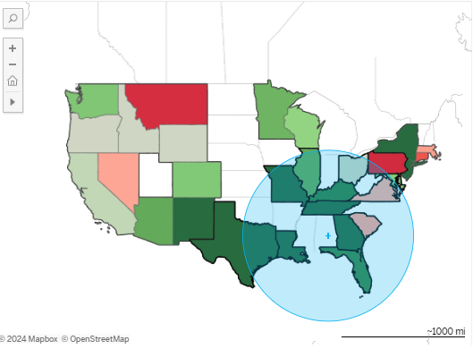
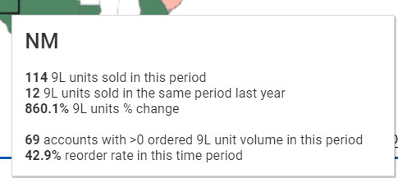
Executive Summary – Regional Performance
Regional Performance
See depletion KPIs by region, state, and county.
Map Selection
Click on the arrow for radial and lasso selection options to select multiple states in order to filter the view by regions.
On-Hover Tooltips
Hovering the mouse cursor over any calculated value will give some additional context or information.
Detailed KPIs
Additional detailed KPIs by CATEGORY SELECTION are available at the bottom chart within the selected region.

Slide 6
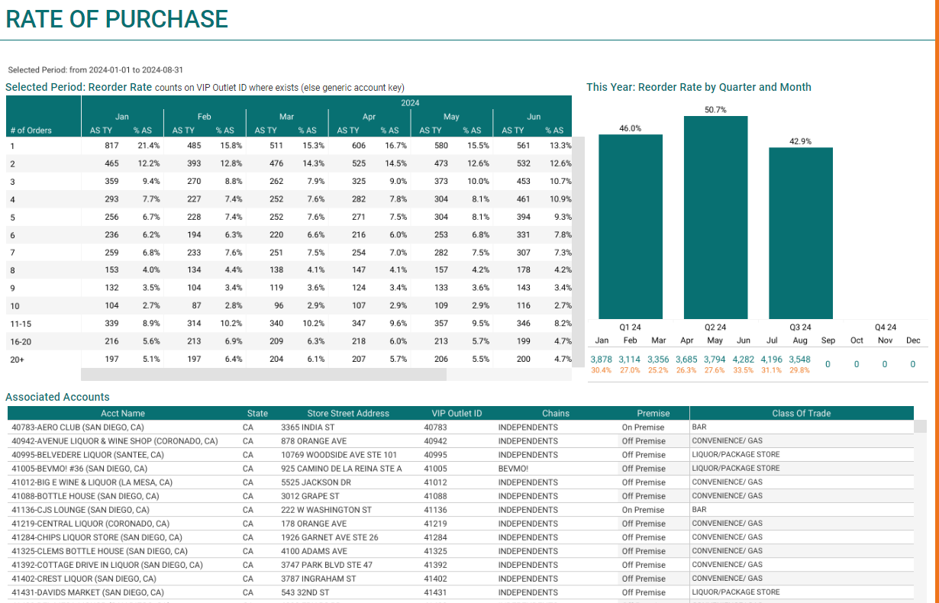
Executive Summary – Rate of Purchase
Rate of Purchase
Re-order rates and purchase behavior
Quarterly Reorder Rate
Reorder rate by quarter and month.
Reorder Rate
Number of accounts with N purchases within the selected period and the percentage of accounts with orders that fall into this category.
Associated Accounts
The account details for accounts with purchases within the selected period.

Slide 7
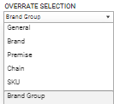
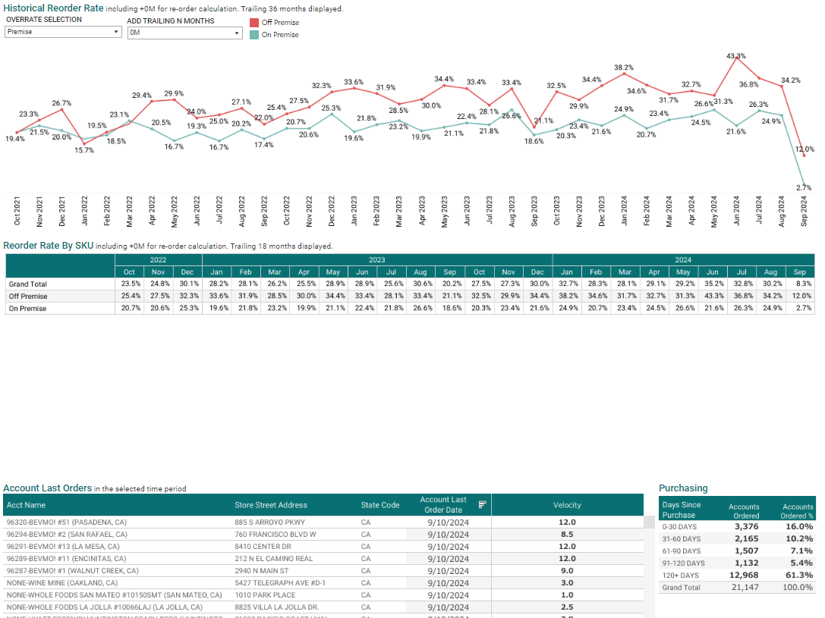
Executive Summary – Rate of Purchase Continued
Historical Reorder Rate
Reorder rate calculated for each item in the OVERRATE SELECTION breakdown. The reorder rate is calculated within-month per item in the category. To expand the time horizon for counting a re-order, use the “ADD TRAILING N MONTHS” dropdown to add additional months for consideration of a reorder.
Reorder Rate by SKU
Monthly reorder statistics by SKU.
Last Order Statistics
Number of accounts with their last order in the given day range.
Account Last Orders
Last order for each account for accounts with orders within the selected time range.

