Slide 1
Distribution
September 2024

Slide 2
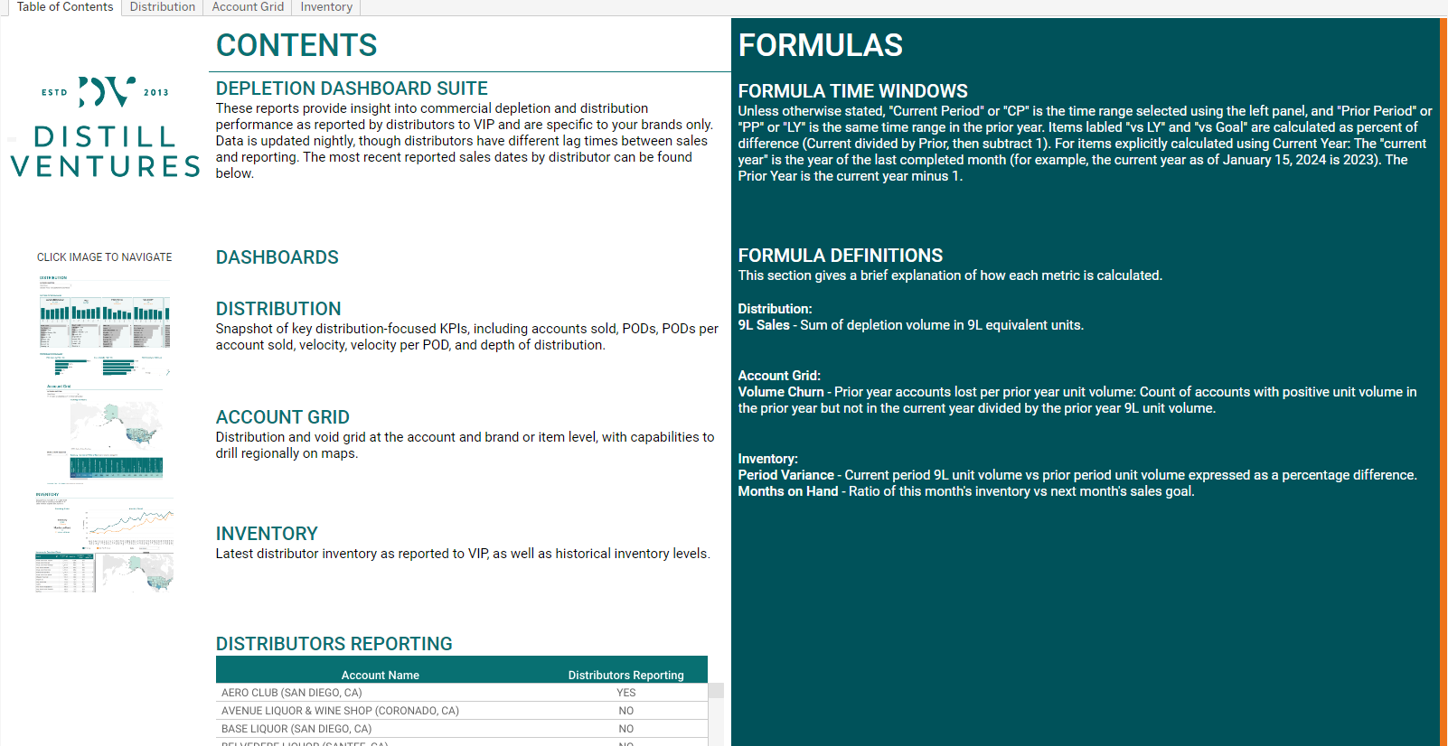
Distribution – Table of Contents
Distribution
Table of contents provide a summary of dashboards and relevant calculations.
Navigation Bar
Use this panel top navigate quickly to different dashboards and views within the report.
Formulas and Definitions
Formulas and definitions used in the report are explained here.
Detailed Nav Pane
Use this pane to navigate to the relevant report dashboards.
Dashboards
A brief description of each dashboard is available here. Click on a dashboard image to navigate to this dashboard.
Distributors Reporting
Does this distributor have updated distribution data for the current month?

Slide 3
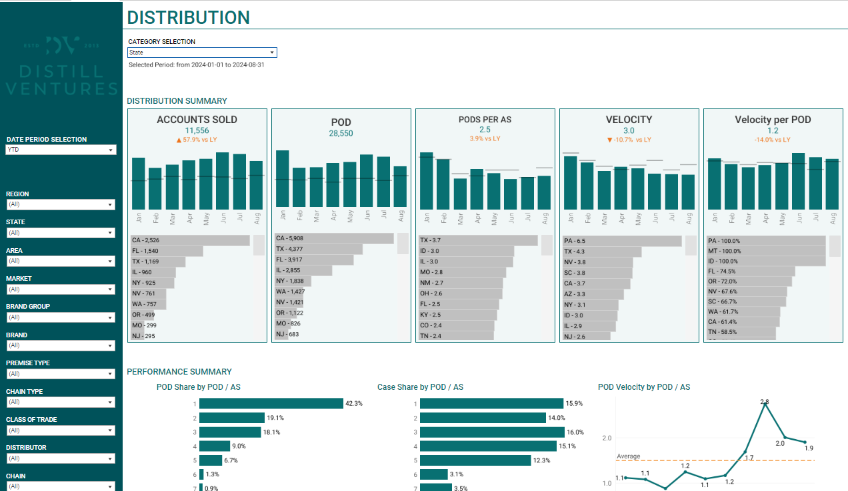
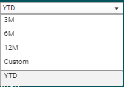
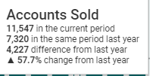
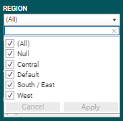
Distribution – KPIs and General Functionality
Distribution
This report provides a snapshot of key distribution-focused KPIs pertaining to accounts sold, PODs, and velocity.
Category Selection
Category Selection shows quick breakdown by the selected value from: Class of Trade, State, Brand Group, Premise Type, and Chain.
Filter Pane
Select filters for the report.
The date selection has preset options for year to date, and trailing 3, 6, or 12 months. A custom date range option is available to select a specific date range where additional input boxes will appear.
Filters include:
Region
State
Area
Market
Brand Group
Brand
Premise Type
Chain Type
Class of Trade
Distributor
Chain
Parent Chain
Distributors Reporting
To apply a filter, open the dropdown panel, select the desired values, then press the Apply button.
On-Hover Tooltips
Hovering the mouse cursor over any calculated value will give some additional context or information.

Slide 4
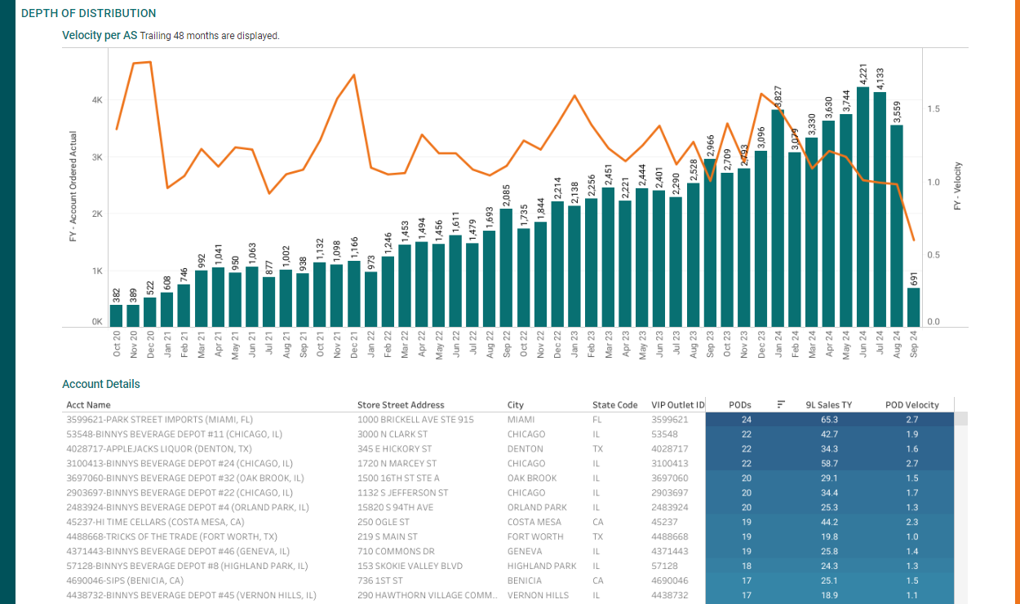
Distribution – Account Performance
Depth of Distribution
Number of accounts with orders and velocity per month for each of the trailing 48 months.
Account Details
Per account, PODs, 9L unit sales and POD velocity.

Slide 5
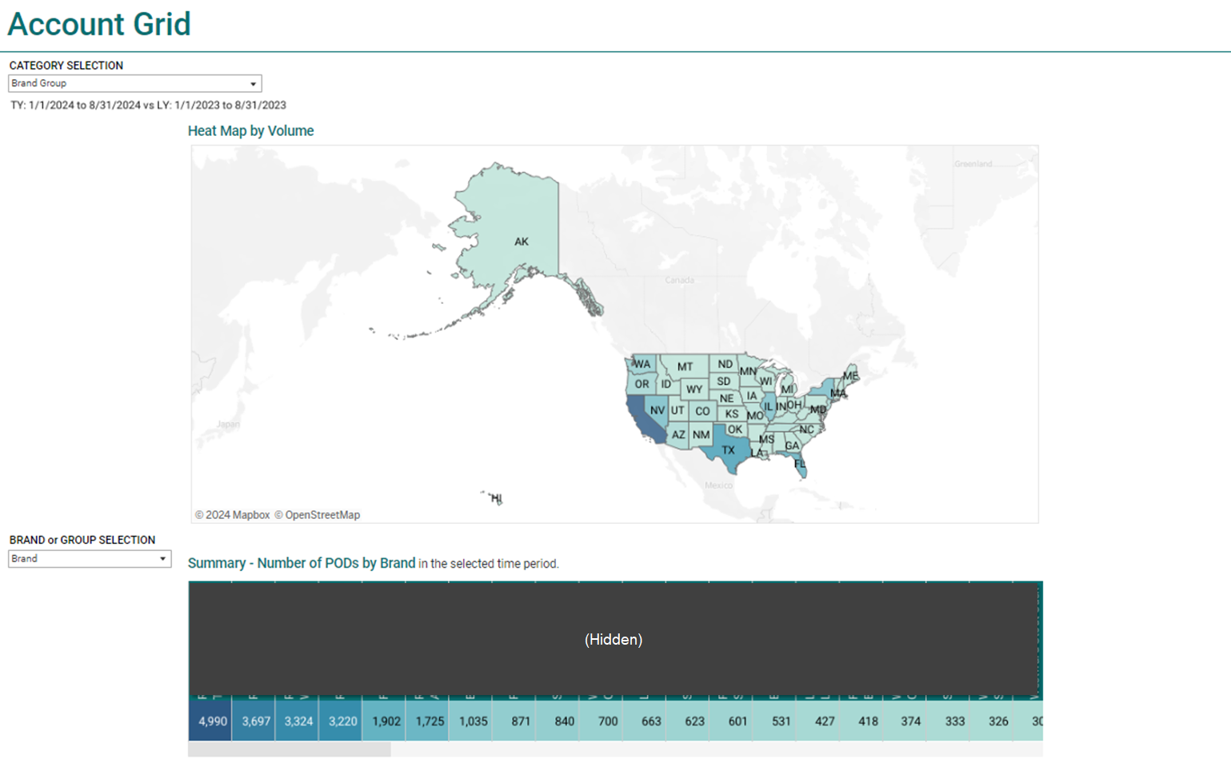
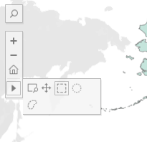
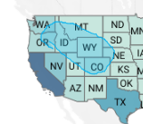
Distribution – Account Grid
Account Grid
Distribution and void grid at the account and brand or item level, with capabilities to drill regionally on maps.
Heat Map by Volume
Heatmap highlighting volume of units sold per state.
Lasso Selection
For map selection tools like lasso and radial selection, click on the arrow that appears on the left side when you hover the cursor over the map.
PODs by Brand
Number of PODs by brand or brand group in the selected time period.

Slide 6
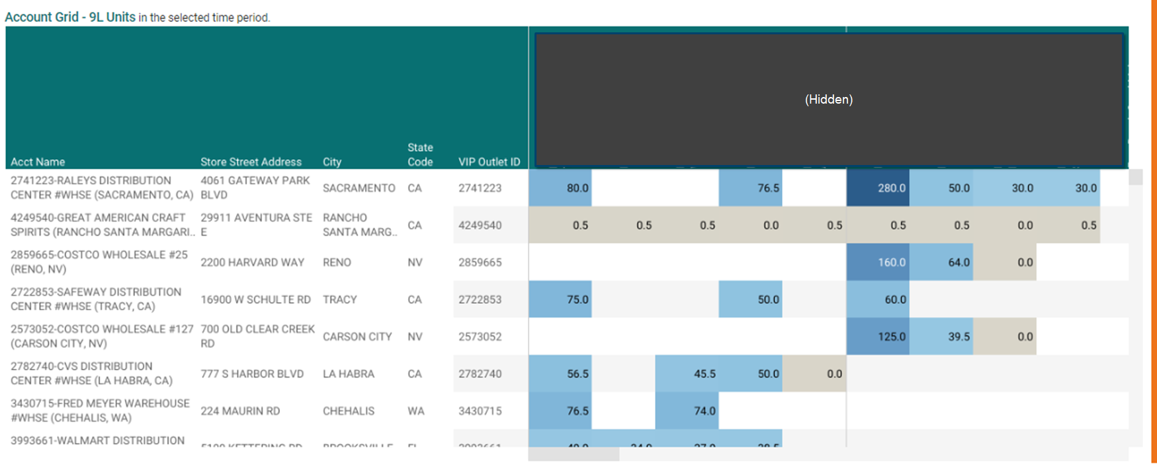
Distribution – Account Grid Continued
Account Grid
Grid of accounts and items grouped by Brand, highlighted 9L units sold. This provides a view of which items are and are not present within an account.

Slide 7
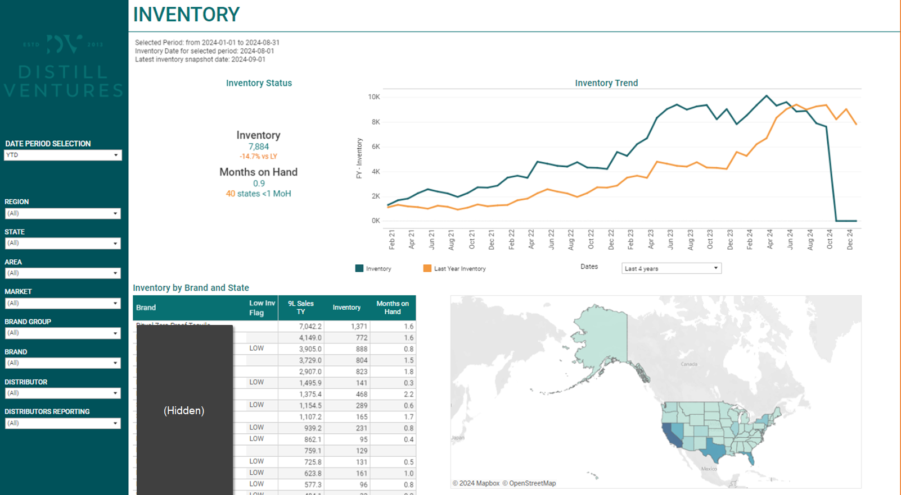
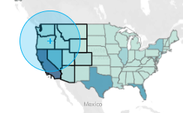
Distribution - Inventory
Inventory
Latest distributor inventory as reported to VIP, as well as historical inventory levels
Inventory and Months on Hand
Trend of inventory on hand for the selected date range (selector under the time trending chart). Items with low inventory are labeled LOW for having less than one month of inventory on hand.
Months On Hand
Months on Hand can be calculated as:
Current Period Inventory / Current Period Next Month Inventory
Lasso Selection
For map selection tools like lasso and radial selection, click on the arrow that appears on the left side when you hover the cursor over the map.

