Slide 1
Nielsen Dashboard
September 2024

Slide 2
Nielsen – Data Sharing Guidelines
Nielsen Data sharing guidelines provide guidance when using licensed Nielsen data. These policies ensure retailer confidentiality is maintained so that retailers will continue to share their data with Nielsen and other information providers.
Please take note of the following rules:
Sharing data with cooperating retailers:
✔ You may share a retailer’s data with itself
✔ You may share market-level data with cooperating retailers
✖ You may NOT share data from one retailer with another
✖ You may NOT aggregate retailer data to share with another retailer
Sharing data with Non-cooperating retailers:
✔ Basic non-data specific observations using high level terms that do not reveal actual retailer data can be shared with non-cooperating retailers
e.g. “Titos is the #1 Vodka Brand in Total US Drug Channel”
e.g. “Non-Alcoholic Beer is the fastest growing segment in the Convenience
Channel”
✖ You may NOT share any actual Retailer or Market-level data with non-cooperating retailers (Non-Cooperating Retailers include but are not limited to Costco, Trader Joes, HEB, Winco, Aldi, Sprouts)
Failure to adhere to these rules may result in Distill Ventures being in violation of its Nielsen contract and losing all data access.

Slide 3
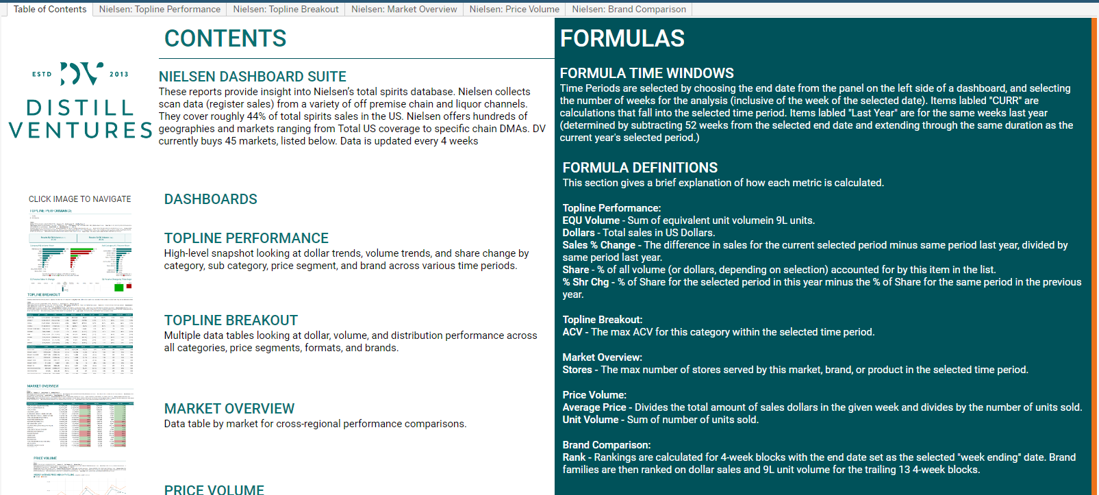
Nielsen – Table of Contents
Navigation Bar
Use this panel top navigate quickly to different dashboards and views within the report.
Formulas and Definitions
Formulas and definitions used in the report are explained here.
Dashboards
A brief description of each dashboard is available here. Click on a dashboard image to navigate to this dashboard.
Detailed Nav Pane
Use this pane to navigate to the relevant report dashboards.

Slide 4
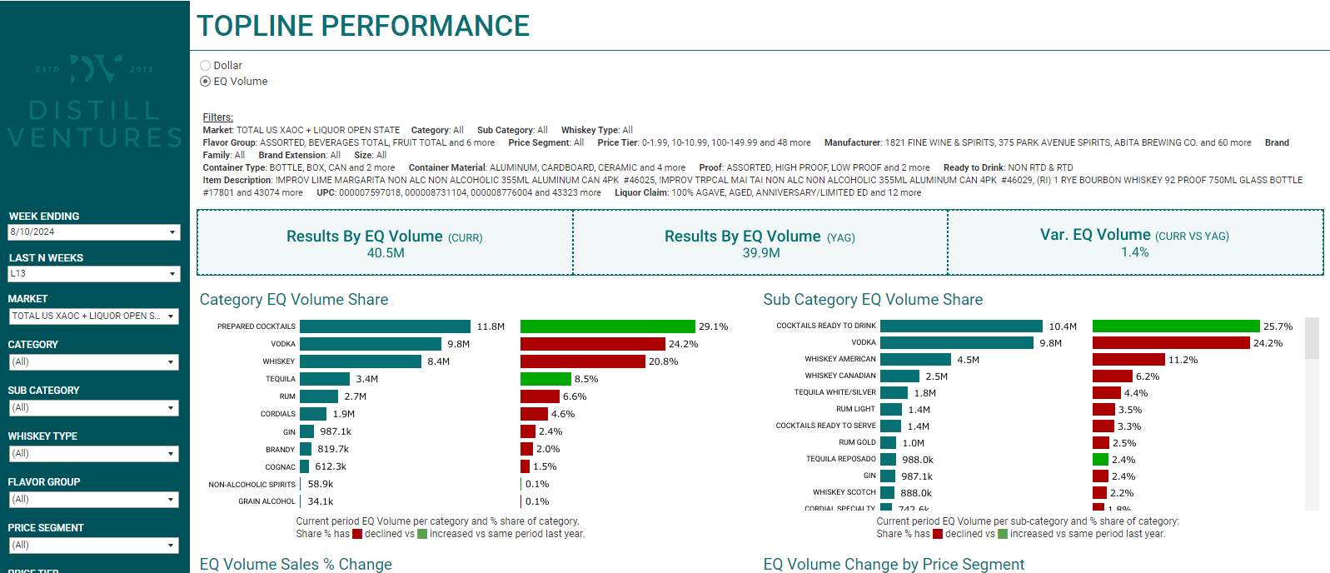
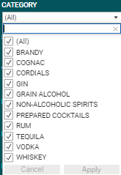
Nielsen - Topline Performance
Topline Performance
High level snapshot report.
Measure Selection
Select to show report by EQ Volume or USD.
Filter Summary
A readout of the currently selected filters applied to the report.
Filter Pane
Select filters for the report.
Week Ending and Last N Weeks control the timeframe for the report calculations.
Filters include:
Market
Category
Sub Category
Whiskey Type
Flavor Group
Price Segment
Price Tier
Manufacturer
Brand Family
Brand Extension
Size
Container Type
Container Material
Proof
Ready to Drink
Item Description
UPC
To apply a filter, open the dropdown panel, select the desired values, then press the Apply button.
On-Hover Tooltips
Hovering the mouse cursor over any calculated value will give some additional context or information (for example, the start and end date of the calculation).
Category Volume/USD Share
Shows the share of EQ Volume or Dollars, depending on measure selection, broken out by category for the selected time period. In addition, shows the percentage of total and highlights whether this share has increased or declined vs the same period last year.
Sub Category Volume/USD Share
Similar to the Category Volume/USD Share panel to the left, but broken down to Sub Category level.

Slide 5
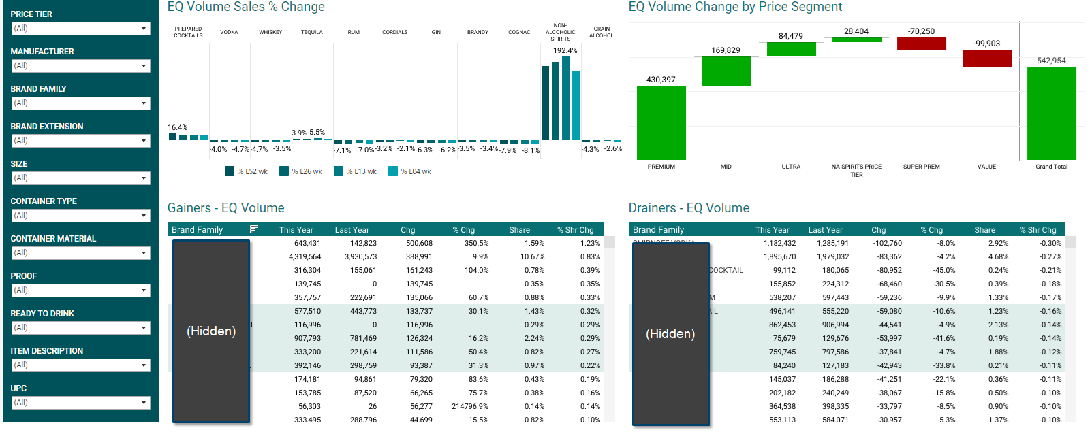
Nielsen - Topline Performance Continued
Sales % Change Chart
Per category, shows the percentage change vs prior year for each category, for 4, 13, 26, and 52 week timeframes.
Change by Price Segment
Year over year change by price segment- shows the breakdown of year over year change in volume or dollars for by price segment for the selected time period.
Filter Pane Continued
Select filters for the report.
Week Ending and Last N Weeks control the timeframe for the report calculations.
Filters include:
Market
Category
Sub Category
Whiskey Type
Flavor Group
Price Segment
Price Tier
Manufacturer
Brand Family
Brand Extension
Size
Container Type
Container Material
Proof
Ready to Drink
Item Description
UPC
Gainers and Drainers
Brand families, broken out by families with gains and losses in % share of dollars or volume within the selected period this year (vs same period last year).

Slide 6
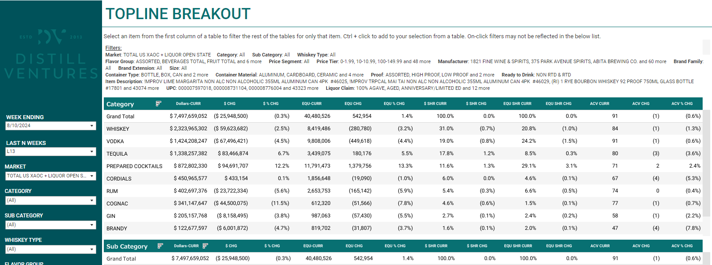
Nielsen - Topline Breakout
Topline Breakout
Topline Breakout report shows key metrics pertaining to dollars, volume, and distribution broken down across multiple categories. Click on a value within a category to filter the remaining tables to show data for only the selected category. Ctrl + click to select multiple categories within a single chart to see values for multiple categories across multiple charts.
Breakout Calculations
For the selected time period, the calculated metrics include dollar spend, EQ unit volume, percent dollar share, percent EQ unit share, and ACV. All measure also calculate the absolute and percentage difference vs the same period last year.
Breakdown Categories
Multiple breakdown categories are presented for key metrics:
Category
Sub Category
Price Segment
Price Tier
Container Material
Flavor
Whiskey Type
Container Type
Size Manufacturer
Brand Family
Select a value within a chart to filter the remaining charts for this value. Ctrl + click to select multiple values.

Slide 7
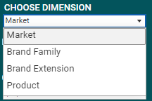
Nielsen – Market Overview
Market Overview
Market Level Data table for cross-regional analysis.
Choose Dimension Option
This report contains a single data table that breaks data down by Market by default. Additional options for breakdowns are available in the CHOOSE DIMENSION selection:
Market
Brand Family
Brand Extension
Product
Note that the table can become very long and take a moment to load if some items are selected without many applied filters.

Slide 8
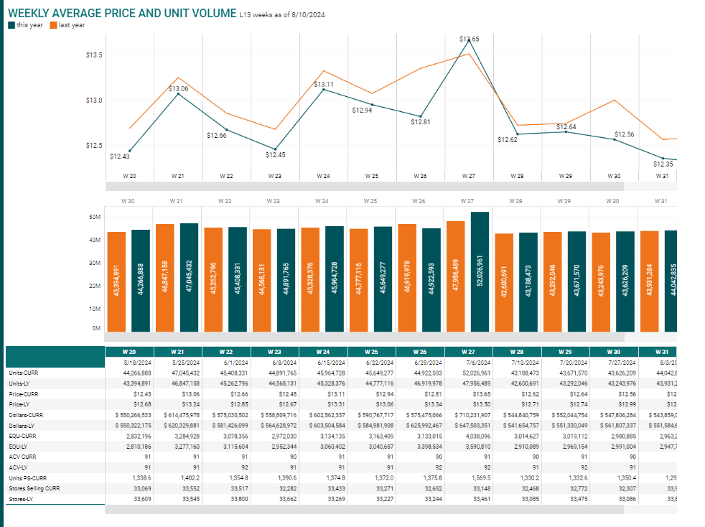
Nielsen – Price Volume
Price Volume
This report contains weekly data points for price and volume for a simple elasticity analysis.
Average Price
Average price calculates the weekly average dollars divided by number of units sold.
Units Sold
The bar chart shows the number of units sold for current and prior year for that week.
Detailed
Shows additional metrics and the week ending date (for the current year). A detailed tooltip shows the week ending date for both current and prior year for the given week.
Tooltip
Hover over the charts to see a tooltip with the week ending dates for the current and prior year.

Slide 9
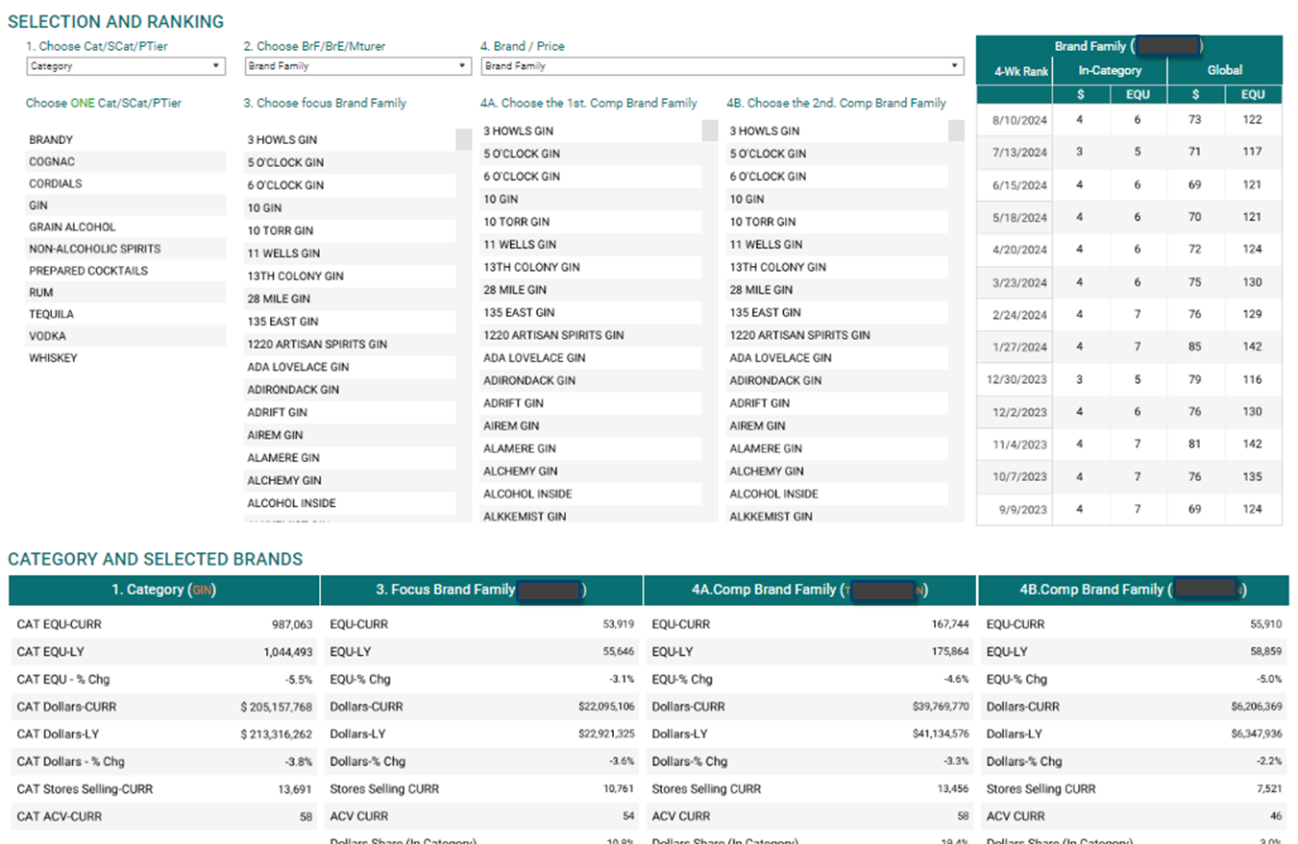
Nielsen – Brand Comparison
Ranking Table
This chart shows ranking for dollars and EQ volume for the selected focus brand. The main ranking is within the selected category (comparing like for like), and a secondary global ranking is displayed to the right.
Brand Comparison
Tools for comparing brand against their category.
Step 1.
Select a category, sub category, or price tier. Click on the item to select. This will populate the “Category” metrics below.
Step 2.
Select a brand family, brand extension, or manufacturer. This will populate the “Focus” category below.
Step 3 and 4.
Select the brand family or price tier for comparison to the focus brand to populate tables 4A and 4B below.
Metrics
For the selected category, focus brands, and comparison brands/tiers, metrics are displayed in these detailed charts:
EQU Volume & Change vs Prior Year
Dollar Values & Change vs Prior Year
Stores Selling
ACV
Dollar Share
Share Change %
Rank (Within Category)

