Slide 1
Before FNA | After FNA
Debt:¹ | Debt:²
They were paying $2,720 a month on 3 credit cards, 1 car, and a mortgage. They would be out of debt at age 58 paying $214,442 in interest | Using the same $2,720 a month, we showed them how to be debt free at age 44. Saving $130,643 in interest. Debt Free: 14 years sooner
Life Insurance:³ | Life Insurance/Income Protection:⁴
$100,000 in coverage on each of them with no protection on the children | $250,000 in coverage on each of them including $10,000 on both children
Cash value policy — $225/mo. | 30-year level term life insurance: $80/mo.
$76,880 Cash Value at age 65 | $225 - $80 = $145/month savings to INVEST
Auto & Homeowner’s Insurance: | Auto & Homeowner’s Insurance:^{5,6}
They were paying $243 per month for auto & home insurance. | Now they pay $178 per month with a top-rated company. Saved $65 per month ($65 per month for 20 years at 9% = $43,000 for college)
Retirement Plan: | Retirement Plan:⁶
They had $20,000 in an IRA at their bank earning 1.5%, with $105 per month contributions. Accumulated savings at age 65 = $79,118 | Rolled over $20,000 IRA into mutual funds. Monthly contributions increased to $250 ($105 + $145 savings from cash value life insurance). 6% rate of return: $372,800 at age 65 9% rate of return: $755,700 at age 65
1 This is a hypothetical family of four consisting of a husband and wife, both age 30 and non-smoking and their two minor children. This family is used to illustrate our products and is not intended to reflect any real people or family. 2 The above example is for illustrative purposes only. The Debt Stacking concept assumes that: (1) you make consistent payments on all of your debts, (2) when you pay off the first debt in your plan, you add the payment you were making toward that debt to your existing payment on the next debt in your plan (therefore you make the same total monthly payment each month toward your debts), (3) you continue this process until you have paid off all of the debts in your plan. In the example above, when Retail Card 1 is paid off, the $220 payment previously made on Retail Card 1 is applied to Credit Card 2, accelerating its payment to $573. After Credit Card 2 is paid off, the $573 payment previously made on Credit Card 2 is applied to the Car Loan for a total payment of $1,124. The process is then continued until all debts are paid off. Note that the total payment per month remains 3. Monthly premium and accumulated cash value for cash value policies is an average of whole life policies from three major North American life insurance companies for male and female, both age 35 and standard risk. Cash value life insurance can be universal life, whole life, etc., and may contain features in addition to death protection, such as dividends, interest, or cash value available for a loan or upon surrender of the policy. Cash value insurance usually has a level premium for the life of the policy. Term insurance provides a death benefit and its premiums increase after initial premium periods and at certain ages. 4. Primerica Custom Advantage policy (non-tobacco use): primary (17CJ0(30)) and spouse rider (17CK0(30)). Hypothetical nominal rates of return, compounded monthly and tax deferred accumulation for IRA is not guaranteed or intended to demonstrate the performance of an actual investment. See End Notes for additional assumptions and other details.
4 $28 per month in most areas. Primerica Legal Protection Program legal protection services are offered by Pre-Paid Legal Services, Inc. dba LegalShield or applicable subsidiary. Neither Primerica nor its representatives provide legal services, representation or advice. Services and benefit availability may vary state to state. 5 Primerica Secure™ not available in Puerto Rico. Auto and home insurance is offered through Primerica Secure, a personal lines insurance referral program in which representatives may refer individuals to Answer Financial Inc. which offers insurance products and services through its licensed affiliates. Not all insurance products and services are available in all states. Primerica, its representatives and the Secure Program™ do not represent any of the insurers in the program. 6 Hypothetical 6% and 9% rates of return, compounded monthly, and tax deferred accumulation for IRA is not guaranteed or intend to demonstrate the performance of an actual investment. Unlike actual investments, these hypothetical accounts grow at a constant rate of return without any fees or charges. Actual investments will fluctuate in value. If fees and taxes were included, results would be lower. Any tax-deductible contributions are taxed and tax deferred growth may be taxed upon withdrawal. Withdrawals prior to age 59 1/2 may be subject to a tax penalty.

Slide 2
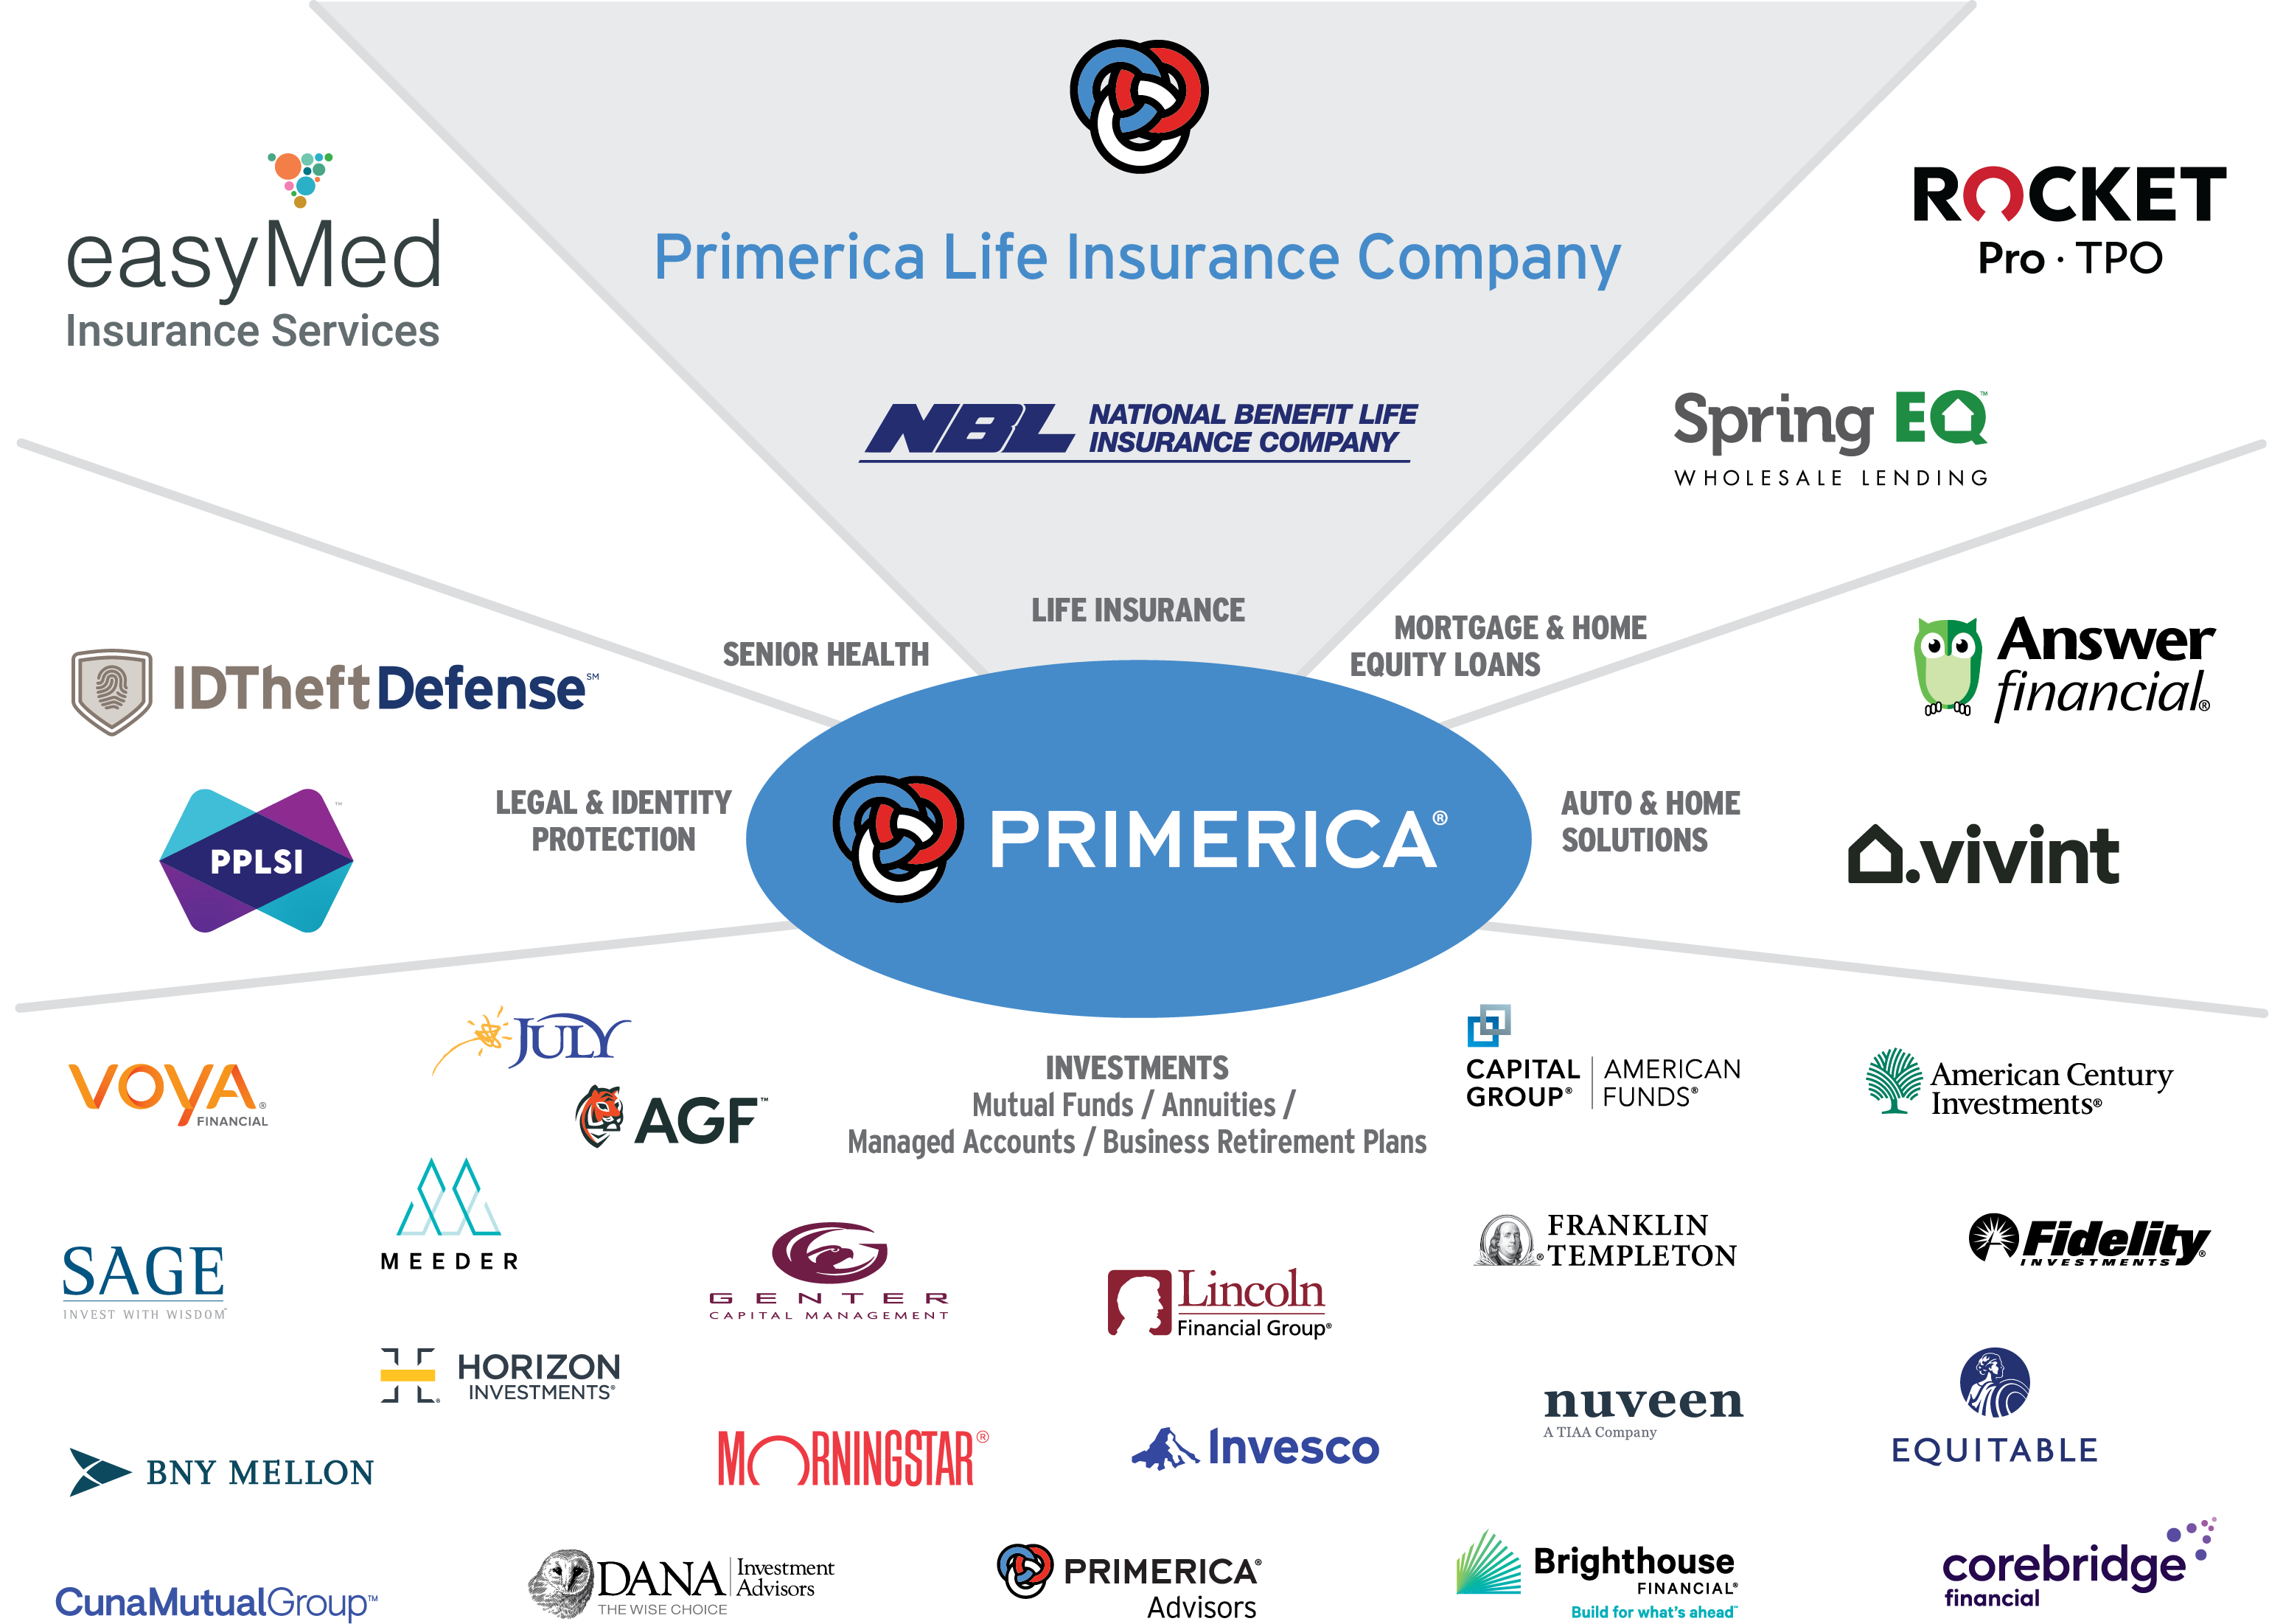
We assist families &
businesses with:
  - Budgeting
  - Debt elimination
  - Saving money on taxes &
  insurance
  - Redirecting savings to
  invest for the future
Not all products and services are available in all states, territories, or the District of Columbia. A representative's ability to offer products from the companies listed is subject to state and federal licensing and certification requirements.

Slide 3





Our Brokerage Model
Similar to Real Estate & Other Financial Agencies
Senior Vice President
Broker/Owner
Broker/Owner
Trainer/Recruiter
Part-Time, Full-Time
&/or Broker
Apprenticeship
Agent
Spare-Time/Part-Time
Personal Producer
1-3 Clients a Month

Slide 4

Insurance
Investment
$99 State
$25 Study & POL
$1800
$124
Study
Appts
PRI 101
Sat. 10:30-12:30
Until Complete Part 1 of Training
(Usually a Handful
of Classes)

Slide 5
Insurance
Investment
$99 State
$25 Study & POL
$1800
$124
Study
Appts
PRI 101
Tues. 6:30-7:45pm Arizona Time
Until Complete Part 1 of Training
(Usually a Handful
of Classes)

