Slide 1
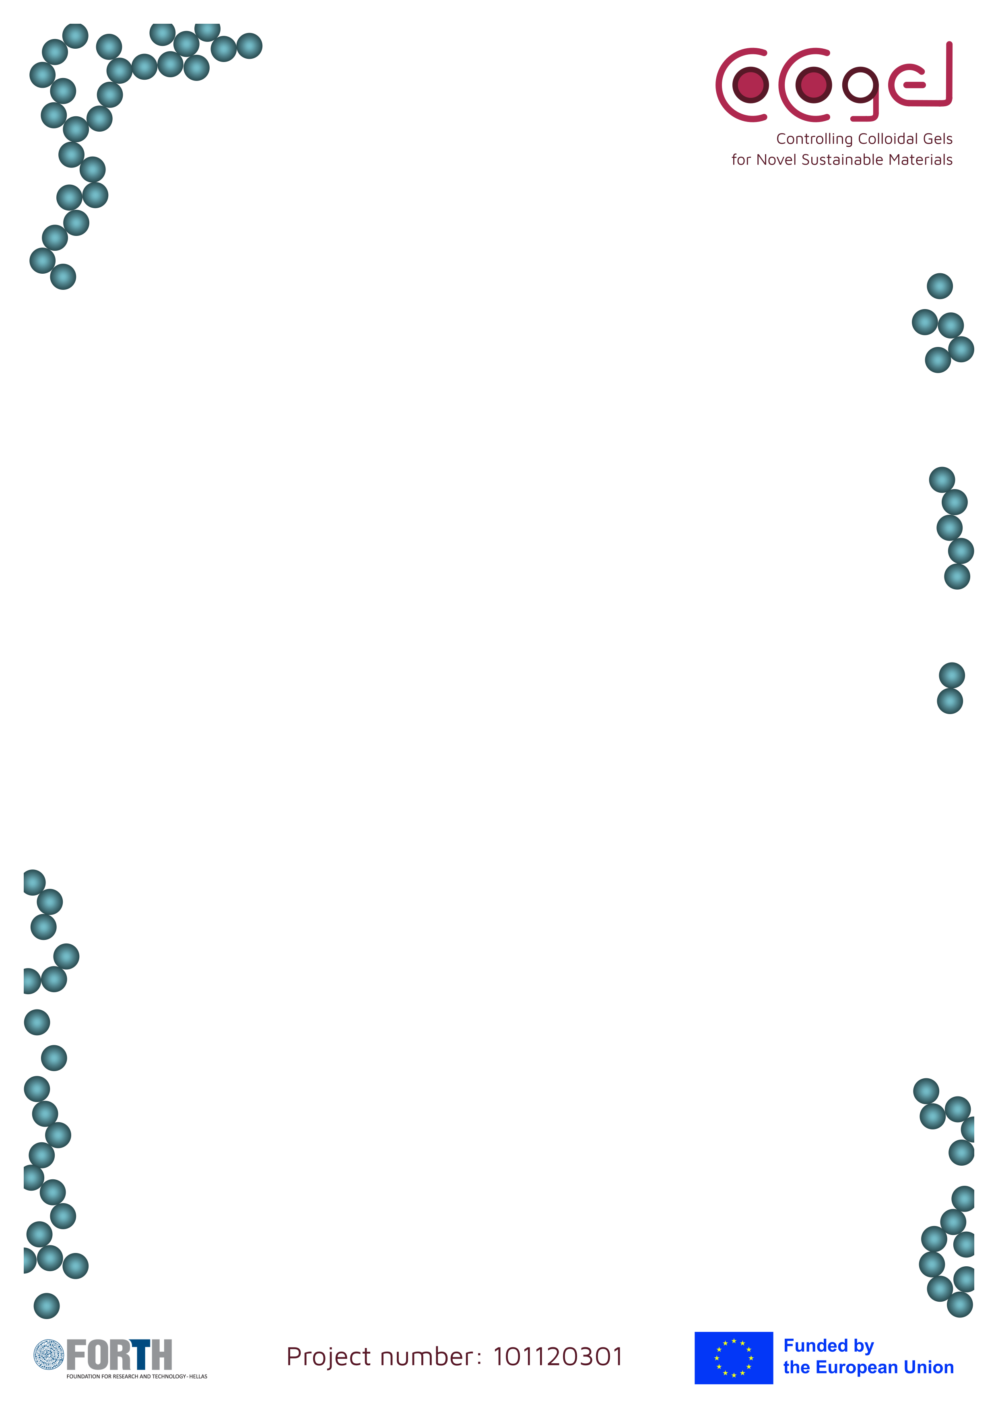


Third training & Project Review Meeting
02-06/11/2026
Monday 2nd of November 2026
Project Review Meeting
09:00 -11:00 | Tuning colloidal gels by ultrasound – DCs update
11:30 – 11:30 | Coffee break
11:30 – 12:30 | Turning colloidal gels by shear – DCs update
12:30 – 14:00 | Lunch break
14:00 – 15:30 | Turning colloidal gels by shear – DCs update
15:30 – 16:00 | Coffee break
16:00 – 18:00 | Turning colloidal gels by shear – DCs update
HERAKLION
Foundation for Research and Technology - Hellas
N. Plastira 100, Vassilika Vouton
GR - 700 13 Heraklion, Crete
Contacts
Coordinator: George Petekidis (georgp@iesl.forth.gr)
Project Manager: cocogel@iesl.forth.gr
Zoom link: To be added

Slide 2
Third training & Project Review Meeting
02-06/11/2026
Tuesday 3rd of November 2026
SAXS
9:00 - 10:30 | SAXS by Martin In and Thomas Gibaud
10:30 – 11:00 | Coffee Break
11:00 – 12:30 | SAXS by Martin In and Thomas Gibaud
12:30 - 14:00 | Lunch break
14:00 – 15:30 | Hands-on SAXS by Martin In and Thomas Gibaud
15:30 – 16:00 | Coffee Break
16:00 – 17:30 | Hands-on SAXS by Martin In and Thomas Gibaud
Location | FORTH Main Building, 1st Floor, Pagiataki Room
20:00 | Social dinner at XXXX
Wednesday 4th of November 2026
XPCS & DDM
9:00 - 10:30 | Confocal by Paddy Royall
10:30 – 11:00 | Coffee Break
11:00 – 12:30 | Confocal by Paddy Royall
12:30 - 14:00 | Lunch break
14:00 – 15:30 | Hands-on Confocal by Paddy Royall
15:30 – 16:00 | Coffee Break
16:00 – 17:30 | Hands-on Confocal by Paddy Royall
Location | FORTH Main Building, 1st Floor, Pagiataki Room

Slide 3
Third training & Project Review Meeting
02-06/11/2026
Thursday 5th of November 2026
DDM Part 2 & Confocal
9:00 - 10:30 | DLS/XPCS/DDM by Harish Srinivasan and Fabio Giavazzi
10:30 – 11:00 | Coffee Break
11:00 – 12:30 | DLS/XPCS/DDM by Harish Srinivasan and Fabio Giavazzi
12:30 - 14:00 | Lunch break
14:00 – 15:30 | Hands-onDLS/XPCS/DDM by Harish Srinivasan and Fabio Giavazzi
15:30 – 16:00 | Coffee Break
16:00 – 17:30 | Hands-onDLS/XPCS/DDM by Harish Srinivasan and Fabio Giavazzi
Location | FORTH Main Building, 1st Floor, Pagiataki Room
Friday 6th of November 2026
Project review meeting & hands-on session
9:00 - 12:OO | Tuning colloidal gels by electric/magnetic fields – DCs update
12:00 – 12:30 | Exploitation and impact on industrial systems – DCs update
12:30 - 14:00 | Lunch break
14:00 – 16:30 | Exploitation and impact on industrial systems – DCs update
16:30 - 18:30 | Hands-on session
Location | FORTH Main Building, 1st Floor, Pagiataki Room

Slide 4
Third training & Project Review Meeting
02-06/11/2026
Monday 2nd of November 2026
Tuning colloidal gels by ultrasound – DCs update
09:00 - 09:30 | DC4 – Matthew Roniger
09:30 – 10:30 | DC5 – Aoxuan Wang
10:30 – 11:00 | DC13 – Nicollas Safanelli
11:00 – 11:30 | Coffee break
11:30 - 12:00 | General discussions
Turning colloidal gels by shear – DCs update
12:00 – 12:30 | DC1 – Starla Liu
12:30 - 14:00 | Lunch break
14:00 - 14:30 | DC2 – Malavika Mekkat Narayanan
14:30 – 15:00 | DC10 – Stefan Schmid
15:00 – 15:30 | DC7 – Dimos Aslanis
15:30 – 16:00 | Coffee break
16:00 – 16:30 | DC14 – Huadan Xu
16:30 - 17:30 | General discussions
Work Packages review
17:30 – 18:00 | Work Packages review

Slide 5
Third training & Project Review Meeting
02-06/11/2026
Friday 6th of November 2026
Tuning colloidal gels by electric/magnetic fields – DCs update
09:00 - 09:30 | DC6 – Jose Lopez Luque
09:30 – 10:30 | DC11 – Federica Castellone
10:30 – 11:00 | DC3 – Arianna Bartolomei
11:00 – 11:30 | Coffee break
11:30 – 12:00 | General discussion
Exploitation and impact on industrial systems
12:00 – 12:30 | DC12 – Anna Lapeta
12:30 - 14:00 | Lunch break
14:00 - 14:30 | DC9 – Sandeep Chinnabathina
14:30 - 15:00 | DC8 – Lennard Schulte
15:00 – 15:30 | DC15 – Paulo Chiam
15:30 – 16:00 | Coffee Break
16:00 – 16:30 | General discussion
Hands-on session
16:30 – 18:30 | Hands-on session

