Slide 1
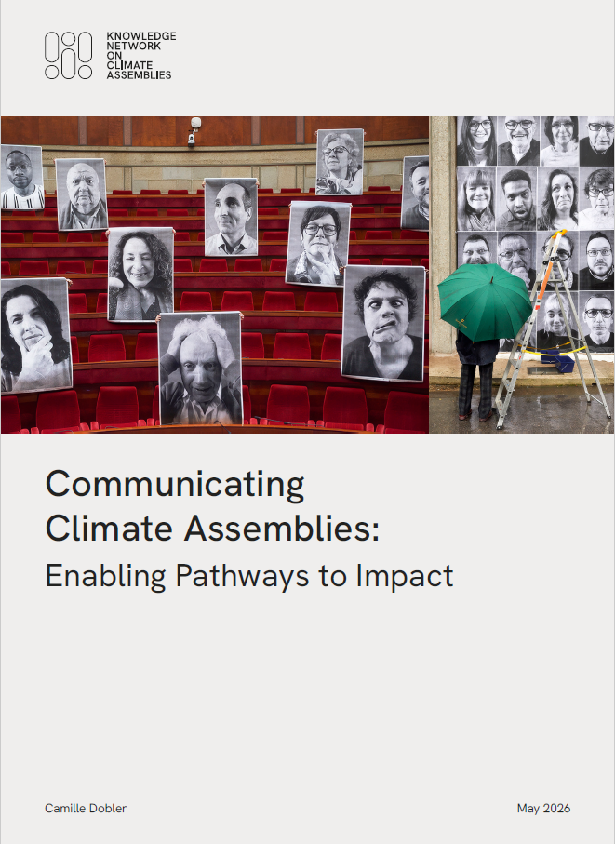
KNOCA Guidance
Communicating
Climate Assemblies
Camille Dobler – Missions Publiques

Slide 2
A 12-Step Guide
Before
Integrating communication from the start
1: Define why communication matters
During
Getting the right message out
6: Write a good story
After
Keeping the narrative alive
10: Plan a high visibility handover
11: Continue supporting members
12: Maintain visibility after handover
7: Empower and support assembly members
8: Pick the right dissemination channels
9: Establish safeguards
2: Secure internal ressources and capacities
3: Identify and understand your audience
4: Identify and reach out to multipliers
5: Anticipate communication packages

Slide 3
Communication is infrastructure for impact
Communication is not promotion. It is part of
the assembly’s impact strategy.
What kind of impact are we communicating for ?
Transparency
Political buy-in
Public debate
Inclusion
  Recruitment
Impact goal?
Audience
Story
Channels
Follow-up

Slide 4
There is no such thing as “the public”
      The public is not one single audience. Audience mapping is a strategic exercise.
  Who can act on the recommendations?
  Who can block or delegitimise them?
  Who can amplify the process credibly?
  And who needs reassurance because they may be suspicious of the topic, the commissioner, or the method?
Assembly Members
Policymakers, stakeholders, affected groups ·
Media, experts, civil society, community intermediaries, creators

Slide 5
Multipliers make the assembly travel
Your website and social channels will not reach far enough on their
own. You will need allies.
Media pathway | What they look for | What you can offer
Generalist | public hook, political relevance | opening, handover, press kit
Local | local person, local place, local consequence | member story, local interview
Specialist | depth, evidence, trade-offs | briefings, expert inputs, recommendations
Social media | Short formats, everyday framing, human stories, visual material | visuals, explainers, myth-busting
    Inspiring cases
Germany Assembly on Nutrition
Turned a national assembly into local stories by matching regional journalists with local members
Bourgogne–Franche-Comté Climate Assembly
Used an embedded France 3 journalist who built trust by following the process closely.
Ireland Biodiversity Assembly
Multiplied messages through stakeholders and professional networks

Slide 6



Tell two stories, not one
Do not lead with abstraction and ‘grand ideas’ only.
The strongest policy story is not “climate action is necessary”.
It is “ordinary people weighed difficult choices about everyday life”
Avoid the three traps:
Green elite story
“This is an activist project”.
Doom or wishful thinking
“Everything is catastrophic” / “We can change the world.”
Technocratic story
“Carbon neutrality, pathways, targets…”
‘The Process’ story | ‘The Issue’ story
‘People like me’ Selection process Weighing evidence together – The learning journey Reaching recommendations –The deliberative journey | Every day life: bills, health, jobs, food, mobility, etc. Real trade-offs: Who pays? Local and near-term: what does it mean here and now?
6

Slide 7
Members are the strongest messengers — if supported
      Their strength is authenticity, not polish.
      Support them to speak — do not turn them into spokespeople.
  Opt-in consent
  Light media briefing
  Mock interview / practical tips “What not to share yet” guidance
  Media requests via comms team
  Buddy / peer support
  Named contact person
  Consent → Prepare → Connect → Debrief → Continue support
    Inspiring cases
Germany Assembly on Nutrition
Opt-in media list; only willing members were filmed/interviewed; small groups not recorded.
Austria Climate Assembly
Interested members received media training; members became visible faces of the assembly.
UK People’s Plan for Nature
Post-assembly workshops, mentoring, toolkits, updates and honoraria.
EU Young Citizens Assembly on Pollinators
Communication & Advocacy task forces supported by a “secretariat”

Slide 8
Prepare for backlash
    Inspiring cases
The Netherlands Climate Assembly
Recurring attacks framed the assembly as an expensive “left hobby”, with members portrayed as green activists or unfairly selected. Organisers responded by increasing transparency: portraits, infographics, expert diversity, Q&As, political observation and day-to-day monitoring.
Most attacks are not about the recommendations / the outputs.
They are about legitimacy / the process.
Predictable attack | What to make visible | Useful asset / response
“It is biased.” | Selection method, quotas, representativeness | Recruitment infographic; plain-language FAQ
“Members are activists.” | Diversity of members, ordinary-life profiles, consent-based portraits | Member portraits; “who is in the room?” explainer
“Experts are manipulated.” | Expert selection, range of views, member agency in choosing inputs | Expert list; evidence map; Q&A on knowledge phase
“It costs too much.” | Budget, purpose, public value, what the process enables | Short budget note; comparison with policy stakes
“It is citizen-washing.” | Mandate, decision route, limits of the assembly, commissioner commitments | Mandate explainer; follow-up timeline
“Nothing will happen.” | Response process, responsible institutions, tracking mechanism | Implementation tracker; scheduled update moments
Respond (Q&As, corrections, monitoring)
Pre-bunk (Make legitimacy visible before attacks start)
Crisis Protocol
Protect (Members, deliberation, privacy, unfinished work)

Slide 9
The story continues after the assembly
Impact is often won or lost after the report is published. And so are
“narratives battles”.
Risk after handover | What communication should do
Members hear nothing | Keep them informed
Follow-up becomes technical | Translate progress
Media moves on | Create new moments (6 months/1 year/2years)
Recommendations disappear inside administration | Track publicly
Political context changes | Keep commitments visible
    Inspiring cases
Brussels Climate Assembly
A monitoring platform tracks recommendations; every six months the Secretariat checks progress with administration experts and publishes updates.
European Citizens Panels
An alumni network keeps the link between organisers and members and a newsletter is now being sent on a regular basis.

Slide 10
KNOCA Guidance
Communicating
Climate Assemblies
camille.dobler@missionspubliques.com

