Slide 1

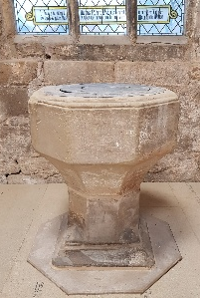

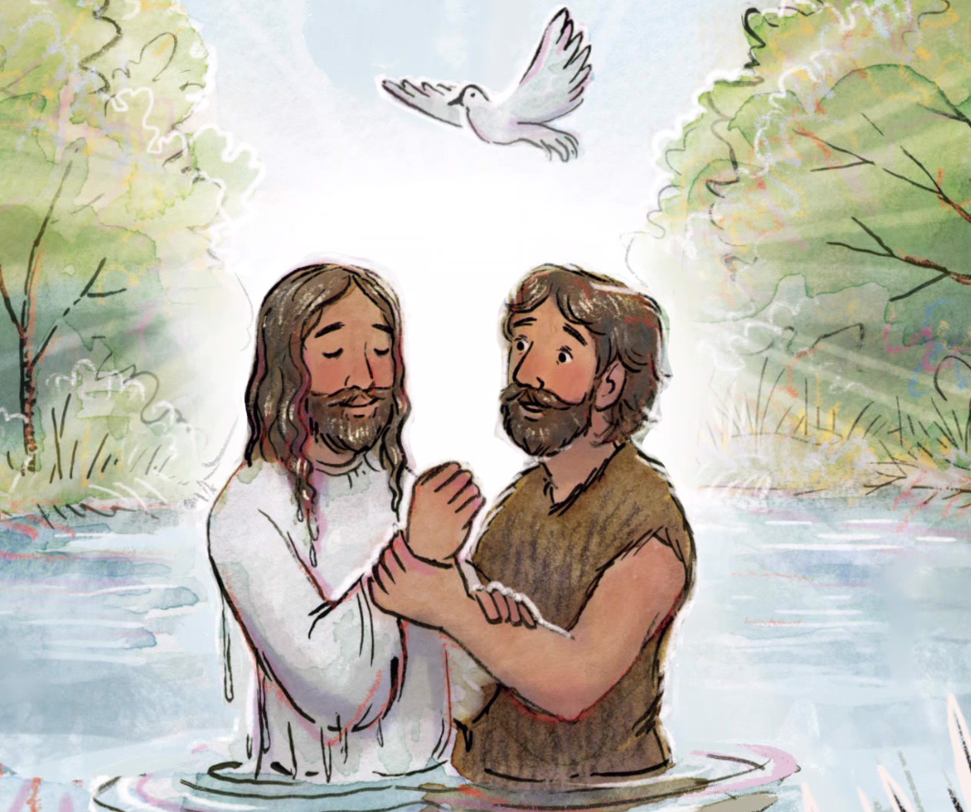

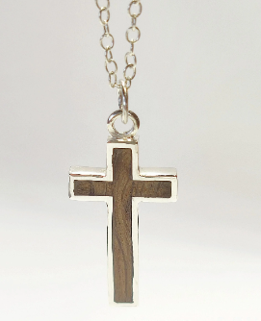

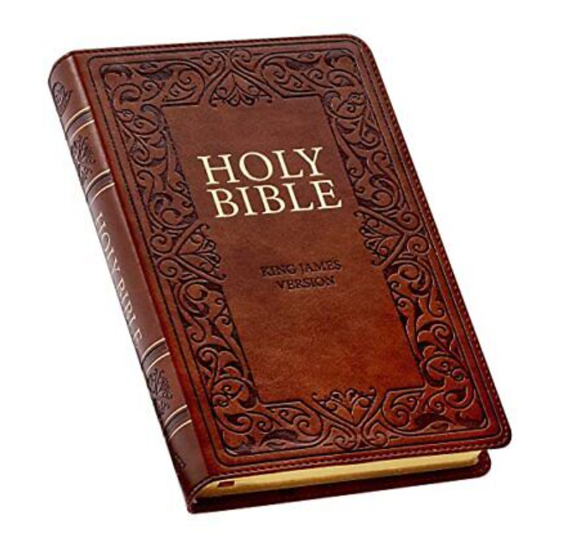
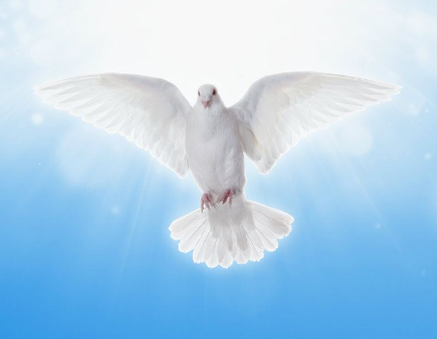
Eggbuckland Vale Primary School | Religious Education | KS2: Year 3
L2.3 What is the ‘Trinity’ and why is it important for Christians?
What I should already know:
That Jesus gives instructions to people about how to behave. Know that Gospel is ‘good news’. Christians say sorry to God and receive forgiveness. Babies are baptised.
New learning (facts):
Water is a symbol in Christianity for rebirth. Christians believe that Jesus has come to earth to save people. Christians are baptised to be forgiven for their sins. Christians believe God is three in one: Father, Son and Holy Spirit. The Nicene Creed is a statement of Christian beliefs that was created by church leaders in 325 CE.
Vocabulary:
Symbol | A thing that represents or stands for something else.
Baptism | Baptism is a symbolic act where a person is briefly dunked under water to represent their old life and sins being washed away.
Gospel | The word gospel means “good news,” and gospel songs often praise God or Jesus.
Holy Spirit | The Holy Spirit does work that the Father and the Son do not.
Prayer | The main form of communication Christians can have with God..
Sin | Sin is the bad stuff people do that makes God sad and often upsets other people.
Font | A container in a church that holds the water for a Baptism.
Disciple | A personal follower of Jesus Christ during his life.
Holy Trinity | Holy Trinity or The Trinity, is a way of describing God the Father, God the Son and God the Holy Spirit.
Father | When talking about the Holy Trinity, the Father means God.
Son | When talking about the Holy Trinity, the Son means Jesus.
Nicene Creed | A Christian statement of their beliefs.
Enquiry questions:
How is water used as a symbol in Christianity? What is the true meaning of Gospel? What is the ‘Trinity’? What does The Nicene Creed tell us about what Christians believe? How is baptism different for babies and adults? Why is the trinity important to Christians?
New learning (skills):
Describe how Christians show their beliefs about God the Trinity in worship in different ways in the way they live. Recognise what a ‘Gospel’ is and give an example of the kinds of stories it contains. Give examples of what these texts mean to some Christians today.

