Slide 1

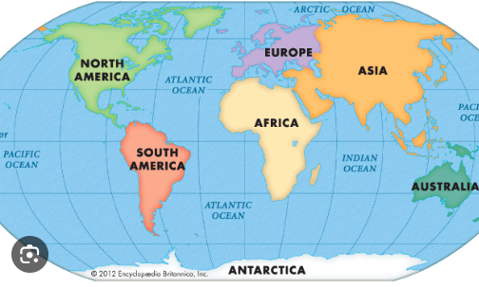
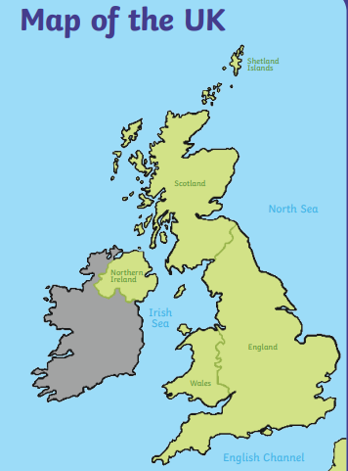

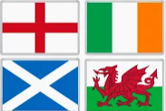
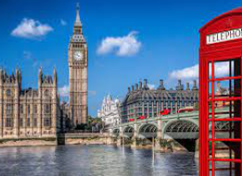



Eggbuckland Vale Primary School | Geography | KS1: Year
Where are we? Star Group Linked learning
What I should already know:
There are different countries in the world I can talk about where I live
Geographical skills
Location – use maps to find the 4 countries of the UK. Place – Compare the different countries of the UK Human and Physical – Identify characteristics of the 4 countries of the UK. Draw a sketch map of my local area
Vocabulary
Continent | A land mass covering earth
Country | An area of land with its own government, rules and borders
city | A centre of population, bigger than a town or village.
landmark | A famous building or site in a city.
UK | The United Kingdom. It is made up of four countries: England, Scotland, Wales and Northern Ireland.
Ocean | A body of water on earth.
Island | An area of land surrounded by water
capital | The largest and main city in a country.
Plymouth
Enquiry Questions
What do we know about the UK?
Where do we live?
What makes England special?
What can we find in Scotland?
Where is Wales?
What are the landmarks in Northern Ireland?
London
Cardiff
Belfast
Edinburgh

