Slide 1

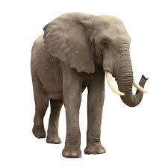
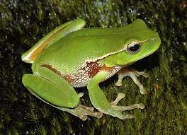
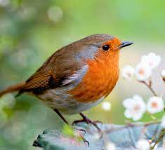
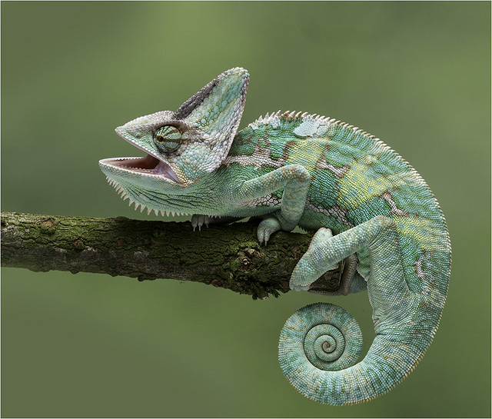
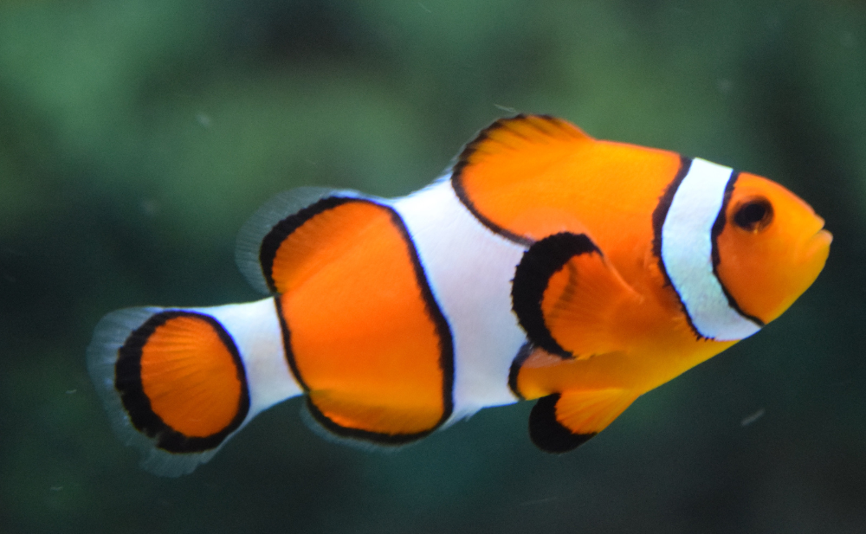
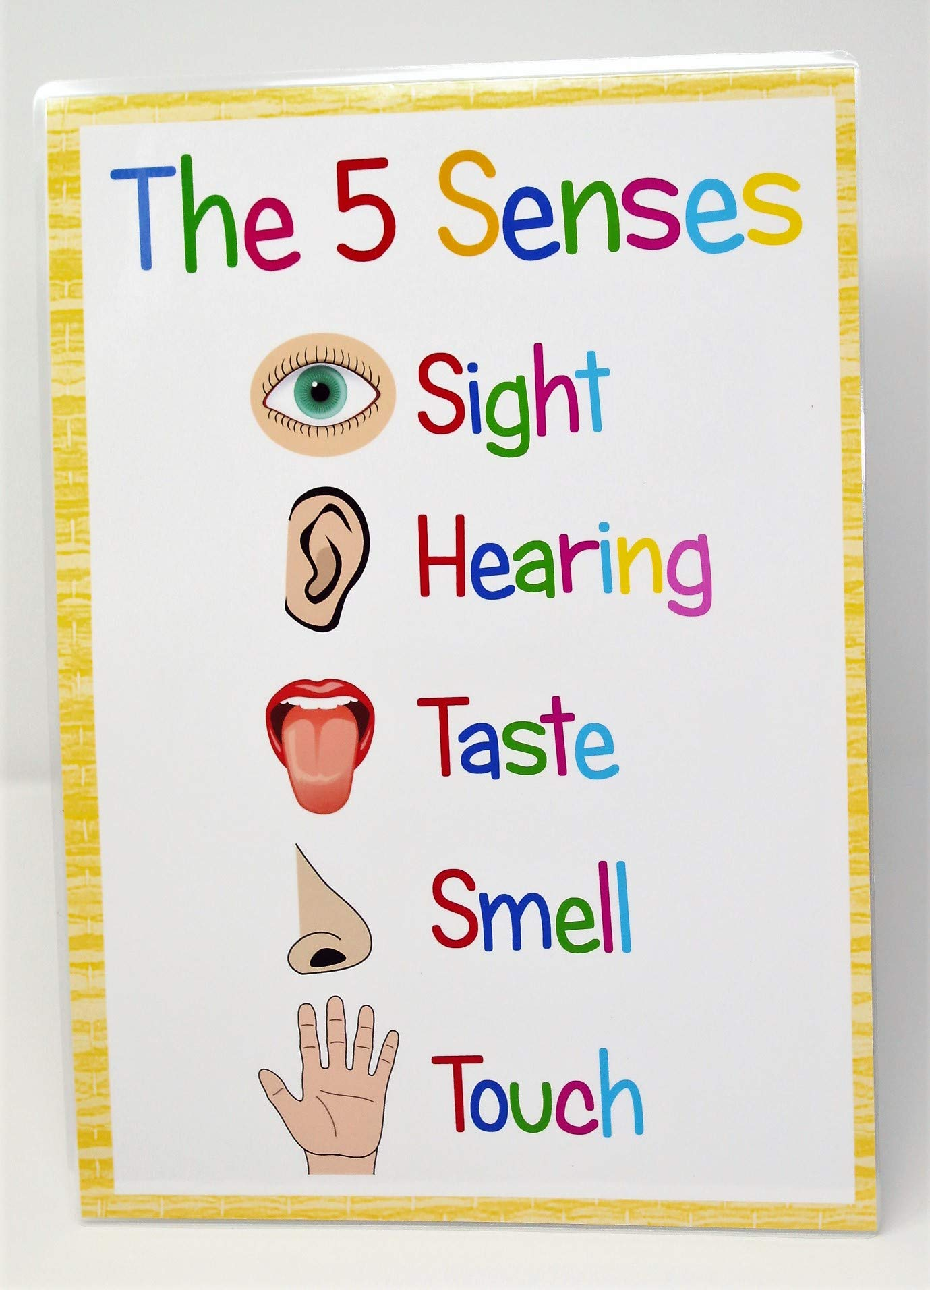







Science | KS1: Year 1
Animals including humans.
Enquiry questions:
What animals are there and how can we group them? What is a mammal, amphibian, reptile, fish and bird? What body parts does each type of animal have? What are herbivores, carnivores and omnivores? What did they eat? What are the senses? Which body parts are associated with them?
Vocabulary:
Mammal | A warm-blooded animal that has hair or fur. Most mammals have live young.
Amphibian | A cold-blooded animal that has gills when young before developing lungs.
Reptile | An animal that has dry scaly skin, they often lay eggs on the land.
Bird | A warm-blooded animal that has wings, feathers and a beak. Most birds can fly
Fish | A cold-blooded animal that has gills and fins. Fish live in water.
Omnivore | An animal or human who eats both meat and plants.
Carnivore | An animal that eats only meat.
Herbivore | An animal that eats plants.
Senses | the ability to see, taste, touch, smell, and hear.
What I already know:
Identify and name a variety of animals (pets) Identify and name a variety of animals (jungle and ocean) Identify and name a variety of minibeasts. Notice that babies grow into adults (Life Cycles).
Mammal
Amphibian
Bird
New knowledge:
Animals can be grouped into mammal, amphibian, bird, reptile or fish. Animals are carnivores, herbivores, or omnivores. Animals have different body parts which can tell us whether they are a mammal, amphibian, bird, reptile or fish. Humans have 5 senses (hearing, touch, sight, smell and taste) These senses are linked to our body parts.
Reptile
Fish
Scientific skills:
Compare and sort different animals. Identify different animals using their features. Observing and predicting whether the poo is from a carnivore, herbivore or omnivore and explaining why. Exploring our 5 senses, identifying what each one does, how they help us and what we need if one is impaired.

