Slide 1

Intake & Office Processes – Building a Scalable Elder Law Firm
Presented by: Doug Weiner (Intake
Coordinator), and Todd Whatley

Slide 2
The Intake Process
Doug Weiner, Intake Coordinator, Generations Legal Group

Slide 3
In This Session
01
04
02
05
03
06
Why Non Attorney Intake?
Taking Care of Business
3 Part Framework
Building Trust
Building The Team
Clean Hand Off

Slide 4
01
Why Non-Attorney Intake?

Slide 5
First Impressions Count
Intake seems like a simple step, but it’s make or break for the firm.
Setting The Tone
Building Expectations
3 Goals - Qualify, Educate, Prepare

Slide 6
Qualify
Can We Help?
People don’t understand that all attorneys aren’t created equally. Making sure they understand that you’re different than the attorney they used for their 5th divorce, 3rd DUI and Injury claim, AND why that matters.
Do They Want Our Help?
Some people look for the cheapest and easiest way to do things. That shouldn’t be you. Your expertise is worth the investment.

Slide 7
Educate
Keep it simple.
Most of your clients won’t understand all of the nuance you do. That’s OK. The intake process is designed to tell them ONLY what’s actionable.
Complexity Is The Enemy of Clarity
What’s in it for me?

Slide 8
Prepare
What Do They Want to Happen?
What Do They Want to NOT Happen?
Give Them The Roadmap
They don’t understand all of the tools available. They don’t need to. They need to know what will solve their problems (That they don’t know they have yet).
Loss aversion is more power for most people than potential opportunity. Make sure they understand what they’re avoiding.
What is the next step? The step after that?

Slide 9
Building The Team
Estate Planning isn’t just legal
Tax Planning
The process of figuring out where assets go at death involves assets. In some cases it involves taxes.
Focusing on 1 aspect isn’t comprehensive, and it isn’t what specialists do.
Is it as simple as having a beneficiary designation on accounts? What if there’s an error?
Financial Planning Coordination
Working with a CERTIFIED FINANCIAL PLANNER(™) who acts as a fiduciary enhances your credibility as a specialist. You are the go-to professional on their team. As such, you have a roster to back you up.

Slide 10
Taking Care of Business
Consent to Plan
Get The Money
Trust or No Trust?
Our firm requires the client consent verbally and in writing to having the CFP(R) present in a meeting.
Securing a downpayment for the work makes sure that interests are aligned and everyone is on the same page.
The intake role doesn’t give legal advice, but can ask questions or frame the relevant issues for clients to consider before meeting w/ attorney
innovative technologies

Slide 11
Building Trust
Tell them what you’re going to do.
Tell them what you told them.
Tell them what you did.

Slide 12
Clean Hand Off
Questions?

Slide 13

Part 2: Closing the Case with Confidence
Presenter: Todd Whatley
13

Slide 14
Turning Conversations Into High-Value Engagements
Why Elder Law Attorneys Deserve to Get Paid Well
Youʼre solving $100,000 problems — not drafting
$500 documents
The better the intake, the smoother the close
This is where purpose meets profitability
14

Slide 15

Building Confidence in the Room
Your #1 Goal: Inspire Confidence, Not Confusion
Validate the clientʼs concerns (“Youʼre right to be worried about nursing homes”)
Frame the attorney as the planner and protector
Trust and authority comes from clarity + calm confidence
12

Slide 16
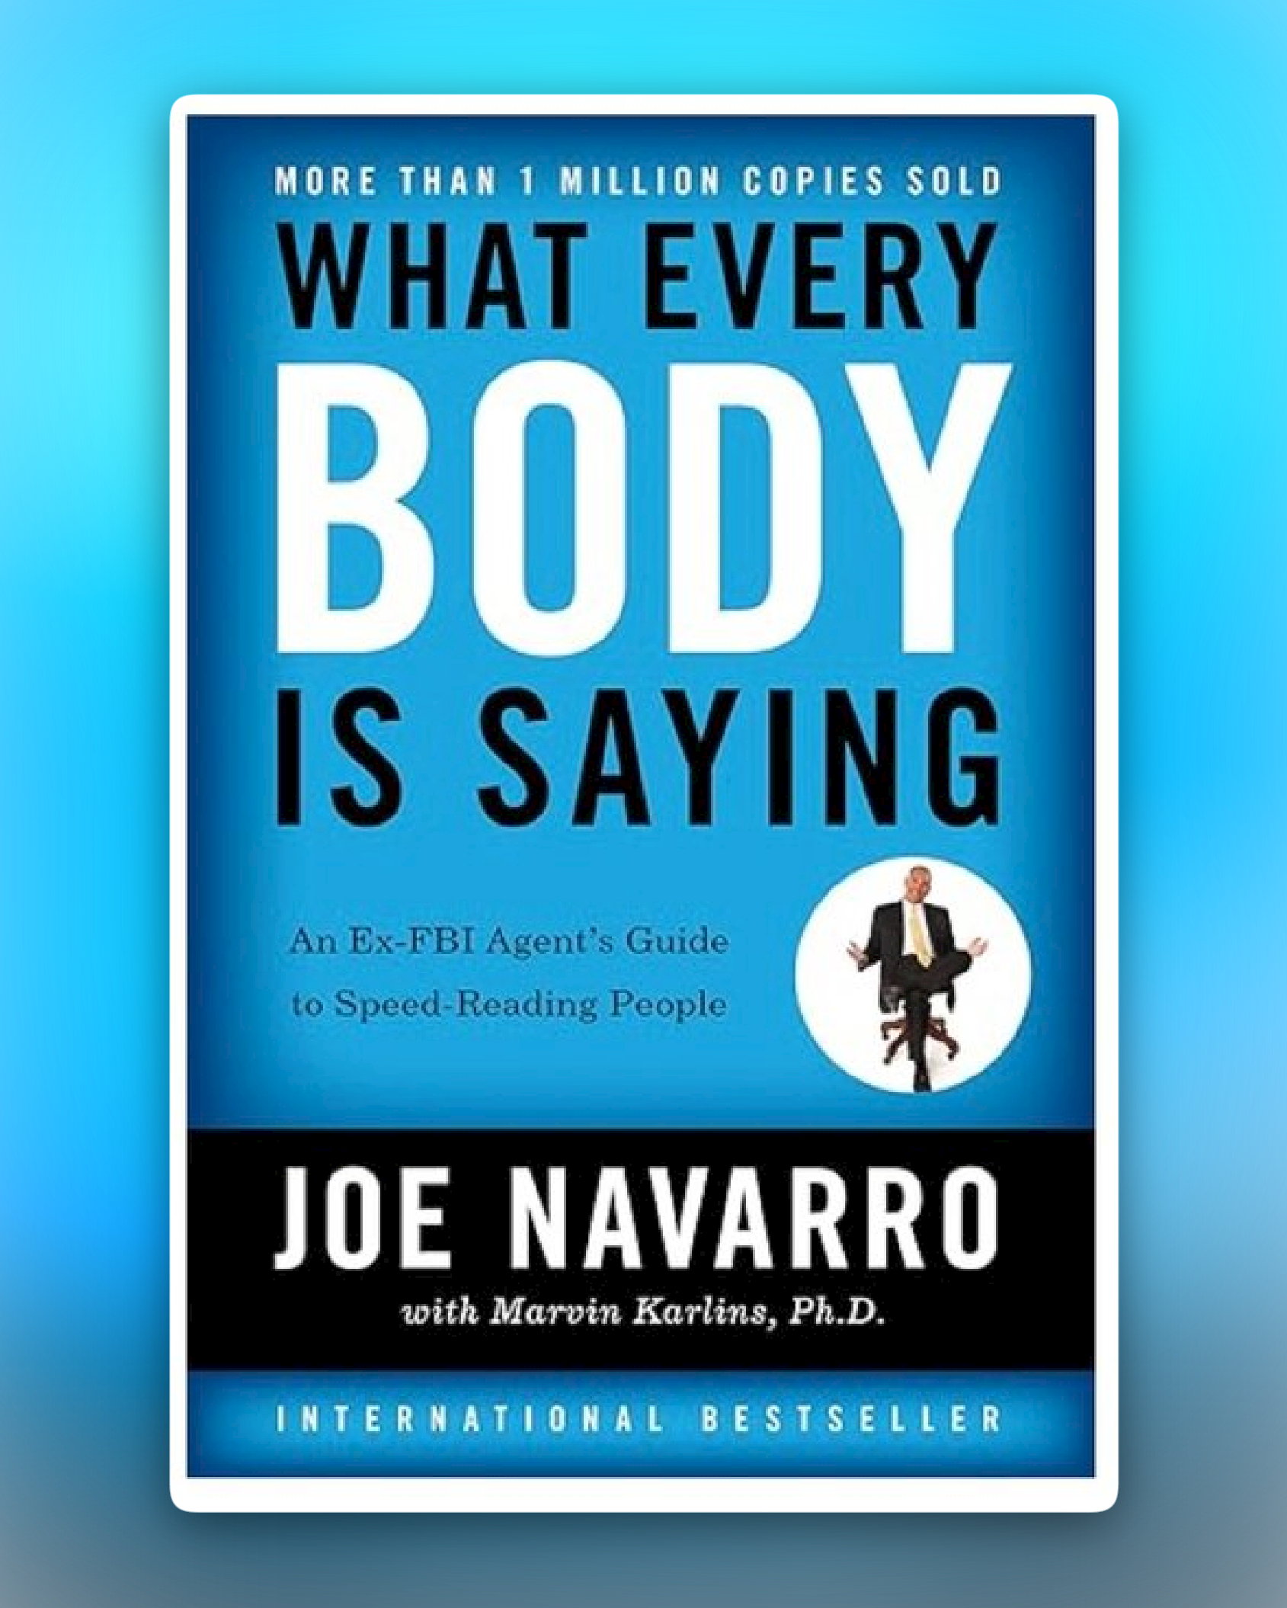
Read the Room
Body language, both
yours and theirs, is
crucial to building
confidence and
knowing what they are thinking.
Book: What Every Body is saying. By Joe Navarro
13

Slide 17

The Psychology of Fee Anchoring
How to Sell a $5,000 or $20,000 Plan with No Pushback
Anchor the value to real, scary numbers:
  Probate: 5 to10% of estate
  Nursing homes: $120,000/year
  Medicaid spend-down risk: their entire legacy
Key Phrase: Every time you say “nursing home or probate” you say the price of it.

Slide 18

Normalizing High Fees
Youʼre Not Expensive—Youʼre a Bargain
Examples:
“The Medicaid planning fee is $14,000—but itʼs saving you
$150,000.”
“Probate will take 12 months and cost $30,000—our trust plan avoids all of that.”
Phrase to Teach:“I'm ONLY charging you $XXXX to do this.”

Slide 19
Closing the Meeting Without Fear
How to Ask for the Engagement
“Would you like us to take care of this for you?”
“Is there any reason we shouldnʼt go ahead with this today?”
Present a clear, written proposal with scope and price
Todd's Favorite: "When do we get to work?"

Slide 20
The Power of the Team Close
Why It Works When Doug and Ian Set You Up
Doug has already built rapport and pre-sold POAs/trusts
Ian brings clarity to the clientʼs financial big picture
YOU deliver the confident legal plan — and close the deal
T“his 3-touch model increases closing rates and reduces objections.

Slide 21
Real-World Fee Examples
Hereʼs What We Charge—and Why
Service | Typical Fee | Anchored Value
POA Package | $750 $1,500 | Basic protection for ALL adults
Revocable Trust Plan | $1,850 $7,500 | Avoids $30,000+ probate
Asset Protection Trust | $7,500 $12,000 | Avoids Medicaid spend-down
Medicaid Qualification Plan | $10,000 $24,000 | Saves $100,000+ in care costs (protects $1 Mill.)

Slide 22
Final Wrap-Up: The Profitable, Purpose-Driven Practice
When Intake, FA Collaboration & Confident Closing Align…
✅ You help more families
✅ You close more cases
✅ You earn what youʼre worth
✅ You build a sustainable, scalable business

Slide 23
Questions???

