Slide 1

Marketing Mastery for Elder Law Attorneys
1

Slide 2

Why Marketing Must Be a Core Skill for Every Elder Law Attorney
Build It and They Wonʼt Come — Unless You Market
Legal knowledge ≠ business success
Even with word-of-mouth, you need consistent lead generation
This session: simple, sustainable ways to grow your visibility AND client base
2

Slide 3

Website & Lead Generation Strategies

Slide 4
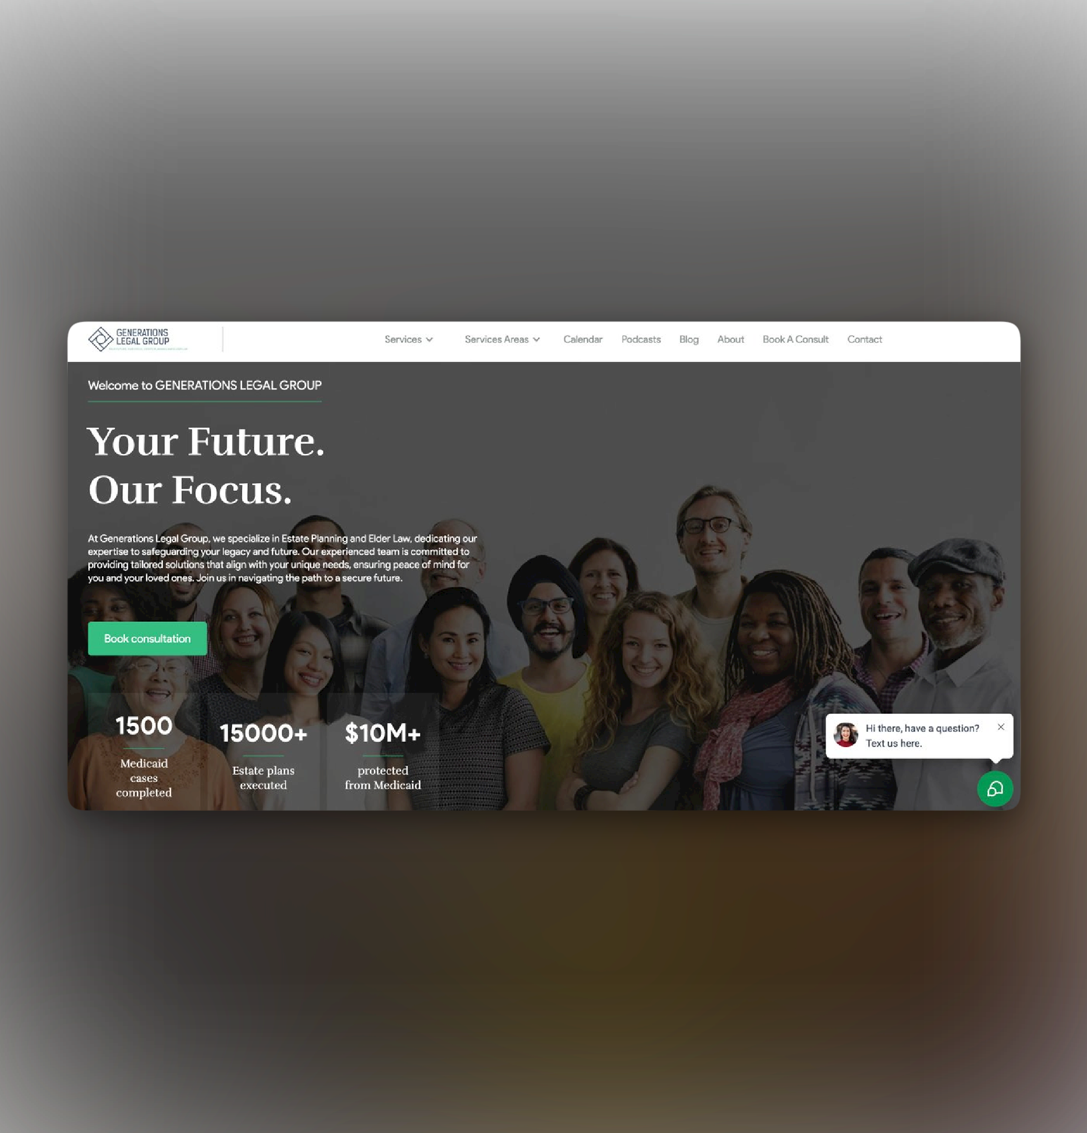
Your Website is Your Digital Office
Must-Haves:
Mobile-optimized design
Fast page load
Clear, emotional headline (“Protect Your Family & Assets With Compassionate Legal Guidance”)
Call-to-Action above the fold Schedule Consultation / Download Free Guide)
Video of you speaking (builds trust instantly)

Slide 5

Build a Lead Machine, Not a Brochure
Tools You Need:
Appointment scheduler (Calendly, Lawmatics, etc.)
Exit-intent pop-up (e.g., “Free 15 Minute Elder Law Consultation”)
Lead magnet (e.g., “5 Ways to Protect Your Assets from the Nursing Home”)
Client testimonials or case study blurbs

Slide 6
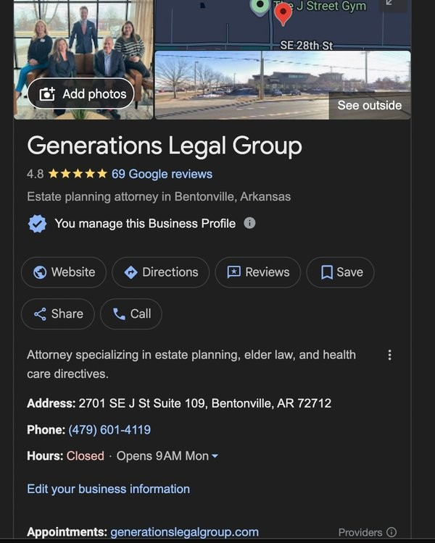
Google Search: Where Estate Planning Begins
Local SEO Basics:
Google Business Profile (Fully filled out)
10 Google reviews (Request them post-consultation)
Keyword pages for: “Elder Law Attorney, City ” / “Medicaid Lawyer, City ”
Blog content to answer FAQs and improve search ranking
6

Slide 7
Social Media & Content That Converts

Slide 8

Where Your Clients (and Their Kids) Are Online
Platforms to Focus On:
Facebook: Local families, adult children
YouTube: Educational videos (hosted webinars, Q&A clips)
Instagram: Behind-the- scenes, testimonials
LinkedIn: B2B referral partners: FAs, CPAs, real estate agents
ChatGPT

Slide 9
5 High-Value Content Ideas You Can Use Now
Content Type | Example
Client FAQ | “Can Medicaid Take My Momʼs House?”
Myth-Busting | “3 Lies People Believe About Estate Planning”
Video Clip | “Why Every Adult Needs a POA – in 60 Seconds”
Downloadable Guide | “Trust vs. Will: Which Do You Need?”
Personal Story | “Why I Do Elder Law – My Story With My Mom”

Slide 10

The Key to Great Marketing?
Consistency
Example:
2 educational posts/week
1 video/month
1 newsletter/month
1 live Q&A every quarter
You don’t have to go viral, you just need to stay seen.
10

Slide 11

Using Webinars & Seminars to Attract Ideal Clients
11

Slide 12

Why Workshops Work
Establish authority in the room. Seniors trust people they can see in person.
Builds trust FAST — before theyʼve even paid you
Creates urgency and immediate booking opportunities
Attorneys who do live events consistently out-earn those who donʼt

Slide 13
Keys to a High-Converting Seminar/Webinar
Checklist:
Simple, bold title (e.g., “How to Protect Your Home from the Nursing Home”)
Teach ONE (maybe two) big problem — and your solution
Tell real stories
Hand out a worksheet (trigger note-taking)
Offer a bonus consultation if they book today
13

Slide 14
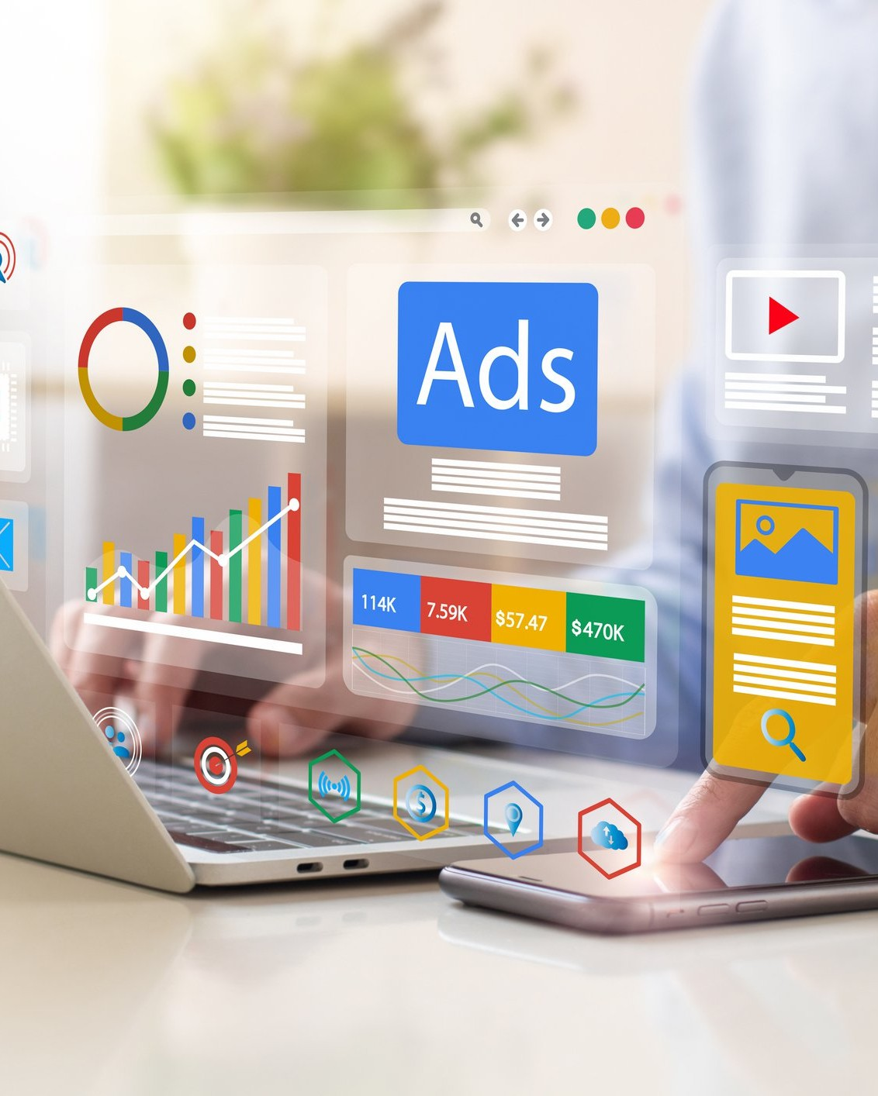
Promote Your Events Like a Pro
Channels to Use:
Email list
Facebook Events + ads
Direct mail (co-branded with FA or community partner)
Referral partners — let them bring their clients!
14

Slide 15
How
to Get Others to Pay for Your Marketing

Slide 16
Most Financial Advisors Have Access to Marketing Dollars
The Truth Most Attorneys Donʼt Know:
FAs who work with Insurance Marketing Organizations, IMOs, often receive marketing budgets from carriers
Unfortunately, many spend this money on generic campaigns that donʼt convert

Slide 17
The Smarter Way: Co- Branded Legal + Financial Events
Instead of:
Paying $3,000 for a dinner seminar alone

Slide 18
Try:
Partnering with an FA (like us!) who can use IMO funding to:
  Cover event costs
  Co-market to their list
  Show up with credibility and planning value
  Result:
You deliver the legal side. They reinforce the financial. Clients see a complete solution.

Slide 19
Examples of Co-Branded Event Topics
Topic | Legal & Financial Angle
“How to Avoid Losing Your Home to the Nursing Home” | Irrevocable trust + LTC annuities or hybrid policies
“Estate Planning That Protects Multiple Generations” | GST trust + investment continuity plan
“How to Pay for Long-Term Care Without Going Broke” | Medicaid plan + asset repositioning

Slide 20
The Win-Win-Win
Party | Benefit
Client | Leaves with answers, confidence, and action steps
Attorney | New high-quality leads & higher conversion rate
FA | Grows client base & solidifies financial relationship

Slide 21
We can Help with This?
Weʼre already doing this.
✅ We know the compliance
✅ We have the infrastructure
✅ We have the IMO support
✅ We WANT to help attorneys like you grow — because it grows our practice too
““We can co-host your next seminar. Weʼll help you fund it, fill it, and close it.”

Slide 22

Recap & Action Plan
✅ Fix your website — make it convert
✅ Start posting — and donʼt stop
✅ Host educational events — they work
✅ Stop marketing alone — let others (like us) help fund and grow with you

Slide 23
Free content calendar template
Sample seminar PowerPoint
List of 25 social media post ideas
Sample email invite for event marketing
Bonus Resources

