Slide 1


August 2025

Slide 2

1
2
3
4
5
6
Mention your name and where you are from.
Everyone speaks same amount of time
(~1 min, use timer) or you can skip.
Reference specific page numbers.
Focus on sharing what you learned or disagreed with.
When sharing, use “I” not “we” or “you.”
This helps each person learn and share independently.
If you have a question, mention it and discuss privately afterwards.
Just Show Up
Book Club Guidelines

Slide 3
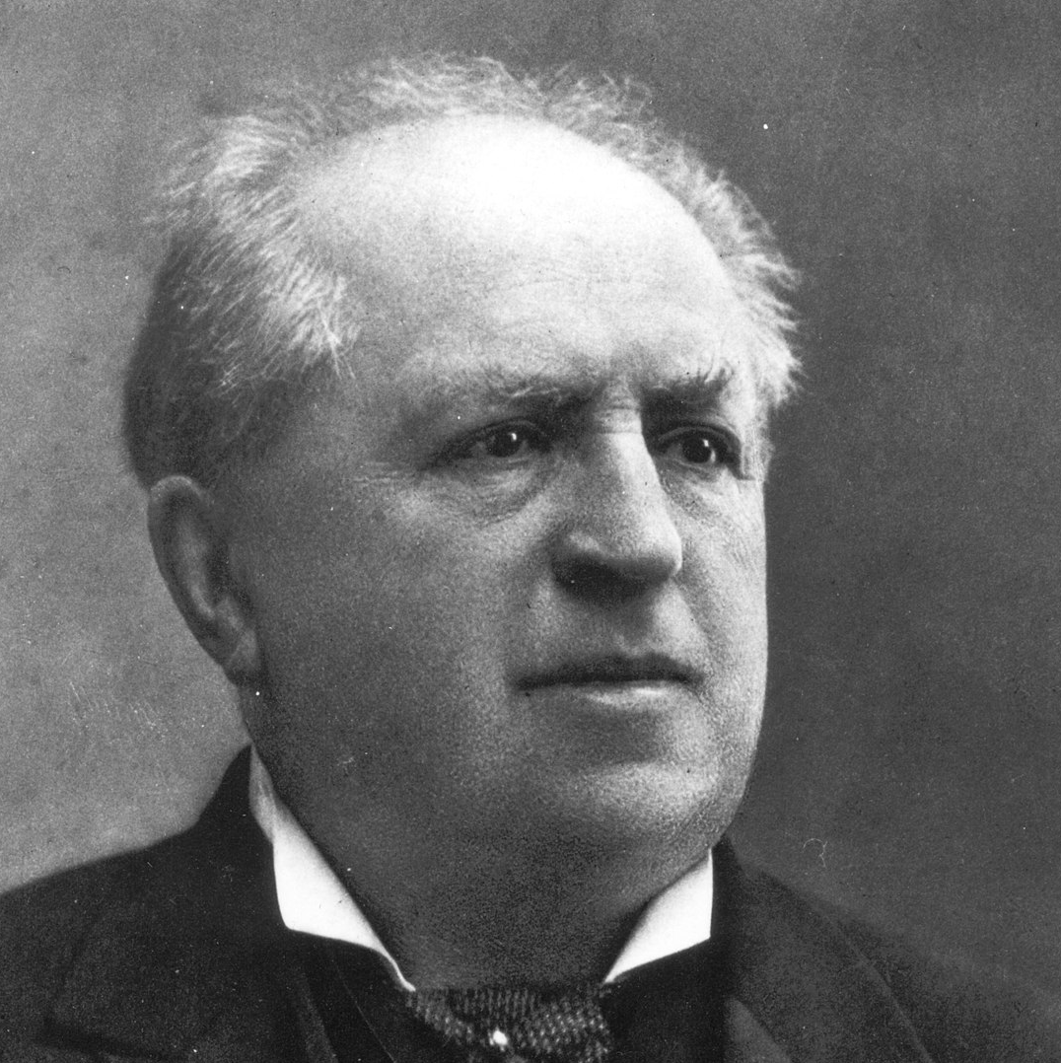
Abraham Kuyper (1837 – 1920):
An active politician, serving as a member of Parliament in the Netherlands beginning in 1874 and serving as Prime Minister from 1901 to 1905.
A theologian, journalist, and educator who founded Vrije University of Netherlands.
Pro Rege: Living under Christ’s Kingship is 1 of 3 volumes which is a part of a 12-volume series of his collected writings on Common Grace, Education, Business and Economics, Charity and Justice and Politics.
His work has influenced countless others, including Francis Schaeffer, Cornelius Van Til, and Alvin Plantinga.

Slide 4
Benefits:
Finishing books by just showing up
No (or optional) homework!
Learning from authors & participants
Building learning communities of all subjects: Theology, History, Investing, Management, Science, etc.
Reading together increases private reading
Reading & listening simultaneously
helps focus on the content
Enhances understanding & knowledge
Doable in many settings such as family,
office, church, schools, etc.
Just Show Up Book Club

Slide 5
1 Timothy 4:13 (NIV)
Until I come, devote yourself to the public reading of Scripture,
to preaching and to teaching.
Comprehensive
Christian Learning
Listening to Scripture: Public & Private
Preaching God’s Word
Teaching:
Reading Books
(JSU Book Club & Private)
Bible Study

Slide 6

G&M U.S. Weekly English PRS & JSU Schedules
Monday Dinner
Wednesday Lunch
Friday Breakfast
JSU 5:30 PM ET
PRS 7:00 PM ET
JSU 11:00 AM ET
PRS 12:30 PM ET
PRS 7:00 AM ET
JSU 8:45 AM ET
Current Book
Leap Over a Wall (8.5 hrs)
by Eugene Peterson
Current Book
Heart of the Holy Land
(~4 hrs)
by Paul Wright
Current Book
Pro Rege (For the King)
Volume 2 (13 hrs)
by Abraham Kuyper
Upcoming (Aug 27)
Excellence Wins: A No-Nonsense Guide to Becoming the Best in a World of Compromise (5 hrs)
by Horst Schulze
Upcoming (Aug 29)
Pro Rege Volume 3
(~13 hrs)
by Abraham Kuyper

Slide 7

For more information, check out
www.prsi.org
www.justshowup.club

Slide 8

If you can, join us for
coffee & tea in the kitchen
until 10:30 AM
Notes:
As we track our progress, we are training ourselves to be in God’s Word, not just trying. And by using the Bible tracker, we can ensure that we read through the whole bible. CLICK

