Slide 1


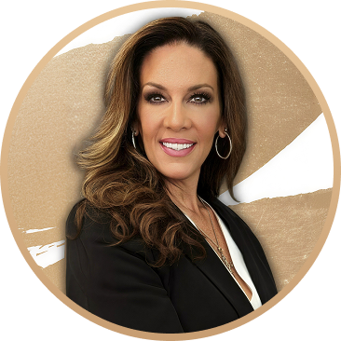
Close What
Others Can’t.
Colleen Harrison-Gamble
Account Executive
(818) 590-0142
colleen.gamble@changewholesale.com
Changewholesale.com/ae/colleen
Flexible Non-QM solutions built to close more deals.

Slide 2
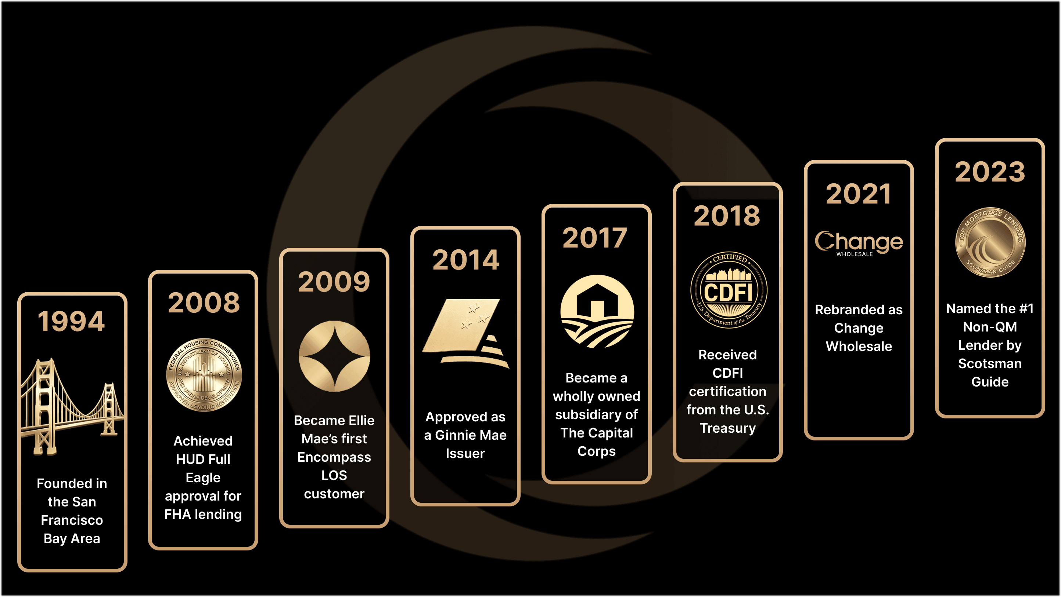
COMPANY HISTORY
Over 25 Years of Lending Experience

Slide 3
The Non-QM Leader Built for Today’s Borrower
Serving prime borrowers who don’t fit traditional guidelines
Flexible qualification options beyond agency rules
Proprietary programs you won’t find elsewhere
Designed to help you close more of your pipeline
25B+
75K+
$1B+
Loans Funded
Borrowers
Total Assets

Slide 4






Our Loans are as Diverse as the Borrowers We Serve.
Fair, responsible lending for prime borrowers whose income doesn’t fit traditional documentation.
Self-Employed &
Small Business Owners
Real Estate
Investors
Borrowers Declined by Traditional Lenders
Contract
& Gig Workers
Asset-Rich & Income-Complex
Foreign National

Slide 5
Products
Community
Mortgage
Alt-Doc
Investor
Foreign
National
Closed End 2nd
Liquid 360
From self-employed to investors, we’ve got it covered.

Slide 6

Community
Mortgage*
No income. No employment. Just qualify using assets.
No employment or income documentation required
Loan amounts up to $2.5M
Cash-out options available (debt consolidation allowed)
Up to 80% LTV (purchase & rate/term)
FICO starting at 640
Reserves as low as 6 months
*The Community Mortgage loan program is not available in DC, MD, ME, NV, PA, WA, or WV. CO: All loan transactions require fully executed CO LO Reasonable Inquiry Attestation and HUD Counseling Certification from the Colorado Housing Assistance Corporation. IL: Allowed provided payment is based on fully indexed rate. TX 50(a)(6) not permitted. Subject to credit and collateral approval. These products have a higher interest rate, more points or more fees than other products that require income documentation. We also offer full-documentation loan programs.

Slide 7

Community
Mortgage*
Simple 3-step qualification.
1
2
3
Confirm
FICO
Review
LTV
Verify
Reserves
*The Community Mortgage loan program is not available in DC, MD, ME, NV, PA, WA, or WV. CO: All loan transactions require fully executed CO LO Reasonable Inquiry Attestation and HUD Counseling Certification from the Colorado Housing Assistance Corporation. IL: Allowed provided payment is based on fully indexed rate. TX 50(a)(6) not permitted. Subject to credit and collateral approval. These products have a higher interest rate, more points or more fees than other products that require income documentation. We also offer full-documentation loan programs.

Slide 8
Alt-Doc
Multiple Ways to Qualify:
Bank Statement
1099
Only
P&L
Only
Asset
Qualifier & Asset Depletion
Asset Assist
(Exclusive)
W-2
Only
Written VOE
Only
One-Year
Tax Return

Slide 9

Alt-Doc
Flexible Non-QM Products. Fast Decisions.
Prime | Advantage | Expanded
Most flexible qualification options
(bank statements + asset qualifier no DTI + asset depletion all in one program)
Highest leverage & loan size
(up to 90% LTV and $3.5M)
Express
Simplified / faster qualification
(streamlined bank statement + P&L options with fewer overlays)
Exclusive
No bank statements required at all
(WVOE/EVOE-only income approach)
Unique borrower flexibility
(ADU income, DACA eligibility, and ability to combine all income types)

Slide 10

Bank
Statement
Flexible bank statement program for
self-employed borrowers.
Up to 90% LTV (80% cash-out)
Loan amounts up to $3.5M
DTI up to 55%
Minimum FICO 640
100% deposits using personal bank statements (no S/E required)
12 months self-employed

Slide 11

1099 Only
For independent contractors using 1099 income to qualify flexibly.
No expense ratio with employer confirmation
Up to 90% LTV (80% cash-out)
DTI up to 55% Loan amounts up to $3.5M
Minimum FICO 640
Primary, second home & investment properties eligible

Slide 12

P&L Only
For self-employed borrowers using CPA-prepared P&Ls to qualify income.
No bank statements required
12-month P&L (CPA/EA/CTEC prepared)
Up to 80% LTV (80% cash-out)
Loan amounts up to $3.5M
Minimum FICO 680
Primary, second home & investment properties eligible

Slide 13

Asset Qualifier & Asset Depletion
Allows borrowers with qualification based on available assets instead of traditional income.
Asset Qualifier: Qualify at 125% of total mortgage debt (no DTI)
Asset Depletion: Qualify by dividing assets over 60 months
Up to 85% LTV
Up to $3.5 million loan amounts
FICO as low as 640

Slide 14

W-2 Only
Full-time W-2 earners using employer-verified income for faster, simpler approvals.
No YTD Paystub Required
Up to 90% LTV (80% cash-out)
DTI up to 55%
Loan amounts up to $3.5M
Minimum FICO 640
Listed for sale cash-out OK
Primary, 2nd home, and investment properties allowed

Slide 15

Written VOE
A simplified qualification method using written verification of employment.
No traditional income documentation required (qualify with VOE)
Up to 85% LTV (80% cash-out)
Loan amounts up to $3M
Minimum FICO 660
DTI up to 45%
Non-occupant co-borrower allowed

Slide 16

One Year Tax Return
Only 1 tax return required to qualify.
Up to 90% LTV (80% cash-out)
Loan amounts up to $3.5M
DTI up to 55%
Minimum FICO 640
Interest-only options available
12-month self-employment accepted

Slide 17

Investor
Offering near-prime rates and alternative qualification options with no personal income documentation required.
DSCR-based qualifying (no personal income)
Up to 85% LTV + $2.5M loan amounts
Interest-only options available
STR / Airbnb income allowed (AirDNA supported)
ADU + projected rent eligible
No sourcing required for large deposits
First-time investors OK + LLC vesting

Slide 18

Liquid 360
The New Standard in Short-Term Capital.
Equity-based qualifying — no income or DTI required
Loan amounts up to $5M
Minimum FICO 600
No reserve requirement (with 720 FICO)
Interest-only payment options available
1st & 2nd liens allowed
*Not available in all states. Terms subject to qualification.
See program guidelines for full details.

Slide 19

Closed End 2nd
Helping borrowers consolidate debt, access equity, or fund new opportunities.
Up to 90% CLTV available
No mortgage insurance required
Loan amounts up to $750K
Standard doc or Alt-Doc options (Bank statement, P&L Only, WVOE)
Fixed-rate closed-end second lien
Primary, second home, and investment properties allowed
Flexible credit event seasoning available

Slide 20

Foreign National
Designed for global borrowers investing in
U.S. properties.
No U.S. credit (FICO) required
DSCR-based qualifying — no personal income or U.S. employment required
Loan amounts up to $2.5M
Up to 75% LTV (70% for cash-out)
Foreign funds allowed (direct wire to closing agent)

Slide 21

Smarter Tools for Brokers
Technology to help you price, market, and close faster.
Quick Pricer
White Label Flyers
Weekly Emails
CLOSR Portal
Bank Statement Desk and More

Slide 22


THANK YOU!
Let’s find the right loan for your client’s real situation.
Colleen Harrison-Gamble
Account Executive
(818) 590-0142
colleen.gamble@changewholesale.com
Changewholesale.com/ae/colleen
Change Lending, LLC dba Change Wholesale is a state-licensed mortgage lender, NMLS ID #1839. To verify licenses, visit www.nmlsconsumeraccess.org. Headquartered at 175 N Riverview Drive, Suite C, Anaheim, CA 92808. AZ: Arizona Mortgage Banker License #0925326; CA: Licensed by the Department of Financial Protection and Innovation under the California Residential Mortgage Lending Act and California Financing Law; CO: Regulated by the Division of Real Estate; GA: Georgia Residential Mortgage Licensee #48010; IL: MB.6761600, Division of Banking, Illinois Department of Financial and Professional Regulation; 555 West Monroe St., 5th Flr; Chicago, IL 60661; 1-888-473-4858; MN: This is not an offer to enter into an agreement and an offer may only be made pursuant to Minn. Stat. §47.206 (3) & (4); NJ: Residential Mortgage Lender License – Licensed by the N.J. Department of Banking and Insurance; OH: Licensed by the Ohio Department of Commerce, Division of Financial Institutions, Ohio Residential Mortgage Lending Certificate of Registration #RM.804654.000; RI: Rhode Island Licensed Lender #20224336LL; For other states, visit www.changewholesale.com. All loans must meet underwriting guidelines. This information is intended for the exclusive use of licensed real estate and mortgage lending professionals in accordance with local laws and regulations. Distribution to the public is prohibited. Subject to change without notice. CHANGE LENDING, LLC AND ITS LOAN PRODUCTS ARE NOT SPONSORED OR ENDORSED OR BEING OFFERED BY THE U.S. TREASURY DEPARTMENT OR ANY OTHER GOVERNMENT AGENCY. © 2026 Change Lending, LLC. All rights reserved. Some of the products referenced in this website are originated by The Change Company CDFI LLC, NMLS #2486868, the parent company of Change Lending, LLC.

