Slide 1

Welmac shareholders meeting
2026

Slide 2
Harvest overview:
Year | 2018 | 2019 | 2020 | 2021 | 2022 | 2023 | 2024 | 2025
WNIS | 181 933 | 178 428 | 58 955 | 140 398 | 150 032 | 253 491 | 242 291 | 218 557
Reject |  |  |  |  | 8 233 | 9 620 | 5 440 | 4 850
Smalls |  |  |  |  | 4 423 | 3 391 | 2 528 | 11 571
Floaters |  |  |  |  | 6 727 | 5 303 | 4 762 | 5 435
DNIS | 155 651 | 162 850 | 54 135 | 120 062 | 128 756 | 213 564 | 206 551 | 196 510
Year | 2018 | 2019 | 2020 | 2021 | 2022 | 2023 | 2024 | 2025
Average ZAR/kg | 56,93 | 61,21 | 62,69 | 46,27 | 39,36 | 23,17 | 38,83 | 47,42

Slide 3
2025 Harvest feedback
The 2025 harvest was a total of 195,000 Kg DNIS . The mature orchards had a lower yield due to alternate bearing.
New orchards are increasing year on year.
Quality was our best since inception with SKR of 35,78% and unsound of 2%.
Harvest was sold to Swiss Gourmet same as 2024.
Welmac is approached by more and more independent buyers.
20Ha replacement trees have been planted in block 2 & 4.

Slide 4
Welmac macadamia production in numbers for the season of 2025 Jan to Dec
Man hours worked: 234,666 (2025) down form 253,544 (2024) hours, down from 279,893 (2022) , down from 253,081 (2023 )
Diesel used: 50,500L (2025) down from 52,736L(2024) down from 63,434 (2022) and 59,298 (2023)

Slide 5
Yield per ha of the mature orchards.

Slide 6
Yield per ha of new orchards:

Slide 7
202,54 T versus expected 151,25T
Longterm Average WNIS
Block Nr | ha | Year planted |  | 2026 T/ha | Total budgetted | 25 May actual | Actual t/ha WNIS | Status
Blok 1 | 12,7 | 2005 |  | 3,10 | 39,37 | 67,31 | 5,30 | done
Blok 2 14,4ha total 7,23 replanted | 7,23 | 2005 |  |  | 0,00 | 0,00
Blok 2 | 7,17 | 2005 |  | 1,80 | 12,91 | 24,88 | 3,47 | Done
Blok 3 | 1,47 | 2005 |  | 3,23 | 4,75 | 4,48 | 3,05 | Done
Blok 4 - 22,6ha in total with 12.2 replanted | 12,2 | 2005 |  |  | 0,00 | 0,00
Blok 4 | 10,4 | 2005 |  | 1,89 | 19,66 | 30,26 | 2,91 | Done
Blok 5 | 3,7 | 2005 |  | 3,00 | 11,10 | 6,03 | 1,63 | Done
Blok 6 | 4,3 | 2006 |  | 3,05 | 13,12 | 18,58 | 4,32 | Done
Blok 7 | 20 | 2020 |  | 1,50 | 30,00 | 23,20 | 1,16 | Done
Blok 8 | 34 | 2018 |  | 2,50 | 85,00 | 12,92 | 0,38 | starting
Blok 9 | 24 | 2018 |  | 2,60 | 62,40 | 68,88 | 2,87 | harvesting
Blok 10 Dry** | 10,2 | 2019 |  | 0,30 | 3,06 | 3,98 | 0,39 | Done
Blok 11 | 1,7 | 2018 |  | 3,00 | 5,10 | 5,73 | 3,37 | Done
Blok 12 Dry** | 14,2 | 2018/2019 |  | 0,20 | 2,84 | 3,69 | 0,26 | Done
Blok 13 Dry** | 18,7 | 2019 |  | 0,50 | 9,35 | 14,40 | 0,77 | Done
Blok 14 | 22,4 | 2020/2021 |  | 0,50 | 11,20 | 0,00 |  | not started
Blok 15 | 20,4 | 2020/2021 |  | 0,10 | 2,04 | 0,00 |  | not started
 |  |  |  | Possible volumes | 312
 |  |  |  | Budget volumes | 300 | 284,34 | WNIS to date
 |  |  |  | Done blocks expected | 151,25 | 202,54 | Done blocks actual
Performance of the finished blocks, actual vs budget.

Slide 8
Welmac quality overview:

Slide 9
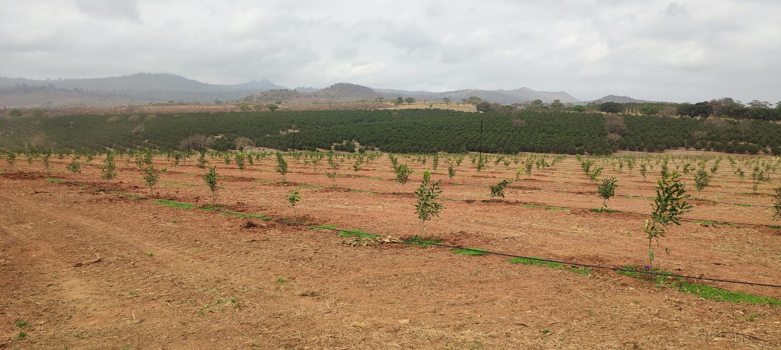
Replacement trees in block 2& 4 being planted

Slide 10
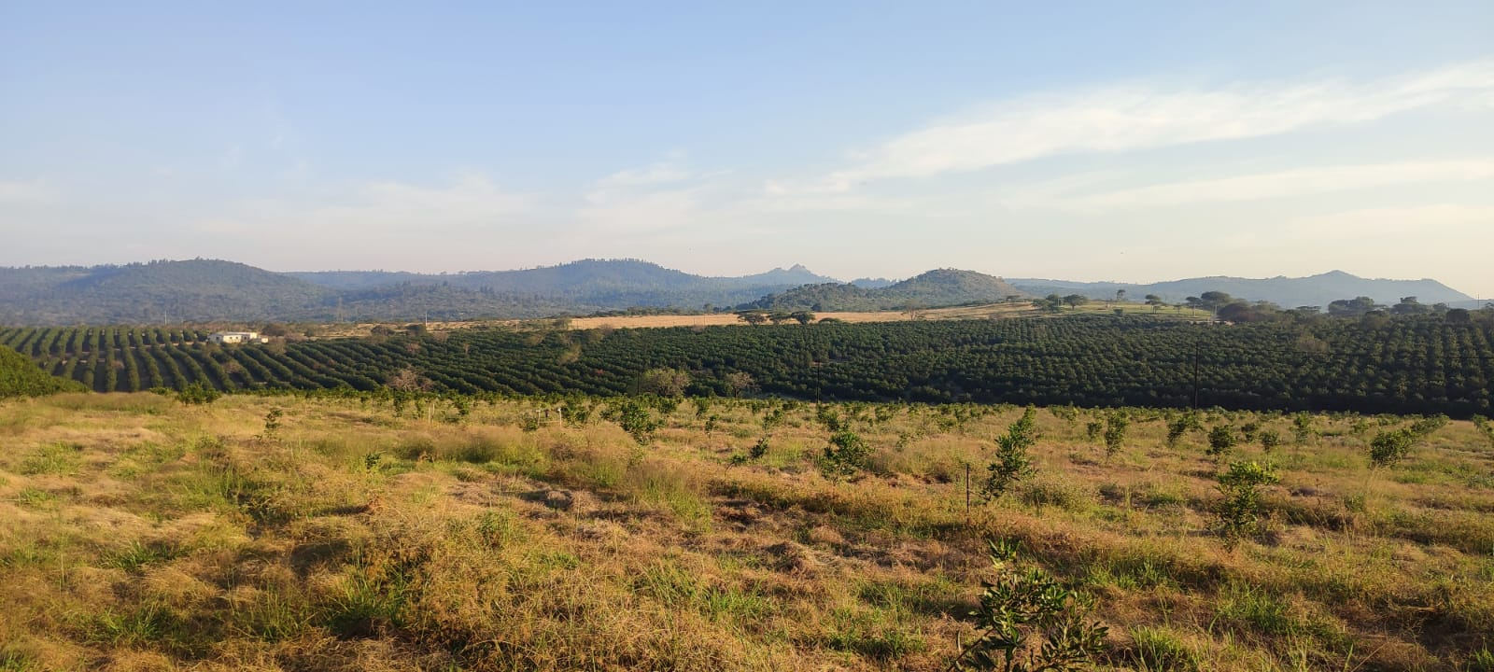
Replacement trees in June 2026

Slide 11
Albasini nursery
We have successfully added guava trees to the product list. We have already sold 6000 trees with expected orders of 10,000+ this coming summer.
Orders for macadamia trees fluctuate due to price fluctuations for macadamia.
We have successfully produced peppers , green bean and tomatoes in the greenhouse and will continue with diversification to add to the revenue stream.
We are planting maize to sell the maize heads to the local market , plans are to expand on this.

Slide 12
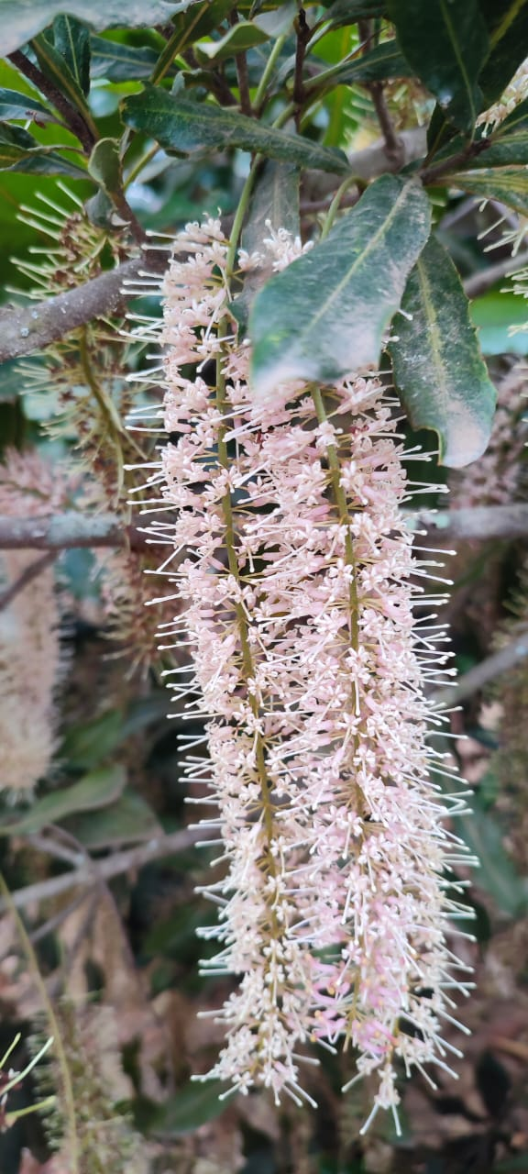
Operational changes since last shareholders meeting
Harvesting and dehusking cycle improved with seasonal staff working Monday to Thursday and permanent staff dehusking through the week and Friday which eliminated 90% of overtime during harvesting.
Workshop manager obtained a diesel mechanic qualification.
Assistant manager resigned, we are in process of finding a replacement.
Adele du Toit is group accounting manager.

Slide 13
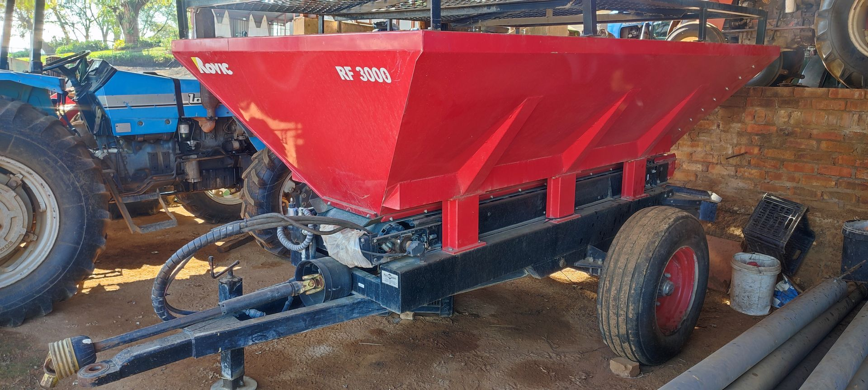
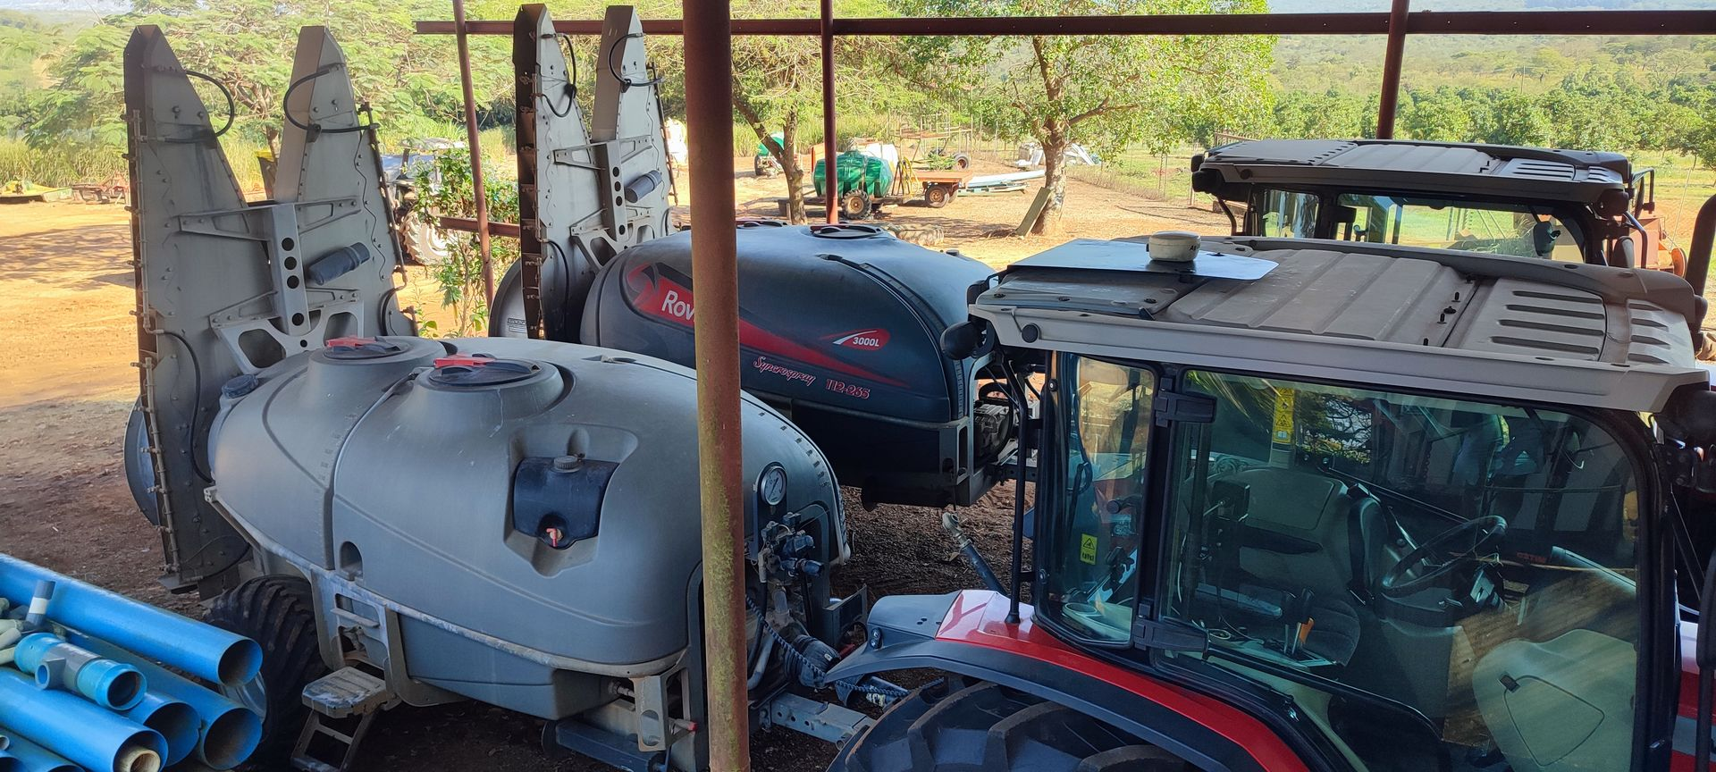
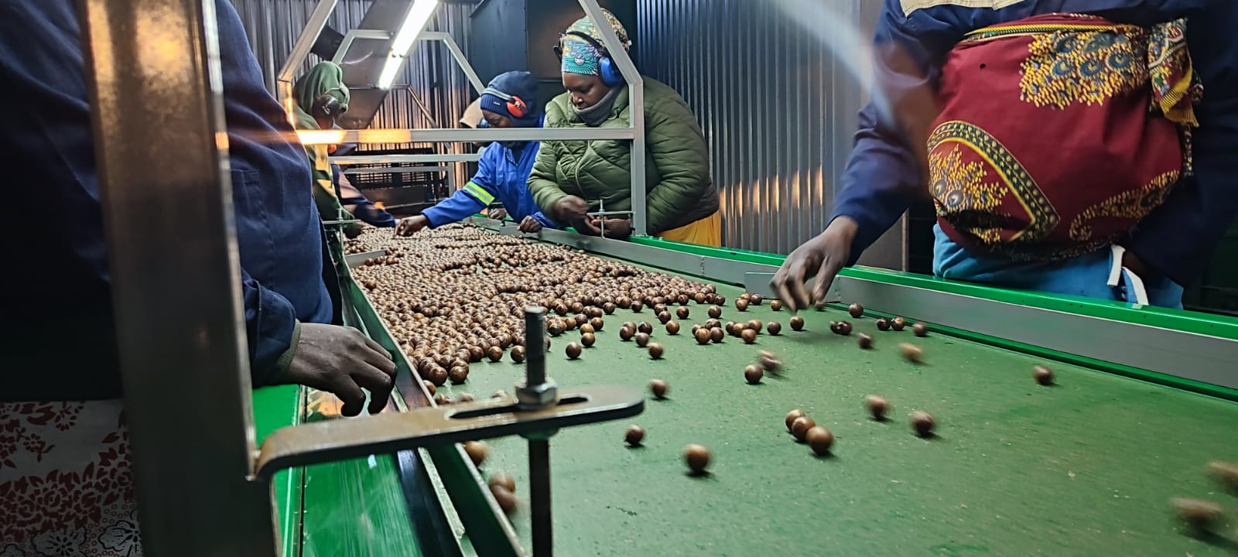
Equipment changes since last shareholders meeting
Limespreader was bought which will have a direct impact on the fertilizer costs.
Rovic 4000L spraycart was bought to add to current fleet of spraycarts.
Sorting table in the dehusking shed was upgraded to remove the bottleneck and increase output of the dehusking process.

Slide 14
Way forward and closing notes
Welmac is experiencing a very good production season which is the direct result of the current team of dedicated staff who have put in a lot hard work to build Welmac to this point.
Planning for the installation of the irrigation on the dryland blocks is well underway which will increase yield volumes.
We are busy with calculations for the expansion of the remainder of the farm taking a staggered approach along with Guava fruit.
Welmac did a trial run this year functioning as an intake depot for a macadamia buyer of which we received 300 Ton of NIS which we aim to expand in the future.

Slide 15
The people that are making a difference at Welmac:

Slide 16
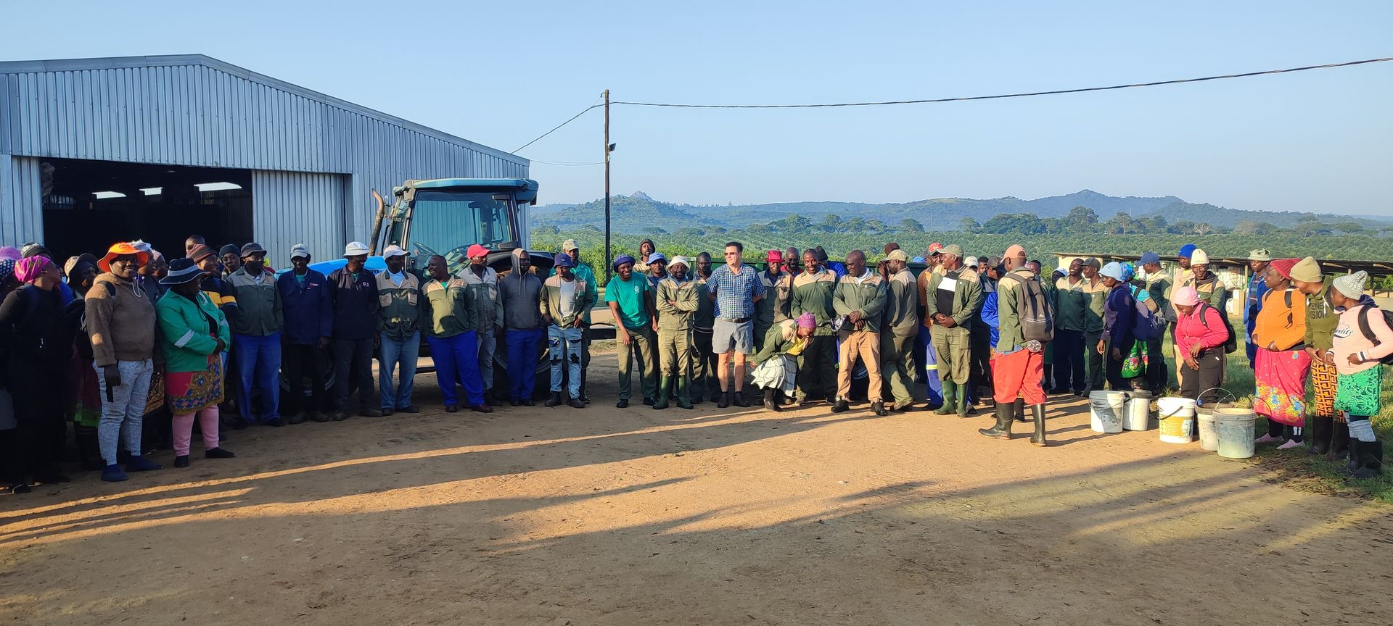
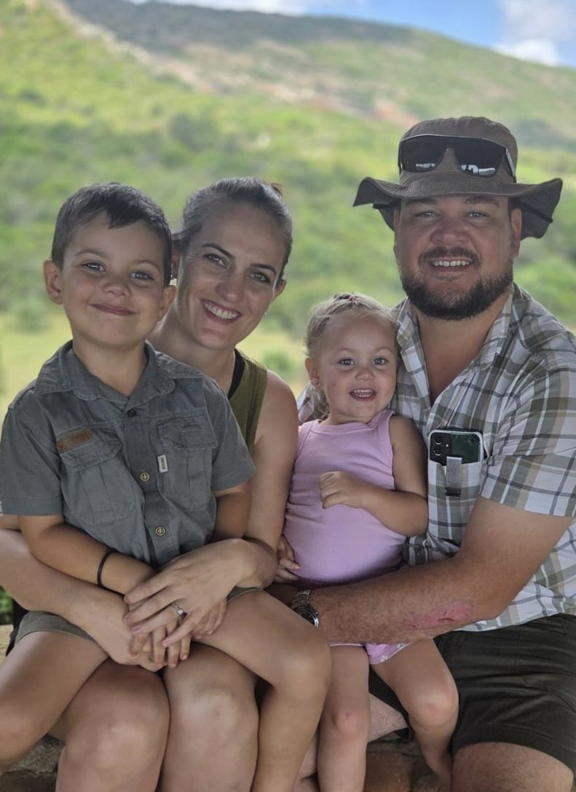
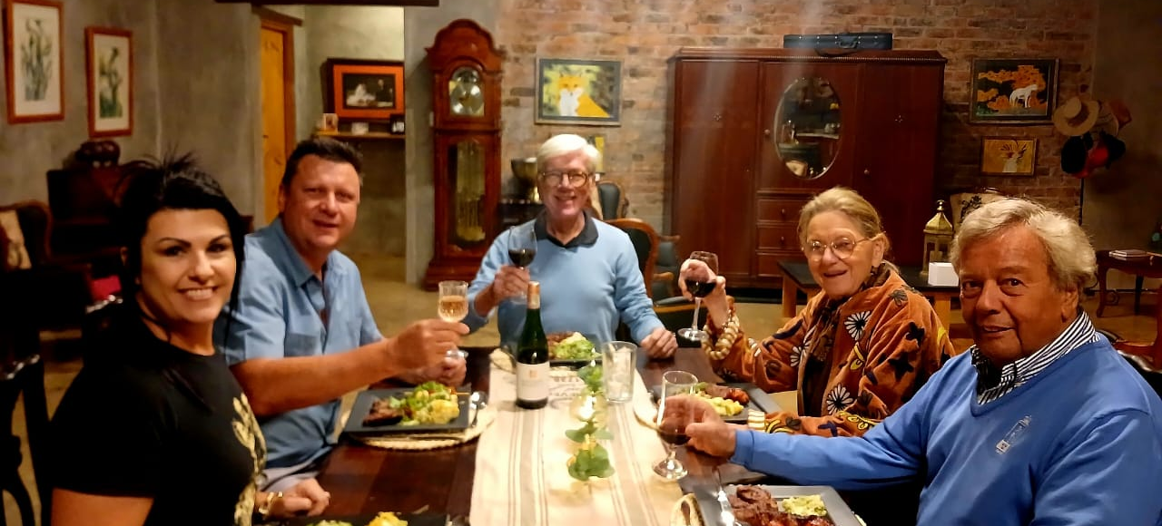

Slide 17
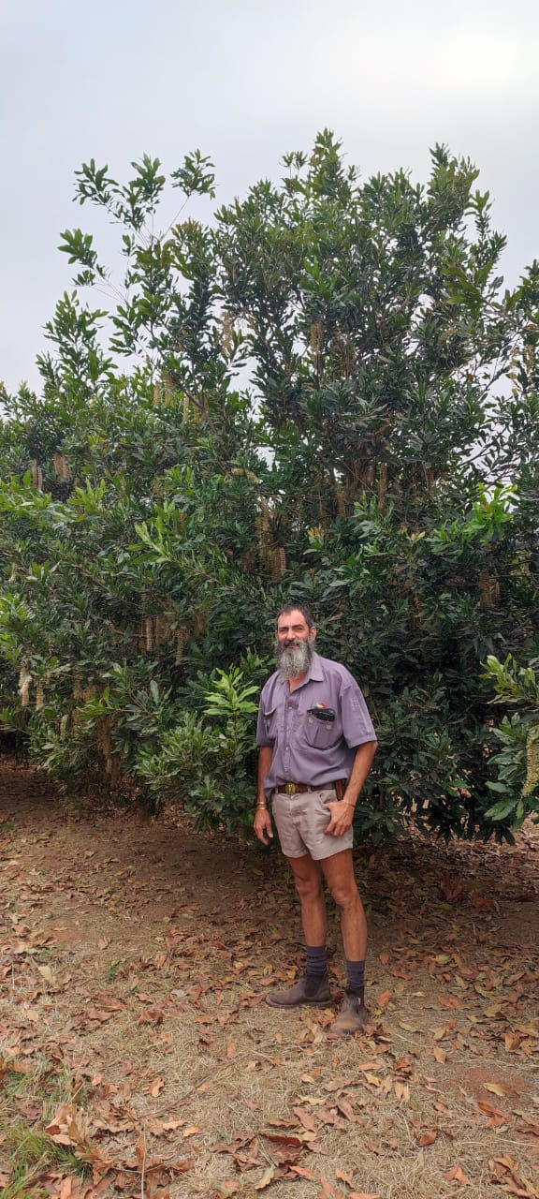
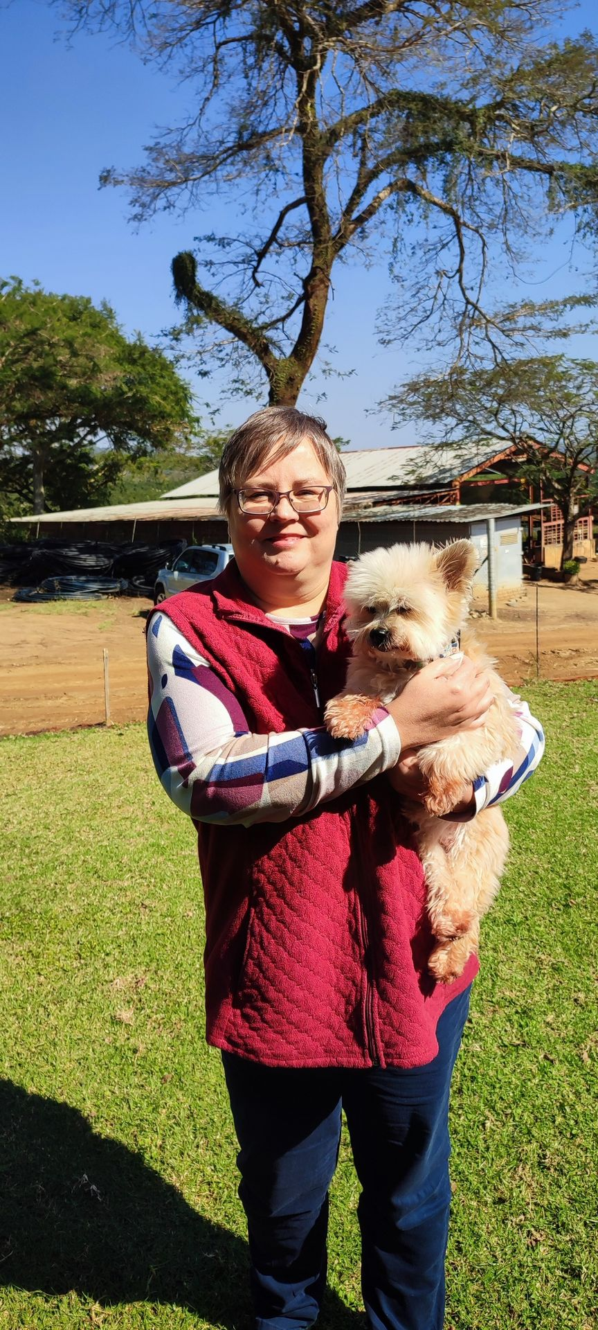
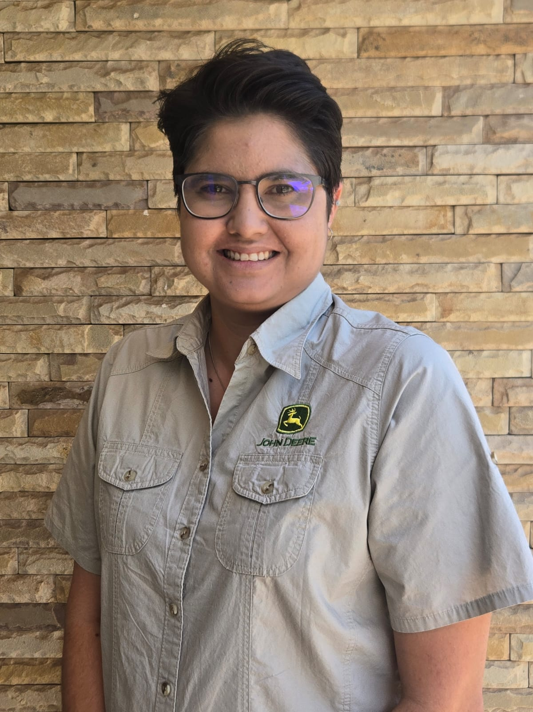
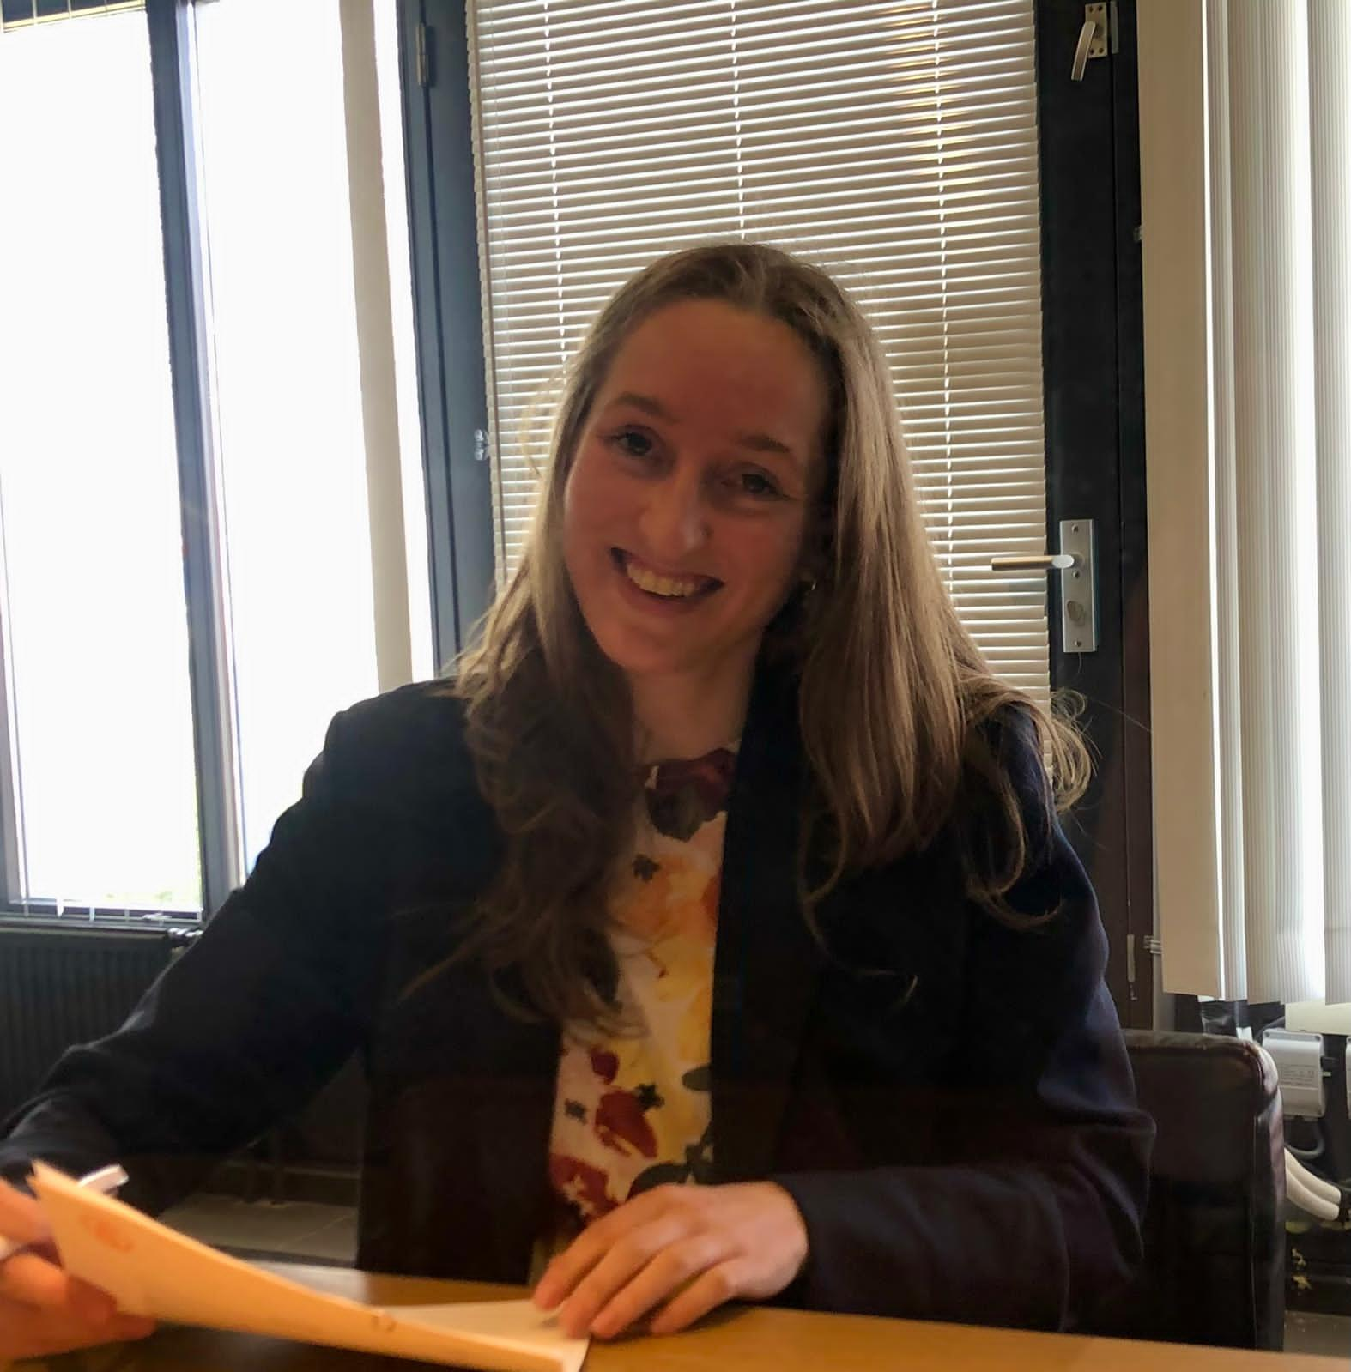

Slide 18

Thank you.
Any questions?

