Slide 1
Is Aging Solvable?
Matt Kaeberlein, Ph.D.
CEO, Optispan
Affiliate Professor, University of Washington
Co-Director, Dog Aging Project
Email: matt@optispan.life
YouTube: www.youtube.com/@optispan

Slide 2
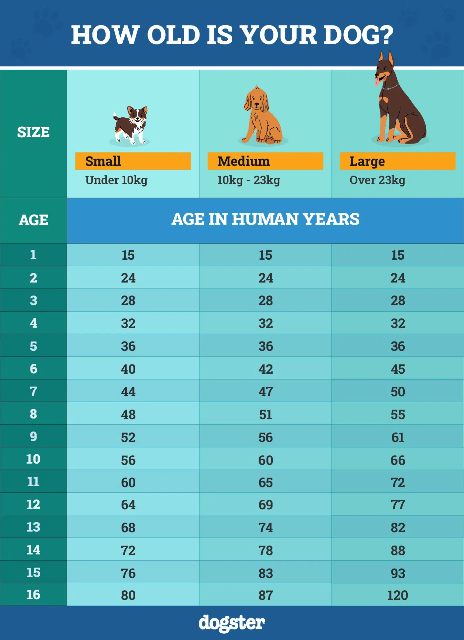
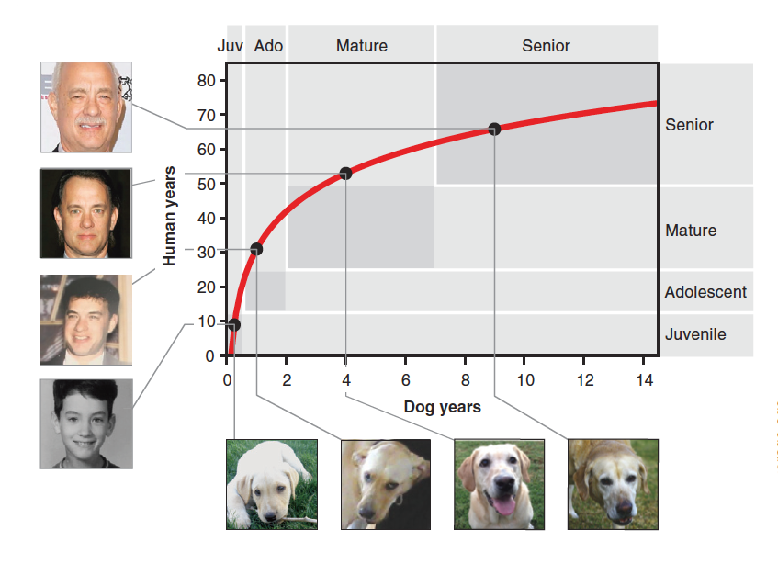
What is biological aging?

Slide 3
Why is this important?
Arthritis
Cognitive
Decline
Cancer
AGING
Immune Decline
Kidney
Disease
Type II
Diabetes
Cardiovascular
Disease
Autoimmune
Disorders
Slowing aging slows the progression of multiple age-associated diseases

Slide 4
The biology of aging is being solved…
Hallmarks of Aging
Genomic instability
Telomere shortening
Epigenetic changes
Loss of proteostasis
Deregulated nutrient signaling
Mitochondrial dysfunction
Cellular senescence
Stem cell exhaustion
Altered cell-cell communication
Lopez-Otin et al., Cell. 2013 Jun 6;153(6):1194-217.
AGE Presents: https://www.youtube.com/watch?v=eH6gC-tQIfs

Slide 5
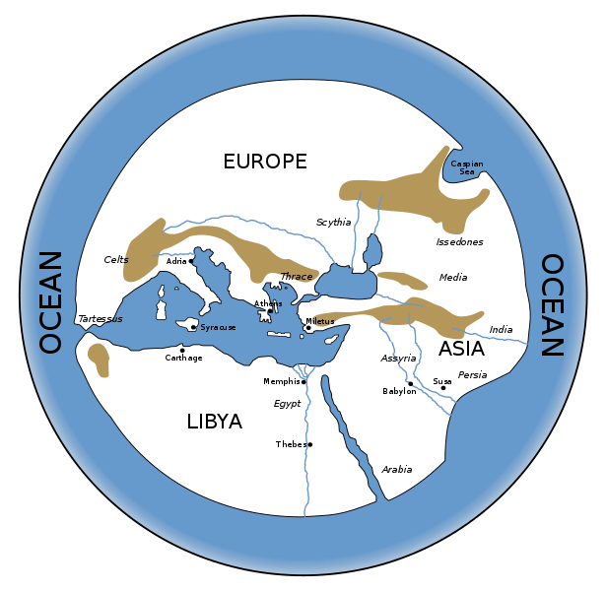
…but we’re far away from “solving aging”
Hecataeus’ Map (~500 BCE)
Lopez-Otin et al., Cell. 2013 Jun 6;153(6):1194-217.

Slide 6
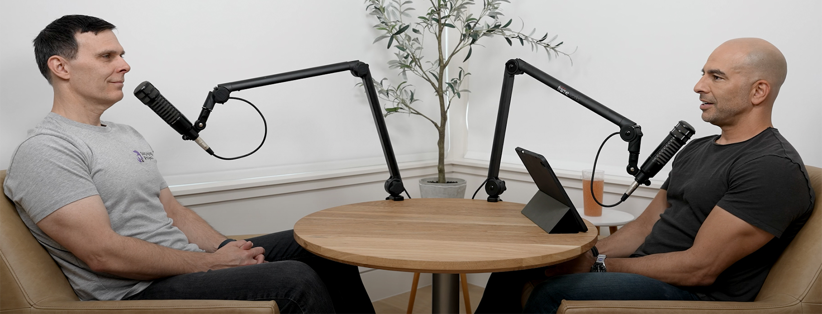
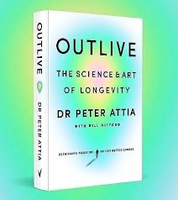
What can we do today?
Medicine 2.0 is scientific reactive disease care
Medicine 3.0 is proactive, personalized healthcare
Medicine 4.0 is ???

Slide 7
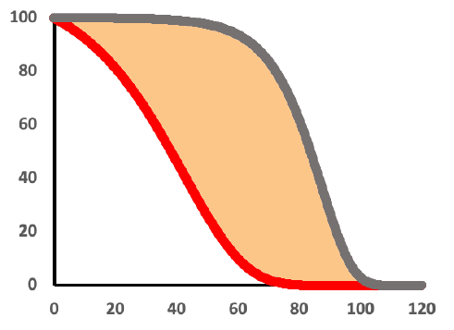
Medicine 2.0: Reactive, disease-focused
Life expectancy has plateaued
Healthspan is decreasing
Sickspan is increasing
60% chronic disease rate
90% of healthcare expenditures
HEALTH
SURVIVAL
CHRONOLOGICAL AGE

Slide 8
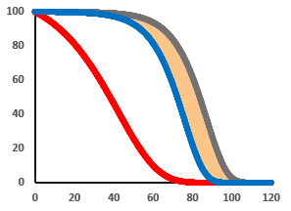
Medicine 3.0 is currently messy
Medicine 3.0 today is
  Medicine 2.0 +
  Proactive screening
  Personalized biomarkers
  Early medical intervention
  Lifestyle modifications
  Questionable supplements and experimental therapies
  Uneven care
  Insufficient to achieve the goal
HEALTH
SURVIVAL
CHRONOLOGICAL AGE

Slide 9

Creating Medicine 4.0
Medicine 4.0 is
  Medicine 2.0+
  Proactive screening
  Personalized biomarkers
  Early medical intervention
  Lifestyle modifications
  Rigorous use of supplements, tests, and experimental therapies
Geroscience
Artificial intelligence
HEALTH
SURVIVAL
CHRONOLOGICAL AGE

Slide 10
Medicine 4.0 >>> Medicine 2.0

Slide 11

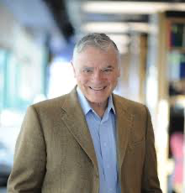
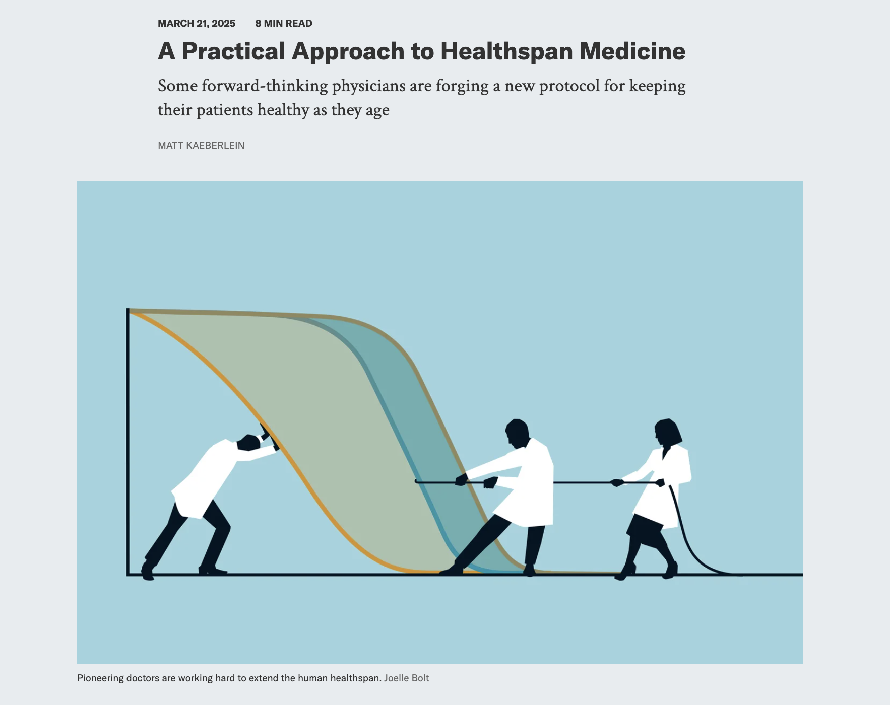
Creating a framework for Medicine 4.0
Goal is to optimize healthspan for as many people as possible
Incorporates”P4 Medicine” (Lee Hood)
  Personalized
  Predictive
  Preventative
  Participatory
Must be scalable
Must be affordable
Must be scientifically rigorous
Must be medically and ethically sound

Slide 12
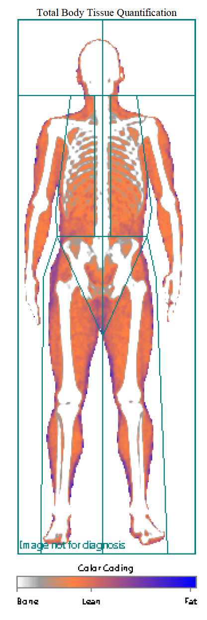
Some basic tools that work in the clinic today
Comprehensive bloodwork
  Inflammation, hormones, vitamins, toxins, lipids, metabolic, CBC, etc.
Imaging
  Ultrasound, MRI, DEXA, iTERO, Dermasensor, CCTA
Advanced cancer screening
Genetics and polygenic risk
Wearables (CGM, Oura, etc.)
Hormone optimization
Pillars optimization: Eat, Move, Sleep, Connect
Measure → Intervene → Measure Again

Slide 13

Some tools that don’t work in the clinic (yet)
DTC microbiome tests
DTC Biological age tests
  These are powerful research tools, but…
    No information on precision or accuracy
    No industry quality control
    No regulatory validation
    Not actionable

Slide 14
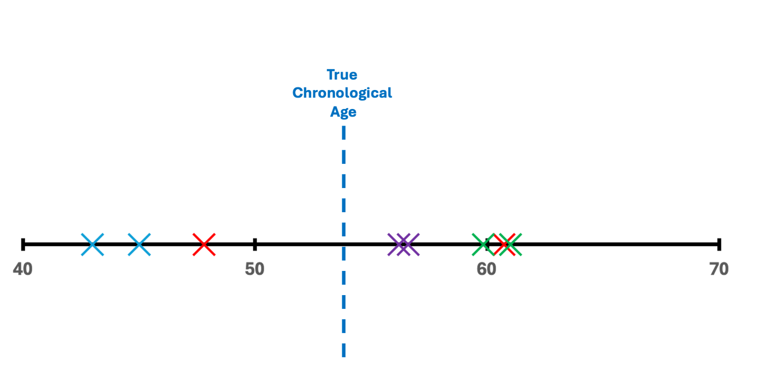
Matt’s epigenetic age experiment
True chronological age: 53.51
N=8 tests, 2 technical replicates x 4 companies
Mean epigenetic age: 53.8
Standard deviation: 7.4

Slide 15
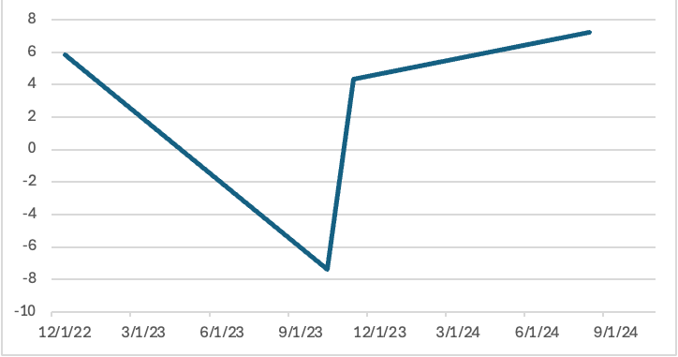
Matt’s epigenetic age experiment
"Biological Age” – Chronological Age
“Aging rate”
+3.8X
“Aging rate”
+140X
“Aging rate”
-15.8X

Slide 16
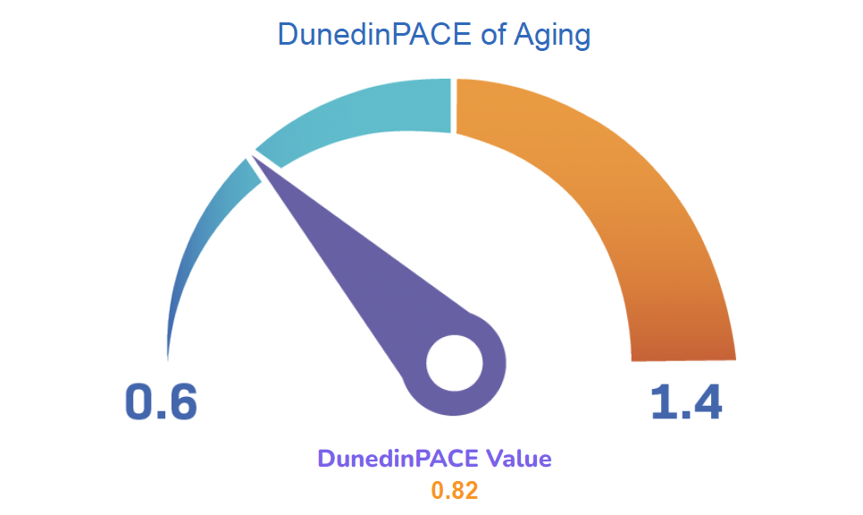
Matt’s epigenetic age experiment
"Biological Age” – Chronological Age
“Aging rate”
+3.8X
“Aging rate”
+140X
“Aging rate”
-15.8X

Slide 17
A whole lot of gray area in longevity medicine
DTC diagnostics
Supplements
Experimental interventions:
  Geroprotectors: rapamycin, metformin, SGLT2i, GLP-1s, PDE5i,…
  Peptides: BPC-157, CJC-1295, Ipamorelin, Sermorelin, Epitalon, MOTS-c…
  TPE, sauna, cryotherapy, stem cells, PRP, infusions, red light therapy, FMT…
  Gene therapy, self-sourcing hormones/peptides/drugs

Slide 18
How do we improve our tools?
Better data
  Reallocation of research funding toward geroscience and discovery science (especially intervention testing)
  Longitudinal multi-omic & clinical population data
  Aggregation of data from “longevity clinics”
Artificial intelligence
  Needs better data to reach potential
  Improved actionable, personal health predictors
  Personal Healthspan Agents

Slide 19
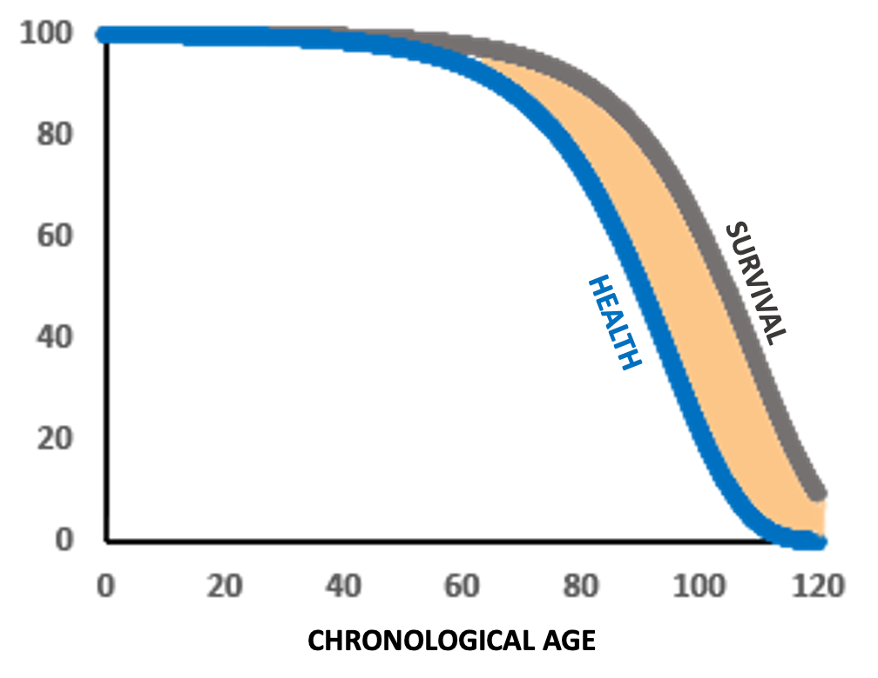
Setting the stage for Medicine 5.0
Today: >50% of the population has chronic disease into their 40s
Medicine 3.0-4.0: 50% of the population avoids chronic disease into their 70s
Medicine 5.0: 50% of the population avoids chronic disease into their 90s
HEALTH
SURVIVAL
CHRONOLOGICAL AGE

Slide 20
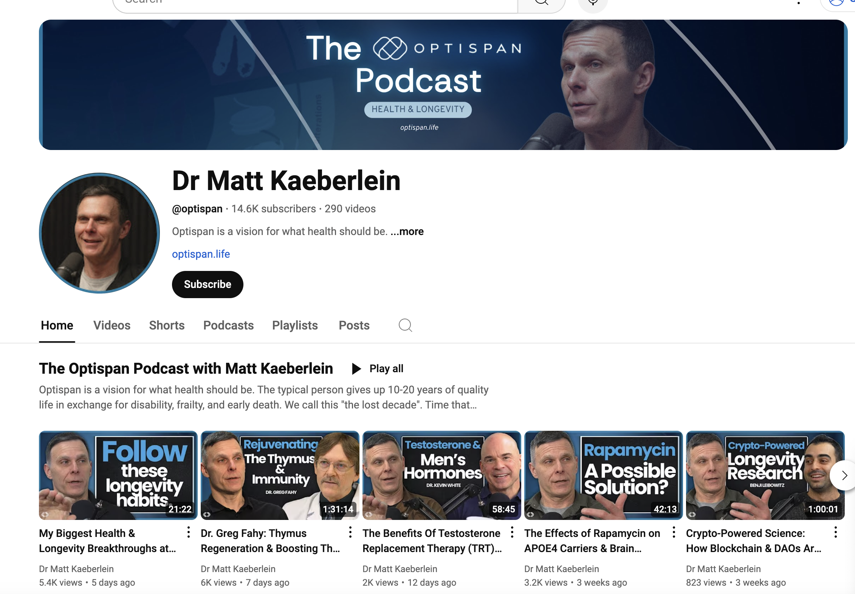
www.youtube.com/@optispan

