Slide 1



How [LIO Name] can help deliver impactful social prescribing
Your Logo
Date
Presenter(s)

Slide 2
The social prescribing ecosystem
A thriving VCSE Sector
Social Prescribing Link Workers
VCSE Support and Development
“active engagement between the PCN and local VCSE sector is influential on the success of local social prescribing… by virtue of their core services, local VCSE infrastructure organisations offer a key role in supporting the relationship”
Notes:
Social prescribing is a model to support people to access a range of local, non-clinical activity, that supports their wellbeing.
There is a body of evidence developing around the impact of social prescribing, looking at the impact on the individual and on healthcare usage. To frame this presentation, I’ll give you one statistic from a report published by Polley and Pilkington at the University of Westminster in 2017, which reports an average 28% reduction in demand for GP services and 24% reduction in A&E attendances for an individual following a social prescribing referral.
(https://westminsterresearch.westminster.ac.uk/item/q1455/a-review-of-the-evidence-assessing-impact-of-social-prescribing-on-healthcare-demand-and-cost-implications )
Forms of social prescribing have been around for decades – both within the NHS and beyond it, and it hasn’t always been called this, but it has gained a lot of attention and traction since NHS England embedded it as a central part of its Five Year Forward View in 2014. Since then, and the subsequent development of PCNs, there has been a push to increase access to social prescribing linked to Primary Care.
There is a large body of literature on social prescribing, and many different types of model. NAVCA has recently undertaken research with VCSE organisations and partners and puts forward a view that there are three key ingredients to the social prescribing ecosystem, each bringing their own benefits and each with their own needs:
A thriving voluntary, community and social enterprise sector is at the heart of effective social prescribing, as these are the organisations and activities that need to exist to meet the needs of individuals.
The Social Prescribing Link worker role is also central to the model, at it provides the mechanism to connect people to the support and activities.
And finally, strong support and development for the local VCSE sector is crucial, to ensure the supply and demand element of the model can be met.
Our presentation today focuses on this aspect, as it is what we do; as the local VCSE infrastructure organisaiton, we provide services and activities that support the local VCSE organisations – both to engage with social prescribing, and be part of the wider health system and other local strategic partnerships and delivery.
What NAVCA’s research found was, that where the local infrastructure organisation was effectively engaged in local social prescribing, there benefits to all – the PCN, the Link Workers and, of course the VCSE organisations.

Slide 3
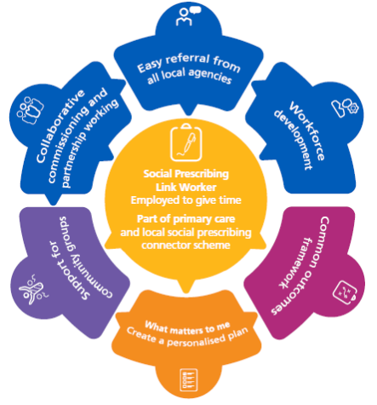
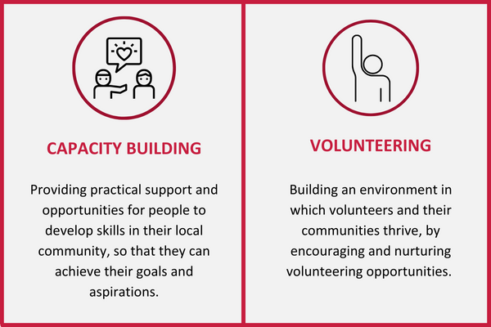
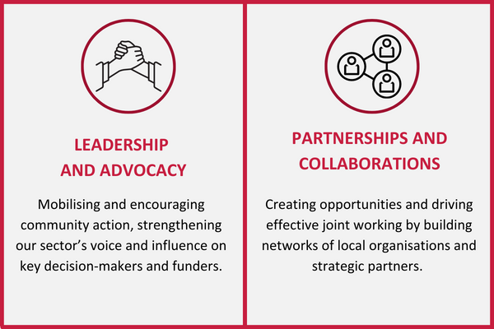
Local VCSE Infrastructure and Social Prescribing
Notes:
On the left is the NHS England’s standard model of ocial prescribing. NHSE engaged a wide range of stakeholders – including people with lived experience, GPs, social prescribing link workers, local authority commissioners, CCGs and the VCSE sector – to set out the key elements of what makes a good social prescribing scheme and what needs to be in place locally.
On the right are the Four Functions of Infrastructure – NAVCA engaged with a wide range of stakeholders – including its members, local VCSE organisations, NHS England, Local Government Association and Government deparments – to set out what is at the heart of an effective local VCSE infrastructure offer.
The aim of this presentation is to set out the core role of local VCSE infrastructure relates directly to, and support the impact of, social prescribing.

Slide 4

[Area]’s VCSE Sector
Add key stats and info on the local sector
Add your own local picture(s)
Notes:
Before we do that, we’d like to give you a brief overview of the local VCSE sector in [AREA]

Slide 5

Local Infrastructure offers:
Intelligence and insight about the local sector
a direct route to connect with the broad and diverse local VCSE sector
Connections at system, place and neighbourhood
Forums and events to engage
Opportunities to develop effective joint models through VCSE participation
Intelligence to inform commissioning based on VCSE experience
Skills and connections to drive effective collaboration within, and across the sector
“Strong community networks are built on trust and take time to develop. Local organisations with deep-rooted community networks need to be commissioned to provide social prescribing services”
Notes:
As the local infrastructure organisation, we play a key role in bringing the broad and diverse VCSE sector organisations together.
We are a trusted partner for the sector, and offer a route to give them a voice in local partnerships.
We have a track record of bringing the sector together around thematic and geographic issues.
Add details here about:
How you collect and share information about the sector and volunteering. E.g. through surveys, reports, briefings, state of the sector reports etc.
Any forums our networks you convene, including Leaders Forums, geographic forums (potentially aligned to “places” or PCN geography) and thematic forums for, for example, organisations working in mental health, wellbeing, skills and employment, befriending, green spaces etc
How you are engaged with the VCSE Alliance operating at system level, including any role(s) you play in leadership at system and place
Work you have or could undertake to support commissioning or funding models – including any grant programmes you assist with delivery of, or links to local funding bodies
Work you have or could undertake to mobilise the sector to engage in social prescribing
Partnerships you lead or are involved in that will support local social prescribing

Slide 6

Local Infrastructure offers
Routes to build knowledge within the sector about the programme, and confidence to take on referrals
Help to communicate to the community about the programme
Opportunities to bring VCSE leaders together to discuss the impact, and approaches to improve or broaden
“This process should be as easy as possible… with awareness and understanding of this process in all agencies…Self-referral is also encouraged”
Notes:
Add details and examples here about your:
Communications activities and channels
Details of any directory (internal or external) you hold of the VCSE sector and how you utilise it to get messages out
Ability to support the sector to convey messages to communities, particularly the seldom heard/marignalised communities
Examples of messages you’ve helped to get out to the sector and communities in the past, particularly working with statutory partners such as health bodies and local councils

Slide 7
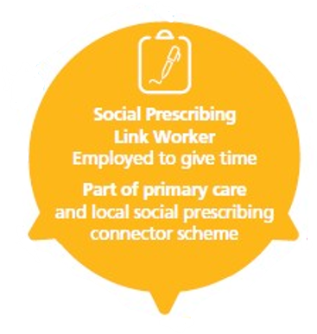
Local Infrastructure Offers
An effective home for Link Workers which connects them directly to VCSE support and community development activity
Opportunities to engage in events and forums which connect them with the local VCSE
A route to inform local sector support and capacity building based on referral needs
Access to a living “directory” of local community activity
It is crucial for link workers to start with ‘what matters to me’ and to value what motivates the person… and are able to work in a person-centred, non-judgemental way across whole, diverse communities.
Notes:
Over a third of SPLW report being hosted in the VCSE sector (NHSE SPLW Survey 2022).
We believe that when SPLWs are hosted within a VCSE organisaiton, and particularly a local VCSE infrastructure body, they benefit in several ways:
They are better connected to the VCSE enabling them to support effective referrals
They are better connected to VCSE support offers, helping them to connect VCSE organisations with the support they need
They are embedded within a non-medical environment, helping them to focus on the core feature of the social prescribing model
Add details here about:
Your role as SPLW host organisation if you are already hosting
Details of the forums and netowkrs and events you host that would be beneficial for SPLWs to attend to connect with local VCSE organisaitons and make contacts for referrals
About how SPLWs could/do connect with your development offer – to inform support in any identified geographic or thematic “cold spots” for support
Details of your directories of VCSEs or intelligence you hold on the sector

Slide 8

Local Infrastructure offers
Support to build VCSE capacity in response to needs arising from referrals
Training an support to have e to effectively manage referrals, including the development of good governance, safeguarding, cybersecurity, financial management
Support to access funding support and help to lever funding from outside the area
Supporting residents to set up new community activity and peer support
Developing Volunteering opportunities and practice
“It is essential to ensure that local voluntary organisations, community groups and social enterprises are locally sustainable and can plan ahead… It is necessary to ensure that community groups have support with all relevant aspects to ensure both people and link workers are safe”
Notes:
Capacity building work is featured in the Social Prescribing Link Worker role. However, we question how much capacity they will have to do this, particularly given issues with case loads feature as a top theme in the most recent NHSE SPLW survey and a large proportion report caseloads much higher than the expected number.
Offering capacity building support is at the core of what we deliver. We have a team of staff who are skilled and experience in VCSE capacity building/community development and offer a range of practical support to local VCSE organisations:
Detail here your capacity building work, including 1:1 support, funding advice and support, training offer.
If you do any community development work – i.e. working directly with communities to set up new activities, detail it here.
If you run a volunteer centre, or do any specific work to develop volunteering opportunities or good volunteering practice, detail it here.

Slide 9

Support to develop data sharing policies between VCSE organisations and statutory partners
Support and training to develop capacity of VCSEs to work with individuals to gather personal feedback
Ability to connect quickly with the sector to check the temperature, identify opportunities and needs
“NHS England has worked with a wide range of stakeholders to develop a Common Outcomes Framework for measuring the impact of social prescribing on the person, on the health and care system, on community groups”

Slide 10
Case Study
Burnley, Pendle and Rossendale
Wakefield

Slide 11

Further reading and resources
SLPW Host Organisation Self-Assessment
Case study materials
Reports on role of VCSE in Social Prescribing
https://navca.org.uk/social-prescribing
Evidence bank
Case studies
Webinar programme
https://socialprescribingacademy.org.uk/
Technical specifications and guidance
https://www.england.nhs.uk/personalisedcare/social-prescribing/

Slide 12
Contact us
Notes:
Add your own contact details

