Slide 1

How can we make funding opportunities fairer and more transparent?

Slide 2

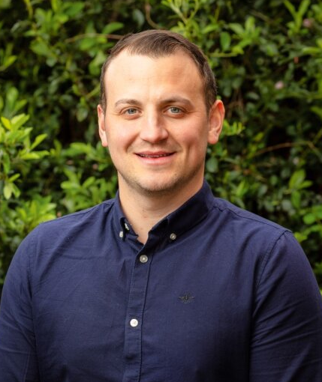
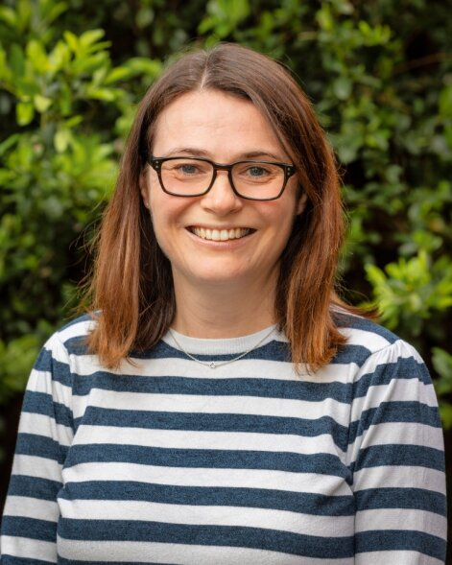
Introductions
Scott Copeland
Contracts & Grants Manager
Helen Betts
Senior Project Support Officer

Slide 3

What was the problem?
For Commissioners
Disconnect between standards needed/ expected and VCSE offer.
Recognising value of ‘Keeping it Local’ but not having all the tools required to facilitate this.
For VCSE Organisations
Accessible funding not allowing/providing ‘platform’ to address gaps and build capacity.
Lack of time to ‘search’ and apply for opportunities and source other providers who can contribute.

Slide 4

The Third Sector Framework
Partnership between Nova Wakefield District, Wakefield Council, Wakefield HCP and Young Lives Consortium.
A fair, open and transparent way of allocating funding to VCSE organisations across Wakefield District.
Focus on Health and Wellbeing services.

Slide 5


4 Key Principles
Coordination
Confidence
Coproduction
Capacity building

Slide 6
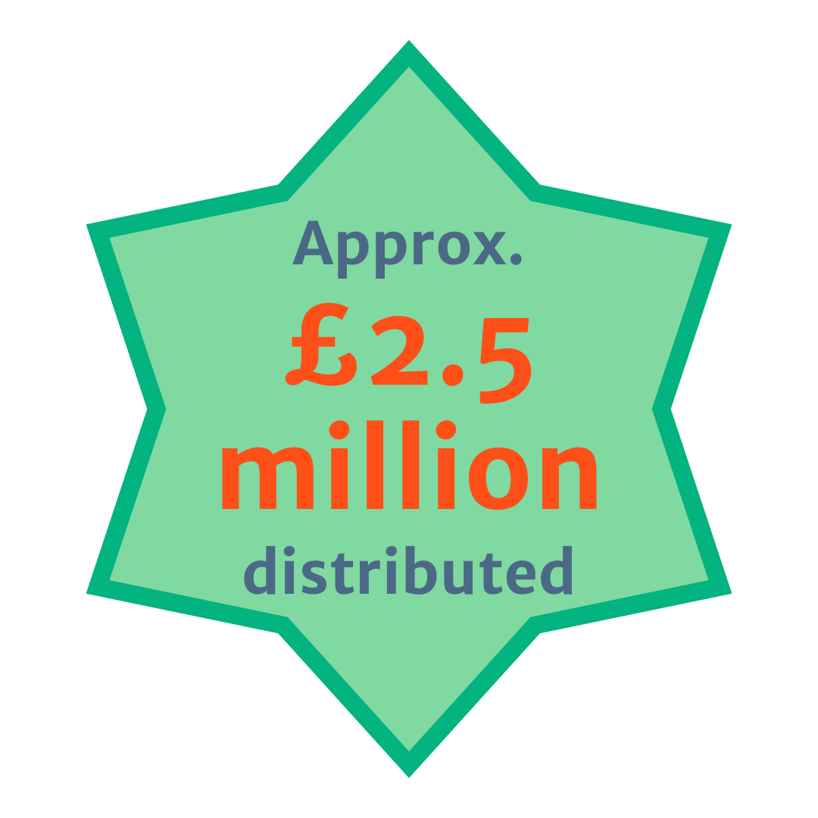
The Story So Far
Funding distributed through 13 funding opportunities.
131 VCSE members across three membership tiers.
Capacity building support provided around governance, policies and procedures, bid writing.
Working with commissioners to encourage and facilitate coproduction where possible.
Improving the ‘member experience’.
Improved communications.
Notes:
3 tiers of membership, meaning that organisations of all sizes can apply and benefit from access to the same funding opportunities.
All members have to meet 5 Universal criteria:
operate in the VCSE sector
provide Health and Wellbeing services and activities in line with the four priorities set by the Wakefield Health and Wellbeing Board
be ‘locally-rooted’ in Wakefield District
be committed to sharing skills, expertise and best practice
be committed to safeguarding.
At Tiers 1 and 2:
√ Financial health
√ Quality systems
√ Suitable organisational policies
√ Suitable governance
√ Technical capacity

Slide 7
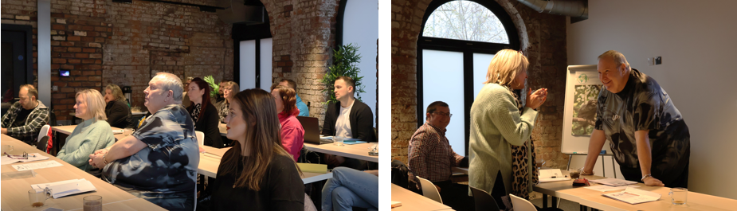
Case Study
Thinking Differently Development Fund
(Mental Health Alliance)
Notes:
Thinking Differently Development Fund (Nova working with Wakefield’s Mental Health Alliance)
Investing in organisations rather than projects. 5 organisations selected from Tier 2 and 3 of the TSF membership.
2-year project designed to build organisations capacity, allowing them to better support people experiencing mental health issues in a community setting.
Externally evaluated by Leeds Beckett University

Slide 8

Commissioner Feedback
“The Third Sector Framework and the role you played was really key in making sure that this process was done in partnership, created the conditions to get in some really strong bids from the VCSE sector and was robust and transparent.”
“There’s a guarantee that the Community Groups who are given funding have passed all the due diligence processes – therefore removing anxiety about funding being given to groups who won’t be able to use the funding as it was meant to be used …”
Notes:
Quote 1: Core20PLUS5 Pregnant Asylum Seekers and Refugees (West Yorkshire HCP)
Quote 2: Community Grants for Climate Activity (Wakefield Council and WYCA)

Slide 9

Group Discussions
Is there anything similar to the TSF in your area or district?
Do you think the TSF approach is open, transparent and
fair?
Could something like the
TSF support you in your role?
In what way? What challenges might you face?

Slide 10
Challenges
Knowledge & expertise
Strategy & governance
Capacity in our team
Ways of working
Wider awareness
Measuring success

Slide 11
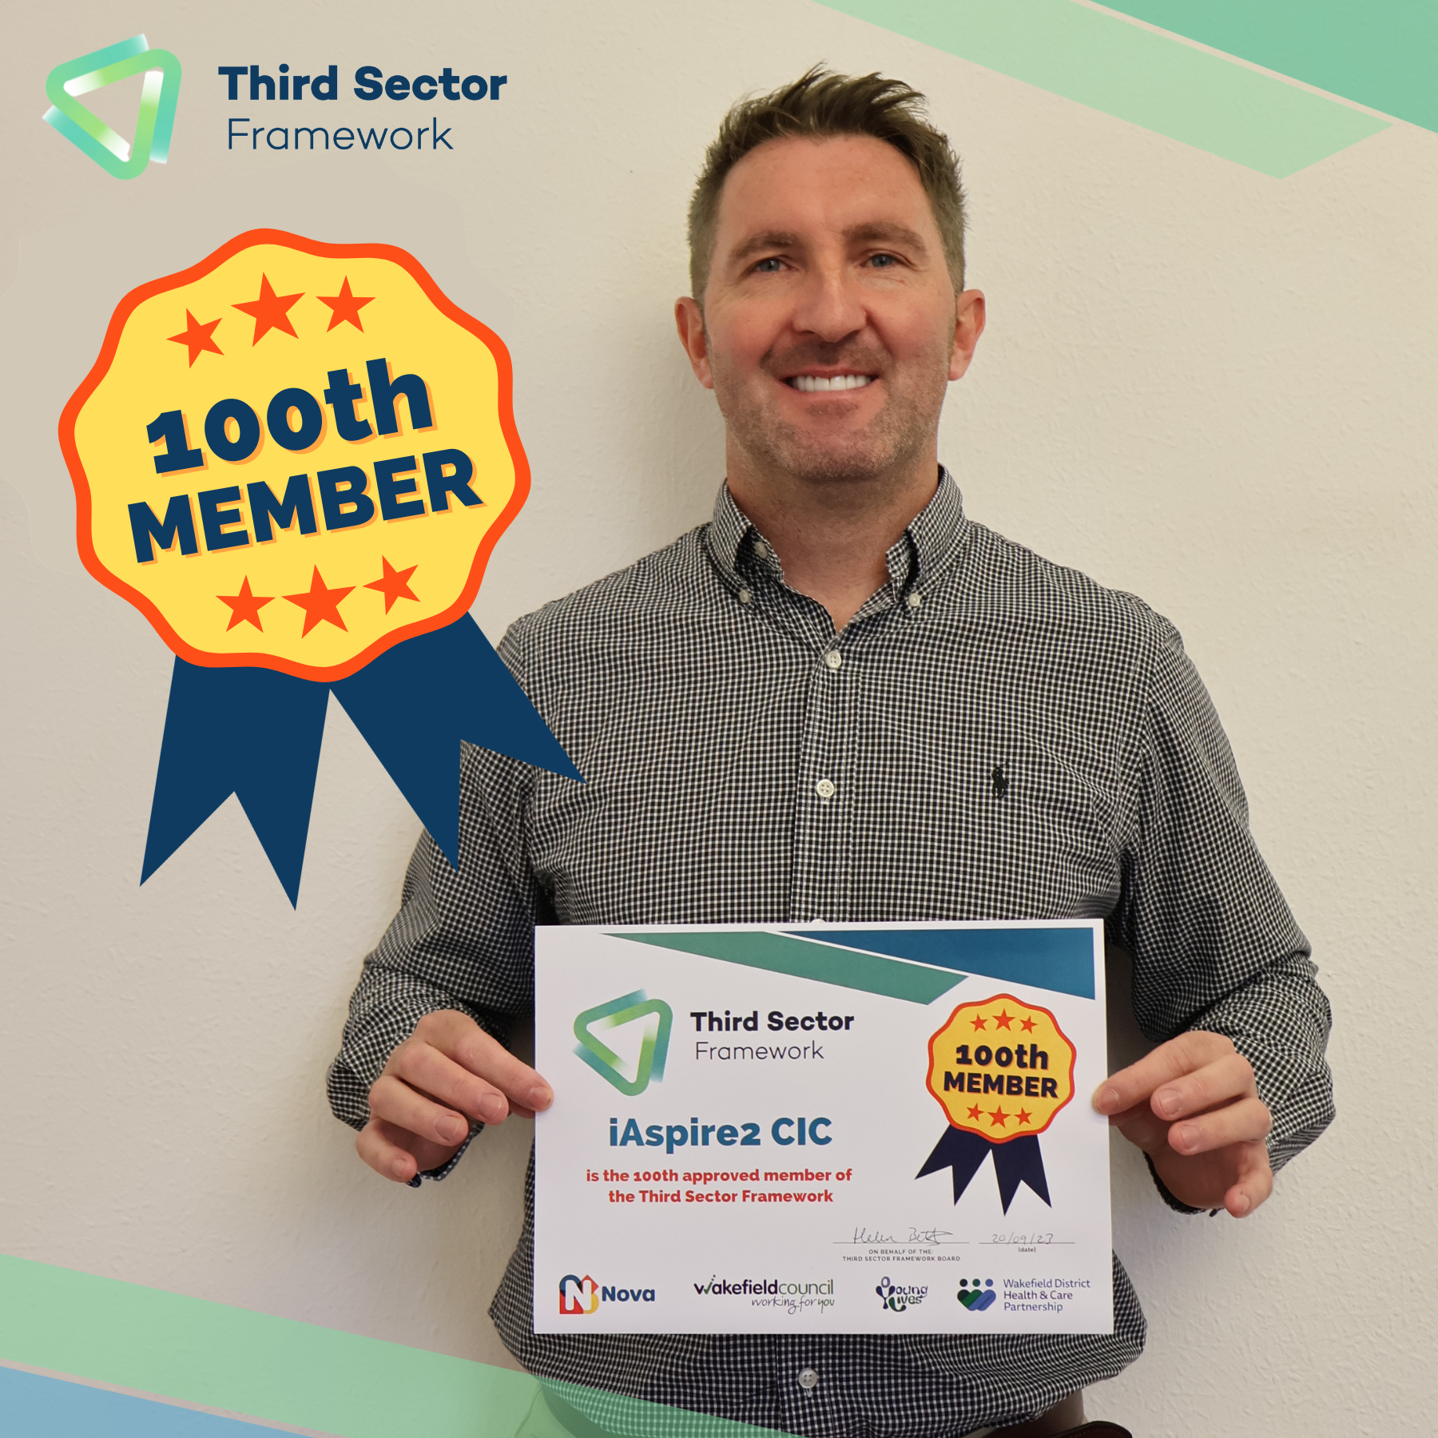
What Next?
Administrative funding until July 2026.
Development Plan work in progress.
New Wakefield District VCSE Collaborative to have strategic oversight – transition in progress.
Improved communications and increased awareness.
New funding opportunities.

Slide 12
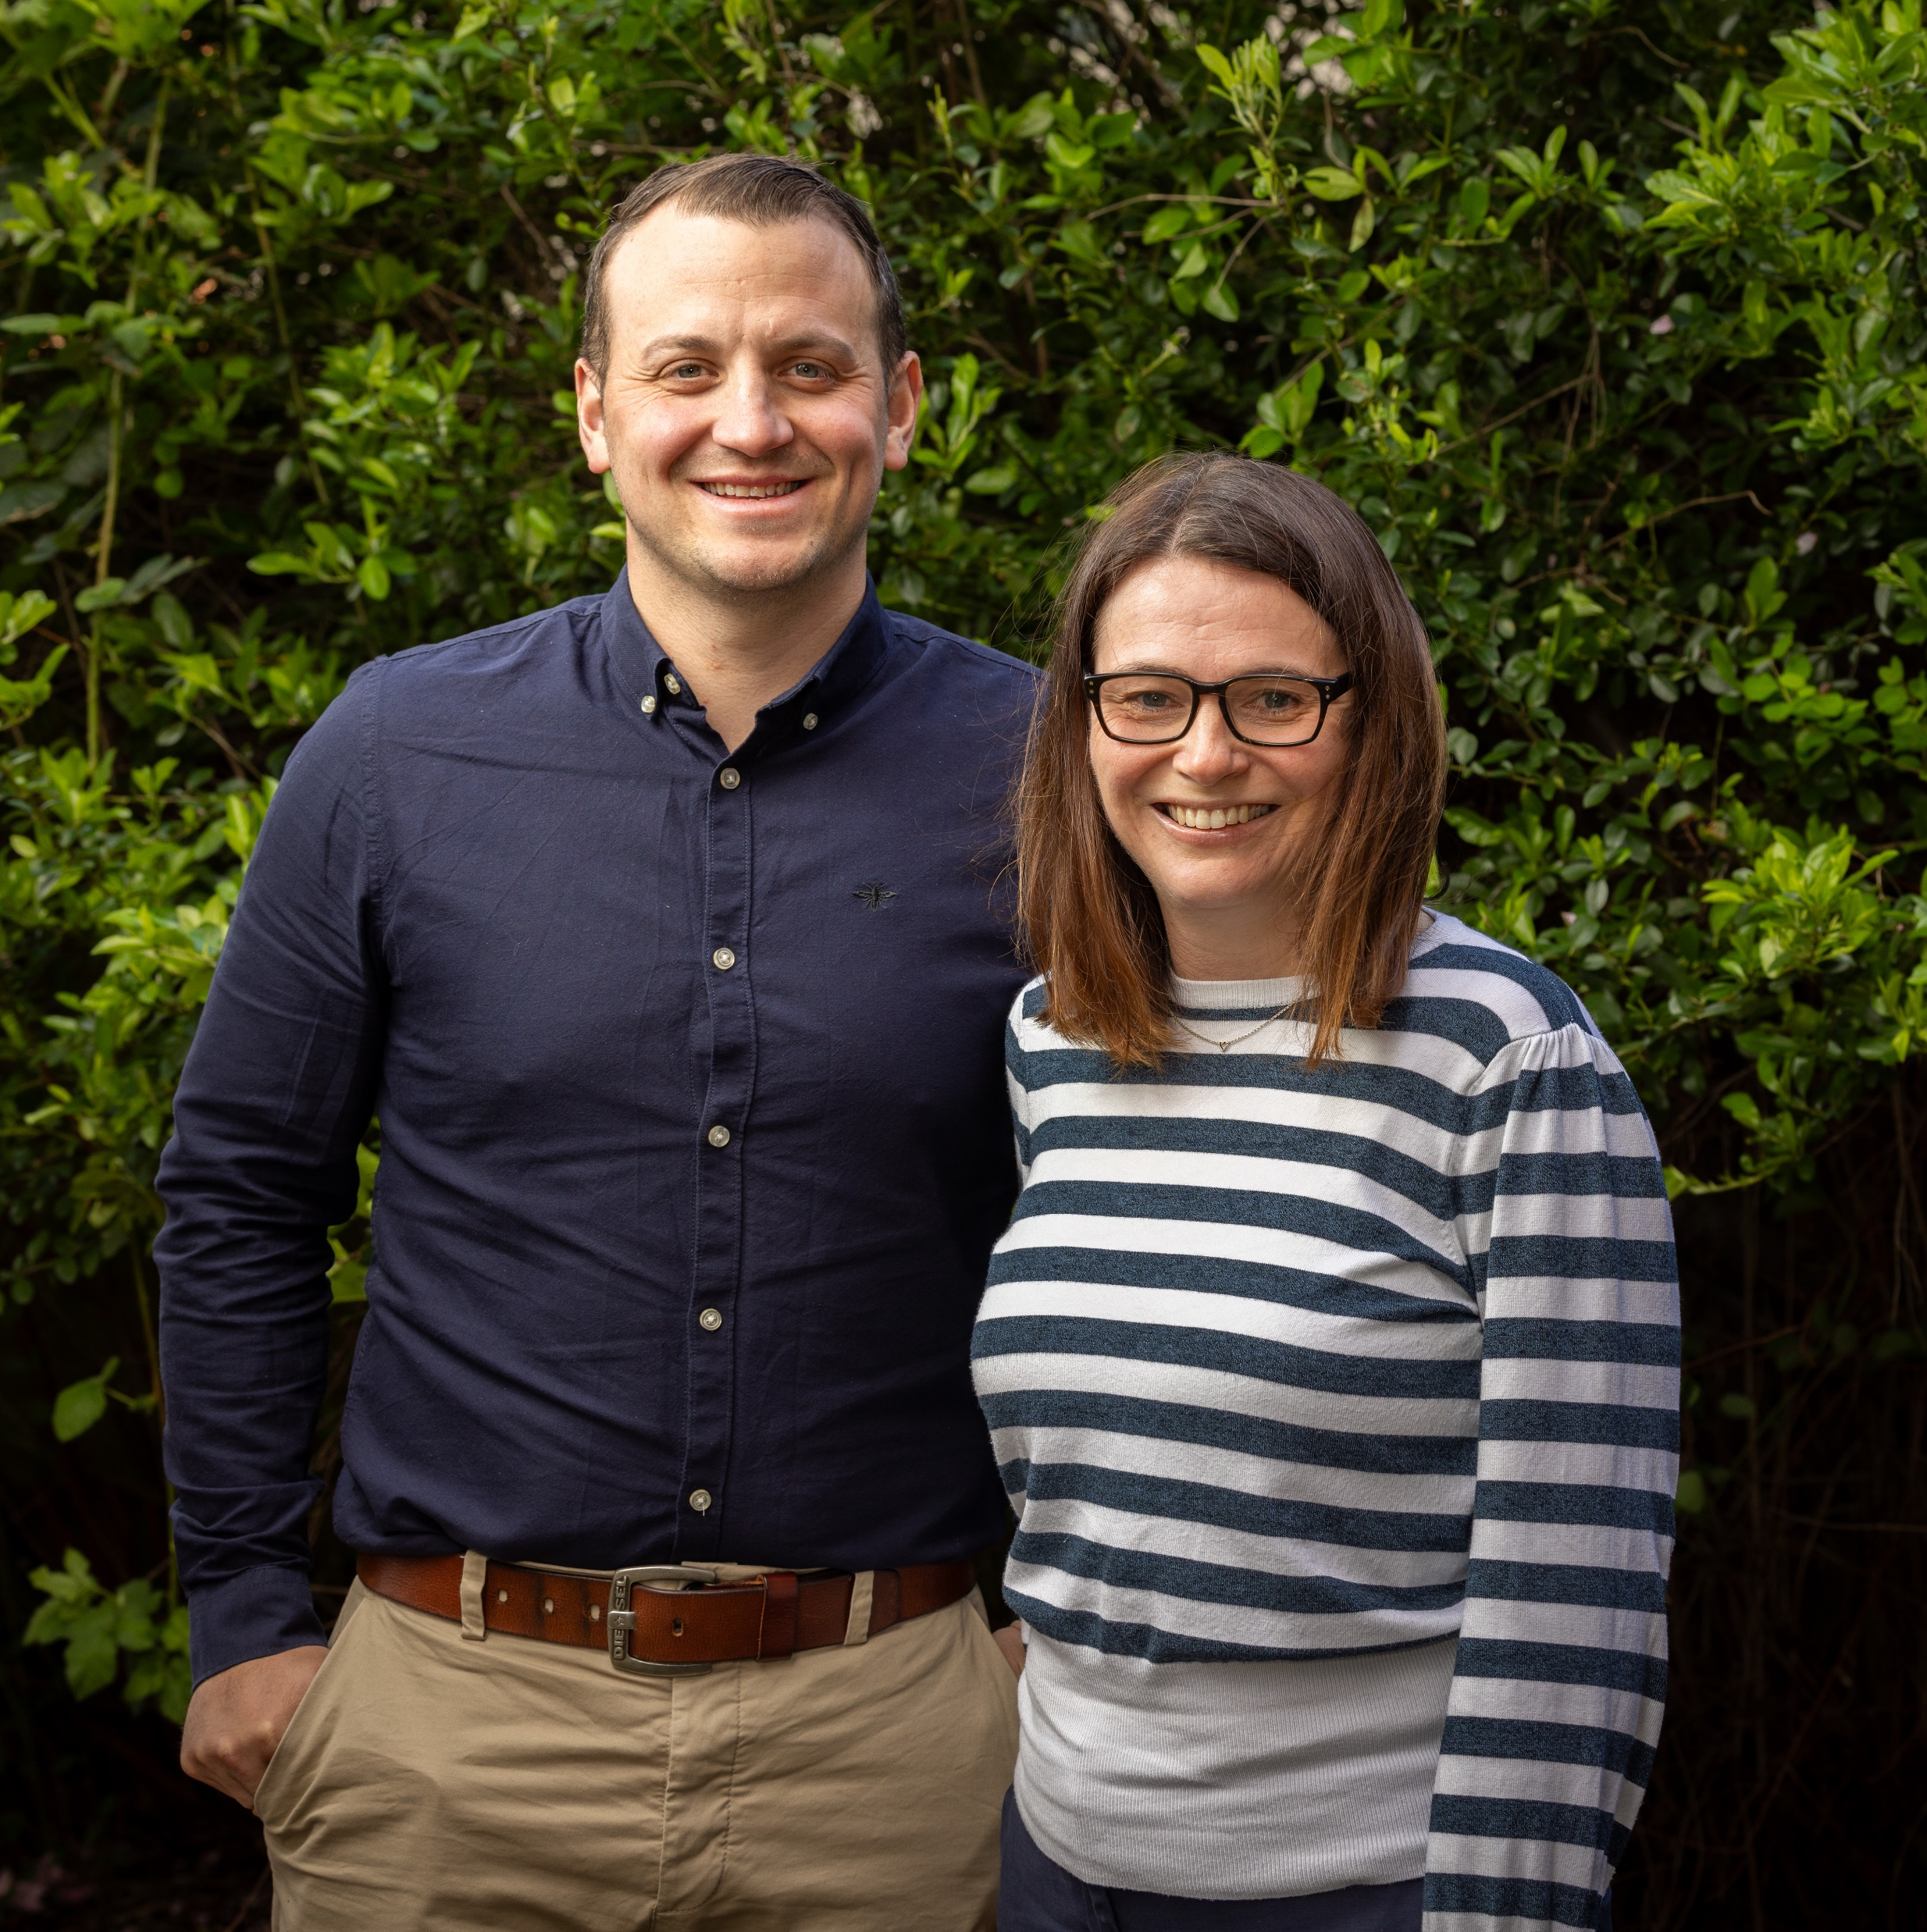

Thank you!
Find out more about the TSF https://www.nova-wd.org.uk/our-work/third-sector-framework
Contact us on framework@nova-wd.org.uk
Follow us on Twitter (X) @tsframework

