Slide 1


Learning from research: What is the power of local infrastructure?
Rob Macmillan
CRESR, Sheffield Hallam University
NAVCA annual conference
15th May 2025

Slide 2
Plan
10 mins: Small group discussion + feedback
25 mins: Learning from research
15 mins: Small group discussion + feedback
Close at 12.45

Slide 3
For discussion
Close your eyes for a moment…
(nothing bad will happen)
Discuss with your neighbour/s - in 2s or 3s
What’s the most important thing, in your view, that can make for effective local VCSE infrastructure?

Slide 4
Fundamental problems for VCSE infrastructure
It is possible that:
you know more about VCSE infrastructure than anyone else…
you care more about VCSE infrastructure than anyone else…
If true, this means you have to:
find compelling ways of explaining what it is…
work out and explain how VCSE infrastructure might help others…
And all in a context of:
the intrinsic invisibility of ‘back office’ work…
the immediacy and intensity of urgent ‘frontline’ priorities…
"everyone understanding what that vision is, what are our aims and how are we going to get there… we've done huge amounts of work with the staff around [this]. That is why we are all here… I think having that shared vision is huge".

Slide 5
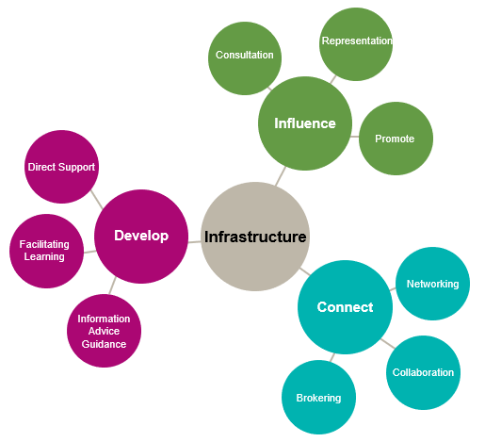
Explaining infrastructure – functions and metaphors
‘FFI’ (NAVCA)
Leadership and advocacy
Partnerships and collaborations
Capacity building
Volunteering

Slide 6
Researching local VCSE infrastructure
1. Purpose/problem statement
what does it do? what is it for?
what is the problem to which VCSE infrastructure is the solution?
2. Configurations
how is local VCSE infrastructure organised?
who does what? how do they relate to each other?
3. Quality, value and impact
is it any good? how so?
what makes it so?

Slide 7
A changing context for local VCSE infrastructure
Wider context | VCSE infrastructure
New Labour, public services and the Third Way financial crisis and recession Coalition, austerity and the Big Society COVID-19 | a ‘coordination project’ (ChangeUp) – peak infrastructure? unsettlement + disenchantment disinvestment + transition (TLI, merger, ‘demand-led’ approaches) a re-animated conversation about infrastructure?
a new government, fiscal constraint and political fragmentation | who knows?

Slide 8
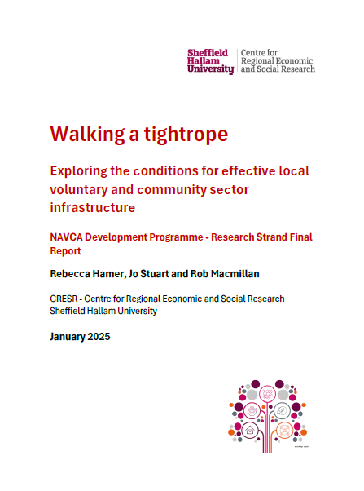
In order for a local infrastructure organisation to serve the needs of the local VCSE sector and system partners…
…what are the internal and external conditions that enable or prevent…
…effective delivery of objectives, efficient operation as a sustainable organisation and achievement of quality accreditation status?

Slide 9
Internal and external conditions
Internal conditions | External conditions
1. Mission, culture and approach | 1. Relationships with statutory authorities
2. Geographical scale/remit | 2. Relationships with the VCSE sector
3. Governance and leadership, structures, policies and procedures | 3. Relationships with infrastructure
4. Workforce capacity and capabilities | 4. Wider policy environment
5. Financial resources and assets | 5. Wider resource environment

Slide 10
Methods and data
Case | Description
A | London Borough
B | Large city, Unitary Authority
C | Rural area, Non-metropolitan District
D | Mixed town/rural Metropolitan District
E | Rural area, County Council
F | Medium-sized city, Unitary Authority
G | Small city, Metropolitan District
H | Large town, Metropolitan District
Review of documents
NAVCA existing notes and data; Connecting Locally transcripts
LIQA/VCQA material
Eight case study LIOs
Interviews: CEO plus up to 3 external stakeholders
Roundtables: LIO staff and VCSE groups
 | Intws | Rndtble | Total
LIO CEO | 8 | 0 | 8
LIO staff | 4 | 28 | 32
Stakeholders | 17 | 0 | 17
VCSE groups | 9 | 18 | 27
Total | 38 | 46 | 84

Slide 11
2.
Money, but not just the money
1.
Balancing capacity and expectations
3.
Importance of people and relationships
Five key findings
5.
Positive and negative spirals
4.
Stabilising and destabilising forces

Slide 12
Balancing capacity and expectations
“because there's so much to do, we try and do an awful lot and… getting the clarity of where we can make the most difference and what we are here to do as organisations, is part of the battle, I think."
Money, but not just the money
“having that that longer term commitment just allowed us to… actually plan a bit further ahead and invest in our processes and procedures".
"Having a good reputation, that's what generates funding opportunities for us. If your reputation goes down the pan so does funding".
"I don't think we would have even got a look in at that if we hadn't spent time building those relationships and maintaining those relationships".
Importance of people and relationships
"what they bring through that shared knowledge and memory and history and delivery over a lot of decades between the team, they're probably going about 100 years of professional experience between them… you can't learn that overnight. I think that's where the trust comes in"

Slide 13
Stabilising and destabilising forces
"there's another organisation that has been… given this patch to deliver on, but their remit sounds exactly the same and that's very difficult".
On the ‘closing off’ of key relationships:
“a huge hindrance… I don't think an infrastructure organisation can survive without it".
Positive and negative spirals
“a lot of it is about external relationships, so we've had a lot of chief officers bought in just to make sure we're fit for purpose...
Then the next one will come in and do a whole load of work about relationship building and then feel nothing's happened and move, and then the very next person comes in and all those relationship building things start to work”.

Slide 14
‘Room’
a relatively secure position from which to work
Remit
scope and scale: where/what/who for
Resources
funding, assets
and people
Relationships
VCSE sector, statutory authorities, infrastructure
Regard
reputation, credibility
and status

Slide 15
So, what is the power of local infrastructure?
passion and enthusiasm – hope and potential amidst ‘polycrisis’ and overwhelm
acting as translators – across boundaries, with a grounded and practical approach
embedded locally – making connections and nurturing networks
knowledge and expertise – from multiple vantage points
mobilising local resources – helping to make things happen

Slide 16
For discussion
Again, in 2s or 3s:
What is the most significant or relevant finding for your organisation?
What one thing might you want to do as a result?
What else do you want to know more about?
(i.e., what further research is needed?)

