Slide 1

How do we engage most effectively with devolved authorities?
Liz Windsor-Welsh, CEO of Action Together CIO [Greater Manchester] Jill Hopkinson, Policy Manager NAVCA

Slide 2

Devolution – what we know so far
All areas of England to have Strategic Authorities by 2029
Six priority devolution areas – first Mayoral elections May 2026
Further areas with be invited during 2025
LGR alongside adds complexity

Slide 3
Seven Areas of Competence
Transport and local infrastructure
Skills and employment support
Housing and strategic planning
Economic development and regeneration
Environment and climate change
Health, wellbeing and public service reform
Public safety including resilience.

Slide 4
Devolution – other changes
Alignment with ICB boundaries and involvement in governance
Move to align Police and Crime Commissioner and Fire and Rescue functions
Minimum population of 1.5M

Slide 5


The VCFSE and Devolution in Greater Manchester
Liz Windsor-Welsh, CEO of Action Together and Director of 10GM
Warren Escadale, CEO of VSNW

Slide 6
We will cover
Our journey in Greater Manchester (role of VCFSE in Devolution and how LIOs have been responding).
What have been some of the opportunities for LIOs and the VCFSE
What have been some of the tricky things for LIOs and the VCFSE

Slide 7
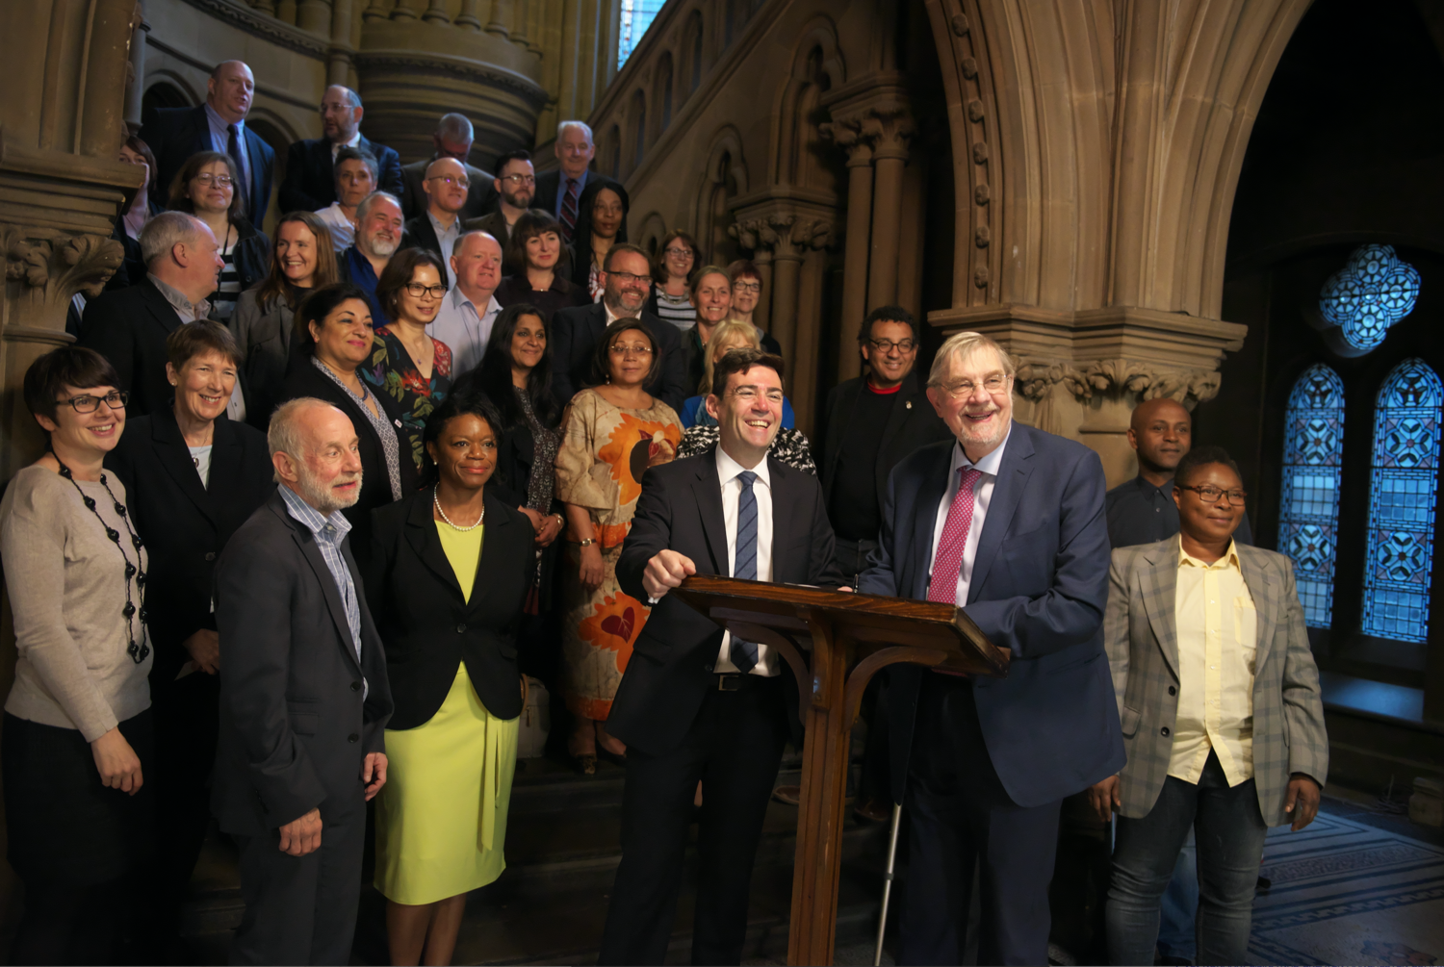
Quick history…
In 2015, we formed as the Greater Manchester VCSE Reference Group in response to the increasing likelihood of devolution. The initial aim was to support sector engagement across Greater Manchester’s devolution agenda.
In 2015, the devolution agreement between the UK government and Greater Manchester allowed for “devolved control” of the region’s £6 billion health and social care budget.
2017 saw the signing of a memorandum of understanding (MoU) between the Greater Manchester Health and Social Care Partnership and the VCFSE sector, to strengthen the relationship between the group and the public sector.
This was followed the signing of the original Accord in November 2017 by the Mayor of Greater Manchester, with several hundred representatives of the VCFSE sector.
The group chose its new name in 2019 to reflect its increasing role in civil society in Greater Manchester. In 2020, the group published a Policy Position Paper, which set out their ambitions.

Slide 8
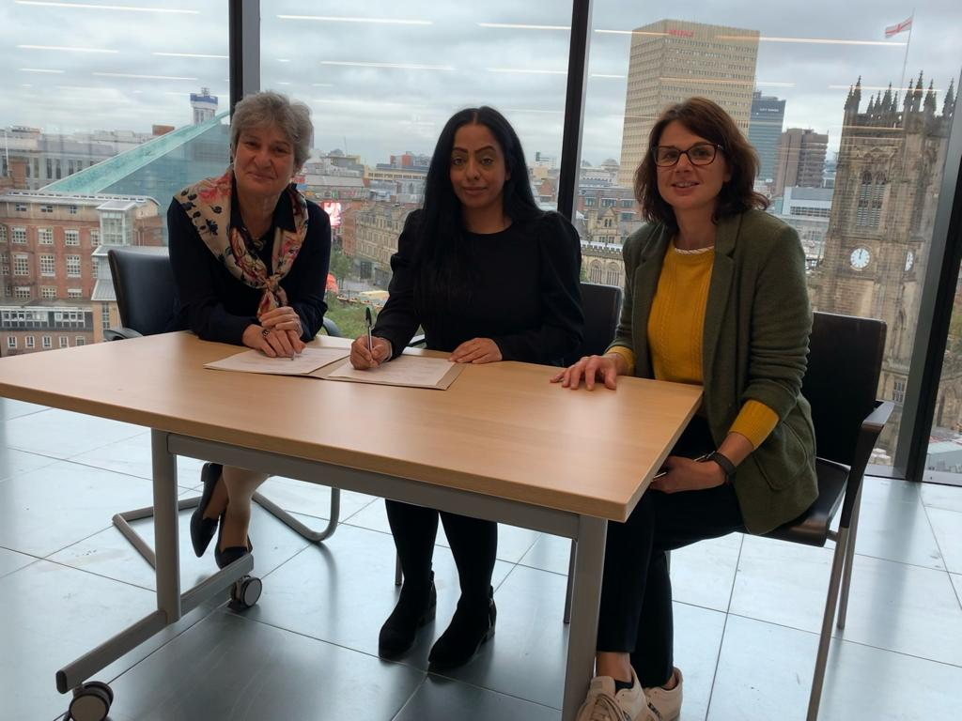
The importance of the VCFSE sector was highlighted during the Covid-19 pandemic, as inequalities were exposed and demanded a response.
Drawing on our experience of strategic engagement, we worked with the public sector to draw up a new Accord to improve outcomes for Greater Manchester’s communities and citizens.
Representatives of local government, health, and the VCFSE sector signed the new Accord, agreeing to work together collaboratively to tackle entrenched inequalities over the next five years (2021 – 2026).
This Accord confirmed the will of all partners to embed the VCFSE sector as a key partner.
The Accord was refreshed in 2023 with a renewed commitment from all partners. As Greater Manchester looks at deepening its devolution deal, the Leadership Group will continue to work as the voice of the sector.

Slide 9
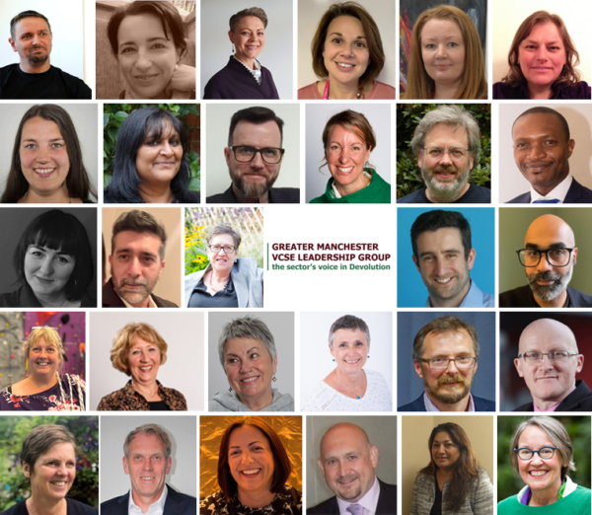
The VCFSE Leadership Group
We’re the voice of the sector in devolution, influencing power and funding as it transfers from national to local governments. We will end inequality in Greater Manchester within a generation.
Our vision is a united and connected VCFSE sector delivering a more equal Greater Manchester.
What we do
Create space to meet the public sector
Share information, link VCFSE representatives and develop responses
Create propositions to catalyse change
Campaign and provide a unified voice for the sector
Improve accountability and governance

Slide 10
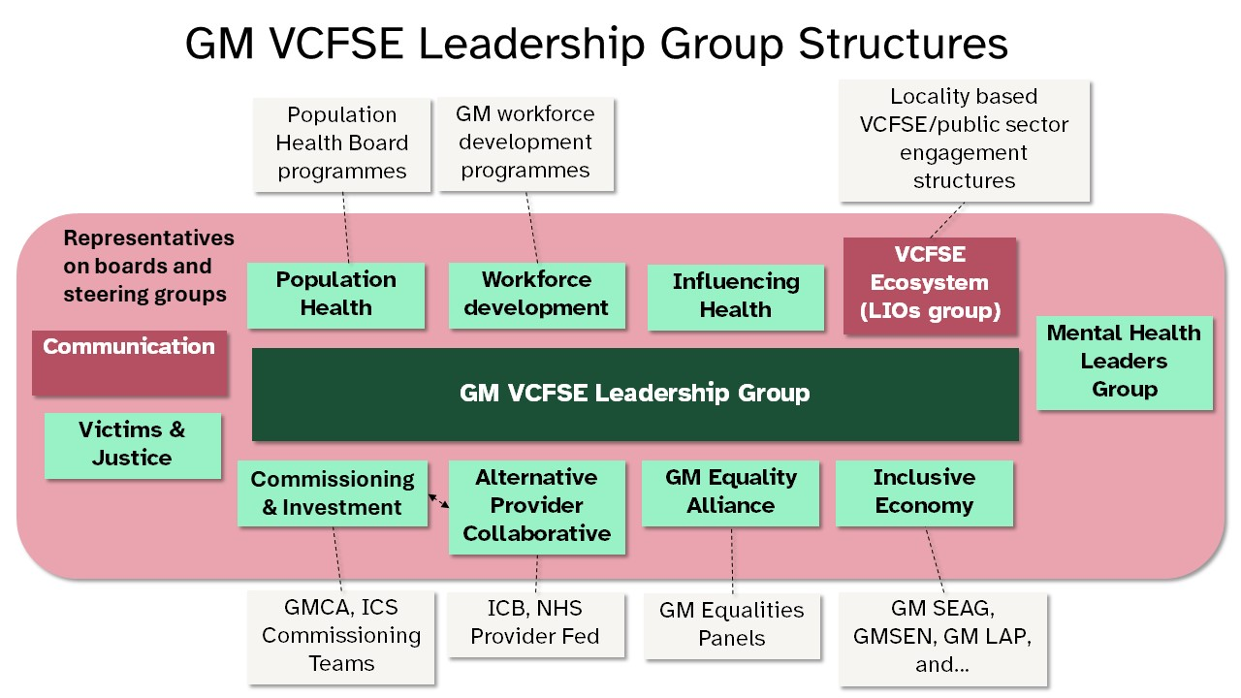

Slide 11
Meanwhile for the LIOs…
2014 onwards LIOs under threat from LA cuts
2015 New MoU between LIO partners, ’10GM’ partnership starting to come together (informally) – many changes and closures/a merger of LIOs across these years
2019 10GM established a legal entity called 10GM (4 of the 10 partners)
2020-now, partnership with all LIO orgs (or emerging ones) to deliver their locality part in funded 10GM initiatives and collaborate through an LIO Network.
Founding partners of 10GM active from beginning in the creation of the VCSE Reference Group (now GM Leadership Group)
Formal role in LG ecosystem development and influencing – 10GM resourced to provide officer support time (for LG Commitment Priorities) and provide a small contribution to the members of the LIO network. New role(s) actively working with GMCA and NHS GM in integrated teams.

Slide 12



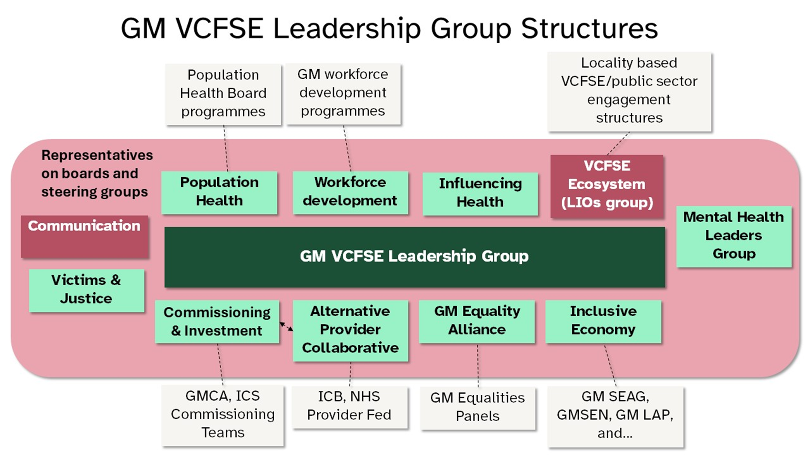









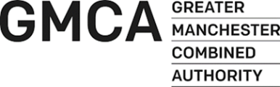


VCFSE Sector
Accord
Infrastructure Leaders
Local Infrastructure Organisations
The GM VCFSE Accord

Slide 13

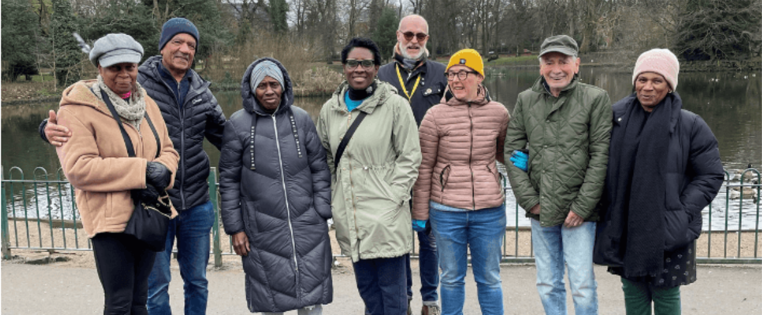
What is the purpose of 10GM?
Increasing the voice and influence of the local VCSE sector at GM level
Securing opportunities which connect localities and Greater Manchester
Supporting locally-delivered projects across all GM communities
Strengthening and championing local VCSE infrastructure support
Notes:
ALISON

Slide 14
Who are 10GM?
10GM is a partnership of 4 local infrastructure organisations: Bolton CVS, Macc (Manchester), Action Together (Oldham, Rochdale, Tameside), and Salford CVS.
In 2019, we registered 10GM as a Company Limited by Guarantee, owned by the partners.
The Chief Executives of the 4 partners are the Directors of 10GM Ltd, working to a Collaboration Agreement based on the 7 Co-operative Principles.
Directors are supported by a central team with a small staff team with specialist skills, knowledge and connections across the city region.
With a combined workforce of over 210 staff, our 10GM Partnership forms an ecosystem of support for driving forward collaborative, community-led initiatives in Greater Manchester.
Notes:
ALISON

Slide 15
What does 10GM do?
We work in collaboration with Bury VCFA, Sector 3 (Stockport), Thrive (Trafford) and VCSE colleagues in Wigan as well as Voluntary Sector North West and a wide range of leaders from across the diverse communities of Greater Manchester.
We champion the local VCSE sector, with a shared purpose to improve the economic, social and environmental wellbeing of people and communities in all 10 areas of GM.
We deliver a range of GM-wide and locally-based initiatives.
We provide a way for public sector bodies in Greater Manchester to build long-term, collaborative relationships with our diverse local VCSE sector of 17,000+ community organisations.
Notes:
DAWN

Slide 16

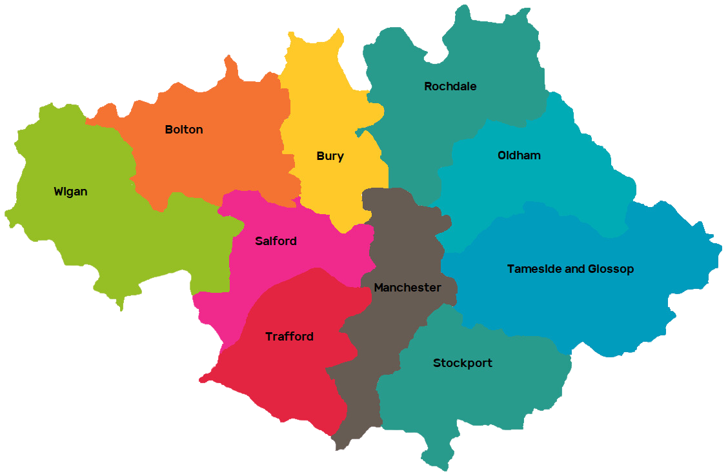
Answer Cancer
Answer Cancer is a partnership working to improve cancer awareness and increase the uptake of cancer screening across Greater Manchester. We do so via grants, delivering cancer screening awareness sessions, supporting a network of Cancer Champions, and providing training.
Answer Cancer is delivered by Salford CVS, on behalf of 10GM.
10GM Initiatives
GM Moving Connecting Communities
10GM was funded by GM Moving to deliver a project that tests how to build capacity and leadership in communities to enable active lives for all. One-off investments were made to Bury VCFA and Wigan's Groundwork.
They aim to tackle inequity of access through the involvement of communities that face the highest barriers to movement, active lives, and active places.
VCSE Population Health Programme
10GM’s Population Health programme brings together VCSE organisations with NHS GM and others to strengthen the influence of the VCSE sector in GM's decision-making and development of population health approaches. We speak up for making shared decisions with communities and people with lived experience of inequality, alongside grassroots voluntary and community organisations.
10GM co-chairs and provides strategic support to the GM VCSE Population Health Group. This group brings people together to share best practice developments across GM and in localities, and to have an influence together.
Community Engagement in
Health and Social Care
We brought VCSE organisations and local Primary Care Networks (PCNs) together to learn how to create long-term, sustainable partnerships and use them to reduce health inequalities. We funded 5 partnerships and appointed an evaluation partner.
We developed a set of recommendations focused on how different people and organisations can work better together and have shared ways of planning and delivering joined-up health and care services.
Violence Reduction Programme
We launched new programmes in Bury, Oldham, Tameside, Wigan, Rochdale, Stockport, and Trafford. These joined existing programmes in Bolton, Salford, and Manchester. This expansion was accompanied by a £1 million investment equally distributed across the ten boroughs, supporting sustainable community-led solutions to reduce serious violence across GM. We also enabled VCSE input into the co-design process of GMCA’s Greater Than Violence 10-year strategy.
Notes:
DAWN: programmes and themes

Slide 17
More 10GM Initiatives
VCSE Workforce
Development Programme
10GM is working jointly with GM LIOs to build VCSE workforce capability in six key areas: Recruitment, HR support, Inclusion, Leadership Development, Personal Development, and Wellbeing.
The programme has built an advisory network of people from the sector. This year we’ve focused on wellbeing – delivering seminars promoting existing resources and making space for organisations to reflect together.
We’ve undertaken research to further understand the needs of the sector and to create an offer of tailored services.
GM VCSE Accord
Facilitation and support to VCSE local infrastructure to develop shared approaches; seize and bid for new opportunities; gather and share insight; and influence system partners.
VCSE Data and Intelligence
Scoping Project
From August 2023 10GM and NHS GM Population Health partnered with Data Orchard CIC to better understand data and intelligence in the VCSE sector.
Through this work, we have:
Gathered views and perspectives on opportunities to improve the use of data and intelligence across VCSE-led activity and services in GM.
Analysed VCSE sector data capacity and capabilities in GM.
Developed recommendations to improve the way data and intelligence is
collected, shared, and used
GM VCSE Infrastructure
Development Programme
This programme brings £1.6m of investment into the VCSE sector in Greater Manchester over three years through the UK Shared Prosperity Fund E11.
It aims to improve locality support for the sector, by building on the strengths of locality infrastructure, identifying gaps and using best practices to accelerate development.
Running until March 2025 and delivered across all 10 boroughs of GM, priority areas include Membership Models and Promotion; Website and Information Strategies; Growing Social Enterprise and Social Investment; Growing Voice and Influence; and developing VCSE Training
and Development.
Notes:
DAWN: Focussed on VCSE capability

Slide 18
What have been the opportunities for LIOs and VCFSE?
What have been the tricky things for LIOs and the VCFSE?

