Slide 1

All Together Now?
The Convening Role of LIOs
Peter Horner and Rob Macmillan
CRESR, Sheffield Hallam University
NAVCA Conference
14 May 2026

Slide 2
Schedule
Introduction: overview of session; background
What is the convening role of LIOs?
  What is convening? Definitions
  Table Discussions: What does convening mean for you?
  Feedback
Successes and Challenges
  Table Discussions
  Feedback
Ongoing Research

Slide 3
What is convening?
Bringing together people and / or organisations for a common purpose (OED, 2026)

Slide 4
Functions of local civil society infrastructure
Facilitating funding such as providing information about opportunities, influencing the design and targeting of grants or other forms of funding and co-ordinating local bids.
Community participation including advice and signposting, promoting community activities, volunteer brokerage and capacity building.
Organisational development such as support for operational management and strategic development, training for frontline staff and bespoke work with organisations.
Convening including bringing together networks of frontline organisations, building collaborations and partnerships across, between and within sectors and arranging community-led activities.
Advocacy such as contributing to strategic cross-sector meetings, intelligence sharing with decision makers and the local VCFSE sector and representing the views of the local sector and decision makers.
(DCMS. 2025)

Slide 5
Functions of local civil society infrastructure
Facilitating funding
Community participation
Organisational development
Convening including bringing together networks of frontline organisations, building collaborations and partnerships across, between and within sectors and arranging community-led activities.
Advocacy
(DCMS, 2025)

Slide 6
What does convening mean for you?
Discuss on your tables:
Who do you convene?
How do you convene?
What is the purpose of your convening?
Feedback on the purposes of convening

Slide 7
Who do LIOs convene?
Organisations
  VCSE
  “Sector”
  Statutory partners
  Private sector
Individuals
  Leaders
  Frontline workers
  Volunteers
Communities
  Geography
  Interest

Slide 8
How?
Networks / Forums
Events
Partnerships
Consortia
Informal connections
Databases

Slide 9
Purpose
brief feedback from each table

Slide 10
Successes and Challenges
Convening is an important, complex and sometimes challenging role. Discuss on your tables:
What convening successes have you had?
What are the challenges?
What do you do about the challenges?
Feedback on
An example of successful convening
A challenge and how to address
Notes:
Some challenges emerging in the research
diversity of voices inclusion
Capacity
Funding
Steered by state

Slide 11
Ongoing Research
PhD research on convening role of infrastructure
Looking at how structured and at how tensions are navigated
4 Case studies
Data collection currently underway

Slide 12
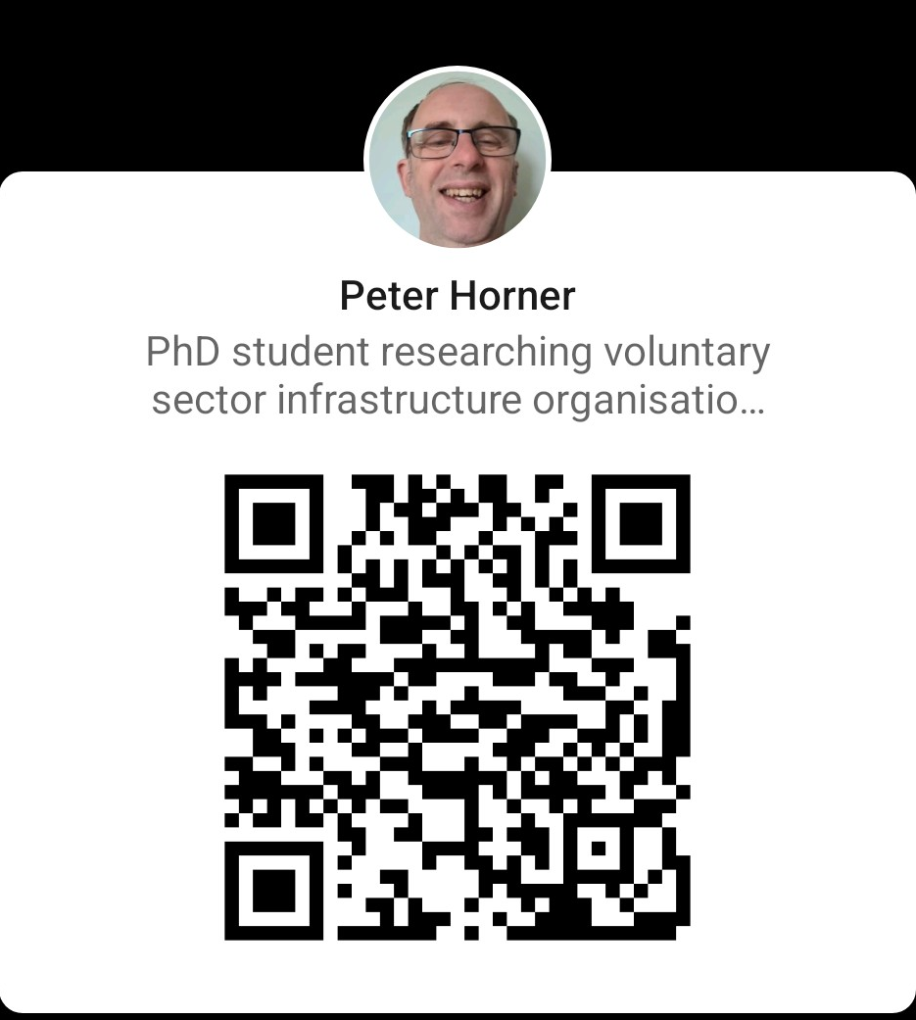
Contact details
Peter Horner peter.horner@student.shu.ac.uk
Rob Macmillan rob.macmillan@shu.ac.uk

