Slide 1



HEARING WHAT MATTERS
Welcome!
A city-wide approach to community insite
Howard Bradley (LS14 Trust)
Claire Graham (Voluntary Action Leeds)

Slide 2
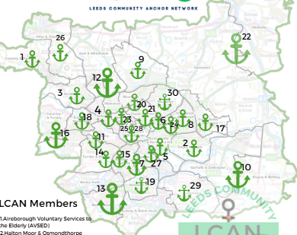
HEARING WHAT MATTERS
What is LCAN?
Leeds Community Anchor Network (LCAN) is a Leeds-wide network of trusted third and faith sector organisations. The network aims to maintain the connections and partnerships which were made during the pandemic.
Collaboration rather than competition is one of our guiding principles and the network works to support smaller organisations and improve city-wide services that provide immediate assistance to communities while also attempting to bring about long-term systemic change.
LCAN is made up of organisations or partnerships who aim to ensure the communities of Leeds thrive

Slide 3
Listening well in Leeds
HEARING WHAT MATTERS
Key points in process
Each anchor funded for their time
Training for all anchors at start
Dissemination to other groups
All wards covered
feedback to communities cruital
Build on answers from previous years
Used to inform wider work
Assets over needs

Slide 4

HEARING WHAT MATTERS
DOWNLOADING (HABIT) “I already know this” → Hearing confirms assumptions → No real change happens
GENERATIVE LISTENING (OPEN WILL) “What wants to emerge here?” → Co-create new possibilities → Shift systems with communities
Listening Well
FACTUAL LISTENING (OPEN MIND) “What is new or different?” → Notice data, patterns, insights → Expand understanding
EMPATHIC LISTENING (OPEN HEART) “How does this feel?” → Step into others’ experience → Build trust and connection
Scharmer, C. Otto (2009). Theory U: Leading from the Future as It Emerges.

Slide 5
HEARING WHAT MATTERS
“The questions we ask shape the future we create.
Wicked questions don’t solve problems: they open better conversations.”
The Wicked question - Staying asset based
Deficit based
Wicked Question
“Why aren’t people attending?”
“How can we grow participation while respecting how people want to engage?”
“What’s the problem with this community?”
“What strengths do we have, and how are they being held back?”
ABCD Institute / John McKnight

Slide 6
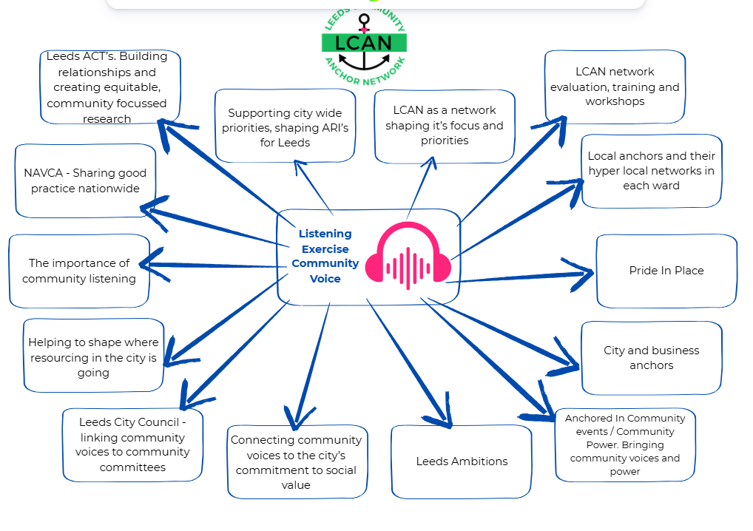
HEARING WHAT MATTERS
Impact and reach

Slide 7
HEARING WHAT MATTERS
Sharing what you are doing.
Time for reflection on asset-based listening
Examples in your areas

