Slide 1


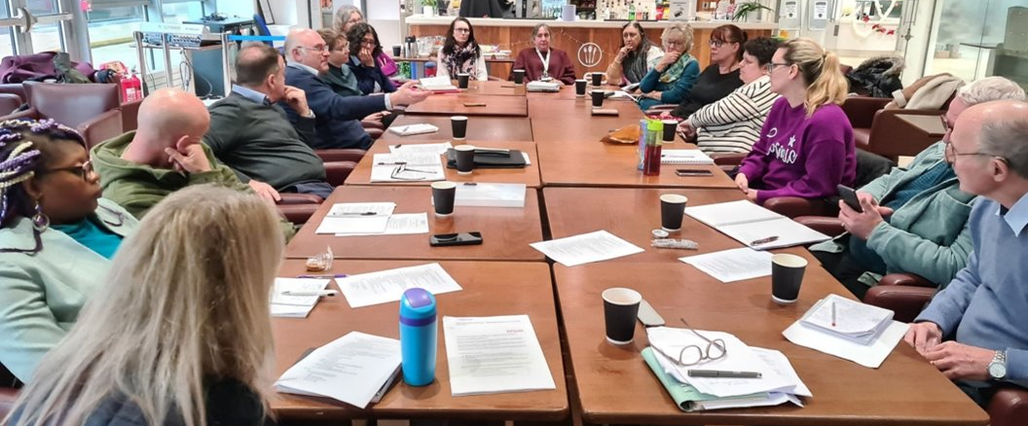


Lessons Learned
Delivering Local Infrastructure Support through Communities of Practice
Chelle Coulton, NTU
Juliana Mainard-Sardon, NTU
Clare Saunders, MVA
Notes:
11:48 Welcome & session plan – Clare
We welcome you into this safe space – where all voices are welcomed and respected, please encourage each other to share and get involved.
We plan to take photos for our LinkedIn and reports to funders – please let us know if you would prefer not to be in photos.

Slide 2
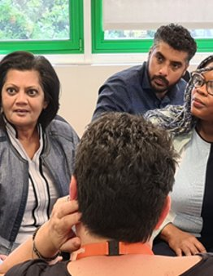

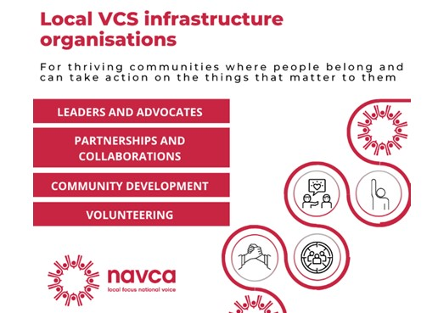
'The old order changeth, yielding place to new'​ (Morte d'Arthur, Tennyson)​
“voluntary organisations need opportunities to share experiences and exchange knowledge as well as to coordinate their actions." (Rochester 2012:109)
"the role of people, skilled relational work and agency within LIOs."
(NAVCA & Sheffiled Hallam University - Walking a tightrope: Exploring the conditions foreffective local voluntary and community sector infrastructure, 2025)
An evolving relationship between the LIO and its members:
Combined efforts of its members rather than a separate body offering services
Capability (mandate, trust?) to convene and 'hold the space' for this to take place
Notes:
11:50 (5) CS – 2.5 min
Felt deeply that traditional infrastructure has had its day (nothing that can’t be googled) – but knew the greater need was collaboration, leadership development and peer-support.
Leaders focus on community development – our aim was to help leaders develop their own VCSEF leadership community, with shared goals, opportunities and new skills development
In line with NAVCA pillars report – look this up and reference here.

Slide 3
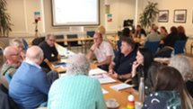
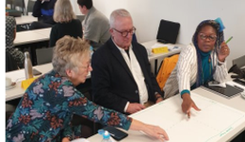
Context
Born out of Covid-19 pandemic and VCSEF leadership consensus – ‘Never Again’.
VCSEF Transformation Academy (Lottery Funded: January 2022. – December 2025).
Delivered in Medway & Swale
A unique collaborative space for learning, new opportunities and innovative approaches to challenges VCSEFs collectively encounter.
Aim: to achieve a‘shift’ in how the sector operates - categorically was not about ‘business as usual’.
Community of Practice members identified and delivered/directed what support they needed (100% community rather than provider driven)​.
Meetings
Training
Task & Finish
Coaching
30 VCSEF Leaders
Theory of Change
NTU Evaluation
‘Tide of Transformation’
Independently Evaluated by NTU...
Notes:
Clare – 2.5 min – Mention Medway!
From this emerged a ‘Never Again...’ attitude from the VCSLeaders Network​:​
Never again should the sector be left so vulnerable​​
Never again will we delay turning interest into action
Pass it to Juliana – NTU Independent evaluator

Slide 4

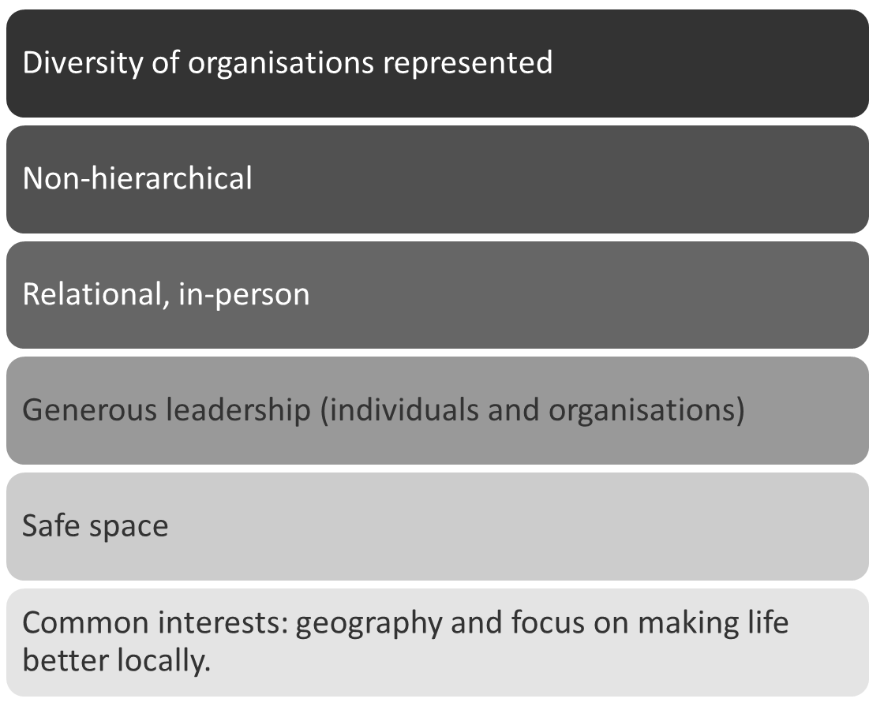
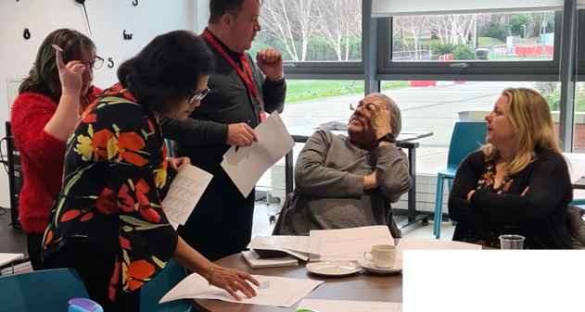

Transformation Academy Project
Community of Practice of up to 30 local VCSEF leaders.
Ran from April 2022-December 2024.
MVA provided secretariat (facilitation, administration, reporting).
NTU as evaluation partner.
“I think it’s more about connecting everybody up in Medway and everybody being on the same path of, this is what we want to achieve, we want Medway to be a great place for everybody”
Notes:
11:55 (2) JMS – Hallmarks – 2 min
Introduce to Chelle
I need 2.20 seconds

Slide 5

Outcomes
Benefits have been wide-ranging, multi-level, and sometimes unexpected.
Some tangibles:
T&F outputs (recruitment toolkit, scoping for vol passport, beta-testing standardised impact measurement/evaluation tool. Most outputs still in progress).
Upskilling through formal trainings (learning & applying).
Coaching (mutual benefit).
Collaborative bids and projects (number and ease).
Notes:
11:57 CC (7min for slides 5-8) -
So what were the outcomes?
Our evaluation focussed primarily on the learning which took place and the value created as a result. What we’ve found is that value is wide-ranging and multi-level, true of social interventions generally – like a ripple in a pond.
There’ve been a number of tangible aspects, including some outputs from the task & finish groups, although most of these are still in progress.
There’s some evidence of upskilling as a result of undertaking and applying learning from formal trainings, especially where topics were new to people, although in many cases these were more refreshers.
The mutual benefit reported from coaching has been striking, with coaches recognising skills they take for granted, realising how far they’ve progressed as leaders, gaining confidence, using their coaching skills within their organisations (teams, trustees, self), finding a possible avenue for further income generation, and feeling a sense of fulfilment in helping another.
And members have become more collaborative on bids and projects – with members reporting greater ease in putting joint bids together, so these are happening more frequently, more naturally, or perhaps even ‘as default’ in some cases.

Slide 6

Outcomes
Many more intangibles:​
Personal: confidence, optimism, informal benchmarking, space to be real, opportunity to step back & think bigger-picture, not having to know everything, identity work making better leaders, sense of community.​
Social: building connections & enduring relationships, accessing others’ networks, referral pathways, understanding landscape (who does what, how we fit in), exploring synergies, pooling ideas, multiple perspectives, reframing problems.​
Sectoral: held in higher esteem by public sector counterparts, reputation, trust, confidence, agenda setting, go-to place for engaging with sector.​
"When I walked into that room, it felt like I was coming home" (TA member)
Notes:
11:59 CC: But in a way, the more intangible outcomes have been more significant. These have happened on 3 levels:
At a Personal level, all members reported gaining confidence (even experienced CEOs), and coming away from meetings feeling more hopeful. People valued the opportunity to compare their own experiences with those of others, being able to be themselves, reflect away from the fire-fighting, not being expected to have all the answers. And ultimately, people were able to engage in the sort of identity work that makes for better leaders.
Socially, the building of connections and relationships was important (with many starting to meet informally for peer support), together with access to one another’s networks (networks beyond the network), better understanding who is out there doing what and how what they do fits into that, and the improved referral pathways which come from that understanding, pooling ideas, hearing different perspectives, reframing problems as shared or sector-wide – it’s not just us – and starting to tackle them differently as a result.
And at a sectoral level, there was some evidence that particularly those involved in the Academy, but also the sector as a whole was regarded more highly by council members, commissioners, and others in local authority and health services. So although relationships between public and VCSE sectors in Medway had been historically positive, external stakeholders talked about trust and confidence, valuing having a ‘go-to’ group when they wanted to engage with the sector, but also starting to find the sector bringing the agenda to them rather than responding to agendas set by the public sector, so all in all, the VCSE sector being taken more seriously.

Slide 7
Enablers
Relationships: many pre-established, trust creating safety via LIO, escalated through deep/frequent/extended interaction.​
Resources: funding (& in-kind donations), secretariat, facilitation, forward planning​
Conditions: significance of place, supportive local authority, proactive LIO, crisis as catalyst (COVID)​
Member dispositions: shared passion for improving lives, strong place-based identity (“We do things the Med-way!”), desire to do things differently, action-orientation, openness to learning, sharing & collaborating, mutual respect & preparedness to trust, generous leadership, …​
Notes:
12:01 CC: So thinking about the key ingredients that have enabled the TA to work as it did, we’ve grouped them into 4 areas:
Relationships – some members already knew each other; deepened through the time spent together. MVA role in promoting relationship building.
Resources – some in-kind – generous leadership, donated meeting rooms. But funding was vital, because secretariat was so key. Facilitation & admin.
Conditions – Medway was conducive – size, local authority – supportive & unitary, well respected, proactive LIO. COVID crisis as a catalyst.
Member characteristics/dispositions – as per slide…
And we can explore these further together in a minute.

Slide 8
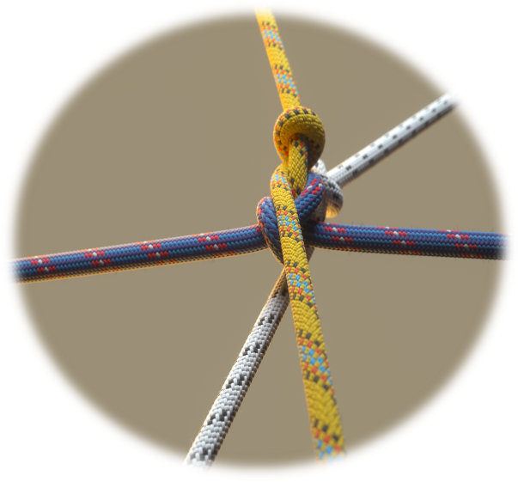
Some challenges & tensions
Short-term funding vs long-term goals and entity
Organisation focus vs sector focus (vs systems focus)
Measurable vs 'real' value
Group churn vs stable group (& open vs closed/big vs small) although welcoming fresh ideas
Co-design/collective ownership vs need for tangible results
Notes:
12:03 CC: And very briefly, it’s also thrown up some interesting challenges and tensions:
I don’t think anyone will be surprised that there’s a mismatch between the short-term nature of project funding, and the long-term priorities the group set itself and the long-term nature of a community of practice – always more to learn, always new issues arising, always new leaders emerging.
Tension around the size and churn of the group – members were really conscious of not wanting to be exclusive and how to enable more leaders to benefit. They also valued some churn because this brought in new ideas & fresh eyes. But there were practical limits on this, and there needed some level of group stability for continuity & trust.
Returning to Generous Leadership – there’s inevitably a balancing act between focusing on your own organisation and doing things which have sector-wide benefit, and beyond that working at a systems level.
Measurable vs real value – the things you can measure were not necessarily the things that were really valuable – vv, the things making the biggest difference to members tended not to be readily measurable.
And finally, a tension felt I think particularly by Clare as facilitator and overall project lead – knowing that the group setting its own agenda and pace is critical to its legitimacy and success, yet needing to show some concrete progress at specific milestones when reporting back to the funder.
[Hand back to Clare]

Slide 9
Over to you...
Table 1: Where are you at? | Table 2: What if...? | Table 3: Practicalities
Are you doing something similar? Tell us about it! What are you finding? What's going well? What's more challenging? | How could you make more use of CoPs? What might be the benefits? What problems could it address? What outcomes might it achieve? Who is(are) your target audience(s)? What reservations or concerns do you have? | What existing capabilities and resources could you use? What support would be needed? Who are your key stakeholders? What are the challenges in setting up this kind of CoP?
Notes:
12:05 Group work (20 min) i.e.: spend 6 min at each table
Clare – Explain activity
Table 1 – Juliana, Table 2: Chelle, Table 3: Clare , take notes, collect some questions

Slide 10
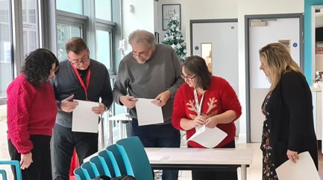
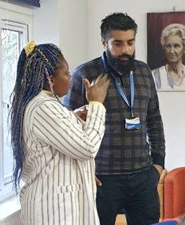
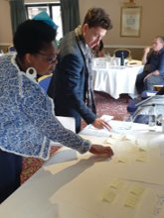
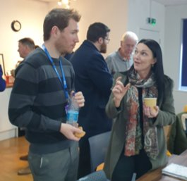
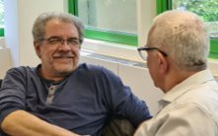
Continuing the discussion...
Notes:
12:25 (15) –
Juliana chairing
Summary of Tables
Q&A – if you feel comfortable, tell us your name and organisation before asking a question.
Spare questions:
1) What is the role of LIOs in community-building within the VCSE sector?
2) Could a CoP-based model be an alternative way of doing local infrastructure? If so, what might that look like?

Slide 11
Takeaway
Write down 3 things you're going to do as a result of this workshop (and when!)
THANK YOU for joining us today!!
Chelle Coulton, Doctoral Candidate, NTU
chelle.coulton2023@my.ntu.ac.uk
https://www.linkedin.com/in/chelle-coulton-8519aa23a/
Juliana Mainard-Sardon, Senior Research Fellow, NTU
juliana.mainard-sardon@ntu.ac.uk
https://www.linkedin.com/in/juliana-mainard-sardon-phd/
Clare Saunders, Programmes Director, MVA
clare@mva.org.uk
https://www.linkedin.com/in/clare-saunders-64954b60/
Notes:
12:40 (5 min)
Chelle
Add contact details – emails and LinkedIn

