Slide 1

Local Civil Society Infrastructure
What the research tells us

Slide 2
What the presentation will cover
  About the research
  What we mean by ‘local civil society infrastructure’
  How it is delivered
  What difference it makes
  Characteristics of strong/effective LCSI (and what happens when it is weak)
  What strengthens LCSI – and what weakens it
  Questions and discussion
Notes:
2

Slide 3
About the research
  Local Civil Society Infrastructure R&D Programme: “a multi-strand mixed-methods research project intended to develop the evidence base on local civil society infrastructure”. Commissioned by the Department of Culture, Media & Sport (DCMS) & carried out by 4 research partners during 2024.
  ‘Walking a Tightrope: Exploring the conditions for effective local voluntary and community sector infrastructure’: Commissioned by NAVCA & carried out by Sheffield Hallam University.

Slide 4
The research explores
  What Local Civil Society Infrastructure is, what it does, and who provides it
  What difference it makes
  What strong and effective LCSI looks like – and what happens when it is weak or ineffective
  What enables strong LCSI – and what weakens it

Slide 5
What is Local Civil Society Infrastructure?
“Every day across the country, charities, community groups and volunteers do incredible work to support their communities. But many of these groups are small, local, and often working on their own. To develop as organisations, connect with others and influence local decision-making, they often draw on external support, services and expertise. Collectively, this wider network of external help can be referred to as local civil society infrastructure, or LCSI.”
-‘Why local civil society infrastructure matters – and what we found out’ by PBE (one of the research partners)

Slide 6
What Local Civil Society Infrastructure does
Notes:
15

Slide 7


What LCSI does
Local Civil Society Infrastructure has five functions (or areas of activity):
  facilitating funding,
  organisational development
  convening
  advocacy
  community participation (volunteering)
Notes:
7

Slide 8
What LCSI does: the five functions
Facilitating funding
Funding information & advice, capacity building funder engagement, coordinating bids, grant distribution
Convening
Bringing organisations together within/across sectors, building collaborations and partnerships, arranging community-led activities
Community participation (including volunteering
Promoting or brokering community activities or volunteering, facilitating volunteer engagement and capacity building
Organisational development
Support, resources, training, bespoke work for operational management or strategic development
Advocacy
Representation, providing data and intelligence, enabling civil society or community voice

Slide 9
Who provides LCSI?
Notes:
15

Slide 10
Who provides LCSI in [area name]?
Core:
  Example 1
  Example 2
  Example 3
Supplementary:
  Example 1
  Example 2
  Example 3
Notes:
12

Slide 11

How LCSI is organised
  Quality of services
  Local relationships and connections
  Well-adapted to local needs

Slide 12
What difference does LCSI make?
Notes:
15

Slide 13
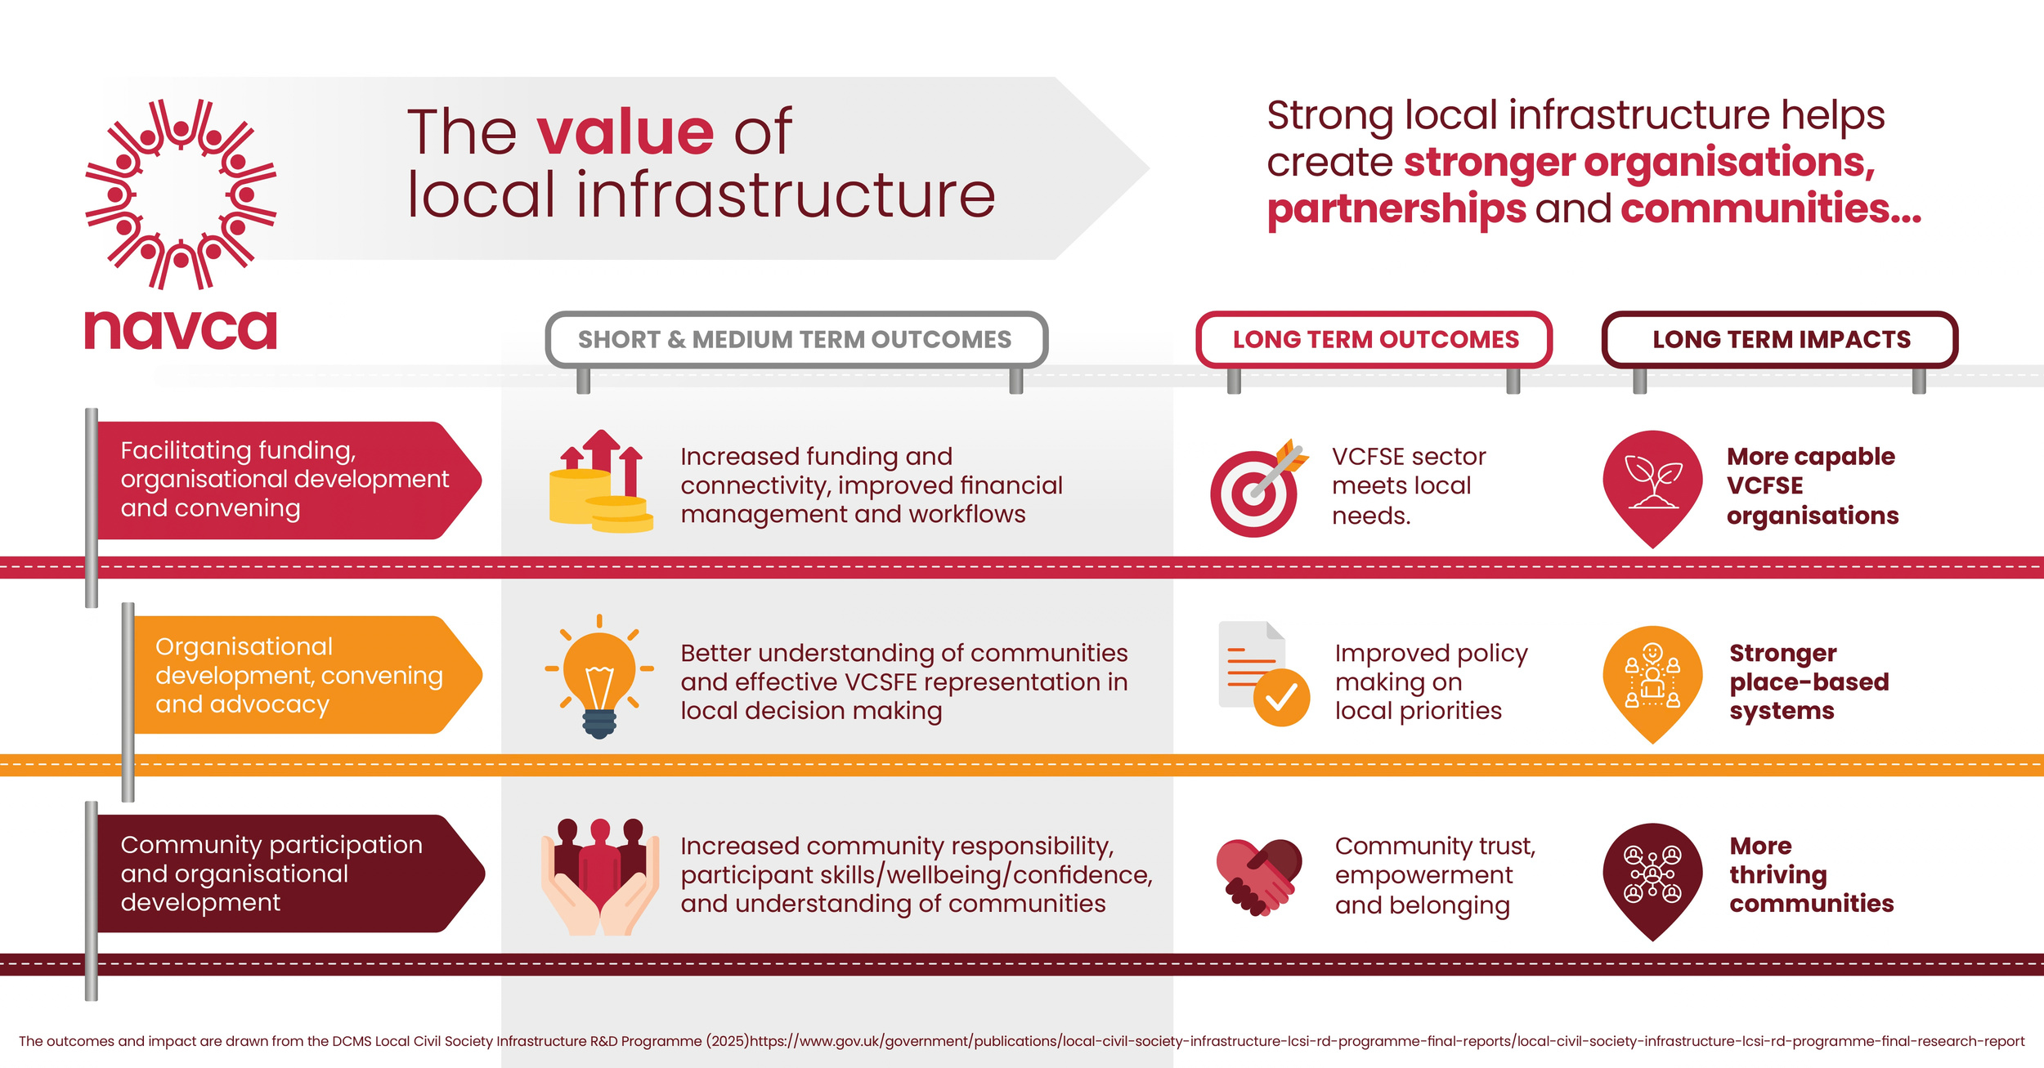
Effective LCSI

Slide 14
Outcome 1: VCFSE sector meets local needs
Strong LCSI
VCFSE sector has access to relevant and trusted funding information, support and opportunities to connect.
Knowledge, skills, understanding and collaboration develop.
Increased and more effective investment which meets local needs.
Weak LCSI
VCFSE sector lacks information, skills, and capacity.
Fragmentation, lack of coordination, competition and duplication.
Funding cold spots, fewer/weaker bids
Reduced and less effective investment.

Slide 15
Outcome 2: Improved policy making on local priorities
Strong LCSI
Well informed and connected LCSI is trusted by VCFSE sector and decision makers as a source of intelligence and honest broker.
Convening leads to meaningful relationships, information sharing and mutual understanding.
Stronger community voice leads to better decision making.
Weak LCSI
VCFSE sector is fragmented, poorly-informed; lack of sector intelligence and collective voice.
Poor or unequal relationships with decision makers; a few voices dominate and some are not heard.
Less inclusive practice and poorer decision making.

Slide 16
Outcome 3: Increased community trust, empowerment, belonging
Strong LCSI
Community participation is supported, facilitated and promoted.
Organisations value diverse community involvement and engagement.
Increased community participation builds confidence, skills and trust.
Weak LCSI
Fewer opportunities and lack of encouragement or support for community participation.
The benefits of diverse engagement is not valued or done effectively.
Missed opportunities, for individuals, organisations and communities.

Slide 17
NAVCA Function(s) and overarching LIQA outcomes | align most closely to the outcomes of | LCSI Outcome Pathway
1: Leadership and Advocacy and 2: Partnerships and Collaboration |  | 2: Improved policy making on local priorities
3: Capacity building |  | 1: A vibrant VCSE sector that meets local needs.
4: Volunteering (along with some of the convening aspects of 2: Partnerships and Collaboration) |  | 3: Increased community trust, empowerment and belonging.

Slide 18
The characteristics of strong and effective LCSI
Notes:
15

Slide 19
Features of strong LCSI
Independence of statutory agencies
People and relationships
Well-connected
A good reputation with civil society i.e. VCFSE sector
Local knowledge
Skills and capacity
Well-funded
A good reputation with policy makers
Speaks on behalf of the sector
Long-term local presence

Slide 20
What strengthens LCSI?
What weakens it?
Notes:
24

Slide 21
The hidden wiring
“LIOs find themselves in highly complex and demanding positions, nested within dense networks of relationships within and beyond the local VCSE sector. They often have to balance limited capacity against multiple expectations for support from different parts of a diverse and contested local VCSE sector and the agendas pursued by different statutory stakeholders. Such a balancing act is based on… the complex navigation of different issues, priorities and dilemmas.”
-‘Walking a Tightrope’ p29

Slide 22
Three enabling factors for strong LCSI
Funding
Sufficient
Consistent
Flexible
Public sector buy-in
Role and contribution of VCSFE and LCSI are understood and valued
Stategic relationships
Local ‘champions’
Formal engagement structures

Slide 23
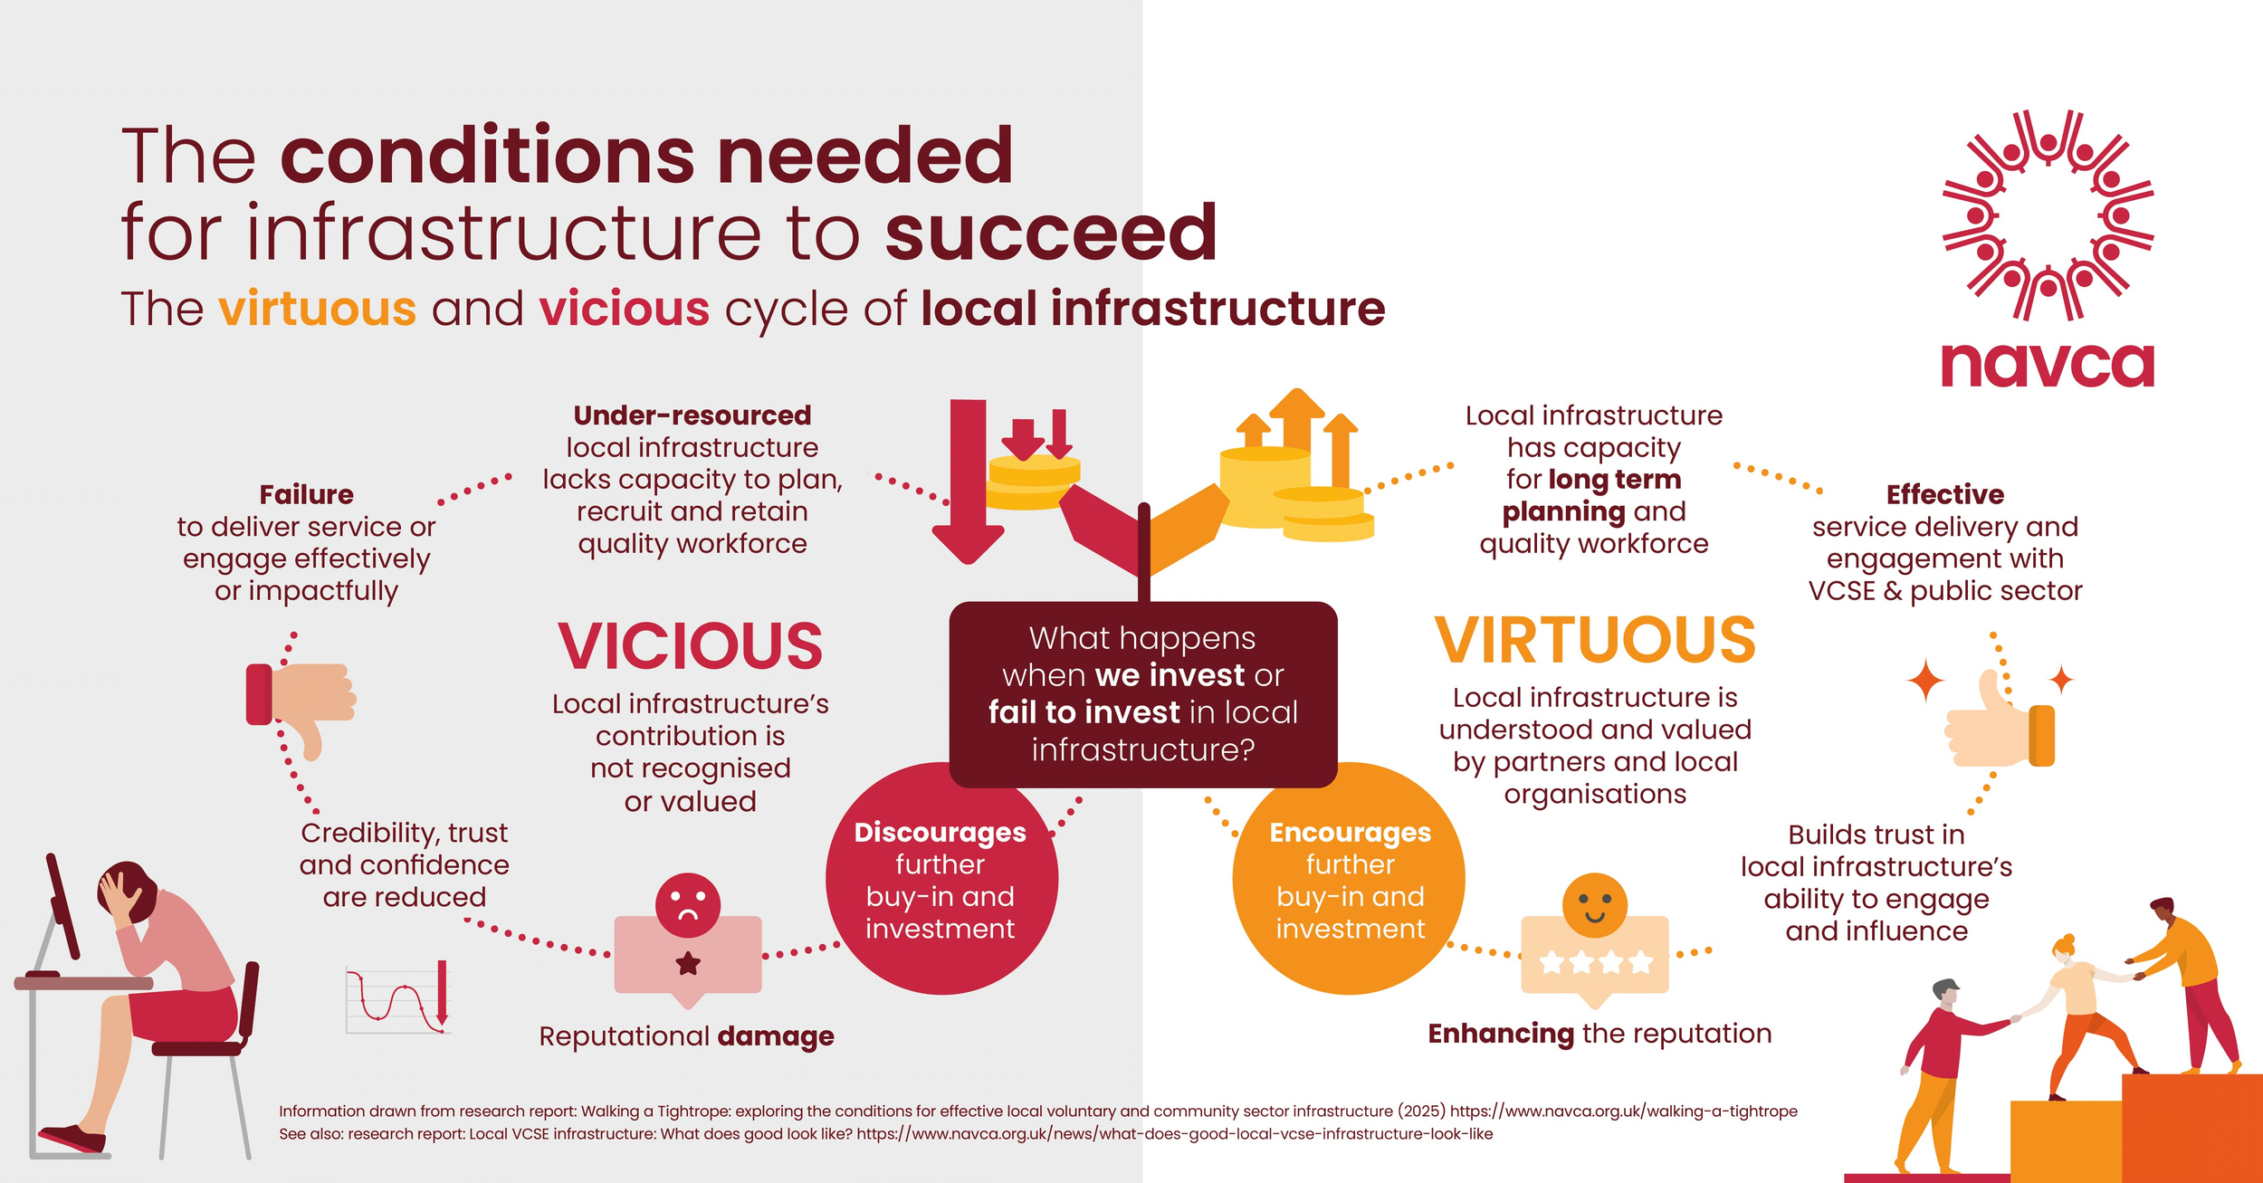
Virtuous and vicious cycles

Slide 24
Key points
What LCSI does
How it is provided
What difference it makes
Characteristics of strong LCSI
What strengthens LCSI
Notes:
29

Slide 25


Questions and discussion
Notes:
30

Slide 26
Links/further reading
NAVCA summary paper: ‘Local Civil Society Infrastructure: A summary of the research evidence’ (handout)
Local Civil Society Infrastructure R&D Programme (Department for Culture, Media & Sport) https://www.gov.uk/government/publications/local-civil-society-infrastructure-lcsi-rd-programme-final-reports
‘Walking a Tightrope: Exploring the conditions for effective local voluntary and community sector infrastructure’ Sheffield Hallam University Centre for Regional Economic and Social Research. https://www.navca.org.uk/walking-a-tightrope
‘Why local civil society infrastructure matters – and what we found out’. Summary article by PBE https://pbe.co.uk/insights/why-local-civil-society-infrastructure-matters-and-what-we-found-out-2/
Notes:
31

