Slide 1
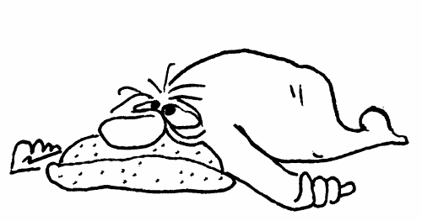
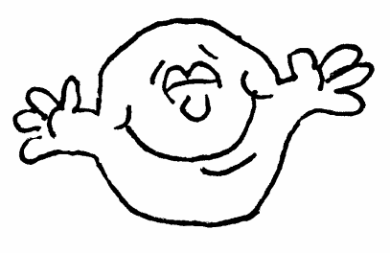
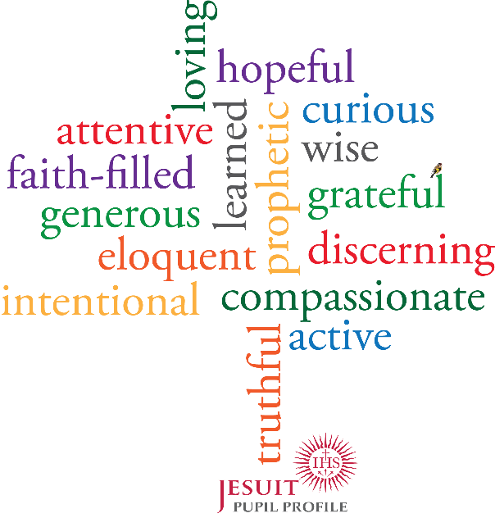
The Examen
is a daily exercise from the Spiritual Exercises of St Ignatius Loyola
which begins with gratitude,
and, in God’s light,
is curious and attentive to that which leads to consolation / desolation,
using the ‘test’ of faith, hope and love,
so I can discern better and intentional choices to make,
resulting in more generous action.
That’s the “magis”

