Slide 1

These slides are intended to provide a simple background for school productions of the short play Campion.
As the children come in, it is suggested the title slide is already up.
The images are timed to fade in once clicked for the scene change.
It is suggested the last-but-one slide is used as the narrator speaks the last words of the play.

Slide 2
C A M P I O N

Slide 3
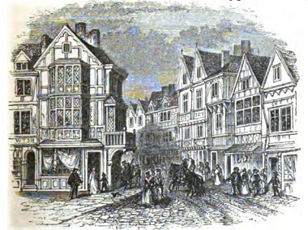
London
Monday 17th July 1581

Slide 4
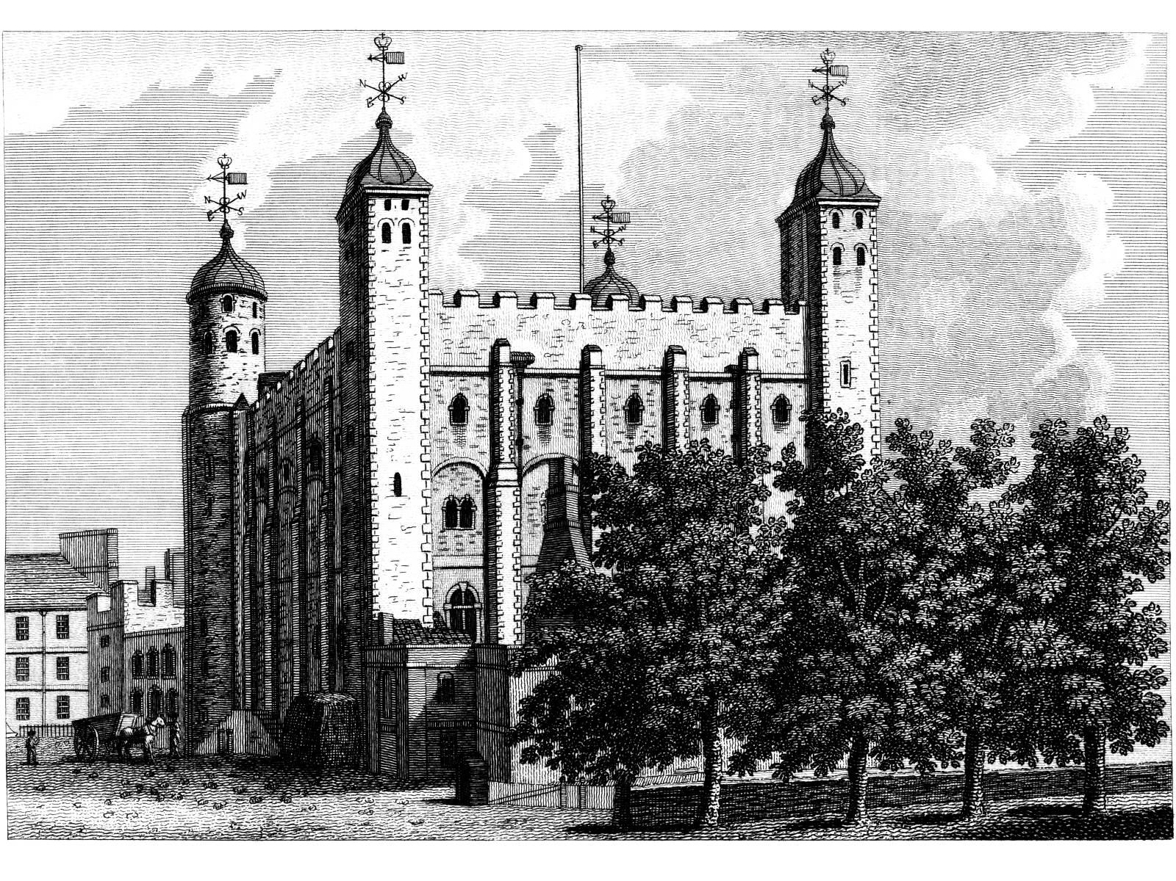
The Tower of London

Slide 5
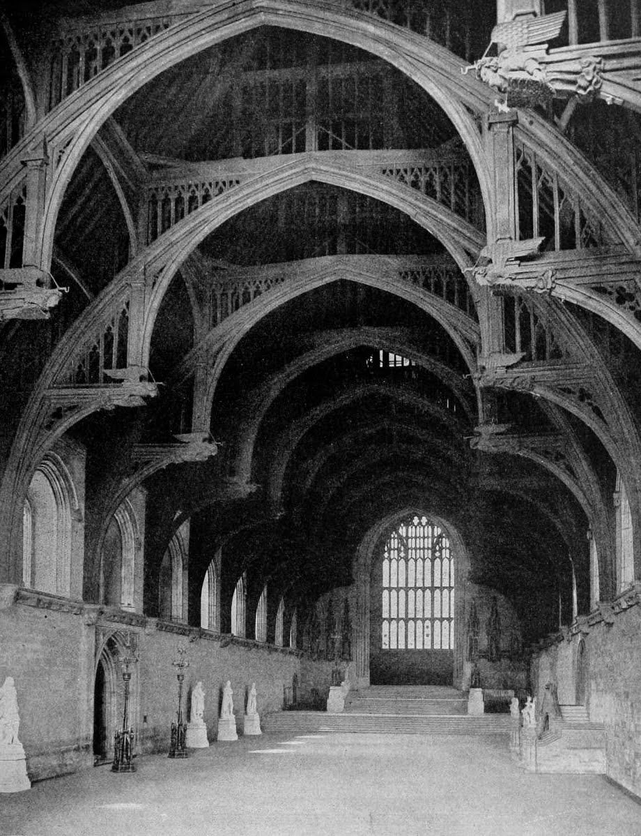
Westminster Hall

Slide 6
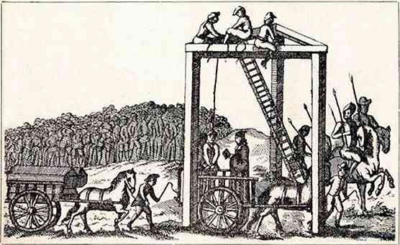
Tyburn Tree

Slide 7
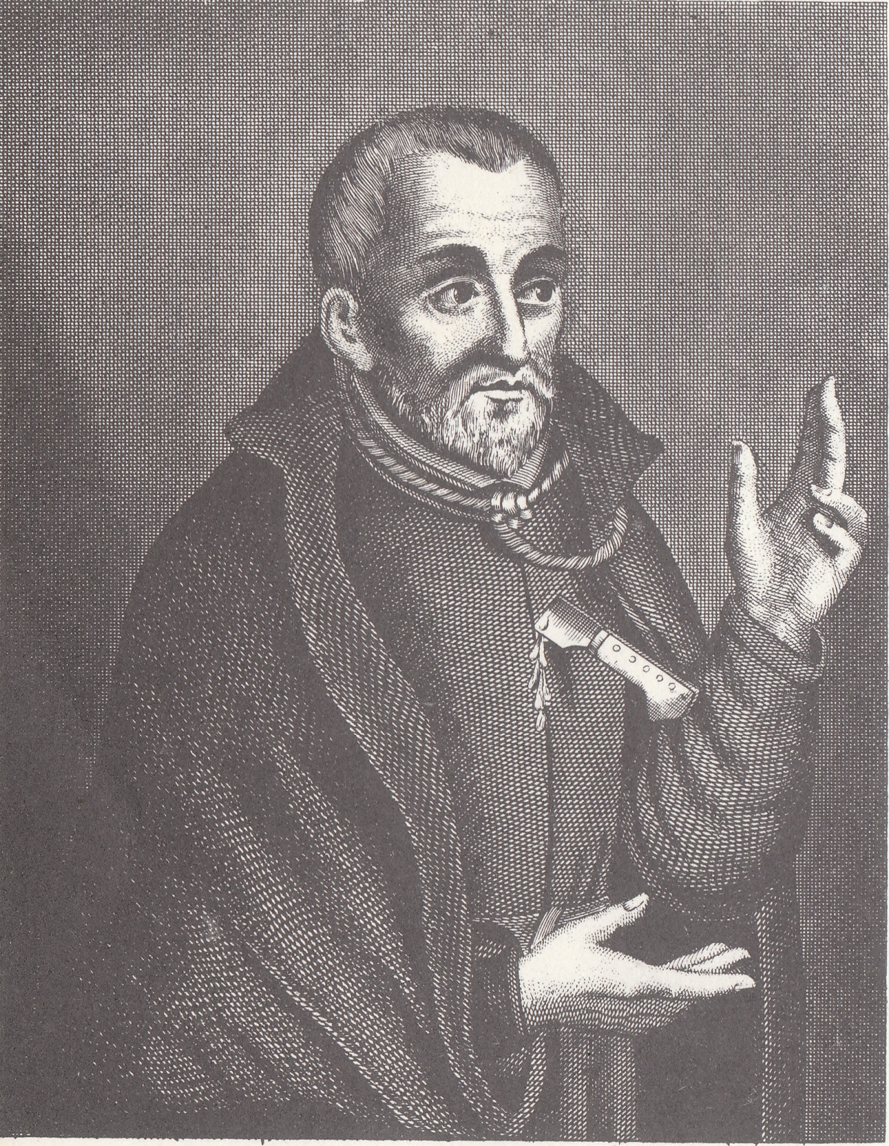

St Edmund Campion
Jesuit Priest and Martyr
Born 1540 at London
Died 1581 at Tyburn

Slide 8
C A M P I O N

