Slide 1
Investor Deck
August 19, 2025
NASDAQ:IDN

Slide 2
Forward-Looking Statements
This presentation contains “forward-looking statements” within the meaning of Section 27A of the Securities Act of 1933, as amended, and Section 21E of the Securities Exchange Act of 1934, as amended. Although the forward-looking statements in this presentation reflect the good faith judgment of management, forward-looking statements are inherently subject to known and unknown risks and uncertainties that may cause actual results to be materially different from those discussed in these forward-looking statements. Readers are urged to carefully review and consider the various disclosures made by us in our reports filed with the Securities and Exchange Commission, including the risk factors that attempt to advise interested parties of the risks that may affect our business, financial condition, results of operation and cash flows.
If one or more of these risks or uncertainties materialize, or if the underlying assumptions prove incorrect, our actual results may vary materially from those expected or projected. Readers are urged not to place undue reliance on these forward-looking statements, which speak only as of the date of this release. We assume no obligation to update any forward-looking statements in order to reflect any event or circumstance that may arise after the date of this presentation.

Slide 3

The only SaaS-based identity validation and proofing service that uses a unique and proprietary analysis of DMV-issued IDs to create trusted, real-time customer identity verification experiences.

Slide 4

Magnitude of the Problem
$27B
1.5 Billion+
$16B
  In U.S. Fraud in 2024, impacting 15 million people¹
  Victims of
  data breaches worldwide²
  In account takeover fraud - a 19% increase¹
29%
79%
  of identity fraud attributed to new account creation in 2024³
  of auto dealerships had an identity fraud related loss within the last year⁴
Bottom Line:
Fraud Isn’t Going Away!
Javelin
Identity Theft Resource Center
Experian 2024 Global Identity & Fraud Report
eLEND study

Slide 5

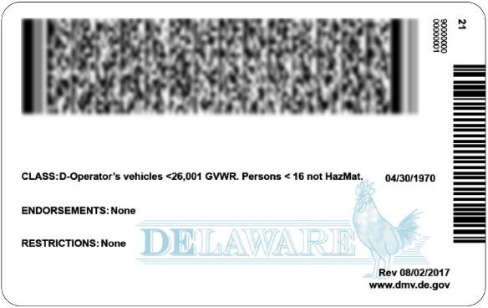
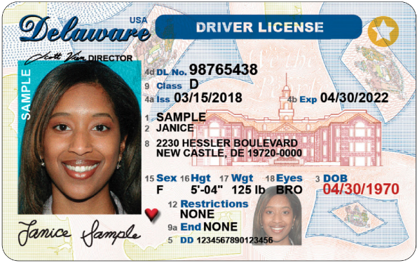
Majority of Fraud is Prevented Through Accurate ID Validation
Criminals copy AAMVA barcode standards that are publicly available online
No state, province or territory DMV uses the same AAMVA standard on its own—each DMV adds additional unique security features
No two states, provinces or territories use the same format, there are over 250 unique ID encryptions in circulation between the US, Canada and Mexico
Which means…parsing the data and comparing it to the front of the ID with traditional document templating won’t cut it.

Slide 6
We Validate Close to 100 Million People in North America Each Year
Auto, Education, Financial Services, Real Estate
Banking
Corporate
Retail
New Account Generation
Branches, Call Centers
Employee Onboarding
Card Not Present
  Physical and digital accounts
  Instant credit, BNPL, Lease-to-Own, bank accounts, loans, automotive test drives and purchases, title insurance and more
  Verification occurs both in-person or through website or mobile app
  Quickly validate customers for risky transactions
  Account updates to stop account takeover, address changes, lost card transactions and more
  Verify applicants and remote employees
  “I forgot my store-branded credit card, can you look me up?”
Account Validation
and Account Reset
Return No-Receipt
  Validate employees and partners with system access
  Stolen goods returned for store credit

Slide 7

ID Validation Technology, Streamlined
Intuitive and easy to use technology
Cloud SaaS integrates with existing in-person and online workflows via existing hardware, mobile app, web portal or webhooks
Simplifies implementations with typically
no new and
costly hardware requirement
  Integrates with existing retail / branch hardware
  Point-of-sale scanner
  Branch check scanner
  Mobile app
Frictionless and customer friendly
  Fast, accurate validation eliminates “good customer frustration” and reduces abandonment
  Easy one step process–no need for front, back and selfie

Slide 8

Positioned for Success
  Very sticky customer base with 100% renewal rate through Q2 2025*
Renewed focus on sales and marketing to drive growth
~90%
  Gross margins consistently
  Expectation of positive Adjusted EBITDA anticipated for 2025 positions us to drive significant operating leverage going forward
  current valuation of
~5x revenue
* Excluding bars and restaurants

Slide 9



Leaders Look to Intellicheck
Four of the top 10 banks
Two of the leading credit card Issuers
Major law enforcement agencies across the country

Slide 10
2025 Significant Callouts
We continued to increase our penetration for authentication with significant organizations and new use cases
One of the most widely recognized brands in banking that is a top ten bank and one of the largest issuers of Visa and MasterCard credit cards renewed with a 15% increase
Leading regional bank in the southeast added in branch validation resulting in a three year very high seven-figure total contract value
Two of the top 3 title insurance companies that are premier providers of title, settlement and risk solutions for real estate transactions are live
One of the leading providers of banking software that serves as a platform for many credit unions is bringing a $20 billion credit union onboard by year-end
Leading private label credit card issuer is going to start using Intellicheck for BNPL transactions at some of their retail clients
Lease-to-Own company with over 1,700 locations successfully completed their proof of concept and is live

Slide 11




Why Our Customers Use Intellicheck to Stop Fraudsters and Safeguard Their Business
  “A true gamechanger in stopping fraud, top 5 all time.”
    SVP of Fraud, top 5 Financial Services Company with over $1.7 trillion in assets
Confidently prove identity in real-time with the only platform that leverages proprietary access to authoritative data in ID barcodes
Validate identity and stop fraud losses while meeting AML/KYC requirements
  “Prior to us using it in the field,
  we scanned over 1,000 known counterfeits, each one was detected.”
    New York State DMV Director of Investigations
Leverage a unique approach that is highly accurate, instant, and fully automated

Slide 12






Management Team
Bryan Lewis
Chief Executive Officer, President
Tim Poulin
Senior Vice President of Sales
Jonathan Robins
Chief Technology Officer
Adam Sragovicz
Chief Financial Officer
Sandra Bower
SVP of Customer Experience and Account Management

Slide 13
Q2 2025 Financial Highlights
Revenue
Total Revenue: $5,123,000
SaaS Revenue: $5,080,000
Gross Margin: 90%
Balance Sheet
Cash & ST
Investments:
$8.6 million
Stockholders’ Equity:
$18.0 million
Debt: $0
(as of June 30, 2025)
Net Income (loss) & Adjusted EBITDA
Net Loss:
$(251,000)
Adjusted EBITDA: $75,000

Slide 14

Analyst Coverage /
Institutional Holdings
Clean cap table with approximately
Mike Grondahl
Northland Securities
Rudy Kessinger
DA Davidson
Scott Buck
H.C. Wainwright
Jeff Van Rhee
Craig-Hallum
45%
of common shares outstanding institutionally held as of 6/30/25

Slide 15

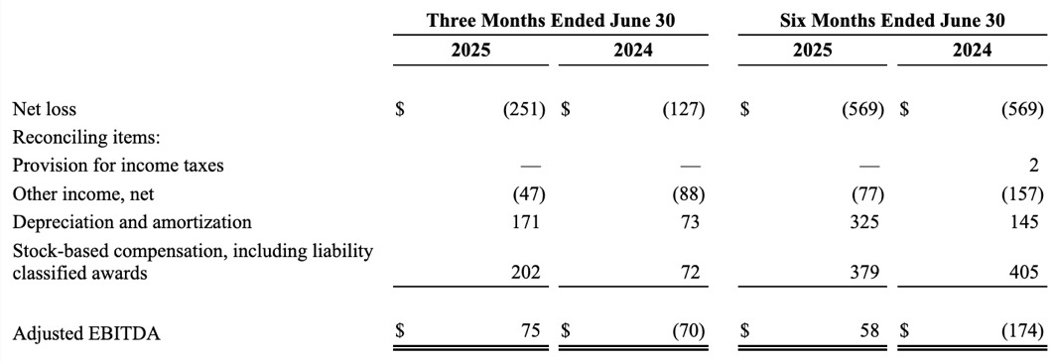
Adjusted EBITDA Reconciliation
Adjusted EBITDA
We use Adjusted EBITDA as a non-GAAP financial performance measurement. Adjusted EBITDA is calculated by adjusting net loss for certain reductions such as interest and other income (expense) and certain addbacks such as non-restructuring severance expenses, provisions for income taxes, depreciation, amortization and stock-based compensation expense. Adjusted EBITDA is provided to investors to supplement the results of operations reported in accordance with GAAP. Management believes that Adjusted EBITDA provides an additional tool for investors to use in comparing our financial results with other companies that also use Adjusted EBITDA in their communications to investors. By excluding non-cash charges such as impairments of long-lived assets and goodwill, amortization, depreciation and stock-based compensation, as well as non-operating charges for interest and provisions for income taxes, investors can evaluate our operations and can compare the results on a more consistent basis to the results of other companies. In addition, Adjusted EBITDA is one of the primary measures management uses to monitor and evaluate financial and operating results. We consider Adjusted EBITDA to be an important indicator of our operational strength and performance of our business and a useful measure of our historical operating trends. However, there are significant limitations to the use of Adjusted EBITDA since it excludes non-restructuring severance expenses, provisions for income taxes, interest and other (expense) income, impairments of long-lived assets and goodwill, stock-based compensation expense, all of which impact our profitability, as well as depreciation and amortization related to the use of long-term assets which benefit multiple periods. We believe that these limitations are compensated by providing Adjusted EBITDA only with GAAP net loss and clearly identifying the difference between the two measures. Consequently, Adjusted EBITDA should not be considered in isolation or as a substitute for net loss presented in accordance with GAAP. Adjusted EBITDA as defined by us may not be comparable with similarly named measures provided by other companies.
The reconciliation of GAAP net loss to Non-GAAP Adjusted EBITDA is as follows in thousands:

Slide 16
Trusted Real-Time Identity Verification
Bryan Lewis
CEO
516.453.6647
blewis@intellicheck.com
Adam Sragovicz
CFO
516.992.1985
asragovicz@intellicheck.com

