Slide 1
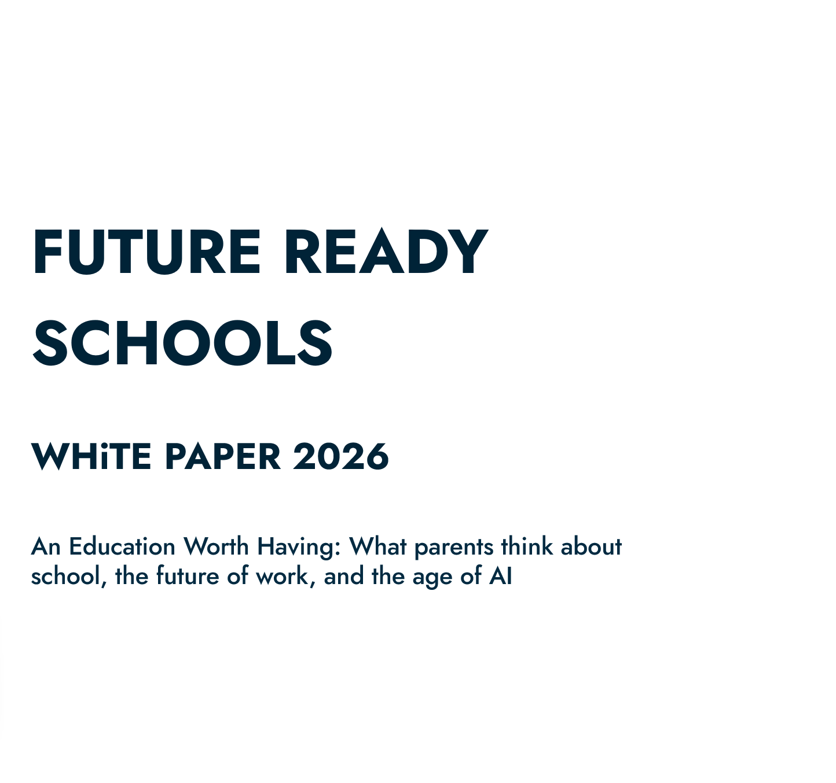
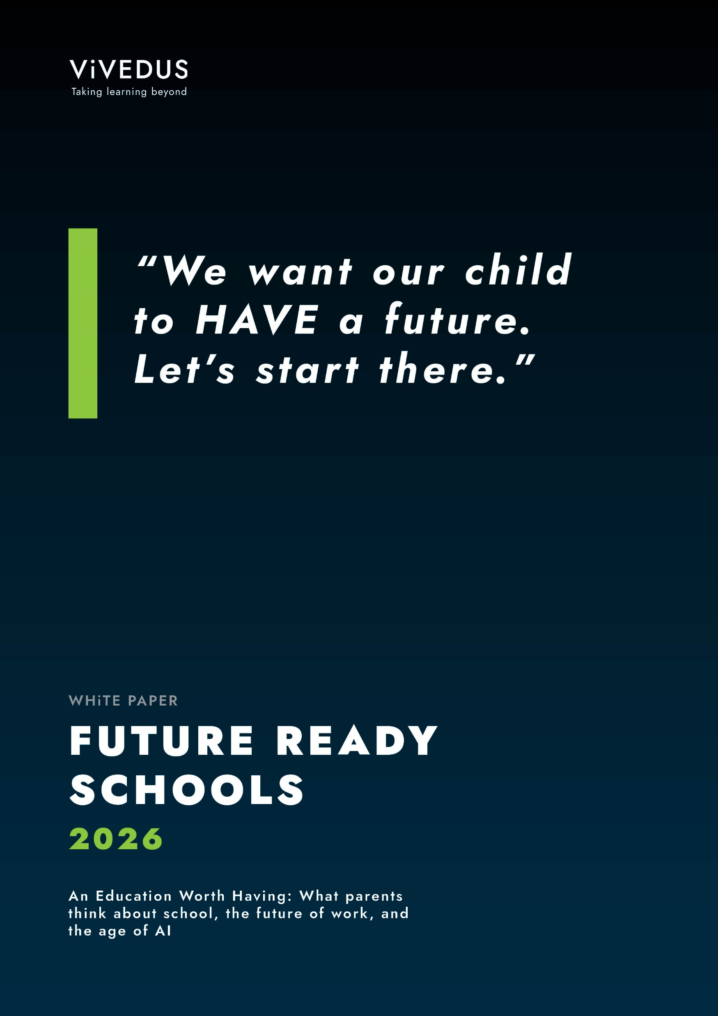
^{FUTURE READY SCHOOLS}
WHiTE PAPER 2026
An Education Worth Having: What parents think about school, the future of work, and the age of AI
Notes:
Permission to use: Schools are welcome to use and share this presentation internally for professional learning and discussion, provided the content is not modified and appropriate acknowledgement is given to ViVEDUS as the source.

Slide 2
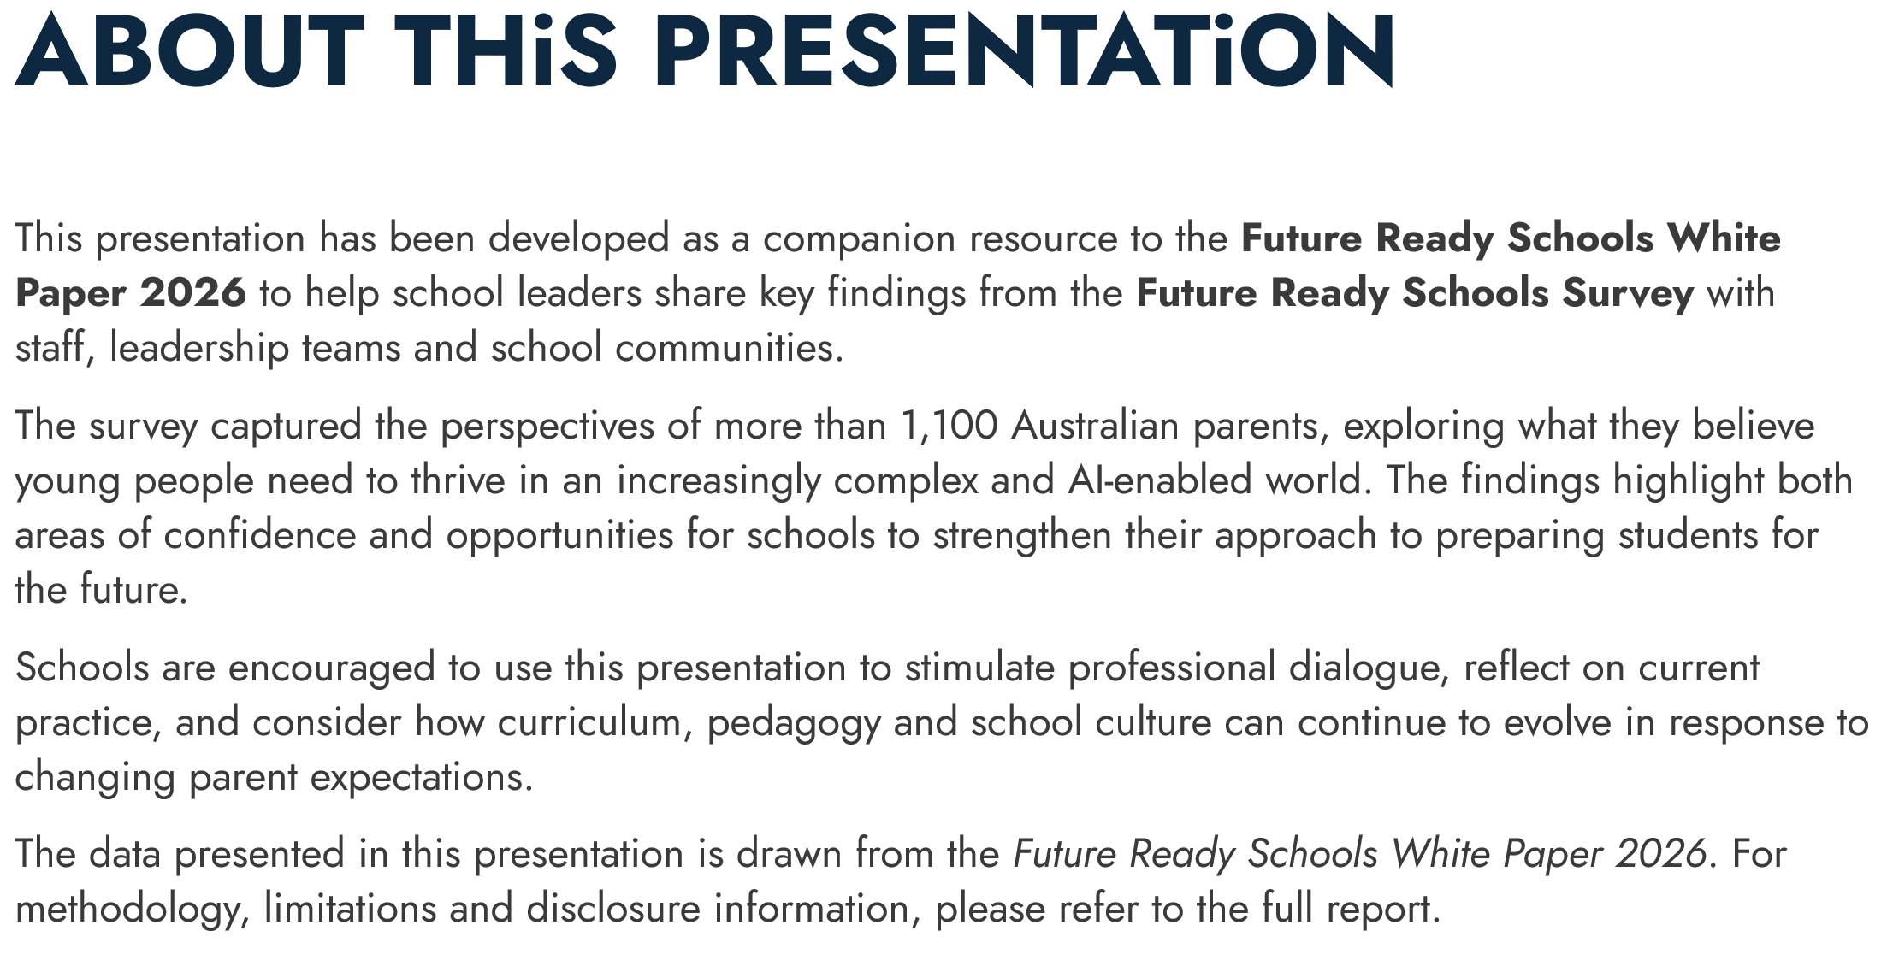

Slide 3
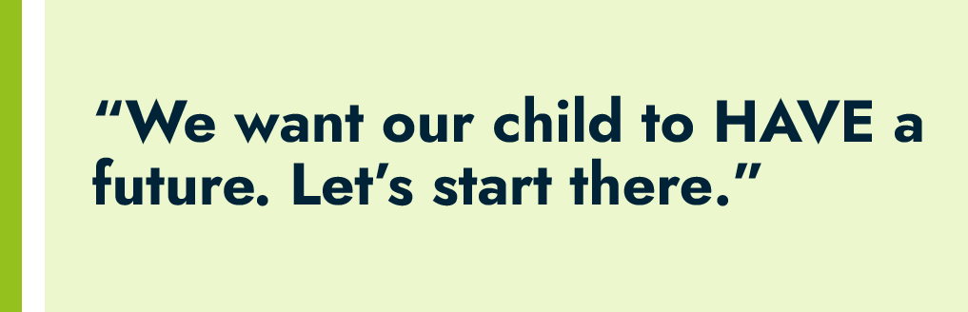

Slide 4
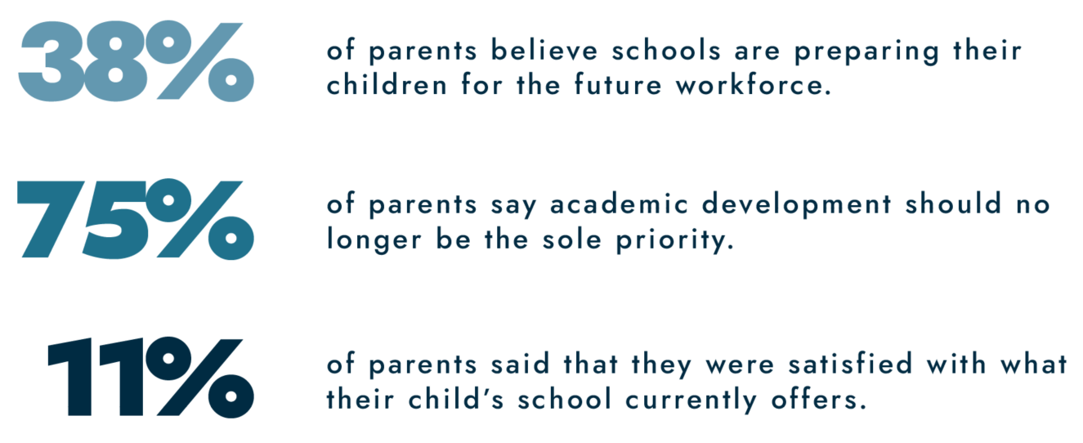

Slide 5
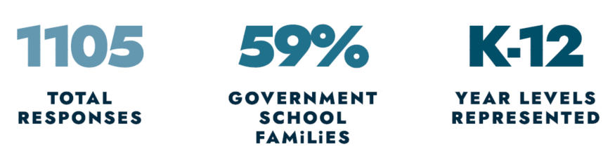

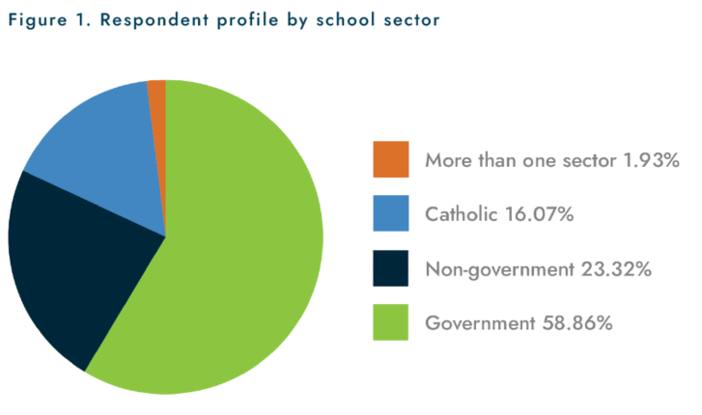
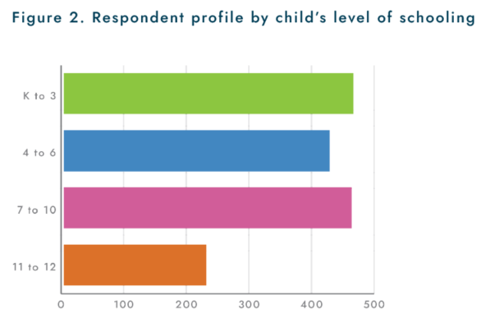

Slide 6

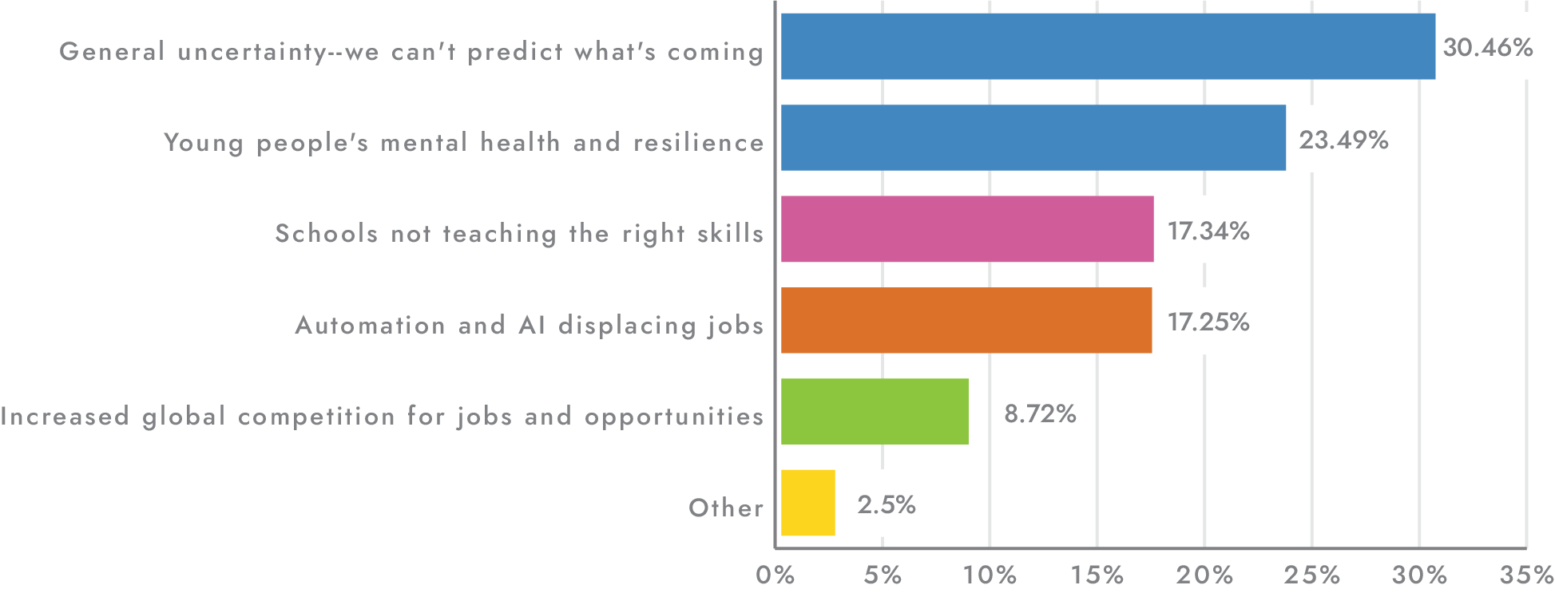

Slide 7
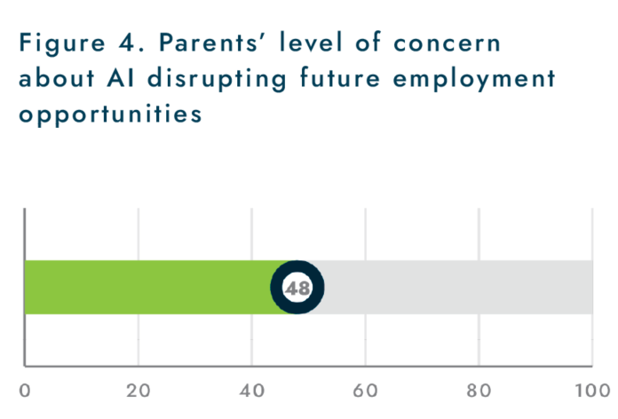
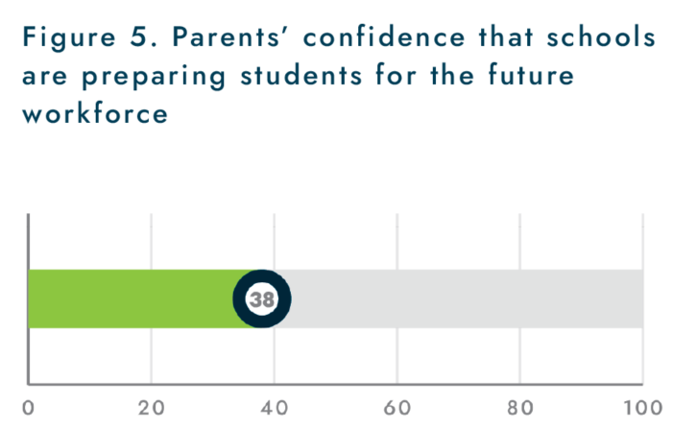

Slide 8
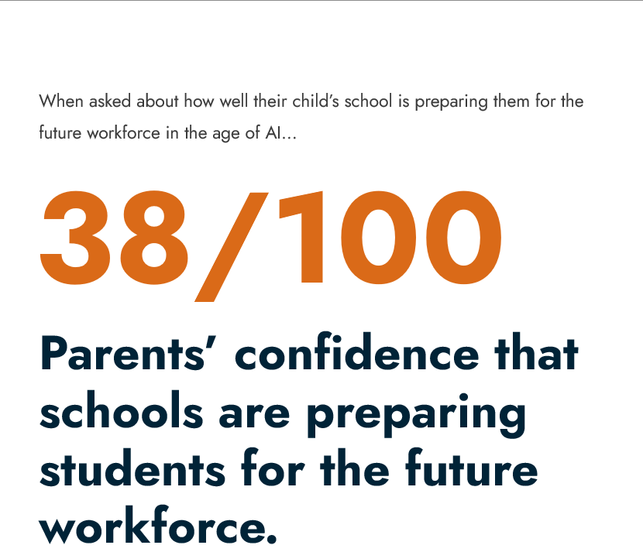

Slide 9
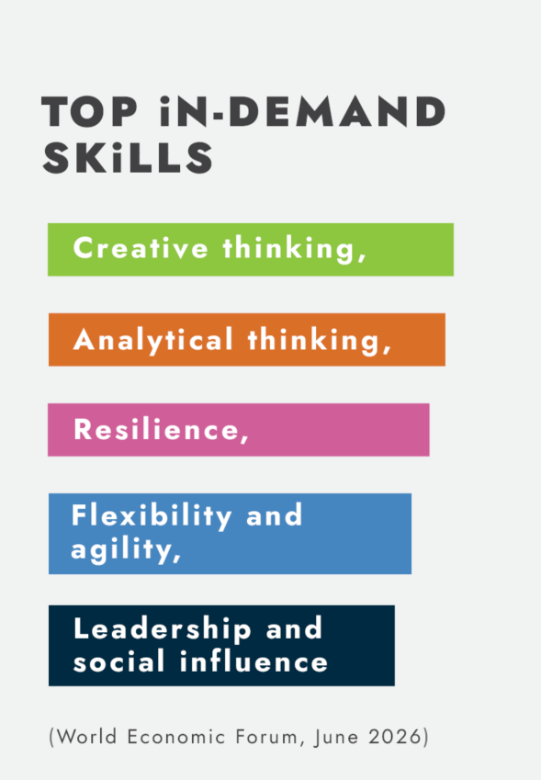

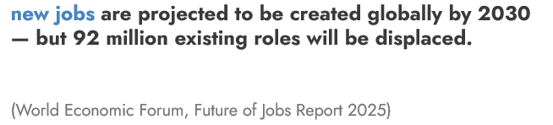

Slide 10
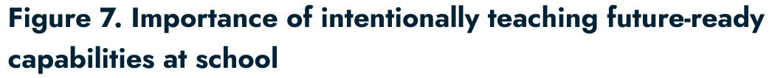
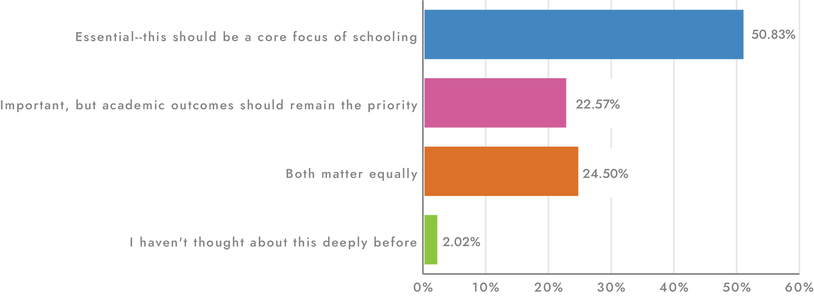

Slide 11
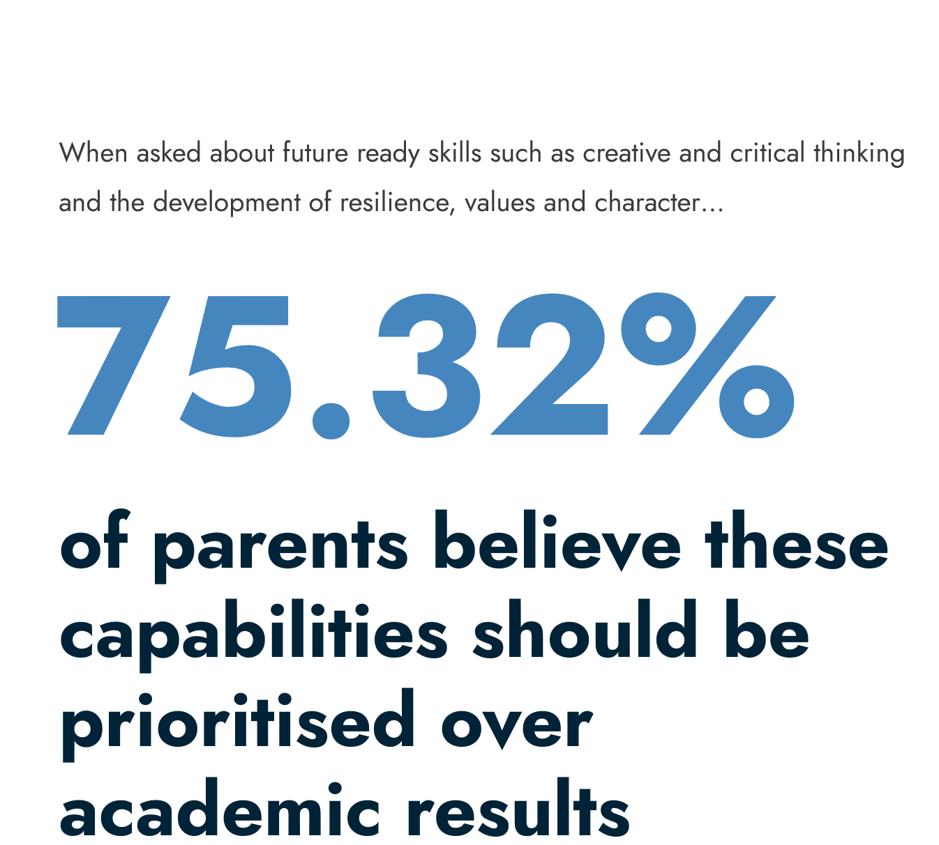

Slide 12
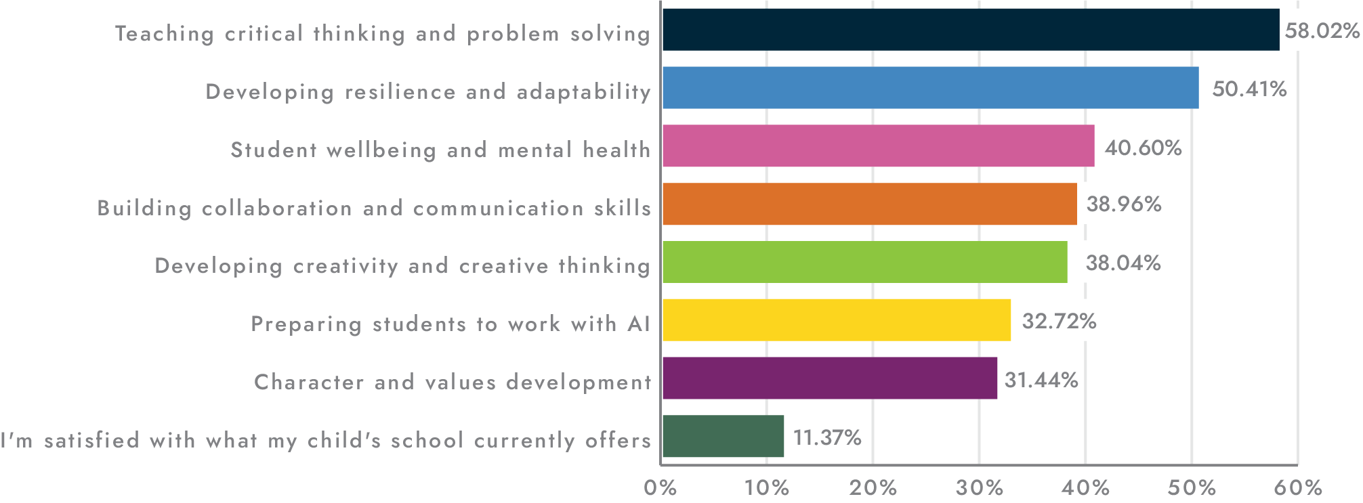
Figure 8. Areas where parents would like schools to place greater emphasis

Slide 13
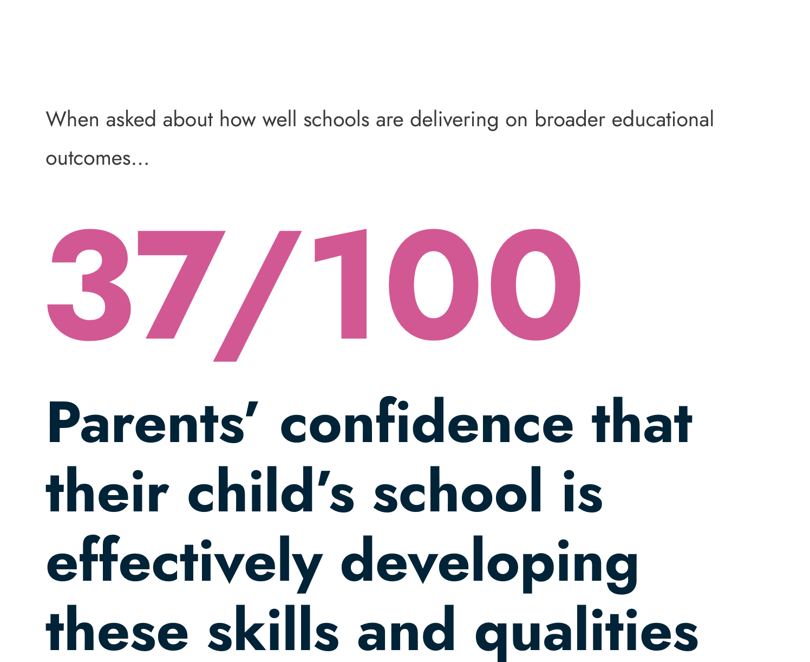

Slide 14
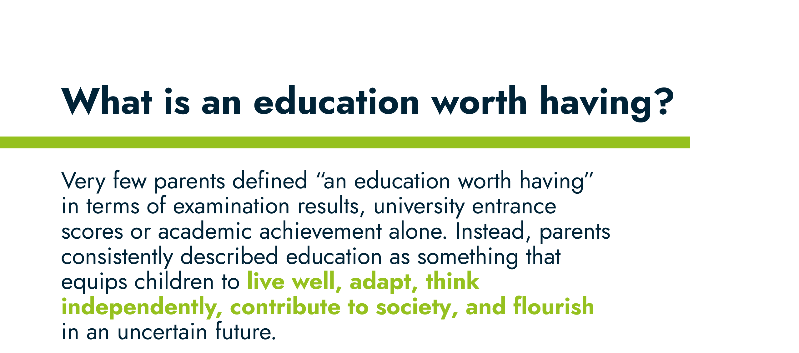
What is an education worth having?
Very few parents defined “an education worth having” in terms of examination results, university entrance scores or academic achievement alone. Instead, parents consistently described education as something that equips children to live well, adapt, think independently, contribute to society, and flourish in an uncertain future.

Slide 15
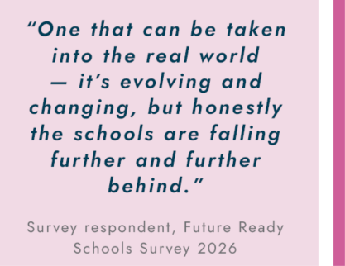
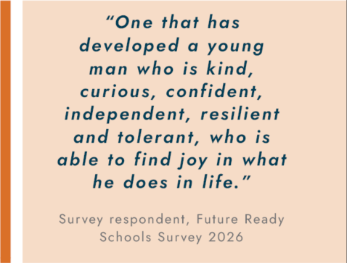

Slide 16
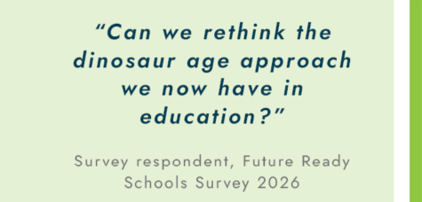
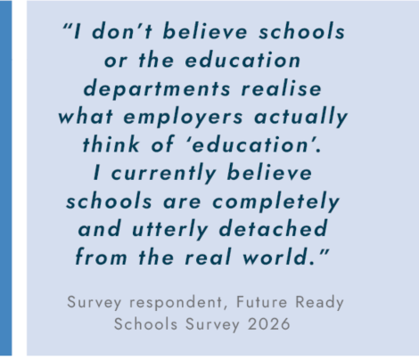
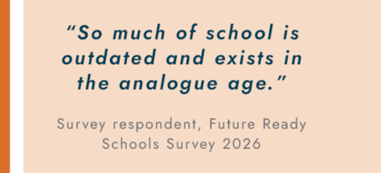

Slide 17
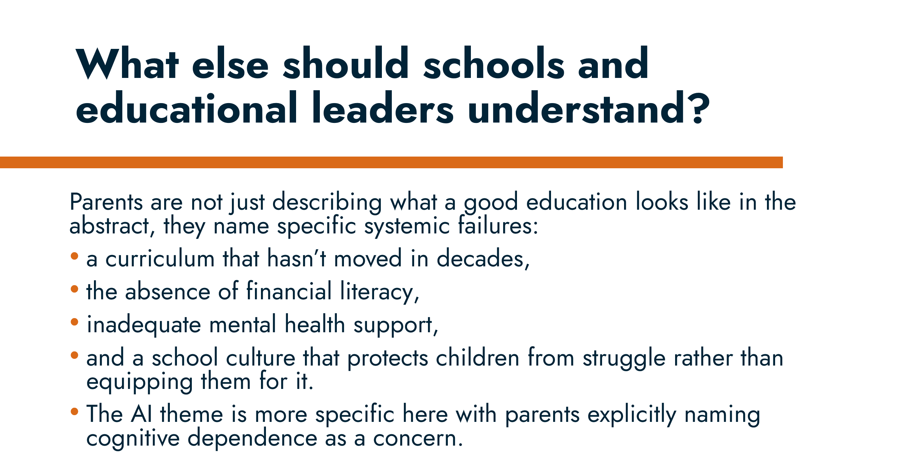
What else should schools and educational leaders understand?
Parents are not just describing what a good education looks like in the abstract, they name specific systemic failures:
a curriculum that hasn’t moved in decades,
the absence of financial literacy,
inadequate mental health support,
and a school culture that protects children from struggle rather than equipping them for it.
The AI theme is more specific here with parents explicitly naming cognitive dependence as a concern.

Slide 18
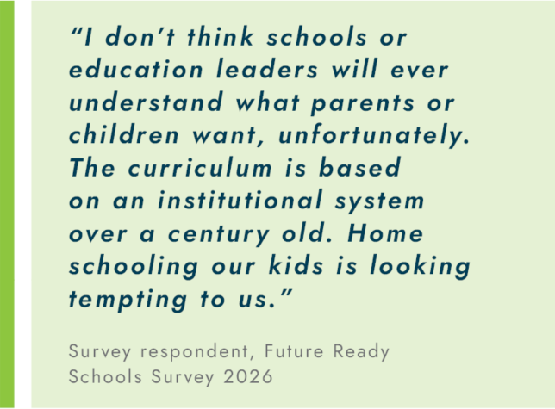
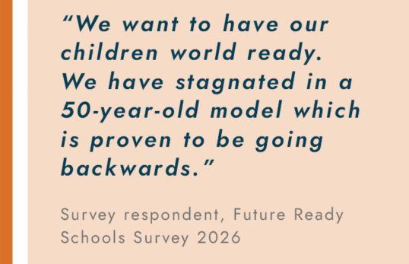
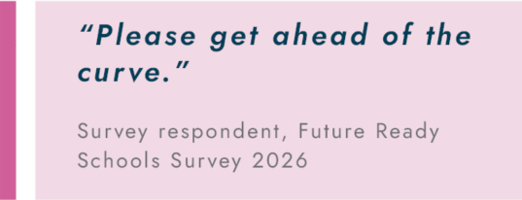

Slide 19
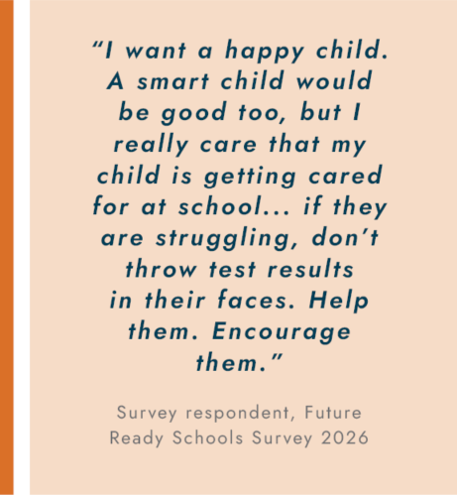
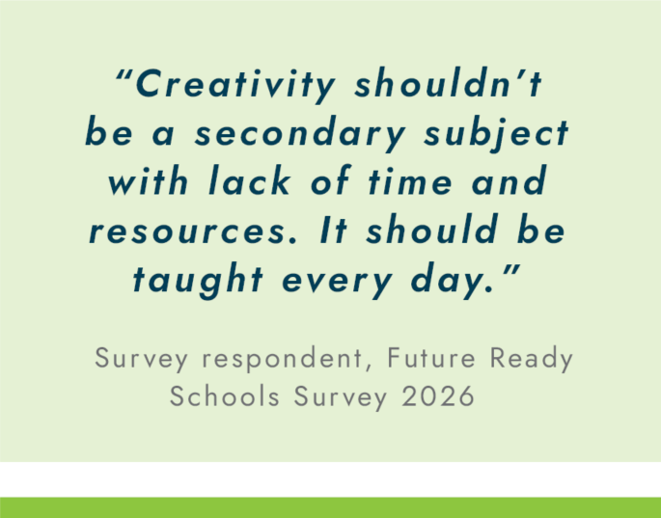

Slide 20
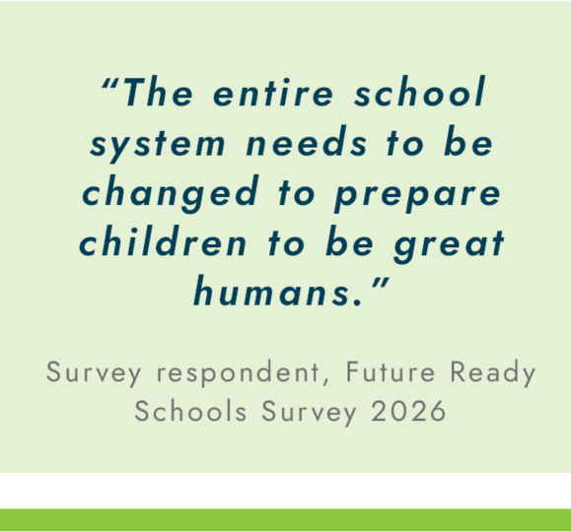
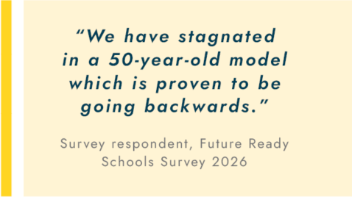
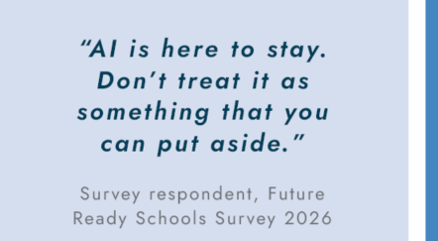

Slide 21
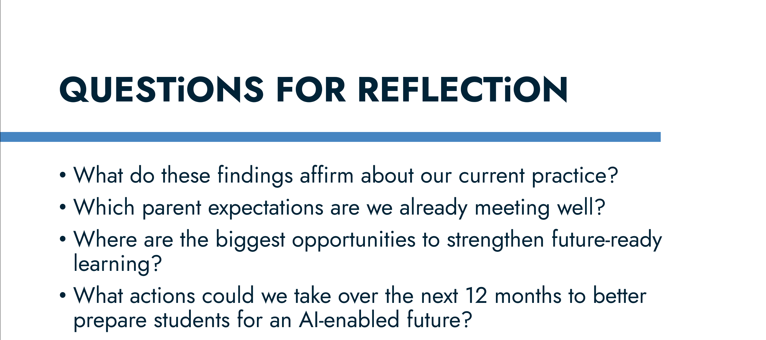
QUESTiONS FOR REFLECTiON
What do these findings affirm about our current practice?
Which parent expectations are we already meeting well?
Where are the biggest opportunities to strengthen future-ready learning?
What actions could we take over the next 12 months to better prepare students for an AI-enabled future?

